Slide 1

Quick tutorial
What is qBraid
Start and monitor a server instance
Modify Idle Timeout
Run on a quantum device or simulator
Integrated AI agent

Slide 2
What is
qBraid is a cloud platform built specifically for quantum computing. Unlike a generic cloud notebook service, the environments, the libraries and the hardware access are all quantum-oriented.
  User-friendly with 100 free CPU hours per month, no credit card required.
  Run classical notebooks directly in your browser, with the quantum SDKs already installed.
  Run on real QPUs or simulators, access to several providers on the same platform.
  Your notebooks and data stay on the platform, accessible from any machine with a browser.

Slide 3
Start and monitor a server instance
qBraid free subscription gives you 100 CPU hours of computation per month
This does not mean that you can run 100 hours of code, the larger the server you are using the more this computation hours are consumed.
The rule is simple : Computation hours = number of vCPU * real time
  Using a Large 8 vCPU, 25GB instance will use 8 hours of computation per real hour.
  Using a Small 2vCPU, 4GB instance will use 2 hours of computation per real hour.

Slide 4
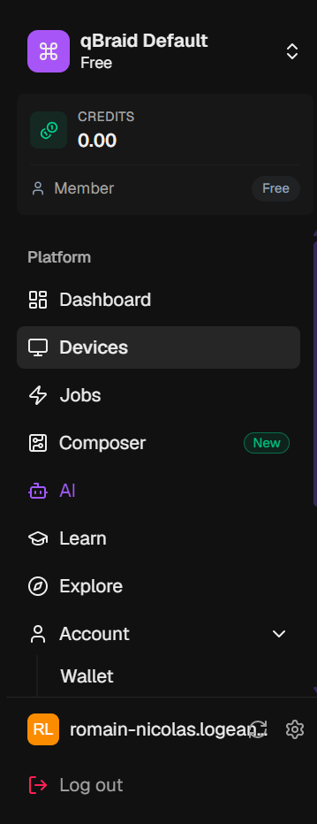
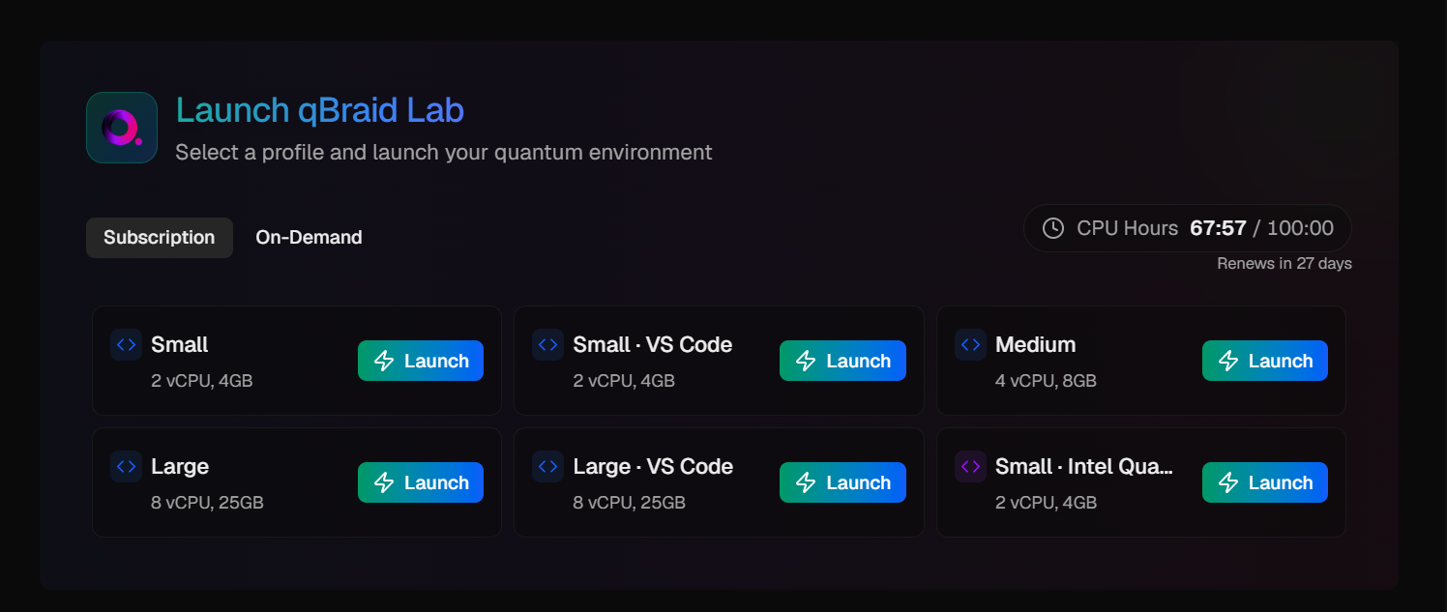
Start and monitor a server instance
You can launch a new server instance on the dashboard, on Subscription tab, and choose between 6 different instances.
You can start a new instance by clicking Launch:

Slide 5

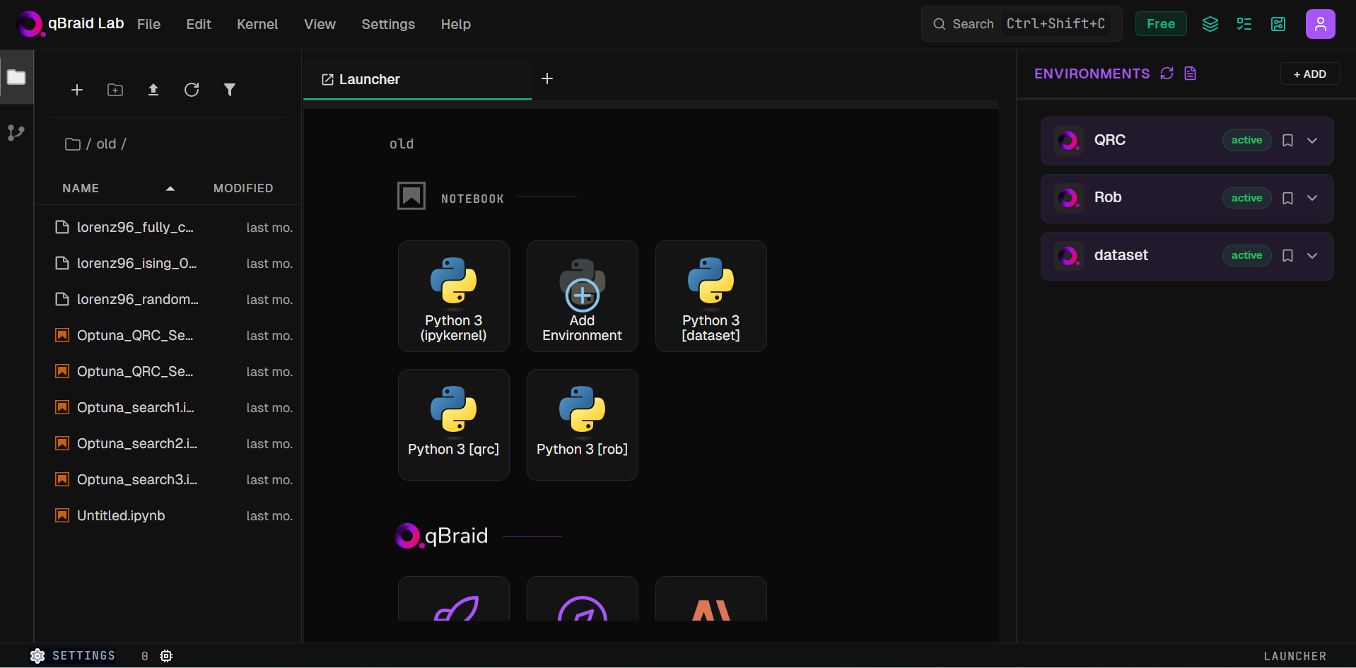
Start and monitor a server instance
Click Open Lab and you have you own server instance where you can create and run files

Slide 6
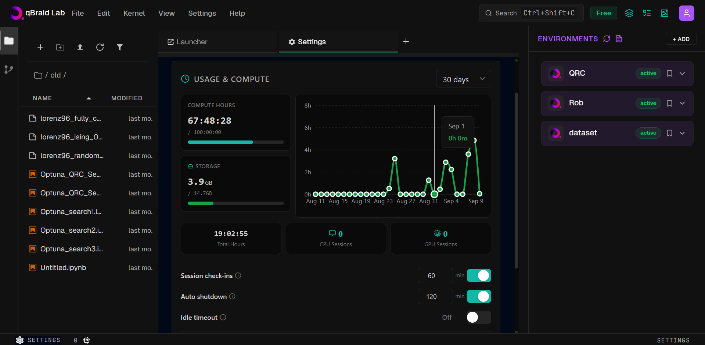
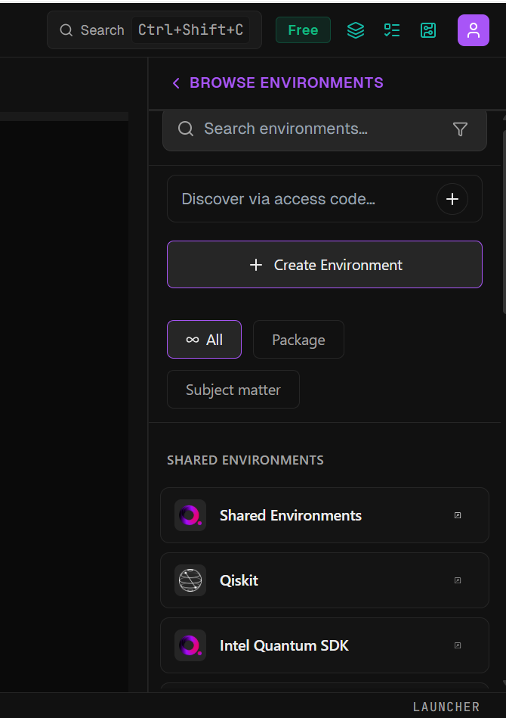
Start and monitor a server instance
To run the code, you want to create a new environment and download libraries:
Alternatively, you can also use existing environment in Shared Environments

Slide 7
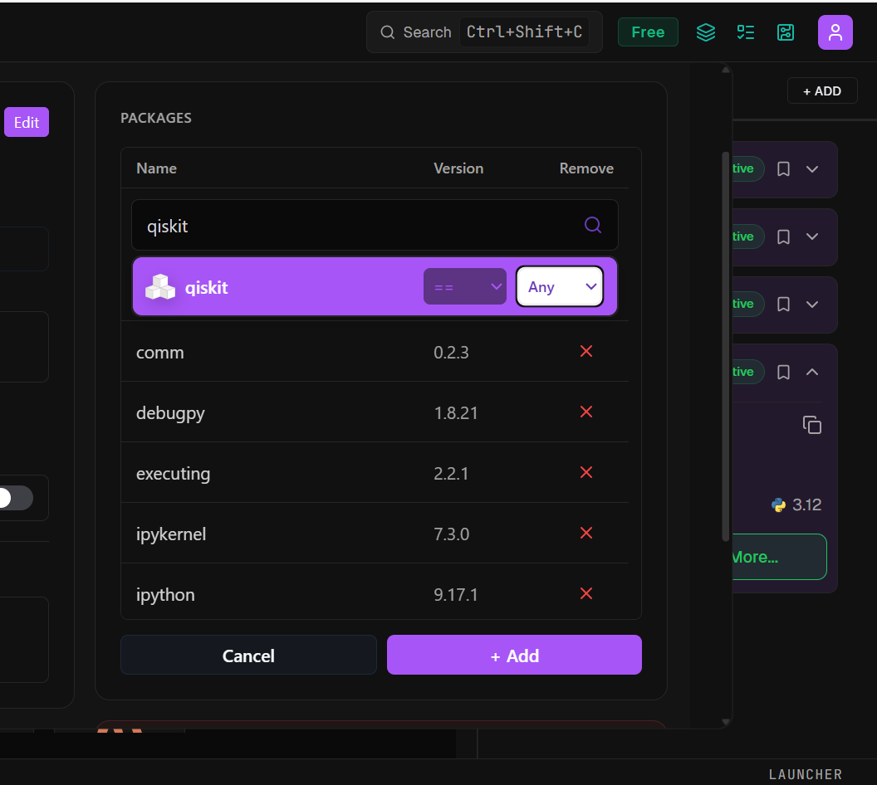
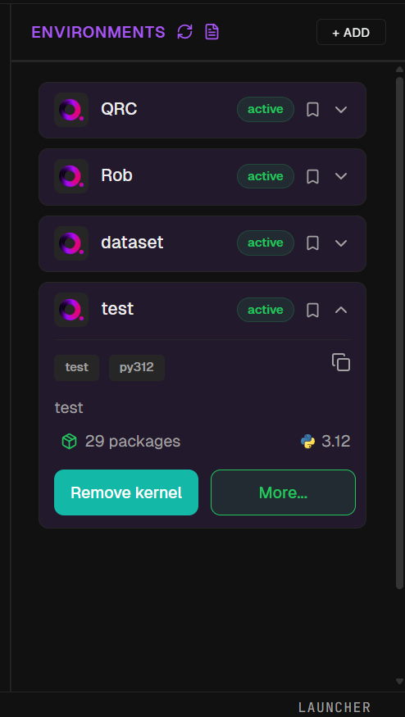
Start and monitor a server instance
Once the environment is created you can add libraries by clicking More…
Then search for the libraries you are interested in, click add and your library will be downloaded

Slide 8
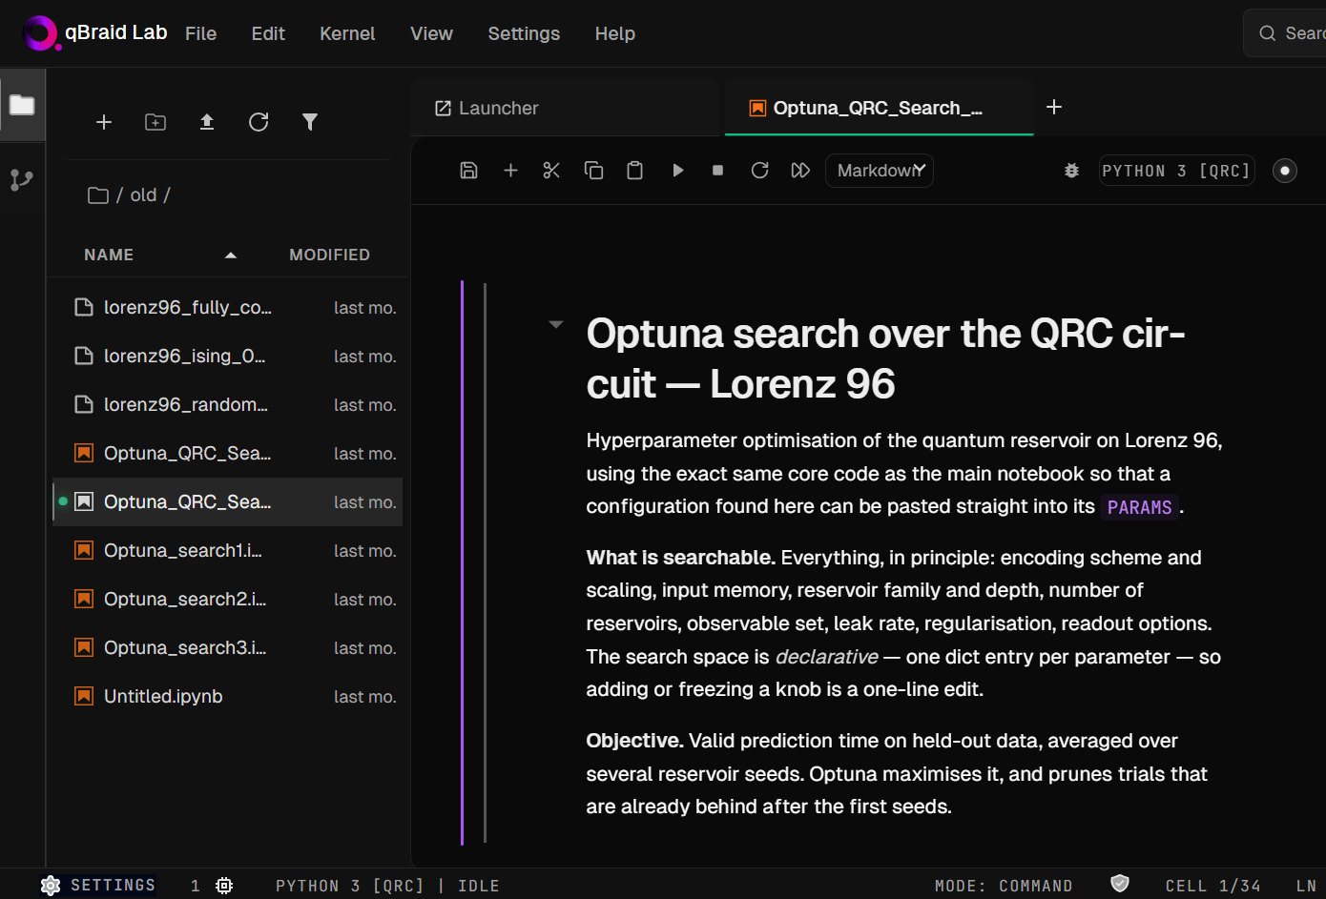
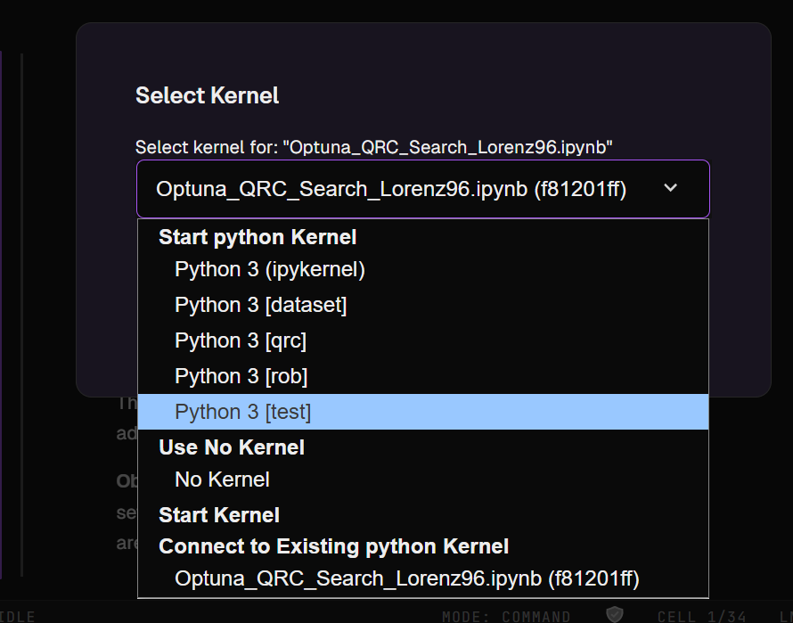
Start and monitor a server instance
To activate your environment, select your kernel and you are good to go!

Slide 9
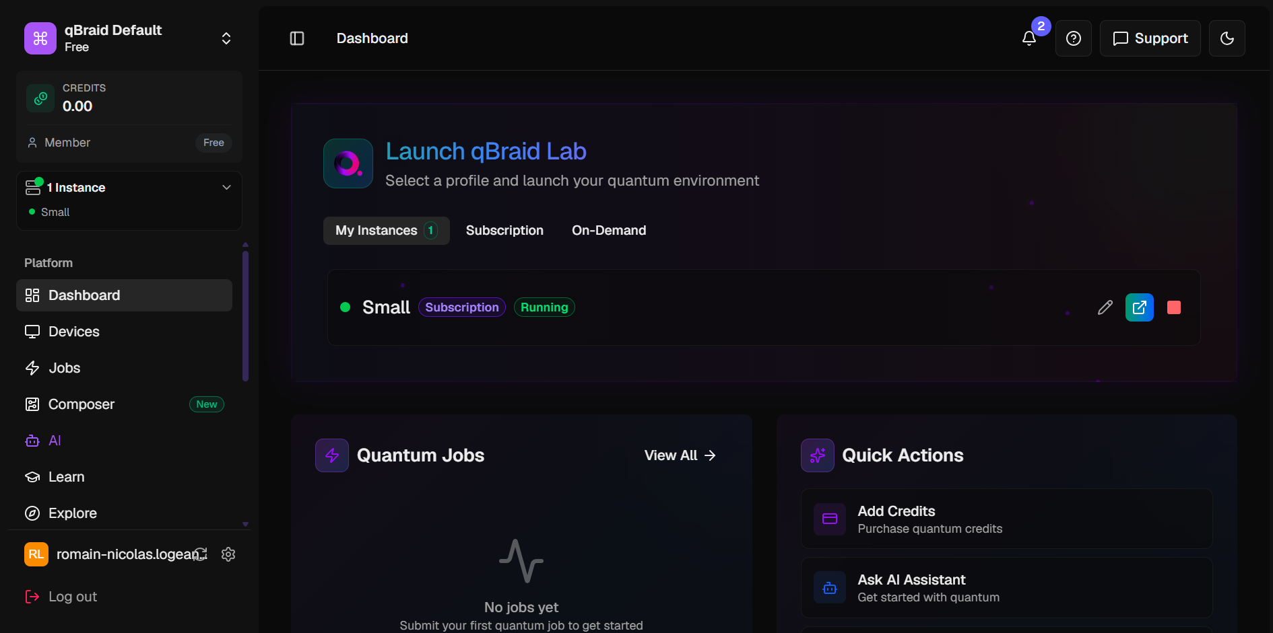
Start and monitor a server instance
To shut down your server instance, click on Stop on the Dashboard tab

Slide 10
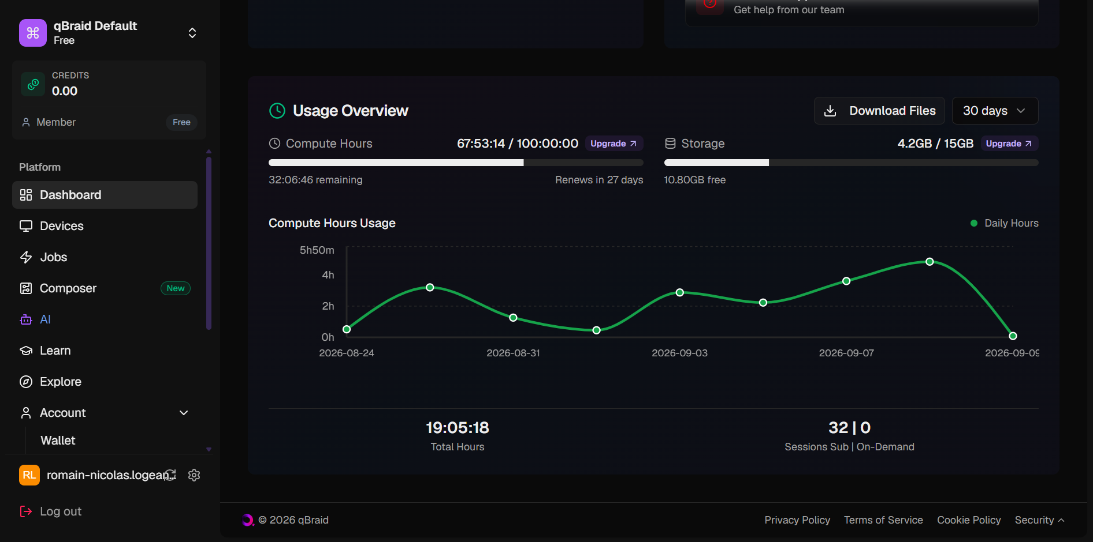
Start and monitor a server instance
See your storage and download your files locally.
The free subscription has a limit of 15 Gb
On the dashboard, you can follow your consumed computation hours for the current month
See the date, when your 100 hours will be reset

Slide 11
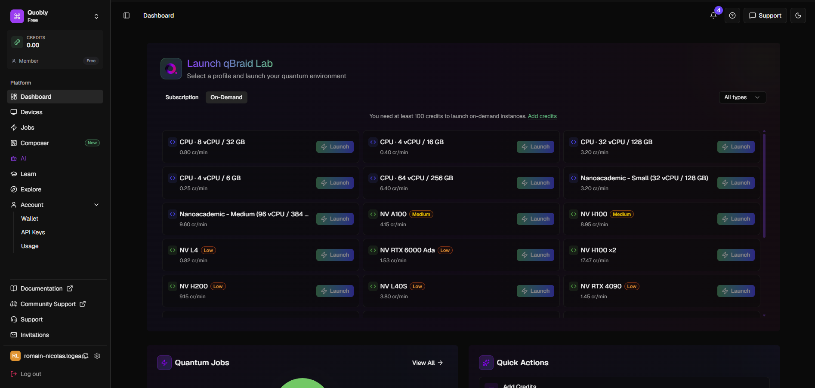
Start and monitor a server instance
Alternatively, if you need a more powerful or GPU-enabled instance, you can launch one from the On-Demand tab using credits (separate from your free CPU hours):

Slide 12
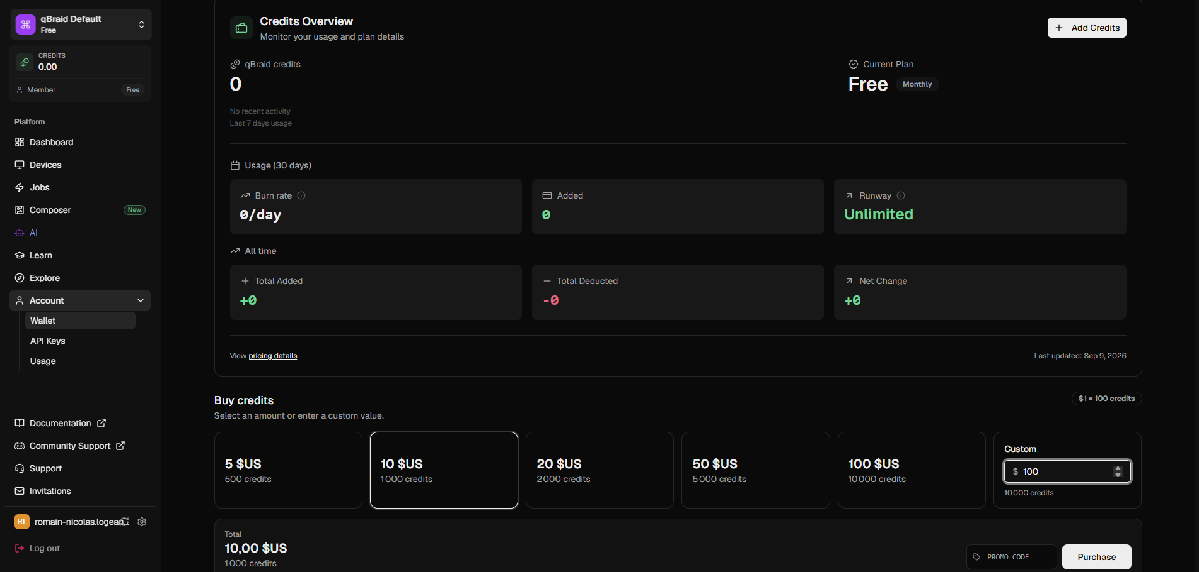
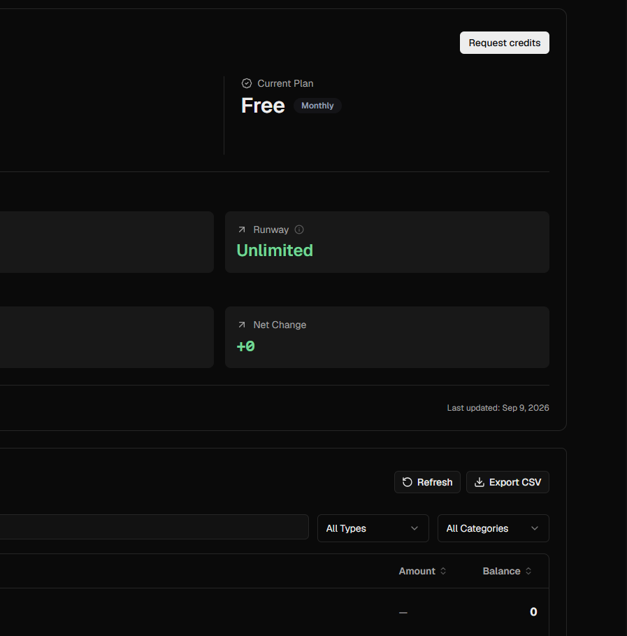
Start and monitor a server instance
You can purchase credits on the Account tab
Alternatively, if you are part of an organization, you can request credits from the same tab

Slide 13
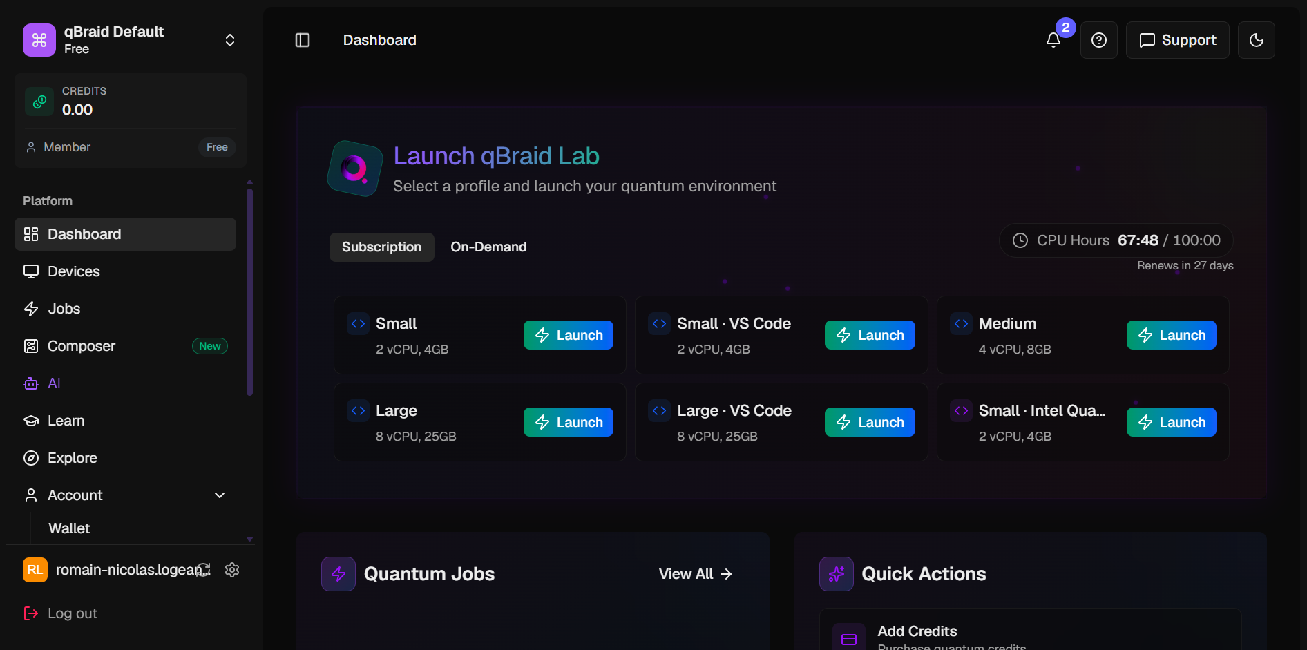
Modify Idle Timeout
By default, after 15 min of inactivity, the server instance is shut down. Idle servers keep burning CPU hours, but a timeout that's too short kills your running code.
To modify this timeout go to Settings on a qBraid lab instance (not a VS Code one!):

Slide 14
Modify Idle Timeout
Click on Open Lab:

Slide 15
Modify Idle Timeout
Open the Settings tab (bottom left corner):

Slide 16
Modify Idle Timeout
Choose your timeout between 10 minutes and 2 hours
You can also disable it, but I'd recommend keeping the auto shutdown enabled: if you forget a running session, it will burn through your monthly CPU hours.

Slide 17
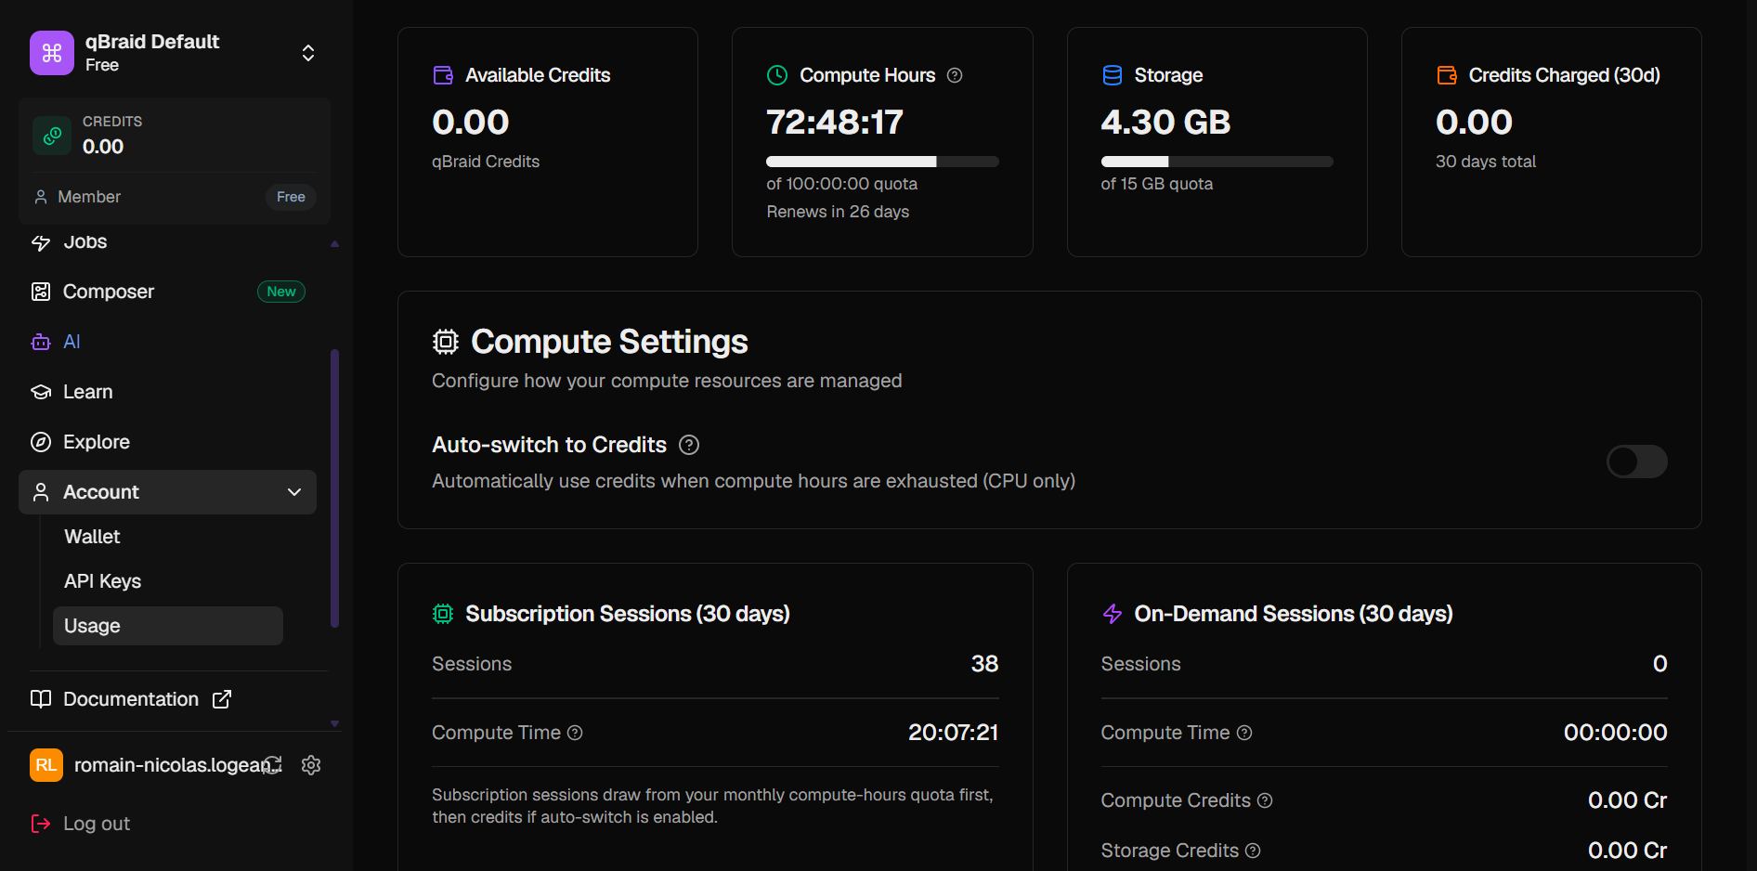
Modify Idle Timeout
Another important option to keep in mind is the Auto-switch to Credits
Idle timeout off + auto shutdown off + Auto-switch to Credits on is a dangerous combination: one forgotten server will burn through all your CPU hours AND your credits!

Slide 18
Modify Idle Timeout
You can access a terminal on your server instance
Go to Manage Instance:

Slide 19
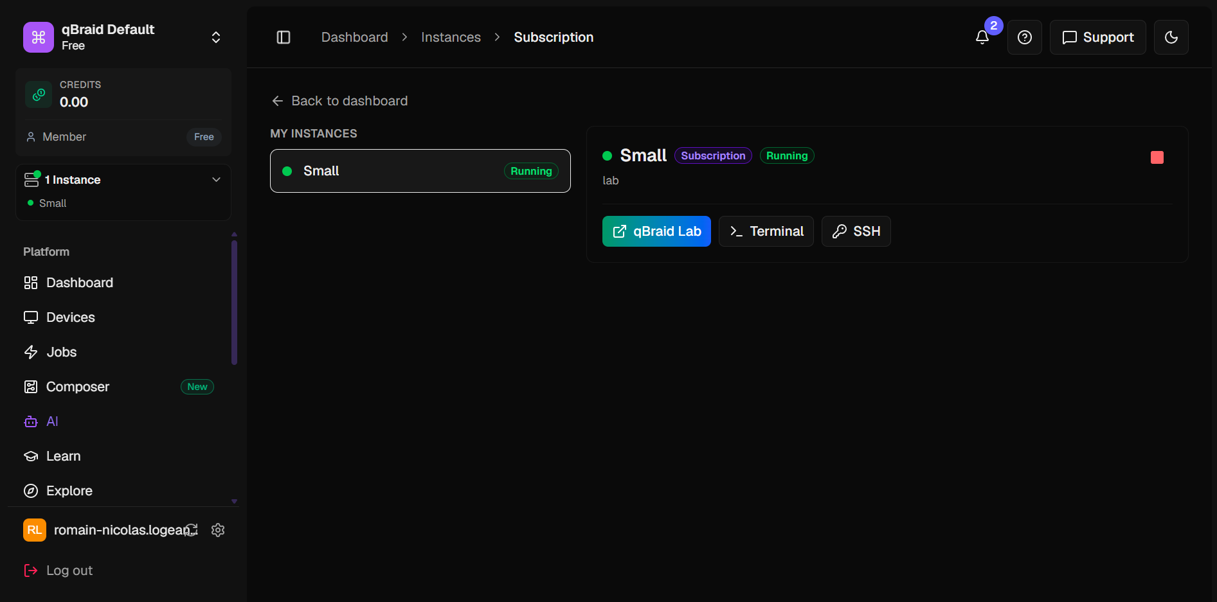
Modify Idle Timeout
And click on Terminal:

Slide 20
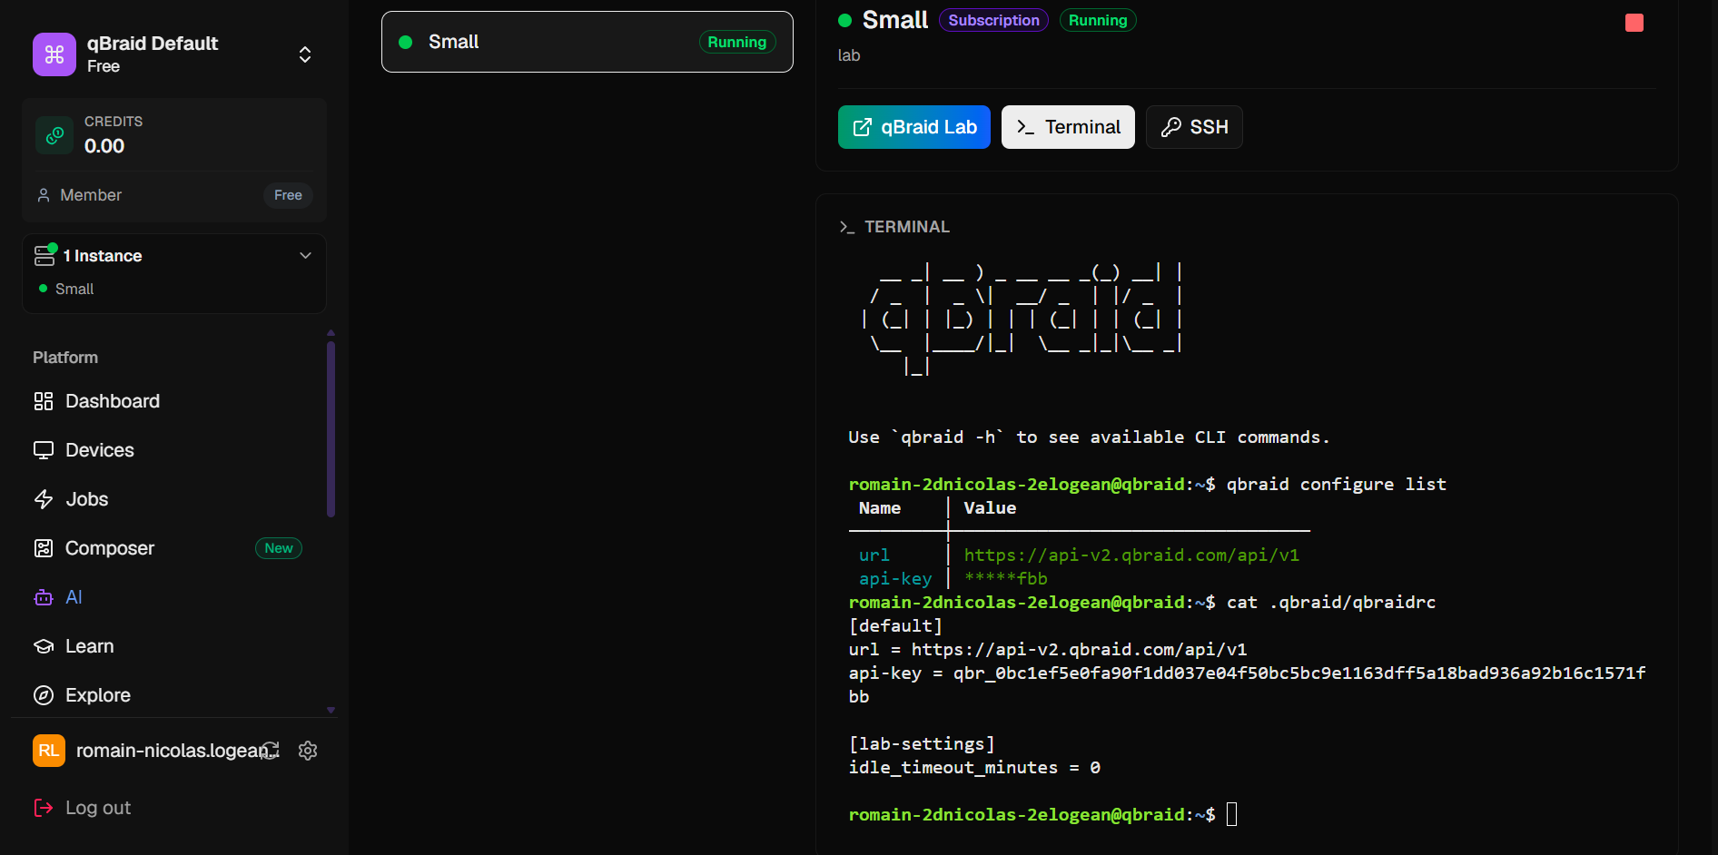
Modify Idle Timeout
All settings are stored in the file ~/.qbraid/qbraidrc
The command qbraid configure list should also show your settings (seem not to be conserved between sessions ?)

Slide 21
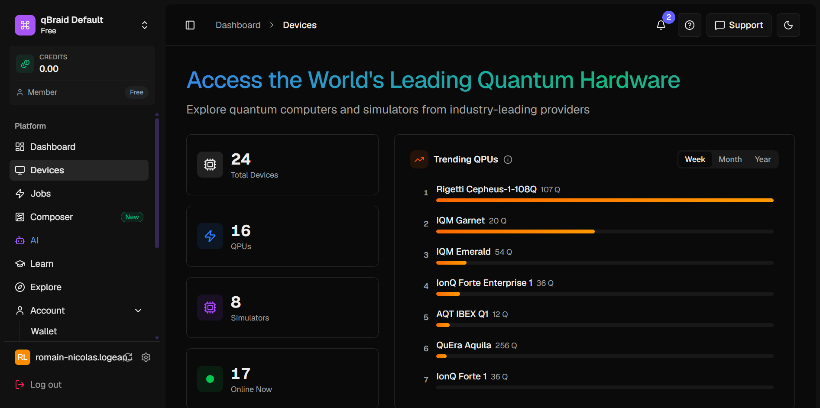
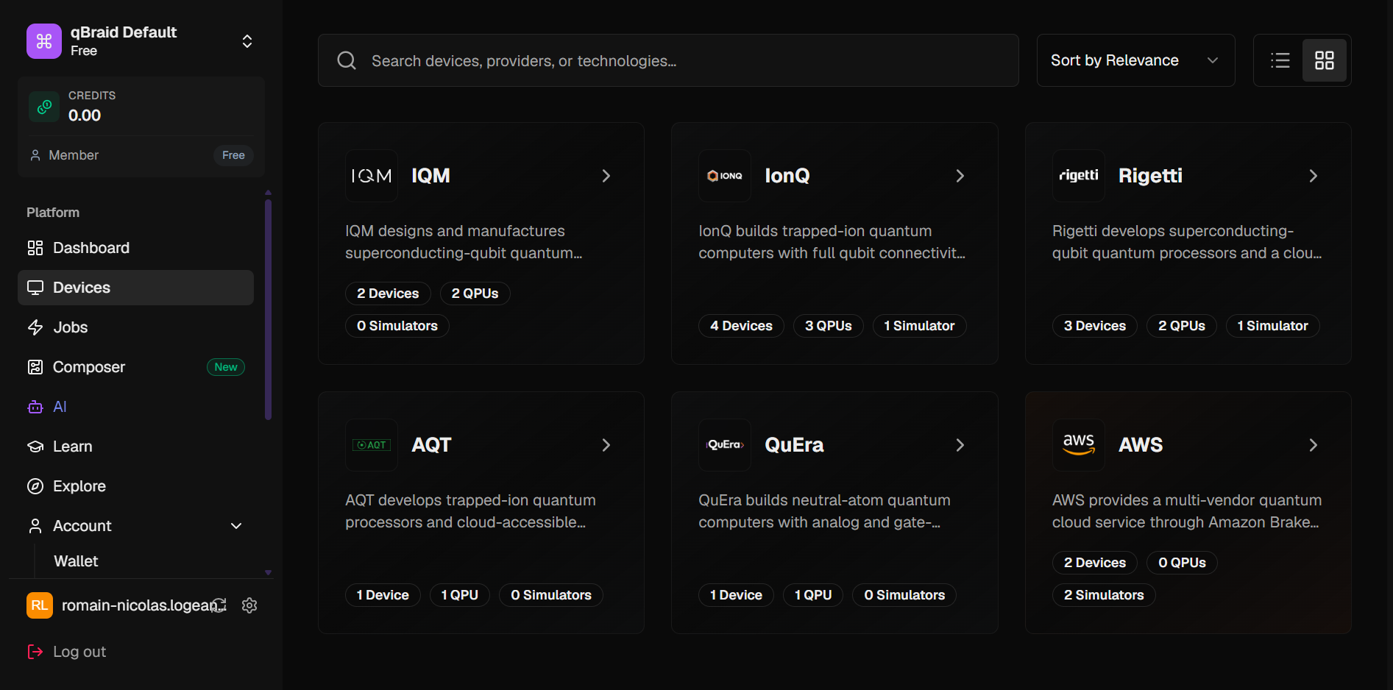
Run on a quantum device or simulator
Go on Device tab to see every available QPU
You can search for the specific QPU you are interested in here

Slide 22
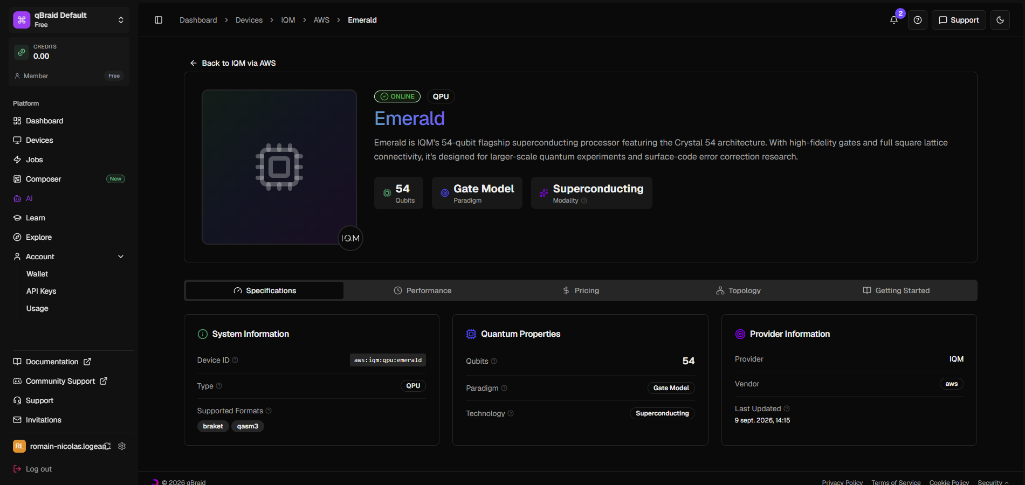
Run on a quantum device or simulator
Select a device you want to use, and check its Device ID:

Slide 23
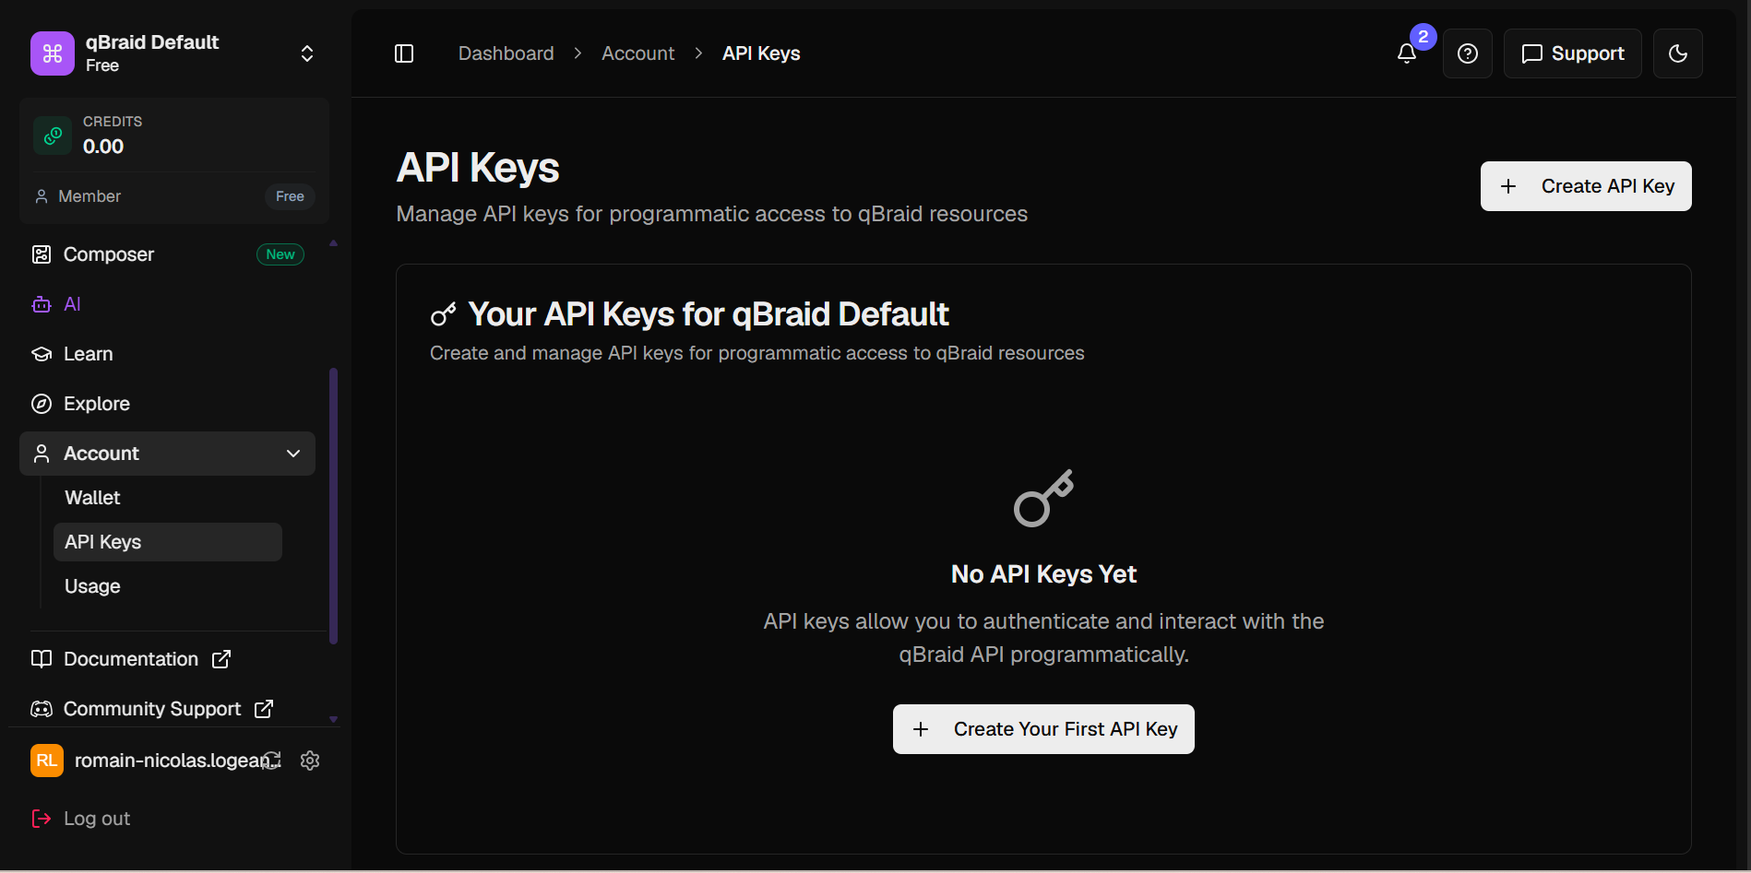
Run on a quantum device or simulator
You also need to create an API key on the Account tab, keep it somewhere safe on your computer.

Slide 24
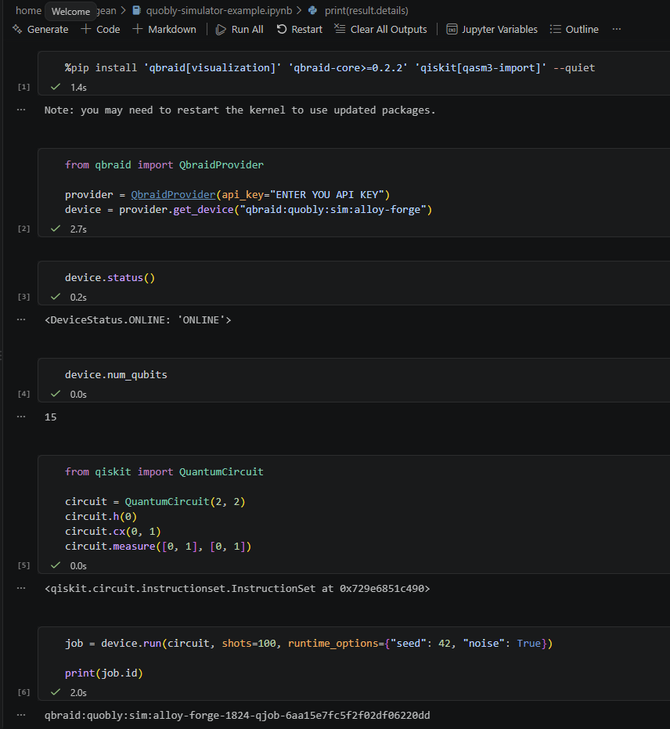
Run on a quantum device or simulator
To use the device you chose:
  Install qBraid libraries
  Enter your API key
  Select your device using Device ID
  Create your qiskit circuit
  Run your job !

Slide 25
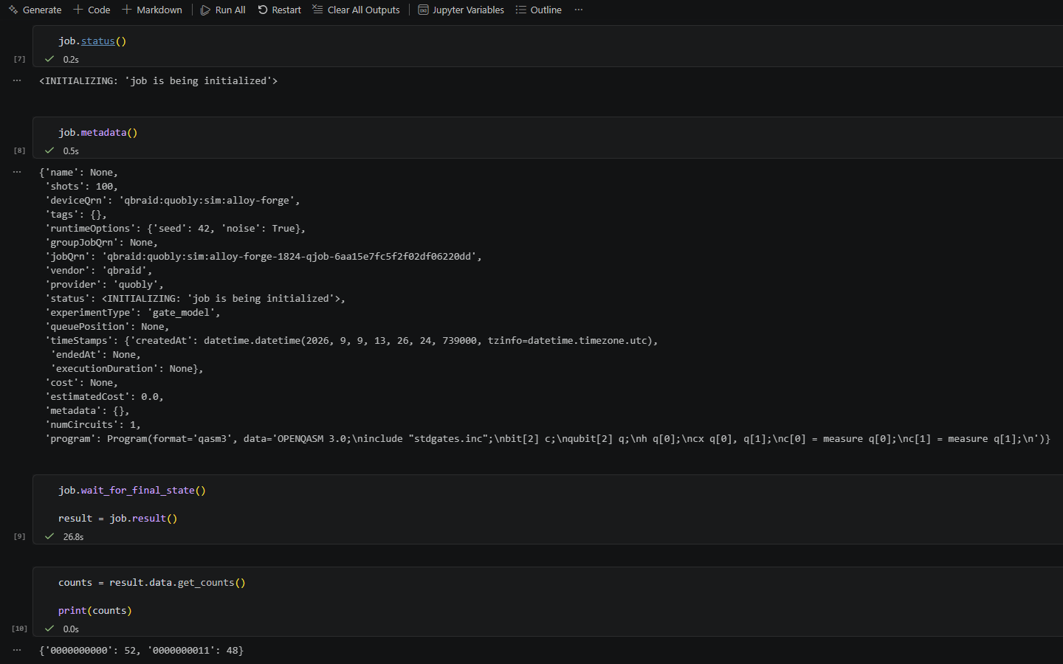
Run on a quantum device or simulator
You can access information about your job status
And finally recover your job results

Slide 26
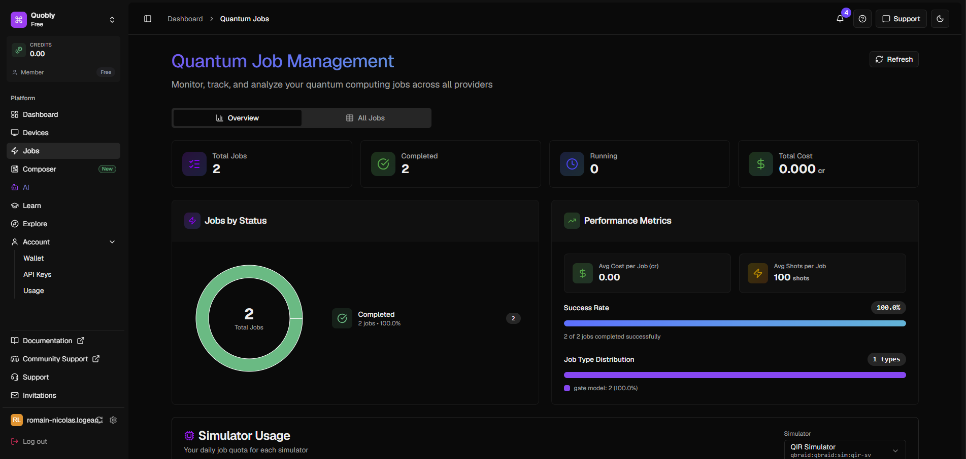
Run on a quantum device or simulator
As for the classical server instances, you can access information about your previous quantum jobs on the Jobs tab:

Slide 27
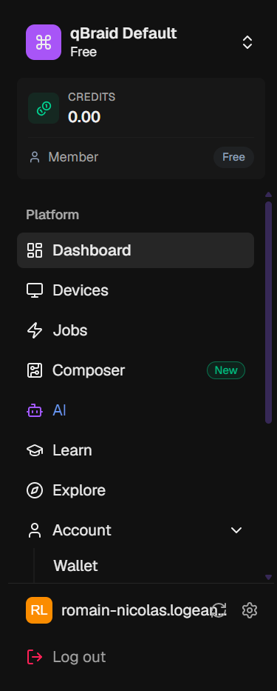
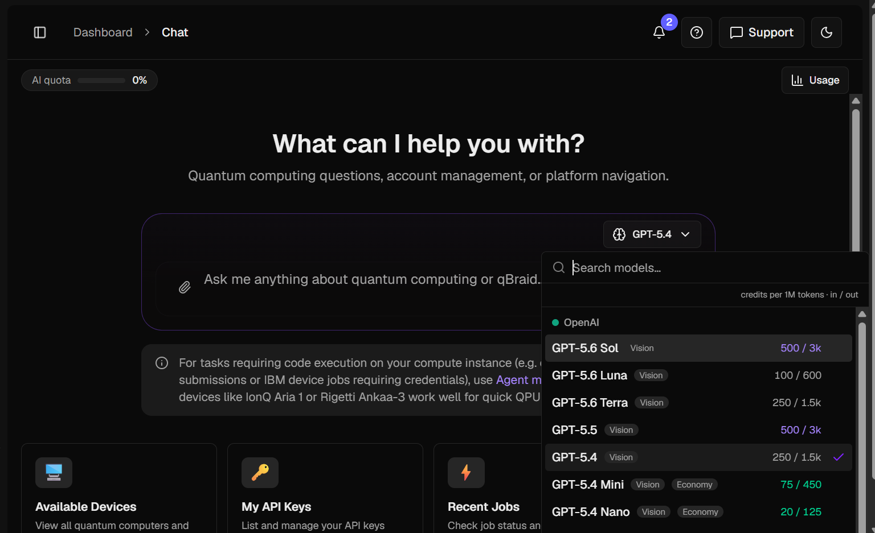
Integrated AI agent
If you have specific question about qBraid, go ask the integrated AI agent
This agent has access to your current server instances and your account, so he can answer precisely about your situation
Be careful you have a limited AI quota per month (you can exceed it using credits)
You can choose your favorite chatbot here

