Slide 1

Capacity Planning: SLAs, KPIs, Headroom, Expiry Date
Presented by:
Karl Arao
Notes:
Outline:
Ultimate Exadata IO monitoring – Flash, HardDisk , & Write back cache overhead http://www.kylehailey.com/oaktable-world/agenda/
I’ll do a session highlighting a very write intensive OLTP Exadata environment and will discuss the different ways to monitor IO from the database and storage layer perspective and correlating it back to the application by mining the dba_hist_sqlstat data. I’ll also touch on utilizing the OEM12c Metric Extensions and BI Publisher integration to ultimately scale the monitoring to a bunch of Exadata environments. It’s going to be a fun hacking session.
> discuss the capacity doodle
> the variables
> monitoring
> the reclaim
> highlight issue on very write intensive OLTP environment
> monitoring problem
on OEM perf page > show IO perf page not accounting the flash IOs
** partly because some people in the team have access to only limited view of things
** or they have difficulty interpreting the numbers, they need simple stuff
on OEM12c storage grid perf > although 12c has exadata IOs monitoring but,
I'd like to get the IOPS number separated by flash and disk
> wbfc patent
> write back cache http://goo.gl/2WCmw
> exadata oltp optimizations
> discuss about the basic architecture
> discuss different ways to monitor IO (email to randy) http://goo.gl/i660CZ
Different views of IO performance
SECTION 1: USER IO wait class and cell single block reads latency with curve fitting
SECTION 2: Small IOPS vs Large IOPS
SECTION 3: Flash vs HD IOPS
SECTION 4: Flash vs HD IOPS with read/write breakdown
SECTION 5: IO throughput read/write MB/s
SECTION 6: Drill down on smart scans affecting cell single block latency on 24hour period
> IO workload correlate up to the topevents and sqlstat data
> causal links - produce analysis which relates database load to application processing creating a strong understanding
front to back as an enabler to ‘fix’
> feedback loop on what is working and what is not
> track IO config changes - IORM (topevents data)
> basic, auto, low latency ... and when it is applicable
> scaling it!
> metrics extension
> BIP
> show data model
> email everyday

Slide 2




whoami
Karl Arao
  Senior Technical Consultant @ Enkitec
  Performance and Capacity Planning Enthusiast
7+ years DBA experience
  Oracle ACE, OCP-DBA, RHCE, OakTable
  Blog: karlarao.wordpress.com
  Wiki: karlarao.tiddlyspot.com
  Twitter: @karlarao
www.enkitec.com
Notes:
Just a brief introduction of myself..

Slide 3
Agenda
Capacity Management Lifecycle
KPIs / SLAs
Headroom
Data Collection / Sources
Automation
Demos
  Component Level Dashboard view
  Headroom in action
www.enkitec.com

Slide 4
Capacity Management Lifecycle
Capacity
Assessment
Capacity Reporting
Capacity
Plan
Tuning / Remediation
Sizing
Performance
Monitoring
www.enkitec.com

Slide 5
KPIs / SLAs
Rates, volumes, latency, elapsed
Content (app/business)
  Trades/day
  Trx/sec
  EOD batch elapsed
Container
  Component level
    CPU, IO, Memory, Storage
Container
Content
www.enkitec.com

Slide 6
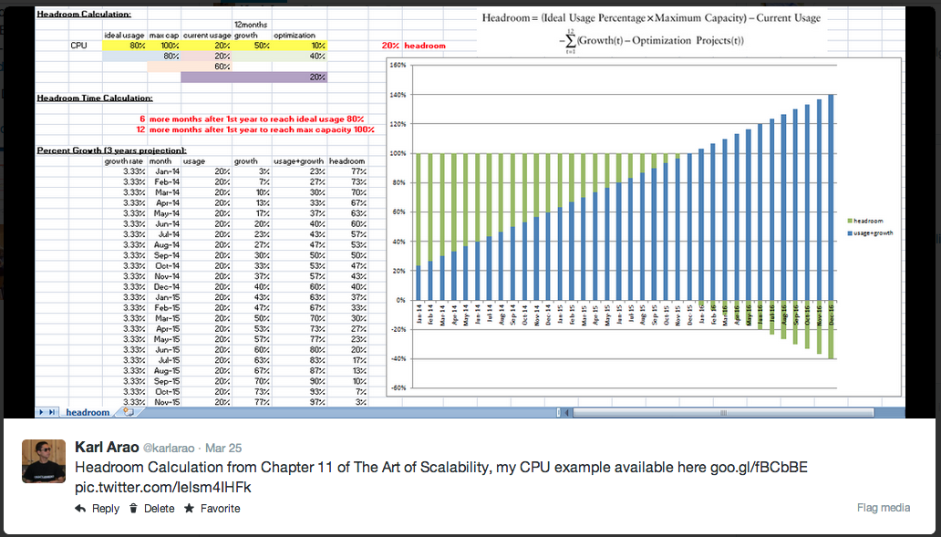
The amount of free capacity that exists within your system before you start having problems such as a degradation of performance or an outage
www.enkitec.com

Slide 7
Component Level Headroom
Scenarios in which you will need to determine the headroom:
  Growth on compute power requirement by new app functionalities
  Consolidation
  SLA breaches, the environment is running out of capacity (saturated the server) and you need to define a new machine or alternative actions (tuning/workload mgt, etc)
  You just want to find out how much utilization and until this month and year to grow
www.enkitec.com

Slide 8
So how does this thing look like?
www.enkitec.com

Slide 9
Data Sources
AWR
AWR warehouse
eAdam (http://www.enkitec.com/products/eadam)
OEM repository
Metric Extensions
www.enkitec.com

Slide 10
Automation
www.enkitec.com

Slide 11
Demo
www.enkitec.com

Slide 12
Summary
Capacity Management Lifecycle
Headroom Calculation / Expiry Date
Component Level Dashboards
Demos
www.enkitec.com

Slide 13
References
    Book: The Art of Scalability - Ch11 “Headroom” http://theartofscalability.com
Exadata Provisioning Worksheet http://www.slideshare.net/karlarao/pape-rkaraoconsolidation-successstory
karl.arao@enkitec.com
karlarao.wordpress.com
karlarao.tiddlyspot.com
@karlarao
www.enkitec.com

