Slide 1

Data Management Training Clearinghouse
Search Process Workflow to Education Publication Workflow

Slide 2
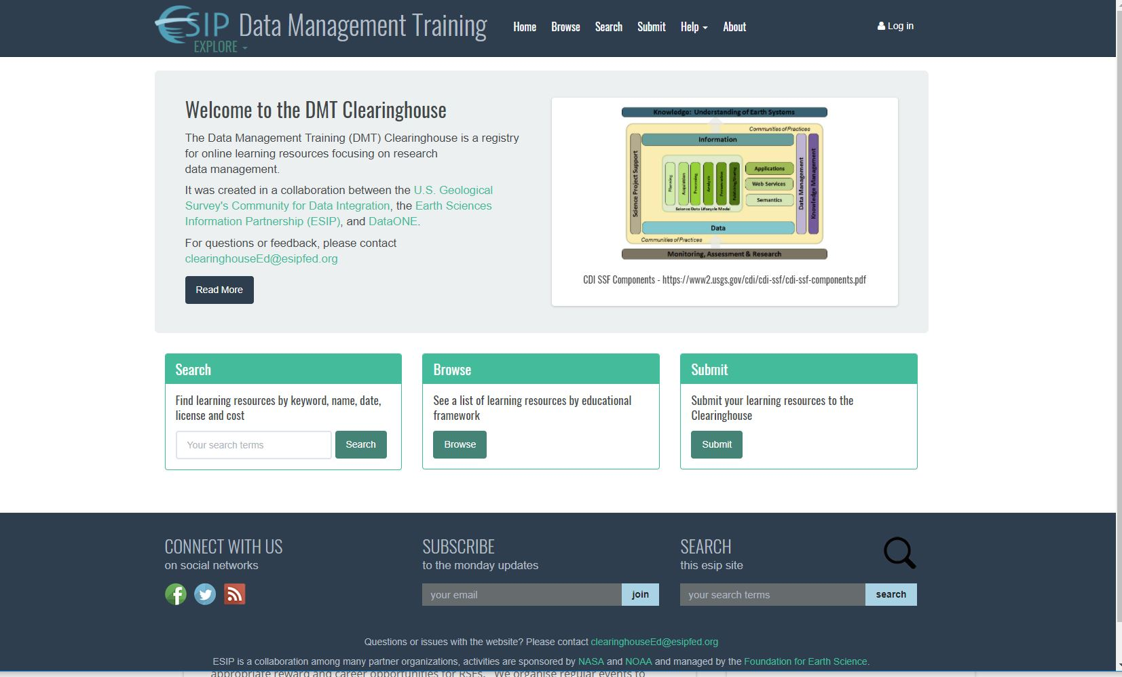
DMT Clearinghouse functionality…
http://dmtclearinghouse.esipfed.org/

Slide 3
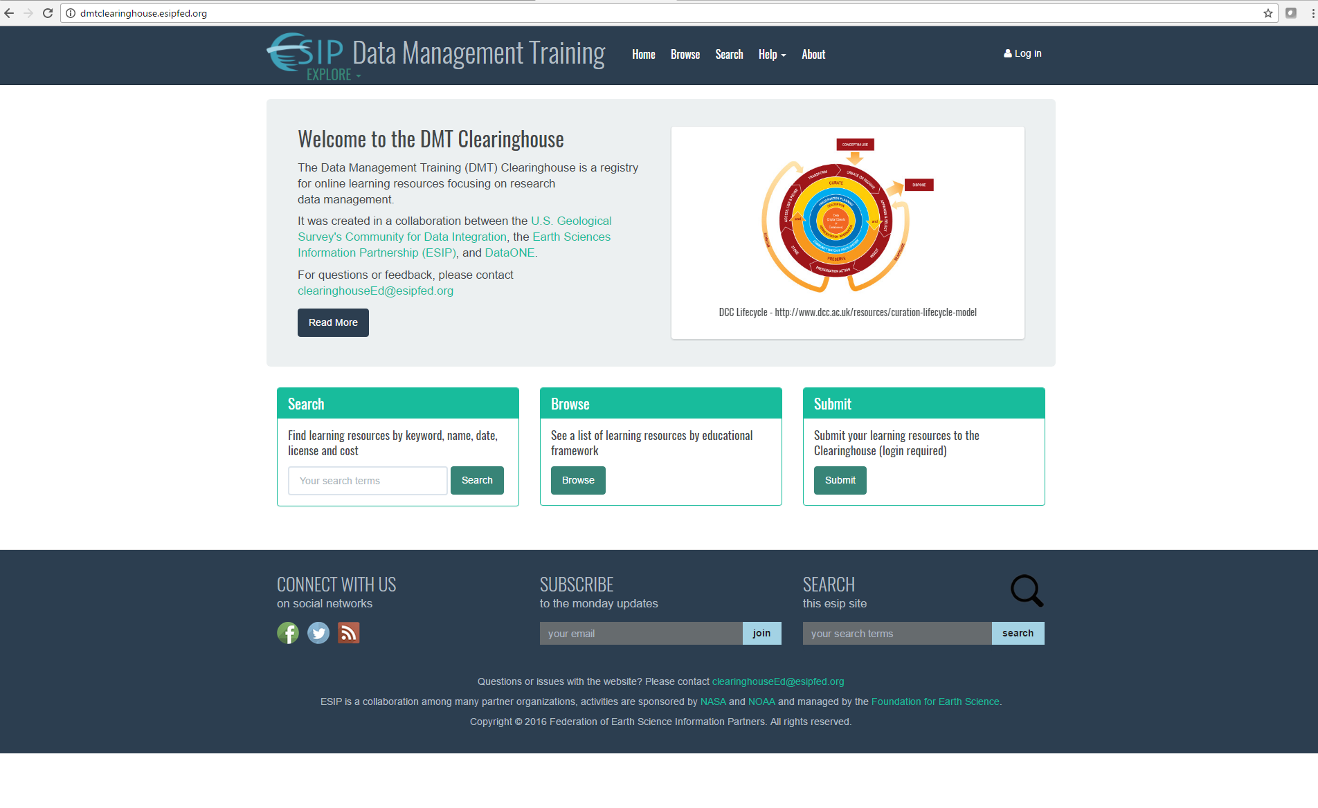
Search Function
Notes:
From Clearinghouse home page

Slide 4
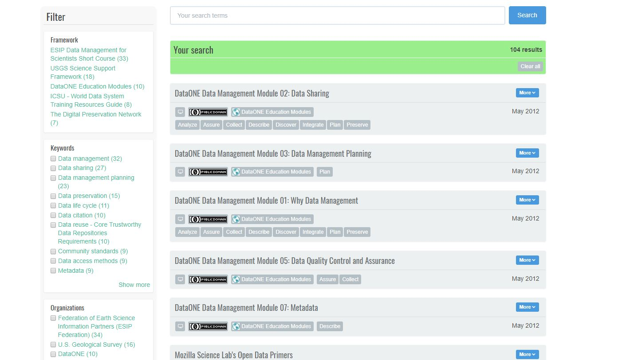
Search Function: Example approaches
You filter
by
pre-set
categories
(“facets”)
You enter your own
search terms

Slide 5
Search Process: Approach 1 = You search using your own terms

Slide 6
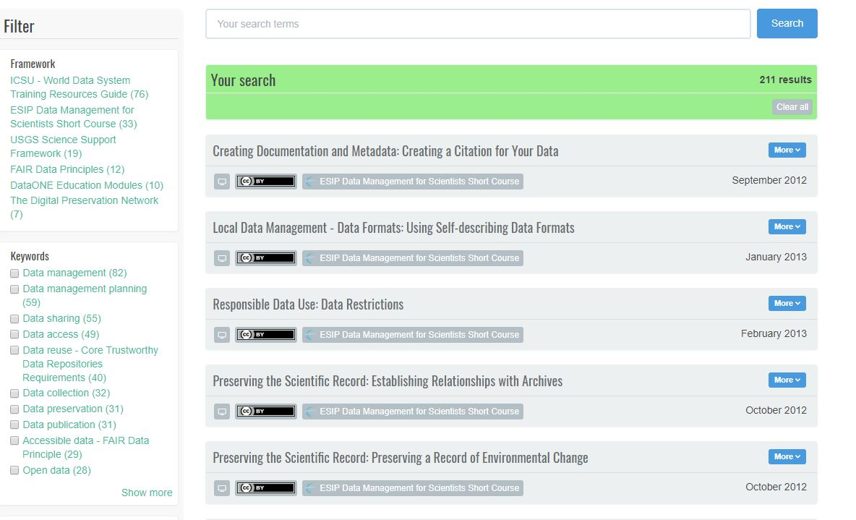
Search Process: Approach 2 = You start by checking boxes within the pre-set categories (“filters”)

Slide 7
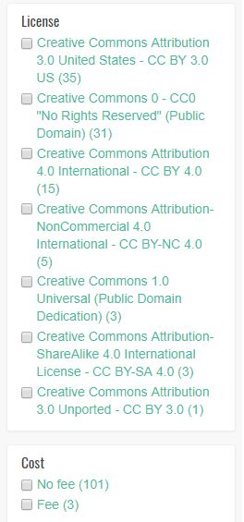
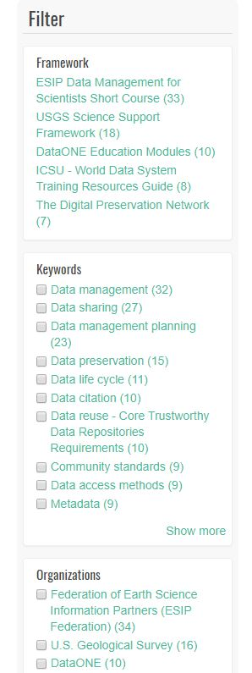
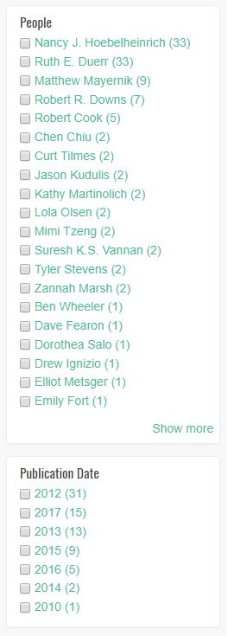
Built-in Search Filters

Slide 8

Search Process: Approach 3: Combining Approach 1 & Approach 2 …

Slide 9
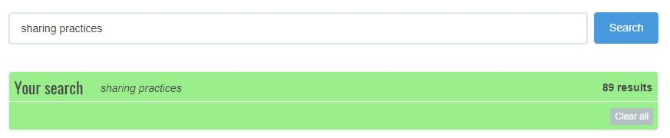
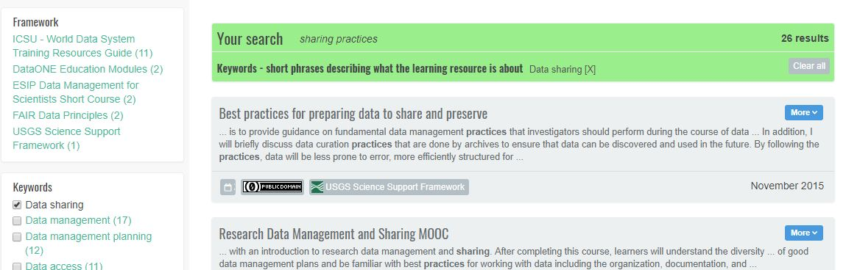
Demonstrating Approach 3: Start by entering your own search term…
Yikes!
… then limiting by Keyword filter…
More precise!

Slide 10
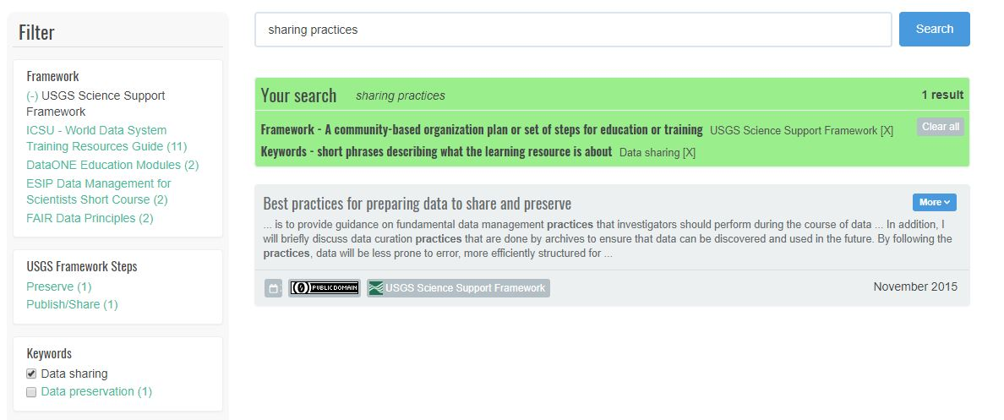
Demonstrating Search: finally, limiting even more by the Framework filter…
Still more precise!

Slide 11
Demonstrating Search: however, if too precise, you can either Clear all to start over … or uncheck filters / facets

Slide 12
Data Management Training Clearinghouse
Search Results

Slide 13
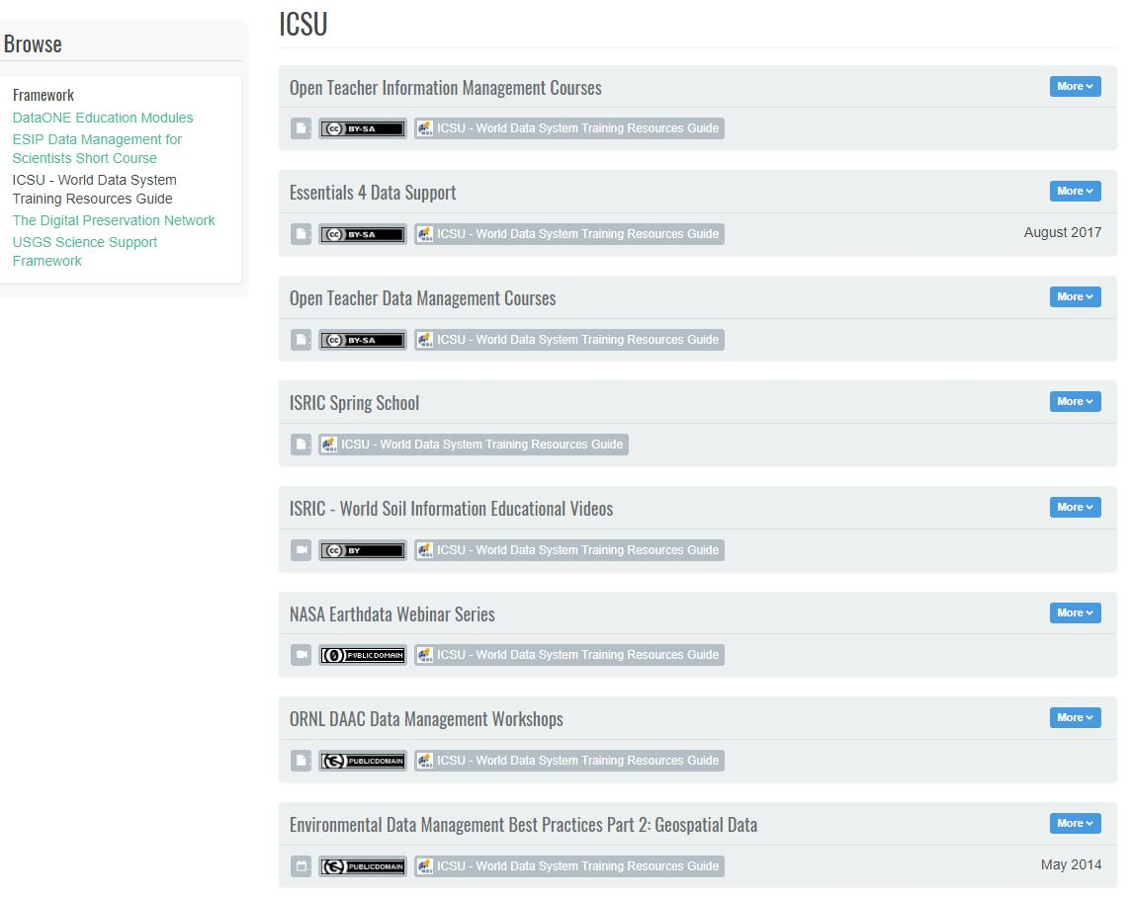
Search Results View -- What does it tell you?
You can either
click on the Title
or the
More
button
to get
more Info

Slide 14
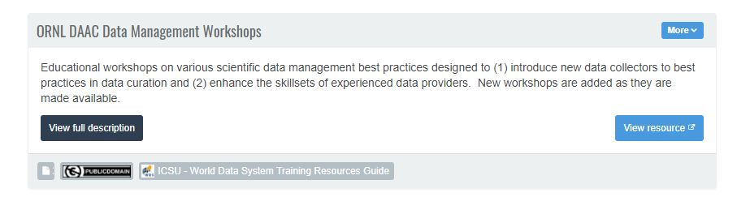
Brief Description -- What does it tell you?

Slide 15
Brief Description -- you want to see more about this one! What next?
Click on the View full description to look at the full metadata … or
the View resource button to go directly to the “landing page” of the resource.
You can either …

Slide 16
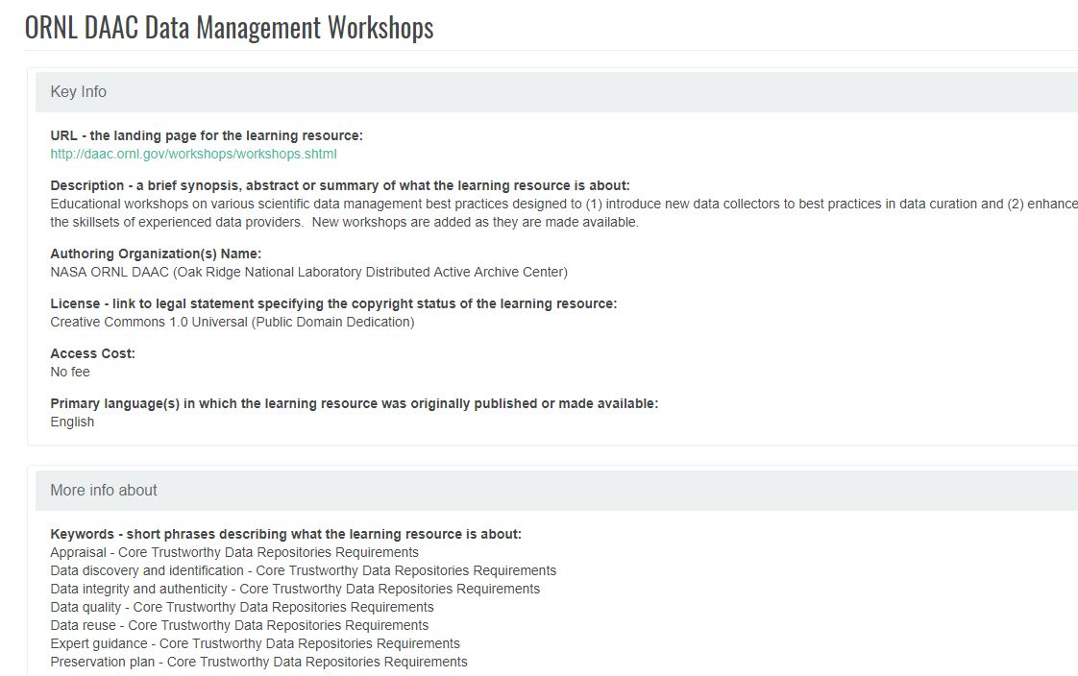
Full Description – 1 of 2

Slide 17
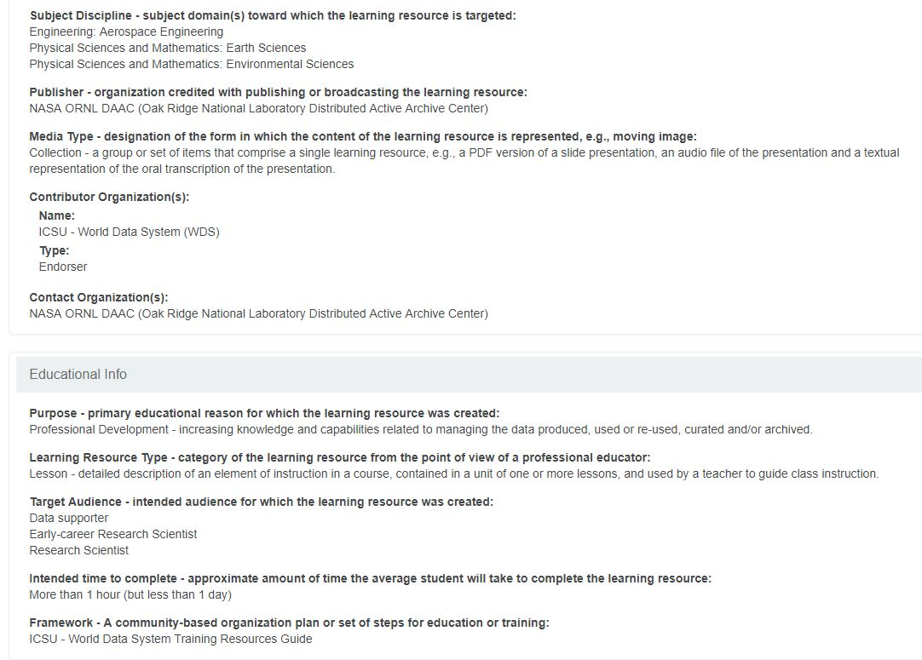
Full Description – 2 of 2

Slide 18
Data Management Training Clearinghouse
Resource Description & Publication Workflow

Slide 19
Current Publication Process
We Invite community volunteers who wish to submit and/or review descriptions of educational resources to the DMTC using existing:
Selection Criteria:
https://github.com/imls-dmt/resources-workflow/blob/master/Nov17_2018_SelectionCriteria.pdf
Tutorial for Submitting Descriptions to the DMTC with suggested workflow:
https://github.com/imls-dmt/resources-workflow/blob/master/Tutorial%20for%20Submitting%20Educational%20Resource%20Metadata.pdf
Metadata input form – using the Dublin Core maintained, and Schema.org endorsed Learning Resource Metadata Initiative schema: http://dublincore.org/specifications/lrmi/
Questions / Interest: email us at: clearinghouseEd@dmtclearinghouse.esipfed.org

Slide 20
“Submit” Function
Notes:
From Clearinghouse home page

Slide 21
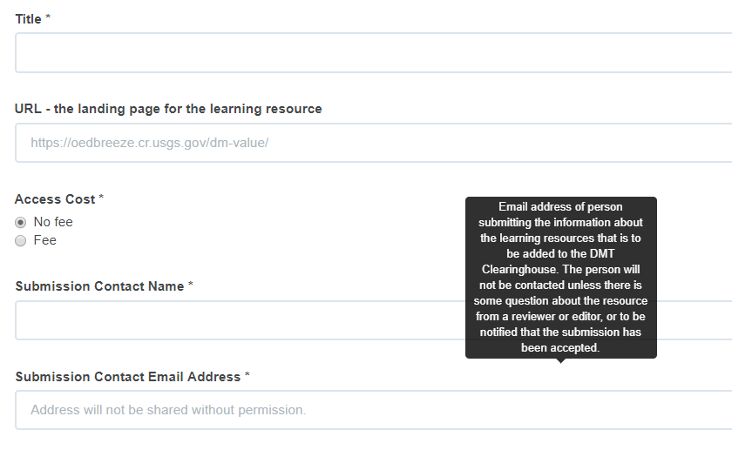
EZ “Submit” Form – no login required
Notes:
From Clearinghouse home page

Slide 22
“Submit” Recommended Information submitted, reviewed & published by logged in user:
Names, Personal & Organizational for Authors and Contributors
Descriptive Information
Educational Context for the Resource
Notes:
From Clearinghouse home page

Slide 23

Current Clearinghouse publication process by role of logged-in user
Task | Submitter | Reviewer | Editor
ID resource
Fill out Required Info
Fill out Recommended Info
Save
Add to Controlled Vocabularies (varies by role)
Submit
Evaluate Appropriateness of Adding Resource
Review / Edit metadata submitted
Save (= Re-submit)
Publish
Update/Maintain (e.g., correct URLs, typos, etc.)

Slide 24
Add to Controlled Vocabularies by role of logged-in user
Task | Submitter | Reviewer | Editor
Personal Names
Organizational Names
Keywords
Save
Subject Disciplines
Target Audiences
Media Type
Learning Resource Type

Slide 25
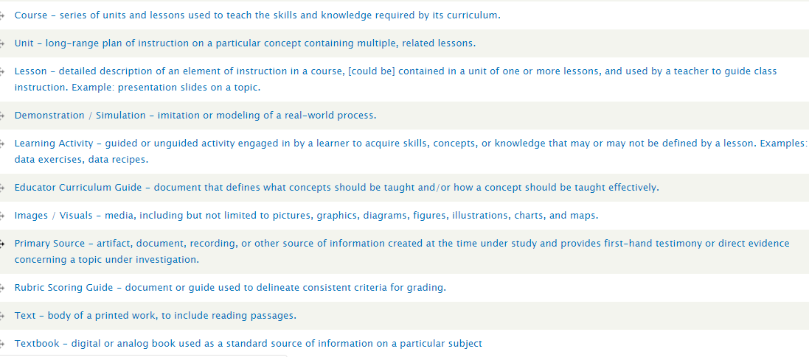
Seeking Learning Resource Types, such as:

Slide 26
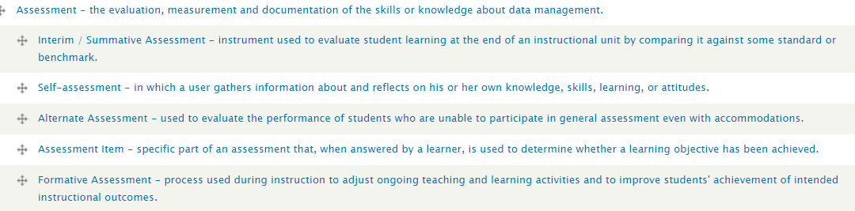
Seeking educational resource types, continued:

