Slide 1

Data Management Training Clearinghouse
Defining User Needs

Slide 2
Agenda
Background Info
Personas & Journey Mapping
Key Roles to Consider
Interactive Questions

Slide 3
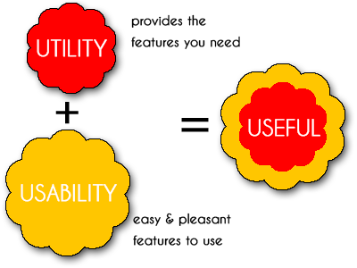
Understanding user needs is a key step for creating a useful service.
Nimit. (2013, September 19). What is usability. Retrieved from https://nimitmangal.wordpress.com/2013/09/19/what-is-usability/

Slide 4


Usability.gov. (n.d.). Personas. Retrieved from https://www.usability.gov/how-to-and-tools/methods/personas.html

Slide 5
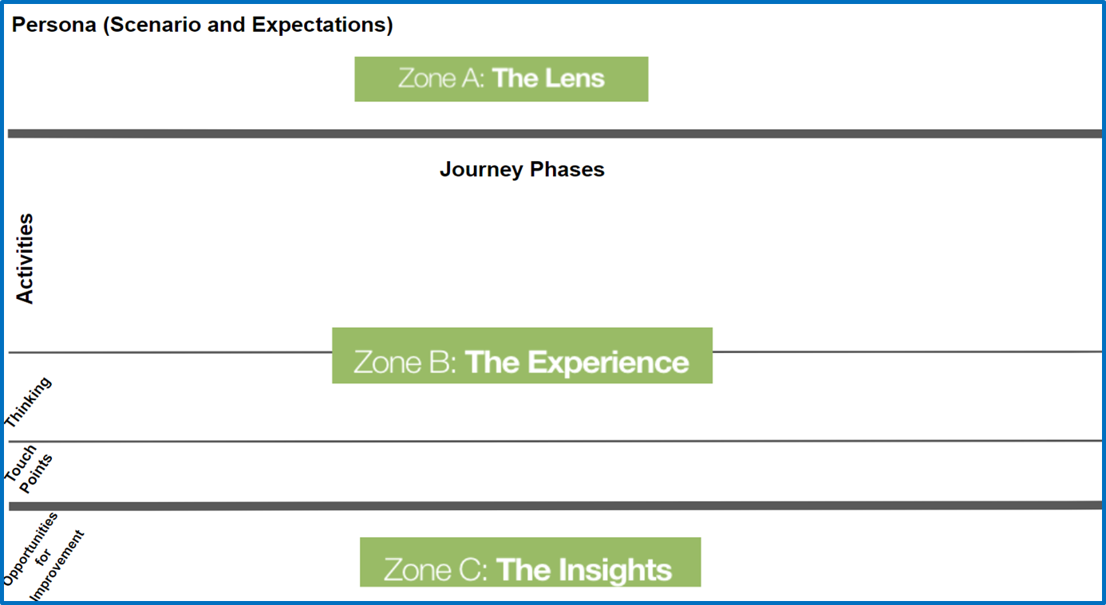
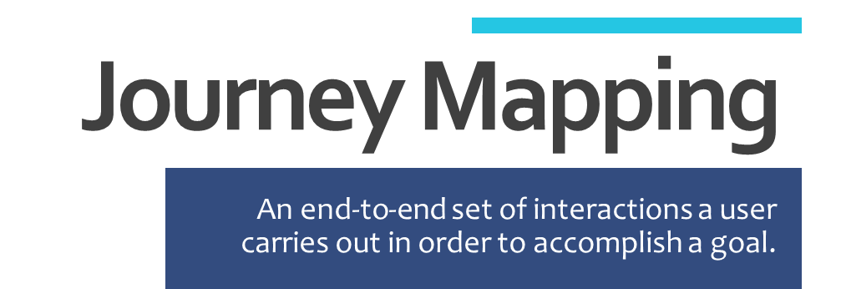
Kaplan, Kate. (2016, July 31). When and How to Create Customer Journey Maps. Retrieved from https://www.nngroup.com/articles/customer-journey-mapping/

Slide 6


As a Trainer
As a Learner

Slide 7
Defining User Needs
Who are you?
What goals do you have?
What motivates you?
What do you need?
What is working well?
What needs improvement?
What is missing?
What is your “moment of truth”?

Slide 8



Thank You
Sophie Hou
http://dmtclearinghouse.esipfed.org/

