Slide 1
Agile Data Curation - Session Introduction
http://commons.esipfed.org/node/9112

Slide 3
Agile Data Curation – Conceptual Foundation
Karl Benedict, Chris Lenhardt, Joshua Young

Slide 4
Overview
What’s the problem?
Parallels with Software Development
Conceptual Mapping
Values
Principles
Technical Debt
Next Steps
Contact Information

Slide 5
What’s the Problem?
Exponential Growth of Data
Non-exponential Growth of Funding
Management
Organize
Format
Curation
Preservation
Archiving
Selection
Maintenance
Collection
Structure
Analyze
Publish
Increased Demand For:
Documentation
Sharing
Preservation
Notes:
The challenges and problems^[define - what are these?] with current research data^[define] curation^[define - as a complement to *management*] practices are commonly a product of ad-hoc^[define] or minimally designed^[define-perhaps in contrast with "engineered"] processes that are not explicitly developed to anticipate diverse needs^[define or illustrate - who and for what?] through a specific arc^[define as an alternative to *lifecycle*] of creation/acquisition, documentation, use, preservation and reuse *<cite>*. In response to this problem of under-design and with the increasing recognition of the value of research data as *products* of the research process that are critical elements for replication, validation and extension of research, a variety of requirements have been put in place by sponsors and publishers for planning for and executing effective data management^[define as a complement to *curation*] and sharing^[define] *<cite>*. While these requirements have resulted in more explicit documentation of *plans* for data curation and management, it remains unclear what impact they are having on *practice* *<cite>*. The set of values and principles developed by members of the software development community around the concept of *agile software development* provides a potential framework from which a set of agile data curation and management values and principles can be derived. Once a set of values and principles have been developed the community of research data producers and consumers is in a position to develop and use practices that are informed by those principles.

Slide 6
Parallels with Software Development
Long development & release cycles
Tightly coordinated development teams
Detailed written specifications
Dedicated documentation development
Targeted at clearly defined target users
High code reuse
Agile
Continuous Development
Small-scale shared development
Continuous change in functional objective
Irregular/unstructured documentation
Developers are the users
Minimally structured and low reuse
Software
Development
Process & Management Tools
Agreements & Specifications
Documentation
Product Delivery & Use
Engineered
Ad-hoc
Long development & release cycles
Division of labor around data lifecycle
Detailed written specifications
Dedicated documentation development
Targeted at clearly defined target users
High degree of discovery & reuse
Focus on in-project continuous management
Individual-scale data management structure
Objective aligned with immediate analysis needs
Unstructured documentation
Managers are users
Local (research team) reuse
Data
Curation

Slide 7
Conceptual Mapping

Slide 8
Agile Software Values
Individuals and interactions over processes and tools
Working software over comprehensive documentation
Customer collaboration over contract negotiation
Responding to change over following a plan

Slide 9
Principles
Maximize the impact of research data through accelerated capacity for discovery, access and use of valuable data
Expect unanticipated needs for and uses of research data (and documentation) and develop flexible systems to support new uses and users without significant modifications
Facilitate automated interaction with data and metadata assets through well documented public web services that enable disintermediated use and reuse of research data
Data creators and data curators should work closely throughout planning, research and preservation activities to ensure the most efficient and streamlined process

Slide 10
Principles
Identify key individuals in a data curation project that have the requisite knowledge and motivation to do the job and get out of their way
Identify the most effective method(s) for maintaining close communication and use them
Delivery, access, use and citation of research data are the primary measures of success
Design principles that enable steady delivery of incremental improvements to research data discovery, access and use should be consistent with a sustainable level of effort and funding from sponsors, data creators and curators, and users

Slide 11
Principles
Continuous attention to technical excellence and good design enhances agility
Start with the basics and only make systems more complex as needed, while maintaining a low bar to entry
Continuously work to develop and evolve a community of data providers, curators and users that all participate in the ongoing evolution of the research data systems that they interact with

Slide 12
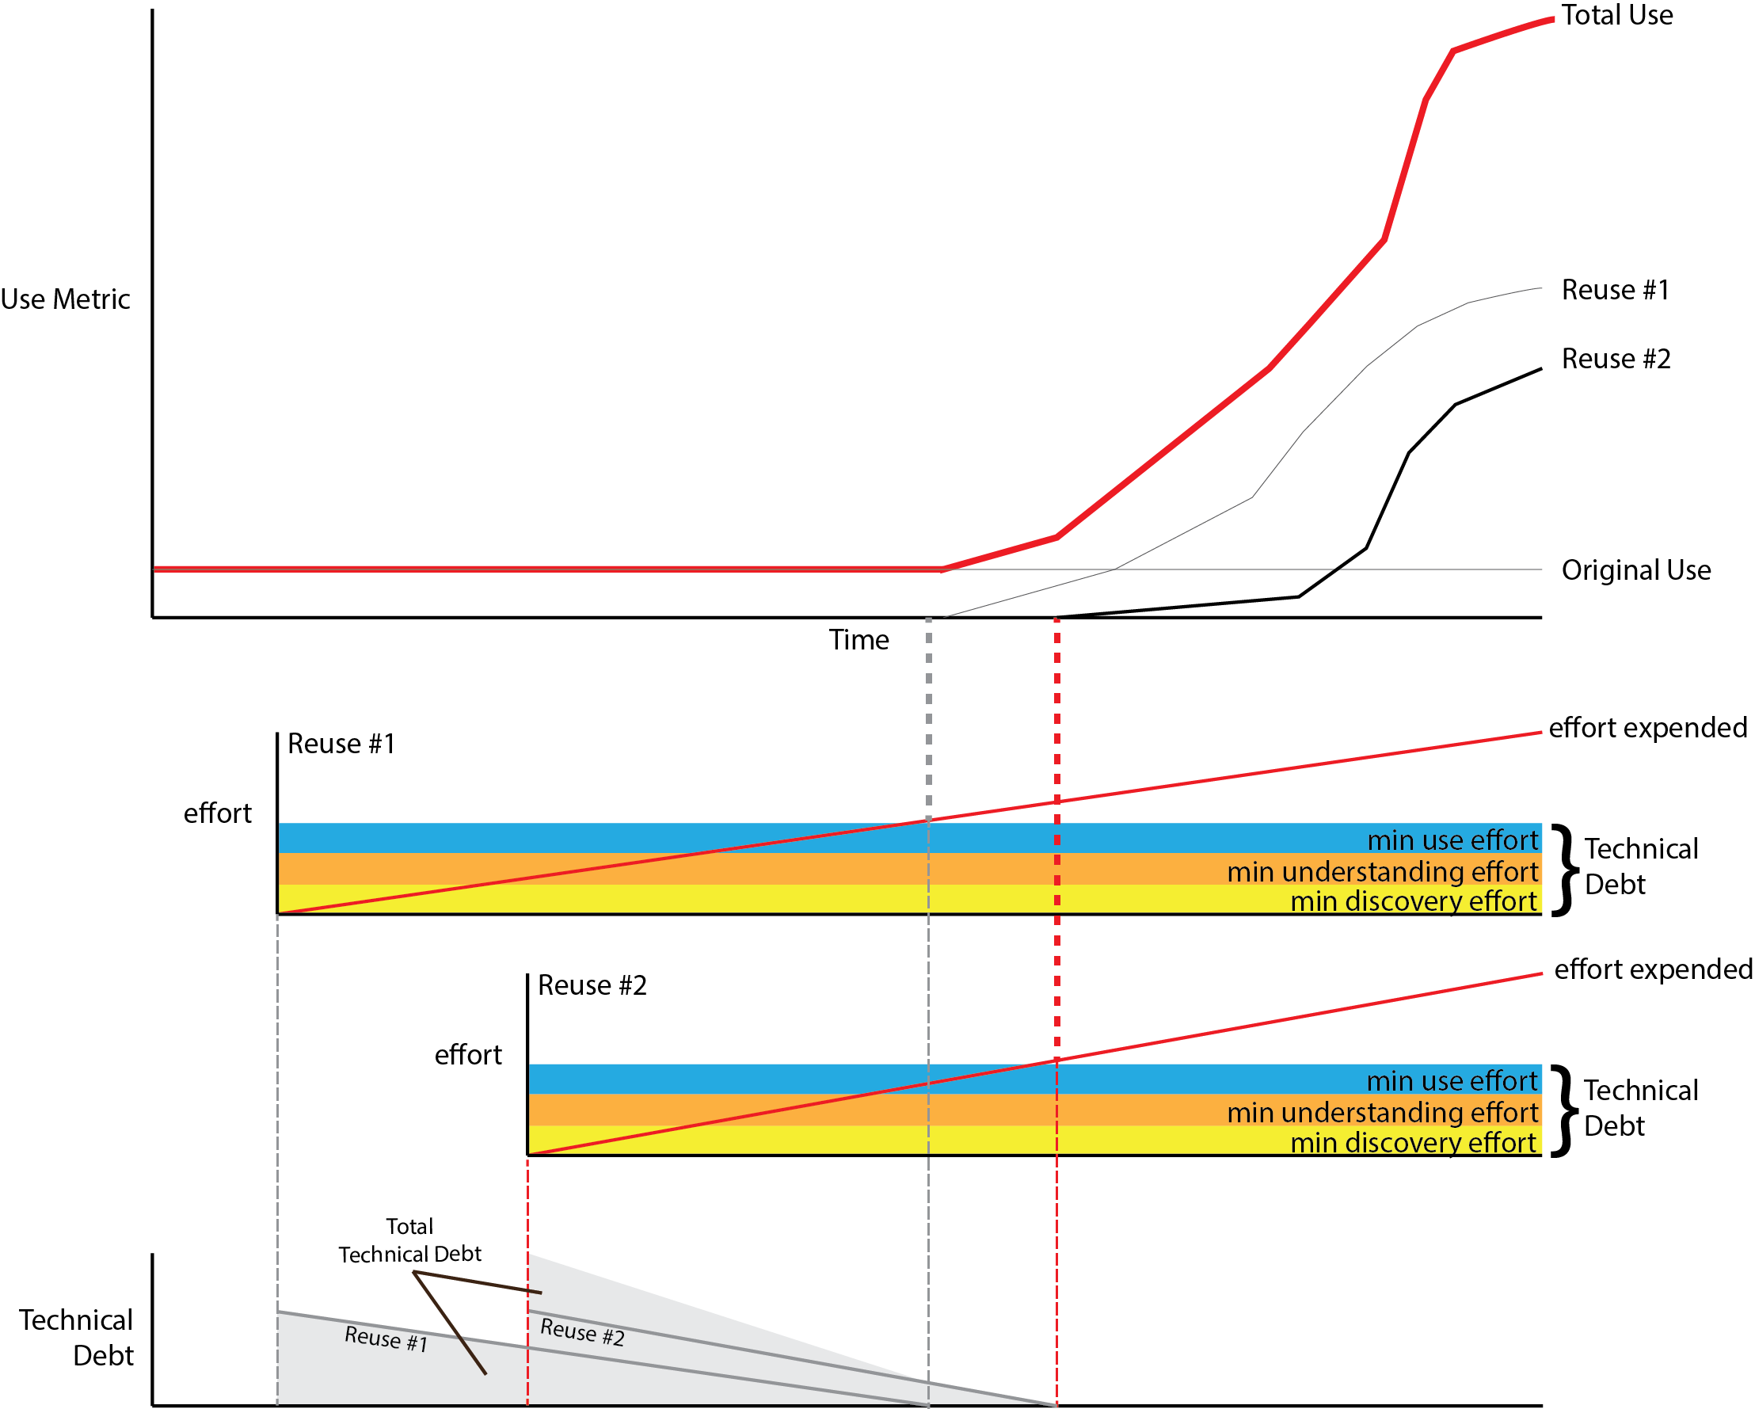
Technical Debt

Slide 13
Next Steps
Begin community conversation and development of shared agile data curation values and principles
Develop capacity to capture structured information about exemplars of agile data curation value and principles to contribute to …
The development of data curation design patterns informed by practice and generalized for reuse in new data management and curation processes

Slide 14
Contact Us …
Karl Benedict – kbene@unm.edu
Chris Lenhardt - clenhardt@renci.org
Joshua Young - jwyoung@ucar.edu
Open Science Framework Coordination Site: https://osf.io/d2bac/

Slide 16
Draft Case Study Capture Form
https://docs.google.com/forms/d/17IWFYcp63Vr74WaFL5dO3V3LgmQdPJ-qamQi3rGGxZQ/edit

Slide 17
Draft Values & Principles Survey
https://www.surveymonkey.com/r/agile-values-principles

