Slide 1
BDD with SpecFlow

Slide 2
Main Take-aways
Using SpecFlow to functional test web services
How to deal with external dependencies

Slide 3
Our sample problem
Music Store
List of Albums and Artists
Ability to search by title
Sample URL: http://[baseUrl]/Albums/Search?title=[searchString]

Slide 4
Set up the web project
Just a (almost) vanilla ASP.NET MVC3 project
Added Castle Windsor package for dependency injection

Slide 5
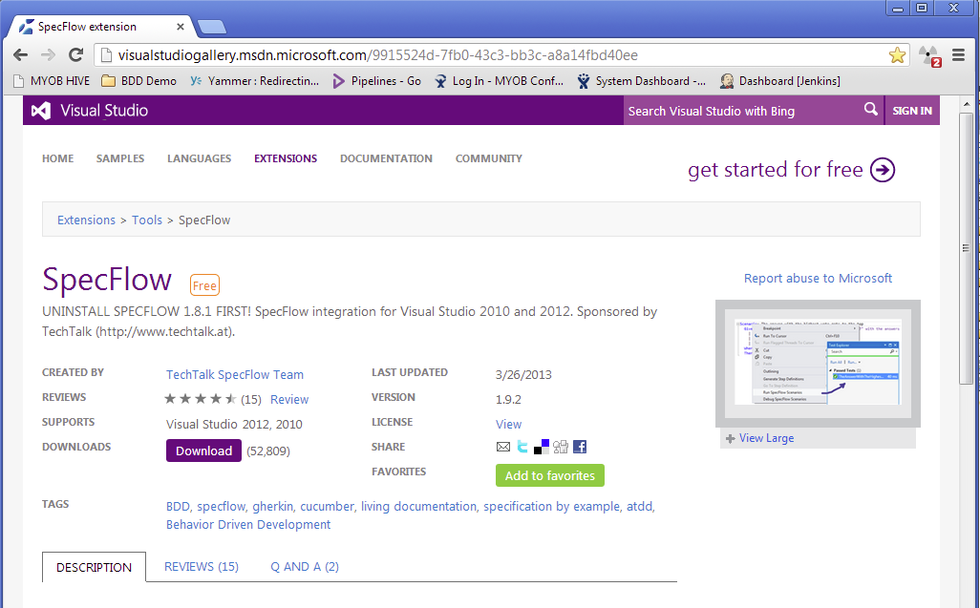
Let’s add some functional tests!
A class library project
Add SpecFlow & NUnit packages
Install SpecFlow Visual Studio extension
Add a couple of scenarios
Define the step definitions

Slide 6
A bit of implementation details
General design
Dealing with external dependencies
The SimulatedAlbumsService (decorator pattern)
The simulation decider (i.e. are we in simulation?)

Slide 7
All real work delegated to AlbumsService
Controller
AlbumsService

Slide 8
Simulation
Controller
Simulated
AlbumStorage
Simulated
AlbumsService
Real
AlbumsService
Decider

Slide 9
Add a Scenario Outline

Slide 10
Make the new scenarios pass

Slide 11
Questions & Comments

