Slide 1
Archiving and Preservation
Fundamentals of Data Management

Slide 2
Course outline
What do we mean by “archiving and preservation”?
Isn’t this the same as “cp files.zip /arch” ?
(clue: the answer is “no”)
After completing this lesson, you should be able to:
Explain where preservation fits in the data management lifecycle
Understand the difficulties in planning digital preservation long-term
Understand the basics of the OAIS archive model

Slide 3
Preservation in the data lifecycle
Preservation is sometimes thought of as “the last thing you do”
But you should think of it as part of the lifecycle
Data have life after preservation!
Assure
Preserve
Discover
Combine
Process
Plan
Describe
Create

Slide 4
Why preserve data?
The lifecycle model tells us:
Because someone may want to re-use it someday
Data form part of the scientific record
Part of the publication record
So they should be archived and preserved in ways that are
Safe
Discoverable
Accessible
Comprehensible
These are the goals of digital preservation systems and organisations

Slide 5
Preservation media
 | Write | Read | Capacity | Durability | Risks
Stone | X slow | Slow | X low | X high | Not much…
Wax | V slow | Slow | V low | High | Fire, fragility
Paper | Slow | Slow | V low | High | Fire, water
Mag tape | Fast | V fast / Slow | X high | Modest | Fire, mechanical failure, EM fields
Optical | Fast | V fast | Modest | High | Fire
Mag disk | V fast | V fast | X high | Modest | Fire, mechanical failure, EM fields
Solid state | V fast+ | V fast+ | V high | Modest | Fire, EM fields, quantum mechanics
DNA | V slow | V slow | X high | X high | Fire
Pro tip: avoid fire. Really.

Slide 6
DNA?
Sure!
DNA is a very long molecule made of of just 4 “base pairs” (atomic sequences), denoted T, G, A and C
Can encode binary data using, eg. T,G = 1 & A,C = 0
So 161 = 10100001 = TAGCAACT (for example)
It’s slow and expensive:
Encoding = synthesising artificial DNA
which takes days and costs $10,000 per MB
Decoding = sequencing it
which takes hours and costs $100 per MB
But it’s very dense and very durable

Slide 7
DNA!
1 gram of DNA can store 700 TB data for 100,000 years in a cupboard*
Using 3 TB hard drives you’d need 233 of them
which would weigh 151 kilograms, 151,000 times heavier
and which might last 20 years, if you’re lucky
Costs of synthetic DNA are also falling rapidly
* See:
* Church, Gao, Kosuri, Harvard Medical School
http://www.sciencemag.org/content/337/6102/1628.abstract
Birney, Goldman et al, European Bioinformatics Institute
http://www.nature.com/nature/journal/v494/n7435/full/nature11875.html

Slide 8
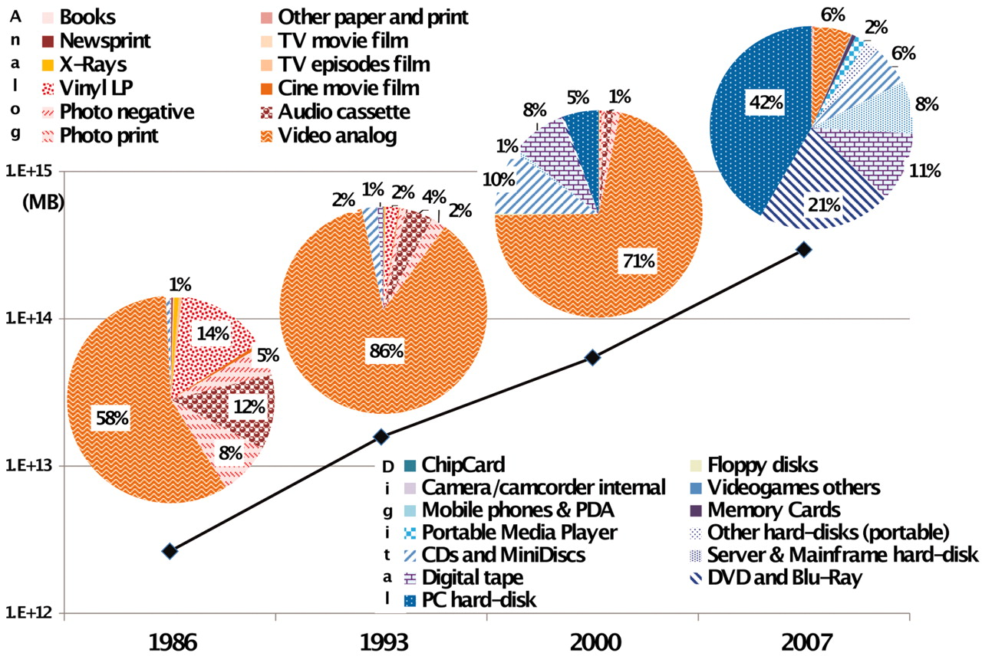

World’s technological installed capacity to store information
M Hilbert, and P López Science 2011;332:60-65
Published by AAAS
Notes:
World’s technological installed capacity to store information (table SA1) (16).

Slide 9
Digital preservation strategies
So, everything is digital
Everything is stored on HDD, tape, or flash/solid state
How reliable is HDD storage?
A 2007 study at CMU* suggested annual replacement rates (ARR) of 1% (best cases) to 13% (worst cases)
Today’s picture is pretty much the same
This means: in an array of 100 3½” 1 TB HDDs, at least 1 will fail every year
You should expect to lose TBs of data per year!
* Schroeder, B; Gibson, G: Disk failures in the real world: What does an MTTF of 1,000,000 hours mean to you? 5th USENIX Conference on File and Storage Technologies

Slide 10
Replication, replication, replication
Tape and flash are better, but not perfect
Key message is:
Expect digital media to fail regularly, and plan for it
If you want your data to be safe, replicate it
Multiple copies, multiple locations
How many copies depends on how valuable the data are, and how much risk you’re happy with

Slide 11
A systematic approach to archiving
OAIS: Open Archival Information System reference model
A standard model of a digital archive
Developed in the 2000’s by the Consultative Committee on Space Data Systems (CCSDS)
Standardised in ISO 14721:2003
Extended in ISO 16363
Used by
US National Archives and Records Administration
US Library of Congress
British Library
Bibliothèque nationale de France
National Library of the Netherlands
UK Digital Curation Centre
OCLC (the Online Computer Library Center)
JSTOR (Journal Storage) scholarly journal archive
Many university library systems

Slide 12
The OAIS reference model
Management
Preservation Planning
Producer
Descriptive info
Data management
Descriptive info
Consumer
Ingest
Access
queries
results
SIP
DIP
AIP
Archival storage
AIP
Administration

Slide 13
Not just for digital libraries
OAIS concepts useful in planning long-term data preservation:
Long Term:
Long enough that basic underlying storage technology may change radically (eg. moving from disk to DNA)
Designated Community:
The group for whom the digital object is being preserved. They may be specialists (eg. chemists) for whom some assumptions about background knowledge are OK. This can affect how much Representation Information is needed
Representation Information (RI):
Extra info that needs to be associated with the object so it can be understood: all kinds of metadata; file formats; programs needed to decode (ie. read) the object, etc.

Slide 14
OAIS Information Packages
SIP:
Submission Information Package: the object and all its necessary RI as sent by the producer to the archive
AIP:
Archive Information Package: how the archive stores data. AIPs are containers which bind together data objects, RI, other metadata including archive management details (timestamps, rules for copying, etc). AIPs are internal to an archive
DIP:
Dissemination Information Package: how data objects are presented to consumers from the Designated Community (or elsewhere). These are logically distinct from AIPs but are typically derived from them
Descriptive Information:
Not an info package, but info about a digital object that could be used to create, eg, a catalogue entry for it

Slide 15
The OAIS reference model
Management
Preservation Planning
Ingest accepts new digital objects (DOs) into the repository
It’s the only way in!
It aims to gather as much RI as possible to ensure the DO is well-documented
This can a very labour-intensive process
Wraps DOs and RI up into AIPs
Producer
Descriptive info
Data management
Descriptive info
Consumer
Ingest
Access
queries
results
SIP
DIP
AIP
Archival storage
AIP
Administration

Slide 16
The OAIS reference model
Archival storage is where the “bits” of the DO are stored, along with associated metadata
Receives AIPs from Ingest
The storage system may make replicas, choose a suitable medium, etc., perhaps depending on repository preservation planning policies
Management
Preservation Planning
Producer
Descriptive info
Data management
Descriptive info
Consumer
Ingest
Access
queries
results
SIP
DIP
AIP
Archival storage
AIP
Administration

Slide 17
The OAIS reference model
Management
Preservation Planning
Producer
Descriptive info
Data management
Descriptive info
Consumer
Ingest
Access
queries
Data management is about cataloguing and keeping track of DOs
It receives a set of descriptive information from Ingest
It keeps track of these metadata, references to copies of the DOs etc.
It needs to provide some queryable or searchable information for Access
results
SIP
DIP
AIP
Archival storage
AIP
Administration

Slide 18
The OAIS reference model
Management
Preservation Planning
Access is about accepting queries from data consumers (usually from the Designated Community) and returning matching results
Interacts with Data management to query indexes, catalogues
Interacts with Archival storage to retrieve DOs
May repackage DOs from their AIPs into something more consumer friendly
Producer
Descriptive info
Data management
Descriptive info
Consumer
Ingest
Access
queries
results
SIP
DIP
AIP
Archival storage
AIP
Administration

Slide 19
The OAIS reference model
Management
Preservation Planning
Producer
Descriptive info
Data management
Descriptive info
Consumer
Administration keeps things ticking
Monitors the archive, catalogues, ingest and access patterns
May be automated or manual
Ingest
Access
queries
results
SIP
DIP
AIP
Archival storage
AIP
Administration

Slide 20
The OAIS reference model
Management
Preservation Planning
Producer
Descriptive info
Data management
Descriptive info
Consumer
Preservation Planning defines policies for how the whole repository works
Usually the preserve of human curators
Ingest
Access
queries
results
SIP
DIP
AIP
Archival storage
AIP
Administration

Slide 21
Using OAIS in data management
Having the OAIS model and ideas in mind helps a lot in data management planning, even on the scale of a research project, a lab or a single researcher
Designated Community: who’s going to want to look at my data in the future?
RI: what other info do I need to store along with my data? What metadata do I need? In what format? What software am I relying on?
AIP: what’s the best way to store my data? What format? What do I need to do to keep it safe? How do I keep everything together?
DIP: if someone asks for my data, what’s the best way to share it?
Long Term: if I store it this way, will it still be there in 3 years time?
Remember the panda…

Slide 22

Repository techs: DSpace
DSpace is a platform for data storage
Text, video, audio, and data
Distributes data over the web
Indexes the contents so users can search and retrieve
DSpace is typically used as an institutional repository
It has three main roles:
Facilitate the capture and ingest of materials, including metadata about the materials
Facilitate easy access to the materials, both by listing and searching
Facilitate the long term preservation of the materials
The University of Edinburgh DataShare is built on DSpace
http://datashare.is.ed.ac.uk/

Slide 23

Repository techs: Fedora Repository
Flexible Extensible Digital Object Repository Architecture
A flexible framework and toolkit for building DO repositories
Has an extensible abstract digital object model
Content Model Architecture supports
federated and distributed repositories
object versioning
object-to-object relations
event histories (for audit trails of access)
RESTful and SOAP/WSDL web-service interfaces
See http://www.fedora-commons.org/

Slide 24
When OAIS isn’t enough
OAIS was designed for central, long-term archives
In a world of increasingly distributed data & the Web, it’s harder to make it fit
Instead of centralising data archives one can fully embrace the “keep copies” approach and design a fundamentally distributed one
LOCKSS, for example, is a strongly-managed approach to distributed archiving
lots of copies keeps stuff safe
designed for keeping safe ‘dark’ copies of science journals
designed to be robust against attack and data corruption
multiple LOCKSS servers vote on content integrity

Slide 25
Distributed & unmanaged archiving
World-Wide Web (of course)
+ robust, resilient, protocol-centric
+ publication is easy
– search and indexing (Google? Bing? Yahoo?)
– provenance, quality, versioning
– no automatic replication (need new techs, eg. ResourceSync)
– keeping things (stable URLs vs 404s?)
Peer-to-peer data sharing (eg. BitTorrent)
+ highly distributed, multiple copies created automatically
– search and indexing (rely on The Pirate Bay?!)
– provenance, quality, versioning (who’s that peer?)

Slide 26
Summary
Archiving & preservation is an important part of the digital object lifecycle
Preservation means “preservation for re-use”
if something is worth keeping, it’s because you want to use it again
Hard disk storage dominates the preservation landscape
Traditional repositories follow the OAIS model
but the Web-connected world makes life more complicated

Slide 27
Acknowledgements
DSpace slide from Lewis and Yates
The DSpace Course - An Introduction to DSpace
http://hdl.handle.net/2160/617

