Slide 1
Final
kayDib

Slide 2
Process
1. Complete change in idea, decided to do portfolio instead
2. Kept the idea of ads, as an interesting way to sell myself
3. Wanted the website to have an “unserious” feel but in a professional way?
4. Adding an audio element

Slide 3
Skills gained
1. Implementing a popup system for ads
2. Using sound, creating a button that can start and pause.
3. Using animations on my elements (rotation)
4. Making P5 sketches look implemented on my website
5. Using online libraries like bootstrap and greensock

Slide 4
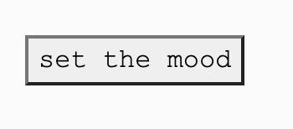
What i struggled with
1. Positioning with bootstrap
2. Making my ads draggable using greensock (failed)
3. Adding pictures to my ads
4. I had to go back and edit the sound for it to loop evenly

Slide 5
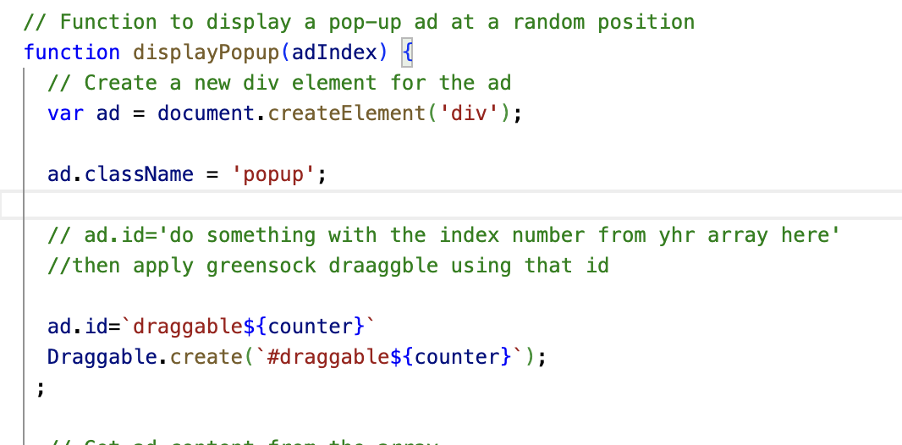
Draggable element

Slide 6
Next Steps
Next steps:
1. making my about page more stable and informing
2. creating a little slideshow for my visual art in my about page.
3. figuring out draggable ads !

Slide 7
Thanks!

