Slide 1
K-nearest neighbors (KNN)
Joe Nese
Week 6, Class 1

Slide 2
Agenda
K-nearest neighbors model
regression
classification
imputation
Non-regular grids

Slide 3
K-nearest neighbors (KNN)

Slide 4
K-nearest neighbors (KNN)
To predict the outcome of a new data point:
Finds the K most similar (nearest) data points in the predictor space
Take the average (regression) or mode (classification) outcome of those K cases
A prediction is made using the training set outcomes for the neighbors (K)
KNN stores the training set data and, when predicting new samples, locates the K training set points that are in the closest proximity to the new sample

Slide 5
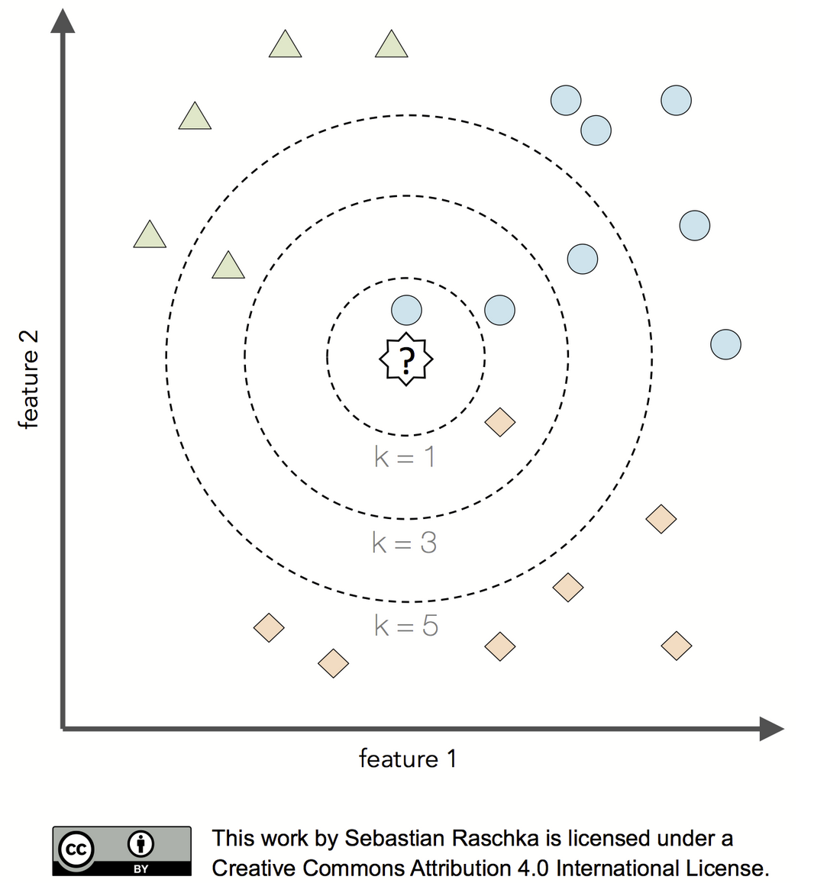

Slide 6
K-nearest neighbors (KNN)
KNN is a nonparametric method
Unlike parametric models, nonparametric models:
cannot be described by a fixed number of parameters that are being adjusted to the training set
the model structure is set a priori (and not defined by the training data)
do not assume that the data follow certain probability distributions (except Bayesian nonparametric methods)
make fewer assumptions about the data (than parametric methods)
KNN uses lazy learning (or instance-based learning)
There is no training or model fitting stage
A KNN model literally stores the training data and uses it only at prediction time
Thus, each training instance represents a parameter in KNN model
Computationally inefficient

Slide 7
K-nearest neighbors (KNN)
Feasible when the data contains more predictors than observations
Requires the predictors to be in common units because the distance between predictors are used directly
(like ridge, lasso models, elastic net, and support vector machines)

Slide 8
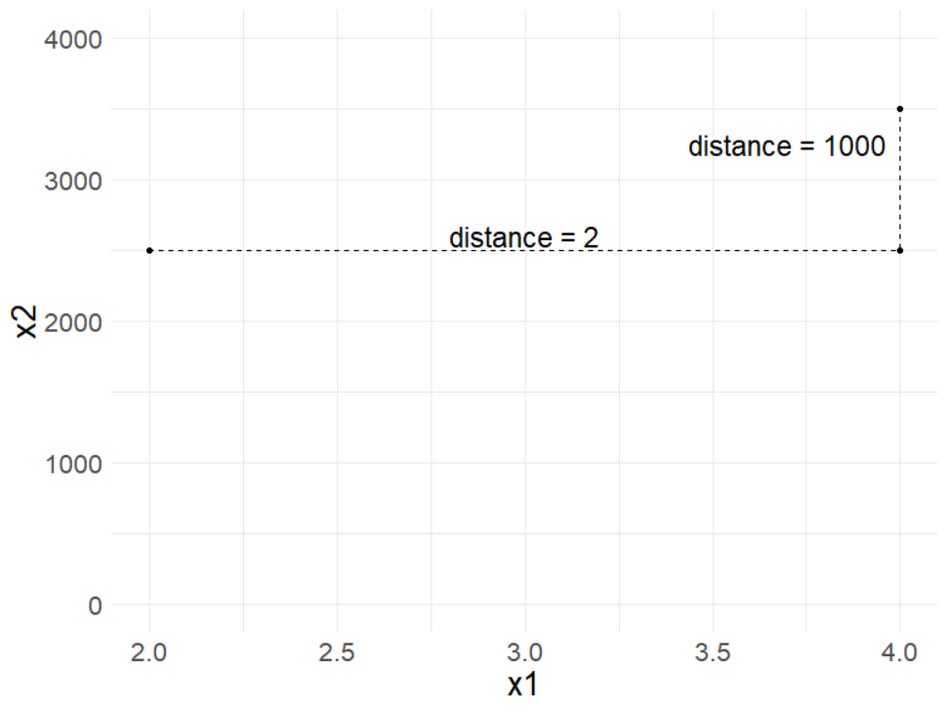
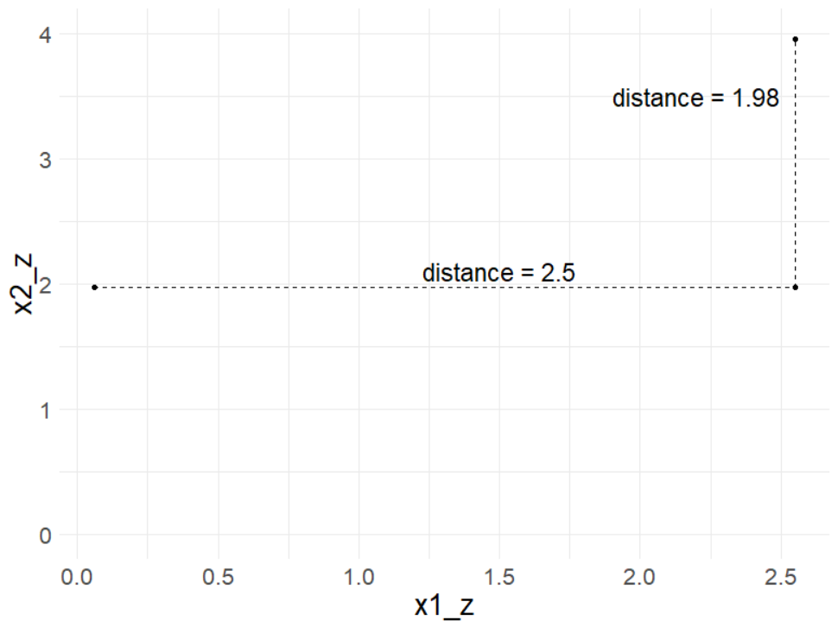
Scaling predictors

Slide 9

nearest_neighbor()
{kknn} is the only engine for KNN in {tidymodels}
the model is nearest_neighbor()
the mode can be either regression or classification
set_mode("regression")
set_mode(“classification")
nearest_neighbor() %>%
set_engine(“kknn") %>%
set_mode("regression")
https://tidymodels.github.io/parsnip/articles/articles/Models.html

Slide 10
nearest_neighbor()
{kknn} is the only engine for KNN in {tidymodels}
the model is nearest_neighbor()
the mode can be either regression or classification
set_mode("regression")
set_mode(“classification")
nearest_neighbor() %>%
set_engine(“kknn") %>%
set_mode(“classification")
https://tidymodels.github.io/parsnip/articles/articles/Models.html

Slide 11

nearest_neighbor() tuning parameters
?nearest_neighbor
neighbors: number of neighbors considered at each prediction
weight_func: type of kernel function that weights the distances between samples
dist_power: The parameter used when calculating the Minkowski distance
Manhattan distance with dist_power = 1
Euclidean distance with dist_power = 2

Slide 12
defaults()
“If left to their defaults here (NULL), the values are taken from the underlying model functions.”
neighbors = 5
weight_func = “optimal”
dist_power = Euclidian

Slide 13
How do we find the most similar (nearest) neighbors?
Two common measures of distance
Euclidian (as the crow flies)
Manhattan (city blocks)

Slide 14
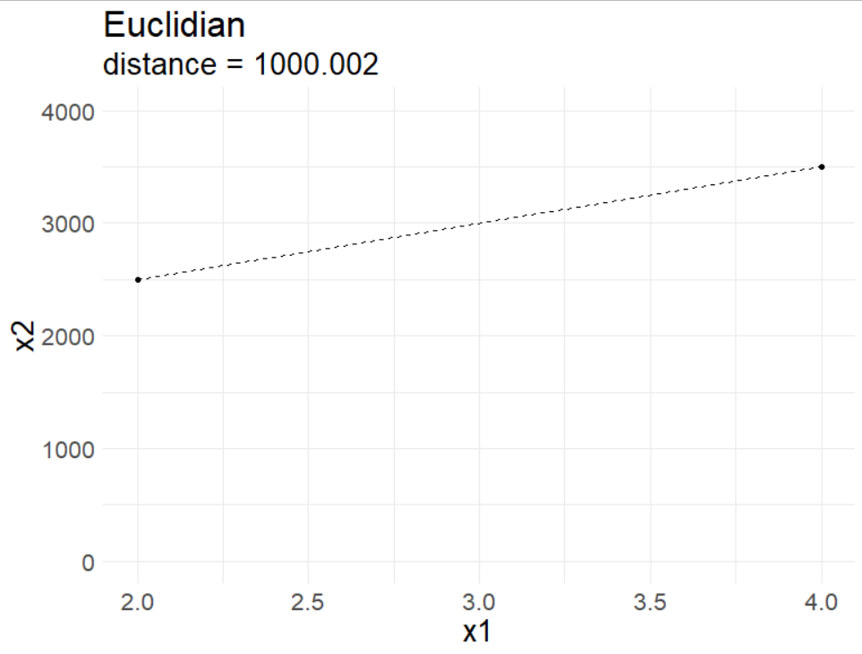
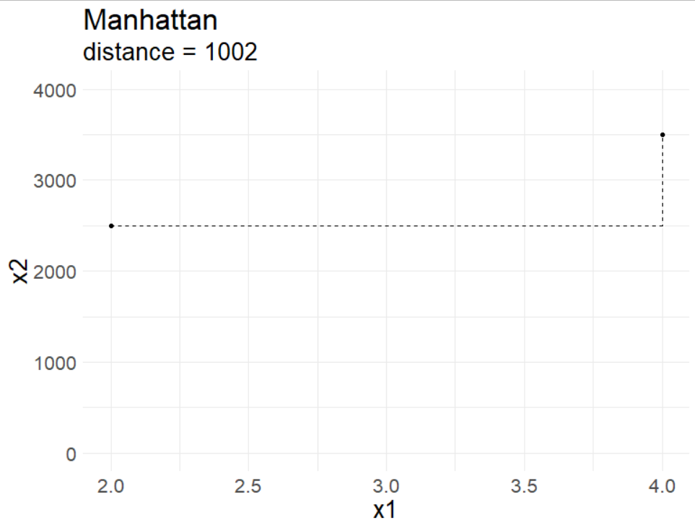
How do we find the most similar (nearest) neighbors?
Two common measures of distance:
Euclidian
Manhattan
as the crow flies
common for continuous predictors
city blocks
common for binary predictors

Slide 15

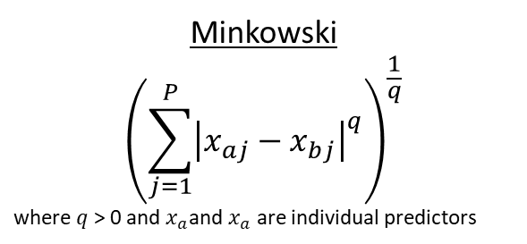



dist_power
Both Euclidian and Manhattan are special cases of Minkowski distance
Minkowski
$${\left(\sum_{j=1}^{P}{{\left|x_{aj}−x_{bj}\right|}^{q}}\right)}^{\frac{1}{q}}$$
where $q$ > 0 and $x_{a}$and $x_{a}$ are individual predictors
when $q$ = 2 we get Euclidian distance
when $q$ = 2 we get Manhattan distance
Euclidian
$${\left(\sum_{j=1}^{P}{{\left(x_{aj}−x_{bj}\right)}^{2}}\right)}^{\frac{1}{2}}$$
Manhattan
$$\left(\sum_{j=1}^{P}{\left|x_{aj}−x_{bj}\right|}\right)$$

Slide 16
weight_func
type of kernel function that weights the distances between samples
“rectangular”
“triangular”
“epanechnikov”
“biweight”
“triweight”
“cos”
“inv”
“gaussian”
“rank”
“optimal”

Slide 17
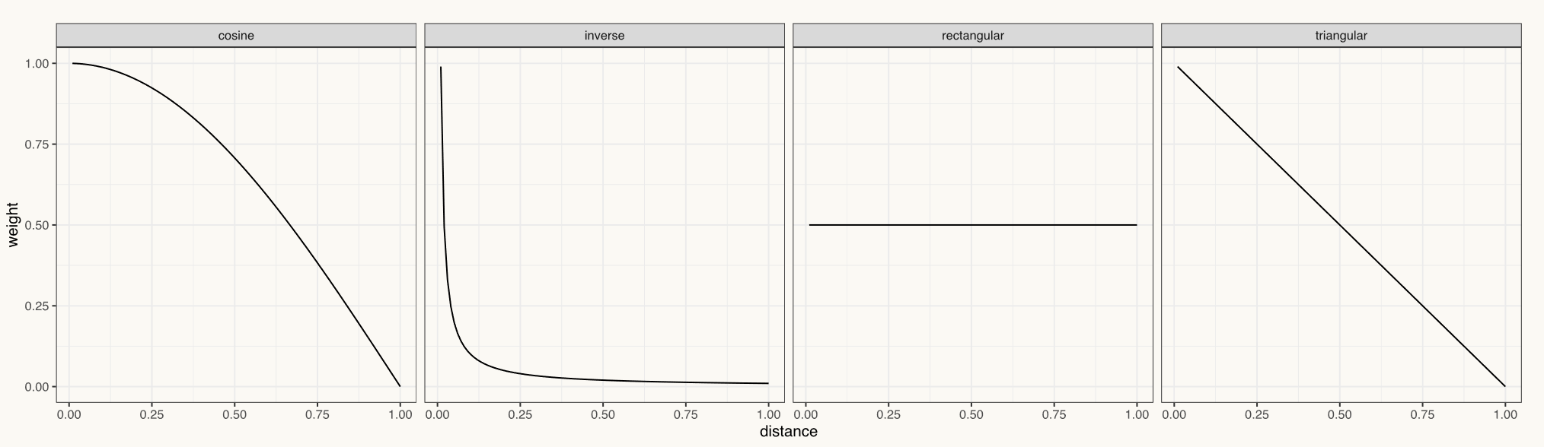
weight_func()
cosine
Slow decrease in weight as distance increases
rectangular
Uniform weight, regardless of distance
inverse
Sharp, immediate decrease in weight as distance increases, then relatively similar weight for those far away
triangular
Constant decrease in weight as distance increases

Slide 18
neighbors
The value of K controls the bias-variance
With a small K, there is a potential for overfitting
imagine K = 1 would be very susceptible to changes in the data
low bias and high variance
smaller values of K tend to work best for high signal data with very few noisy (irrelevant) predictors
With a large K, there is a potential to underfit
too many potentially irrelevant data points are used for prediction
high bias and lower variance
larger values of K tend to work best for data with more noisy (irrelevant) predictors in order to smooth out the noise

Slide 19
math <- math %>%
drop_na(lat) %>%
mutate_at(vars(enrl_grd), list(~as.factor(.))) %>%
sample_frac(size = .02)
# 1 - Initial Split
set.seed(210)
math_split <- initial_split(math)
math_train <- training(math_split)
math_test <- testing(math_split)
# 2 - Resample
set.seed(210)
math_cv <- vfold_cv(math_train)

Slide 20
math <- math %>%
drop_na(lat) %>%
mutate_at(vars(enrl_grd), list(~as.factor(.))) %>%
sample_frac(size = .02)
# 1 - Initial Split
set.seed(210)
math_split <- initial_split(math)
math_train <- training(math_split)
math_test <- testing(math_split)
# 2 - Resample
set.seed(210)
math_cv <- vfold_cv(math_train)

Slide 21
math <- math %>%
drop_na(lat) %>%
mutate_at(vars(enrl_grd), list(~as.factor(.))) %>%
sample_frac(size = .02)
# 1 - Initial Split
set.seed(210)
math_split <- initial_split(math)
math_train <- training(math_split)
math_test <- testing(math_split)
# 2 - Resample
set.seed(210)
math_cv <- vfold_cv(math_train)

Slide 22
math <- math %>%
drop_na(lat) %>%
mutate_at(vars(enrl_grd), list(~as.factor(.))) %>%
sample_frac(size = .02)
# 1 - Initial Split
set.seed(210)
math_split <- initial_split(math)
math_train <- training(math_split)
math_test <- testing(math_split)
# 2 - Resample
set.seed(210)
math_cv <- vfold_cv(math_train)

Slide 23
math <- math %>%
drop_na(lat) %>%
mutate_at(vars(enrl_grd), list(~as.factor(.))) %>%
sample_frac(size = .02)
# 1 - Initial Split
set.seed(210)
math_split <- initial_split(math, strata = "srt_tst_typ")
math_train <- training(math_split)
math_test <- testing(math_split)
# 2 - Resample
set.seed(210)
math_cv <- vfold_cv(math_train, strata = "srt_tst_typ")

Slide 24
# Preprocess
knn_reg_rec <-
recipe(
score ~ enrl_grd + lat + lon,
data = math_train
) %>%
step_dummy(enrl_grd) %>%
step_normalize(lat, lon) #not necessary here

Slide 25
# 3 - Set Model
## KNN
knn_reg_mod <- nearest_neighbor() %>%
set_engine("kknn") %>%
set_mode("regression")
translate(knn_reg_mod)
K-Nearest Neighbor Model Specification (regression)
Computational engine: kknn
Model fit template:
kknn::train.kknn(formula = missing_arg(), data = missing_arg(),
ks = 5)

Slide 26
# 4 - Tune
## Let's run the default tuned KNN model for `neighbors`, `weight_func`, and `dist_power`
knn_reg_mod <- knn_reg_mod %>%
set_args(neighbors = tune(),
weight_func = tune(),
dist_power = tune())
translate(knn_reg_mod)
K-Nearest Neighbor Model Specification (regression)
Main Arguments:
neighbors = tune()
weight_func = tune()
dist_power = tune()
Computational engine: kknn
Model fit template:
kknn::train.kknn(formula = missing_arg(), data = missing_arg(),
ks = tune(), kernel = tune(), distance = tune())

Slide 27
knn_reg_res <- tune::tune_grid(
knn_reg_mod,
preprocessor = knn_reg_rec,
resamples = math_cv,
control = tune::control_resamples(verbose = TRUE,
save_pred = TRUE)
)

Slide 28
knn_reg_res %>%
collect_metrics(summarize = FALSE) %>%
distinct(neighbors, weight_func, dist_power)
# A tibble: 10 x 3
neighbors weight_func dist_power
<int> <chr> <dbl>
1 15 biweight 0.346
2 7 biweight 1.16
3 10 cos 0.668
4 13 epanechnikov 1.01
5 2 inv 0.450
6 9 rank 1.27
7 11 rank 1.43
8 1 rectangular 0.0878
9 6 triangular 0.854
10 4 triweight 0.255

Slide 29
Performance estimates
knn_reg_res %>%
show_best(metric = "rmse", n = 10)
# A tibble: 10 x 8
neighbors weight_func dist_power .metric .estimator mean n std_err
<int> <chr> <dbl> <chr> <chr> <dbl> <int> <dbl>
1 13 epanechnikov 1.01 rmse standard 106. 10 2.40
2 11 rank 1.43 rmse standard 106. 10 2.43
3 15 biweight 0.346 rmse standard 107. 10 2.45
4 9 rank 1.27 rmse standard 107. 10 2.36
5 10 cos 0.668 rmse standard 108. 10 2.42
6 7 biweight 1.16 rmse standard 112. 10 2.29
7 6 triangular 0.854 rmse standard 113. 10 2.16
8 2 inv 0.450 rmse standard 127. 10 2.21
9 1 rectangular 0.0878 rmse standard 142. 10 2.02
10 4 triweight 0.255 rmse standard 196. 10 25.2

Slide 30
Performance estimates "by hand”
knn_reg_res$.metrics %>%
bind_rows(.id = "fold") %>%
filter(`.metric` == "rmse") %>%
group_by(neighbors, weight_func, dist_power) %>%
summarize(mean = mean(`.estimate`),
se = sd(`.estimate`)/sqrt(n())) %>%
arrange(mean)
# A tibble: 10 x 5
# Groups: neighbors, weight_func [10]
neighbors weight_func dist_power mean se
<int> <chr> <dbl> <dbl> <dbl>
1 13 epanechnikov 1.01 106. 2.40
2 11 rank 1.43 106. 2.43
3 15 biweight 0.346 107. 2.45
4 9 rank 1.27 107. 2.36
5 10 cos 0.668 108. 2.42
6 7 biweight 1.16 112. 2.29
7 6 triangular 0.854 113. 2.16
8 2 inv 0.450 127. 2.21
9 1 rectangular 0.0878 142. 2.02
10 4 triweight 0.255 196. 25.2

Slide 31
show_best() & select_best()
knn_reg_res %>%
show_best(metric = "rmse", n = 1)
# A tibble: 1 x 8
neighbors weight_func dist_power .metric .estimator mean n std_err
<int> <chr> <dbl> <chr> <chr> <dbl> <int> <dbl>
1 13 epanechnikov 1.01 rmse standard 106. 10 2.40
knn_reg_res %>%
select_best(metric = "rmse")
A tibble: 1 x 3
neighbors weight_func dist_power
<int> <chr> <dbl>
1 13 epanechnikov 1.01

Slide 32
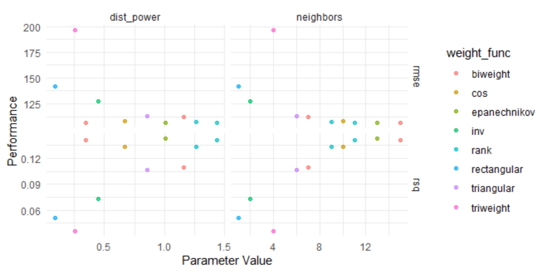
autoplot()
knn_reg_res %>%
autoplot()

Slide 33
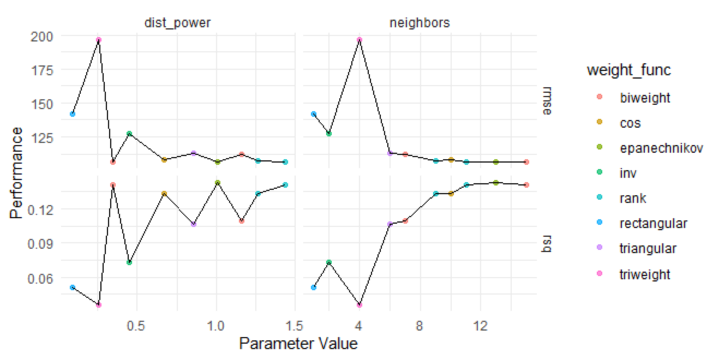
autoplot()
knn_reg_res %>%
autoplot() +
geom_line()

Slide 34
autoplot()
autoplot(
object,
type = c("marginals",
"parameters",
"performance"),
metric = NULL,
width = NULL,
...
)

Slide 35
autoplot()
autoplot(
object,
type = c("marginals",
"parameters",
"performance"),
metric = NULL,
width = NULL,
...
)
a tibble or results from tune_grid() or tune_bayes()

Slide 36
autoplot()
autoplot(
object,
type = c("marginals",
"parameters",
"performance"),
metric = NULL,
width = NULL,
...
)
tune_grid()
"marginals" = for a plot of each predictor versus performance "parameters“ = each parameter versus search iteration
tune_bayes()
"performance" = performance versus iteration

Slide 37
autoplot()
autoplot(
object,
type = c("marginals",
"parameters",
"performance"),
metric = NULL,
width = NULL,
...
)
which metric to plot
(default NULL is all metrics shown via facets)

Slide 38
autoplot()
autoplot(
object,
type = c("marginals",
"parameters",
"performance"),
metric = NULL,
width = NULL,
...
)
For type = "perfomance“
A number for the width of the confidence interval bars (where zero prevents them from being shown)

Slide 39
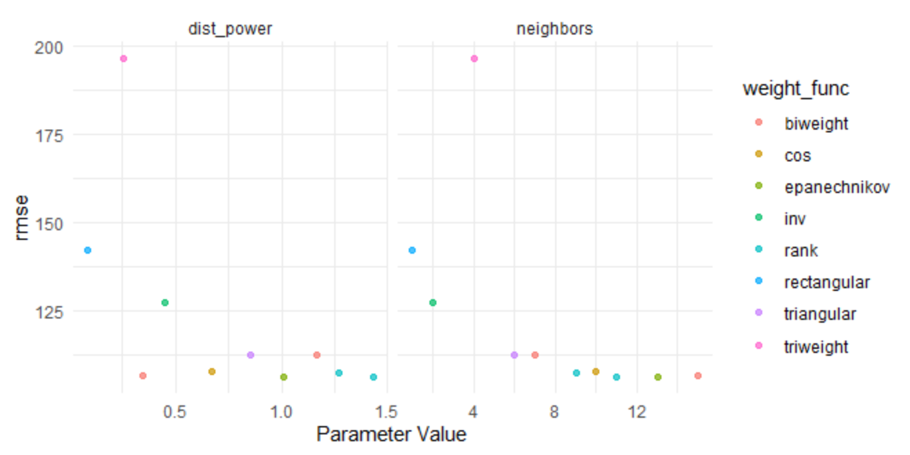
autoplot()
knn_reg_res %>%
autoplot()

Slide 40
autoplot()
knn_reg_res %>%
autoplot(metric = “rmse”)

Slide 42
More grids
non-regular grids

Slide 43
Regular vs. Non-regular grids
Regular grid
a known, pre-defined set of tuning parameter values
the number of values don't have to be the same per parameter
Quantitative and qualitative parameters can be combined
As the number of parameters increases, so does the burden of dimensionality
Thought to be inefficient but not in all cases
Non-regular grids (or random grids)
define a range of possible values for each parameter and randomly sample the multidimensional space enough times to cover a reasonable amount
beneficial when there are a large number of tuning parameters and there is no a priori notion of which values should be used
A large grid may be inefficient to search, especially if the profile has a fairly stable pattern with little change over some range of the parameter
Good for neural networks and gradient boosting machines

Slide 44
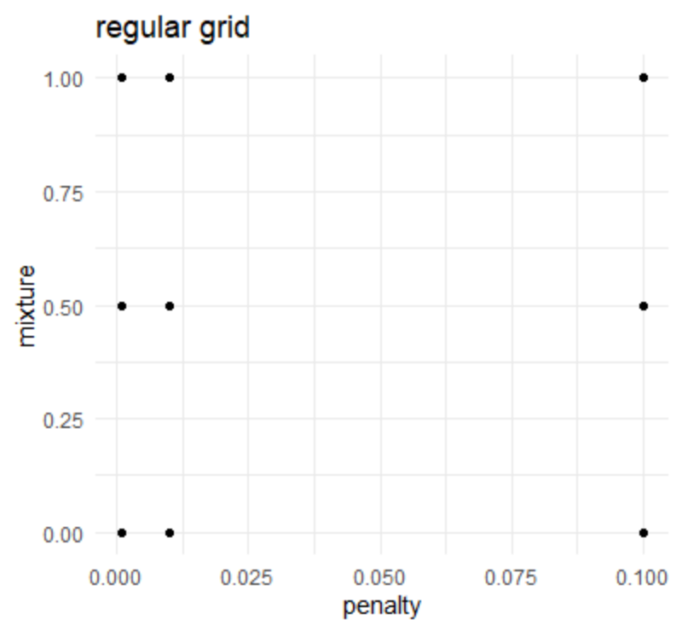
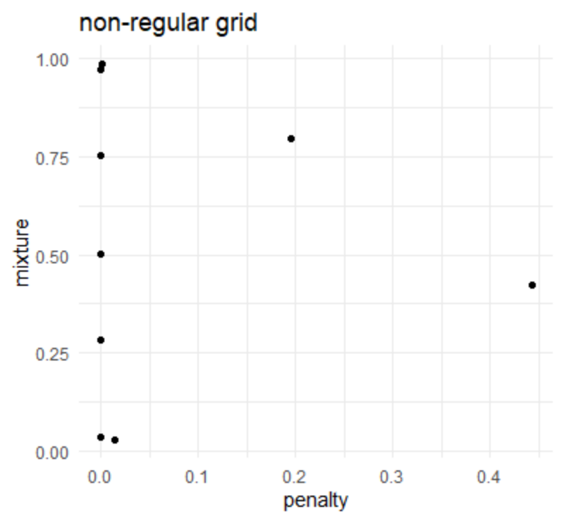

Slide 45
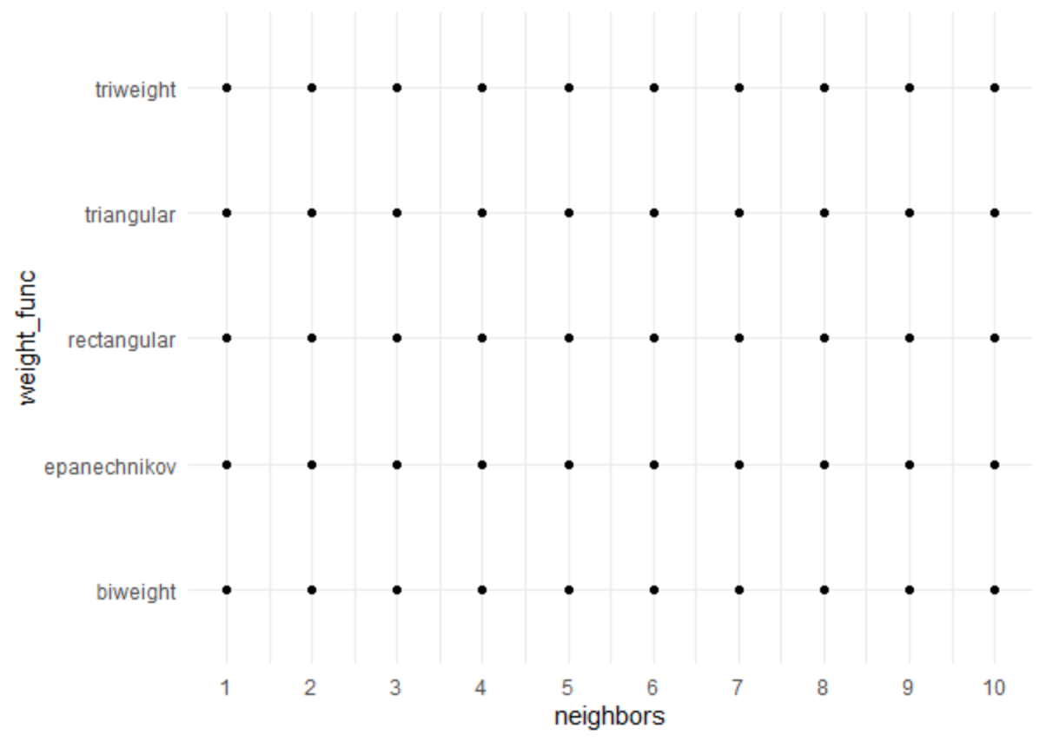
Let’s look at a regular grid
knn_params <- parameters(neighbors(), weight_func())
knn_reg_grid <- grid_regular(neighbors(), weight_func(), levels = c(15, 5))
dim(knn_reg_grid)
[1] 50 2

Slide 46
A closer look at knn_params
str(knn_params)
Classes ‘parameters’, ‘tbl_df’, ‘tbl’ and 'data.frame': 2 obs. of 6 variables:
$ name : chr "neighbors" "weight_func"
$ id : chr "neighbors" "weight_func"
$ source : chr "list" "list"
$ component : chr "unknown" "unknown"
$ component_id: chr "unknown" "unknown"
$ object :List of 2
..$ :List of 7
.. ..$ type : chr "integer"
.. ..$ range :List of 2
.. .. ..$ lower: int 1
.. .. ..$ upper: int 10
Two ways to address this

Slide 47
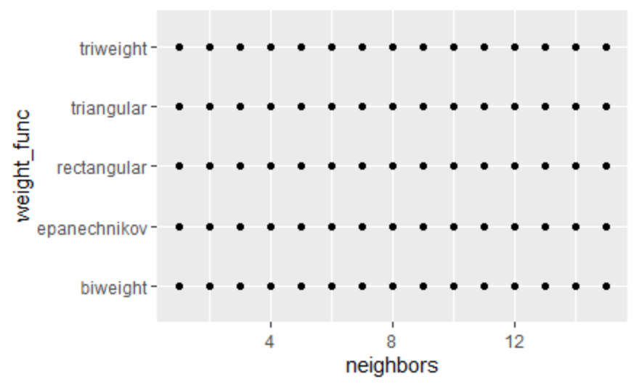
(1) use the arguments within the hyperparameters
?neighbors()
neighbors(range = c(1L, 10L), trans = NULL)
?weight_func()
weight_func(values = values_weight_func)
values_weight_func
"rectangular" "triangular" "epanechnikov" "biweight" "triweight" "cos" "inv" "gaussian" "rank" "optimal"
knn_params <- parameters(neighbors(range = c(1, 15)),
weight_func(values = values_weight_func[1:5]))
knn_reg_grid <- grid_regular(knn_params, levels = c(15, 5))
knn_reg_grid %>%
ggplot(aes(neighbors, weight_func)) +
geom_point()

Slide 48
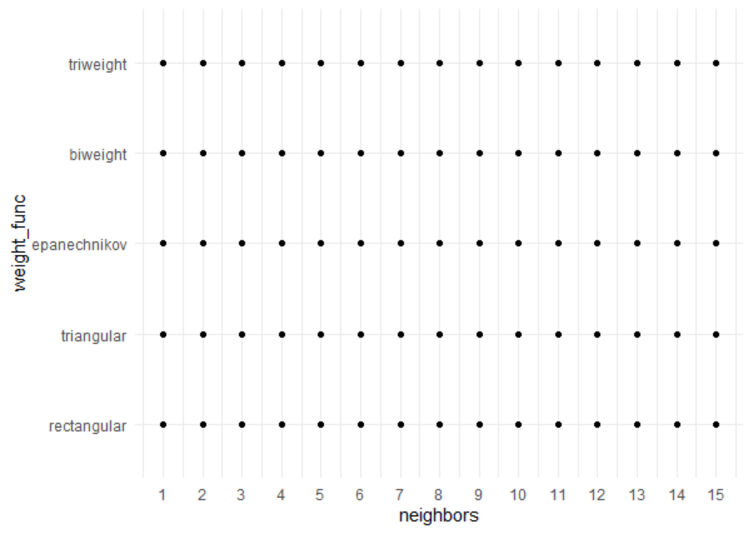
(2) Let’s make our own
Complete flexibility
knn_reg_grid_man <- expand.grid(
neighbors = c(1:15),
weight_func = values_weight_func[1:5])

Slide 49
Non-regular grids
There are two main methods to make non-regular grids
Random grids uniformly sample the parameter space (that might already be on a different scale)
Space-filling designs (SFD) are based on statistical experimental design principles and try to keep candidate values away from one another while encompassing the entire parameter space
There's no real downside to using SFD, so we will focus on these

Slide 50

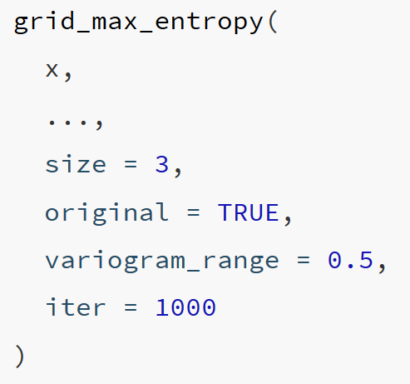
grid_max_entropy()
x : A param object, list, or parameters
... : One or more param objects (e.g., penalty()). Cannot have unknown() values in the parameter ranges or values
size: A single integer for the total number of parameter value combinations returned
original: A logical: should the parameters be in the original units or in the transformed space (if any)?
variogram_range : A numeric value greater than zero. Larger values reduce the likelihood of empty regions in the parameter space.
iter : An integer for the maximum number of iterations used to find a good design.

Slide 51
grid_max_entropy()
x : A param object, list, or parameters
... : One or more param objects (e.g., penalty()). Cannot have unknown() values in the parameter ranges or values
size: A single integer for the total number of parameter value combinations returned
original: A logical: should the parameters be in the original units or in the transformed space (if any)?
variogram_range : A numeric value greater than zero. Larger values reduce the likelihood of empty regions in the parameter space.
iter : An integer for the maximum number of iterations used to find a good design.

Slide 52
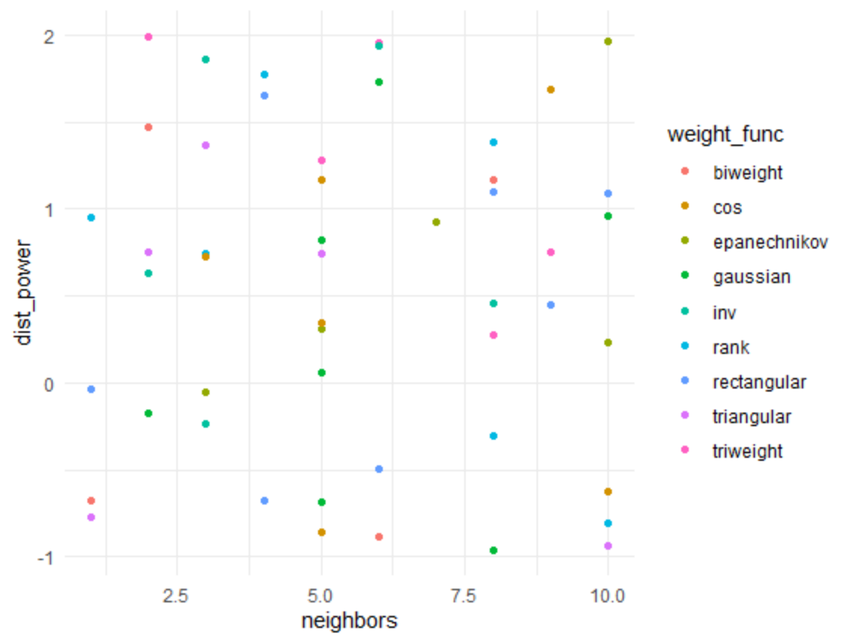
grid_max_entropy()
knn_params <- parameters(neighbors(), weight_func(), dist_power())
knn_sfd <- grid_max_entropy(knn_params, size = 50)
knn_sfd %>%
ggplot(aes(neighbors, dist_power)) +
geom_point(aes(color = weight_func))

Slide 53
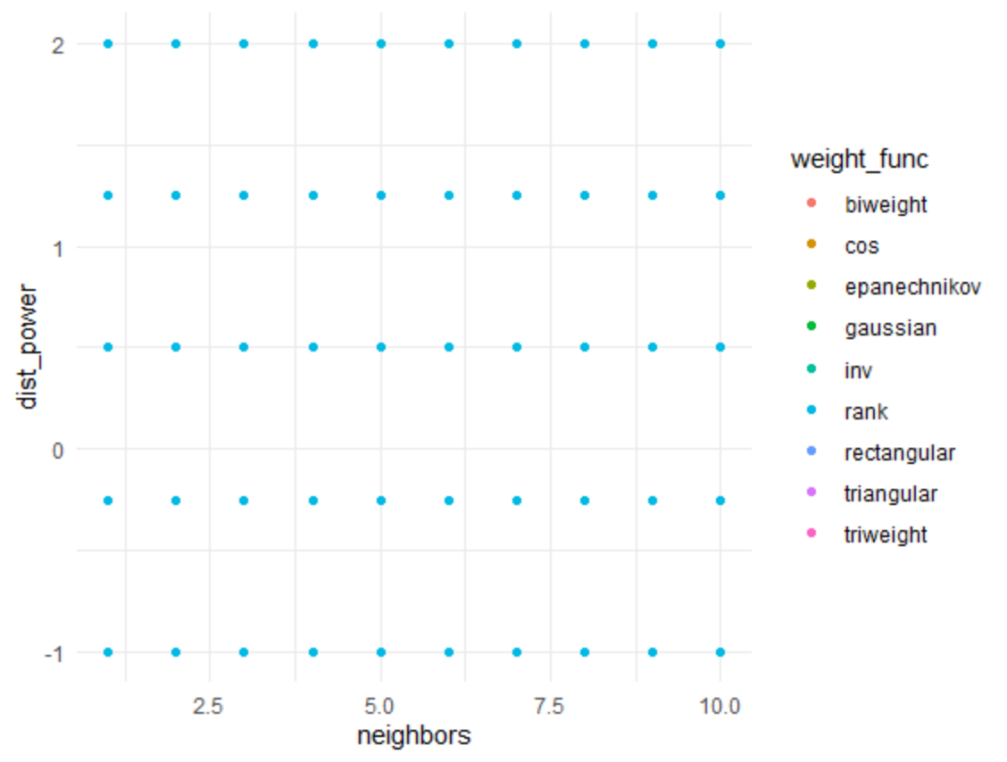
grid_regular()
knn_params <- parameters(neighbors(), weight_func(), dist_power())
knn_grid_reg <- grid_regular(knn_params, levels = c(10, 9, 5))
knn_grid_reg %>%
ggplot(aes(neighbors, dist_power)) +
geom_point(aes(color = weight_func))

Slide 54
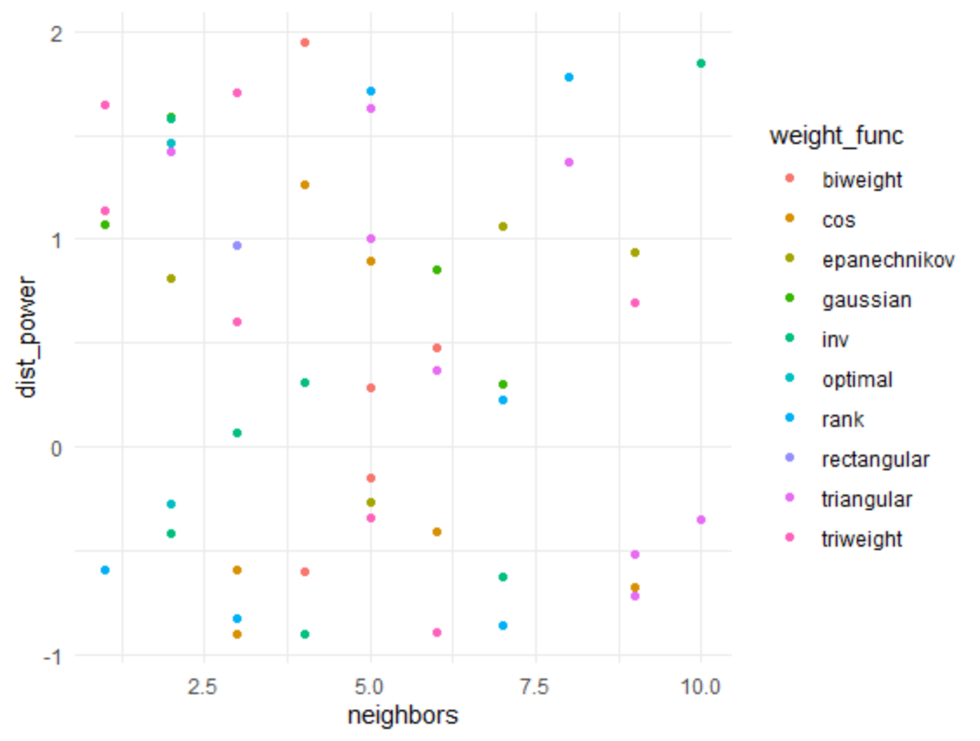
grid_random()
Uniformly samples the parameter space without taking into account the previously generated sample points
knn_grid_ran <- grid_random(knn_params, size = 50)
knn_grid_ran %>%
ggplot(aes(neighbors, dist_power)) +
geom_point(aes(color = weight_func))

Slide 55
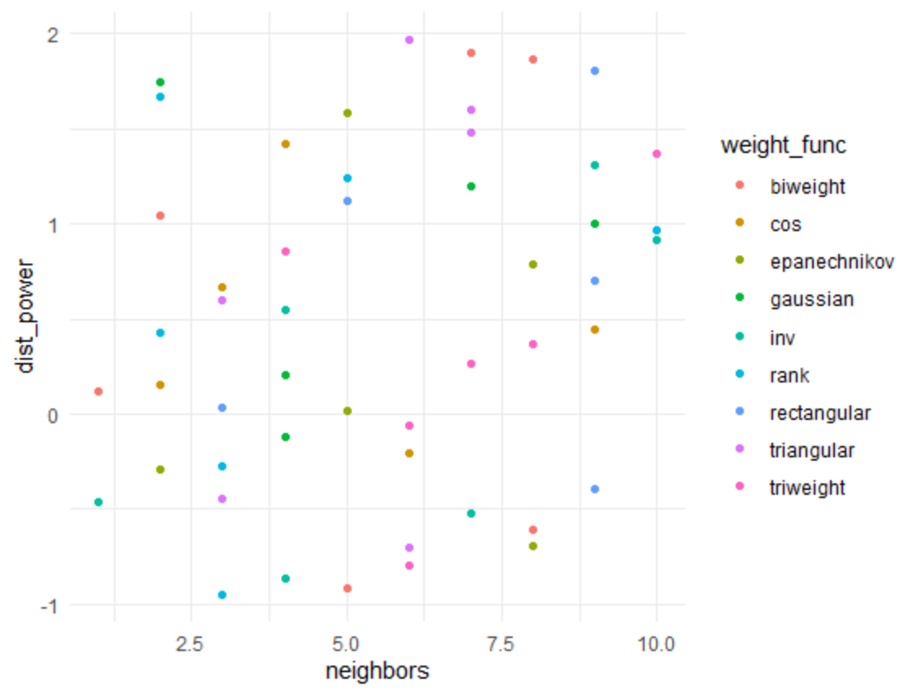
grid_latin_hypercube()
Hyperspace generalization of a Latin square (one sample in each row and each column)
knn_grid_lhs <- grid_latin_hypercube(knn_params, size = 50)
knn_grid_lhs %>%
ggplot(aes(neighbors, dist_power)) +
geom_point(aes(color = weight_func))

Slide 56
Iterative searches
grid searches
candidate values need to be pre-defined and don't learn from previous results
don't know the best values until all the computations are finished
difficult to efficiently cover the parameter space with a lot of parameters
easily optimized via parallel processing
iterative searches
builds a probability model to predict better parameters to test based on previous results
more flexible in how the parameter space is searched
less opportunities for efficiency optimizations

Slide 57
List of iterative searches
nonlinear search methods (computationally expensive)
Nelder-Mead simplex search procedure
simulated annealing
genetic algorithms
Bayesian optimization
an initial pool of samples are evaluated using grid or random search
previous parameters used as predictors and performance measure used as the outcome
Bayesian optimization process searches the grid to find the "best" new parameters to evaluate using resampling
{tune} function is tune_bayes()

Slide 58
Classification

Slide 59
# Preprocess
knn_clas_rec <-
recipe(
classification ~ enrl_grd + lat + lon,
data = math_train
) %>%
step_dummy(enrl_grd) #NOT all_nominal()
# Set Model
knn_clas_mod <- nearest_neighbor() %>%
set_engine("kknn") %>%
set_mode("classification") %>%
set_args(neighbors = tune(),
weight_func = tune())

Slide 60
# Use an SFD grid
knn_params <- parameters(neighbors(), weight_func())
knn_sfd <- grid_max_entropy(knn_params, size = 50)
# Tune
knn_clas_res <- tune::tune_grid(
knn_clas_mod,
preprocessor = knn_clas_rec,
resamples = math_cv,
grid = knn_sfd,
control = tune::control_resamples(verbose = TRUE,
save_pred = TRUE)
)

Slide 61
knn_clas_res %>%
collect_metrics()
# A tibble: 94 x 7
neighbors weight_func .metric .estimator mean n std_err
<int> <chr> <chr> <chr> <dbl> <int> <dbl>
1 1 rank accuracy multiclass 0.349 10 0.00515
2 1 rank roc_auc hand_till 0.561 10 0.00377
3 1 rectangular accuracy multiclass 0.349 10 0.00515
4 1 rectangular roc_auc hand_till 0.561 10 0.00377
5 2 cos accuracy multiclass 0.378 10 0.00599
6 2 cos roc_auc hand_till 0.576 10 0.00639
7 2 epanechnikov accuracy multiclass 0.378 10 0.00599
8 2 epanechnikov roc_auc hand_till 0.576 10 0.00638
9 2 gaussian accuracy multiclass 0.378 10 0.00599
10 2 gaussian roc_auc hand_till 0.576 10 0.00643
# ... with 84 more rows

Slide 62
knn_clas_res %>%
show_best(metric = "roc_auc", n = 5)
# A tibble: 5 x 7
neighbors weight_func .metric .estimator mean n std_err
<int> <chr> <chr> <chr> <dbl> <int> <dbl>
1 10 gaussian roc_auc hand_till 0.602 10 0.00690
2 8 gaussian roc_auc hand_till 0.600 10 0.00681
3 10 cos roc_auc hand_till 0.600 10 0.00698
4 10 epanechnikov roc_auc hand_till 0.600 10 0.00699
5 10 rank roc_auc hand_till 0.600 10 0.00687

Slide 63
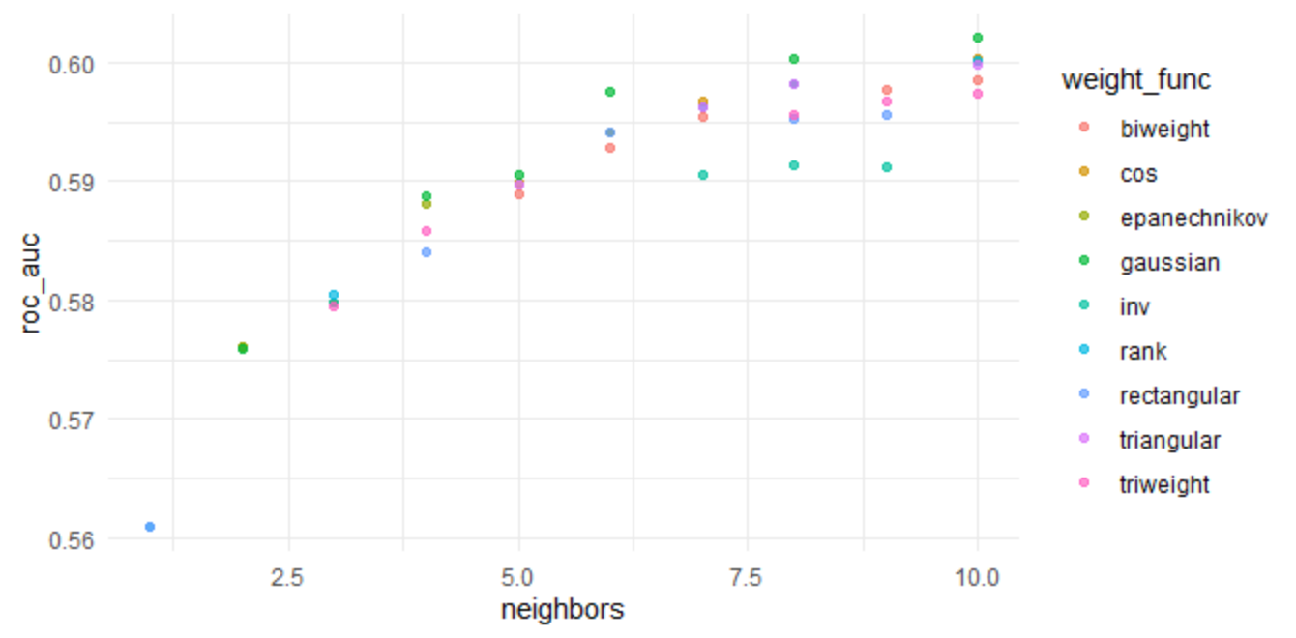
knn_clas_res %>%
autoplot(metric = "roc_auc")

Slide 64
Classification objective functions

Slide 65
Final Fit
# Select best tuning parameters
knn_reg_best <- knn_reg_res %>%
select_best(metric = "roc_auc")
# Finalize your model using the best tuning parameters
knn_reg_mod_final <- knn_reg_mod %>%
finalize_model(knn_reg_best)
# Finalize your recipe using the best turning parameters
knn_reg_rec_final <- knn_reg_rec %>%
finalize_recipe(knn_reg_best)
# Run your last fit on your initial data split
knn_reg_test_results <- last_fit(
knn_reg_mod_final,
preprocessor = knn_reg_rec_final,
split = math_split)
#Collect metrics
knn_reg_test_results %>%
collect_metrics()
# A tibble: 2 x 3
.metric .estimator .estimate
<chr> <chr> <dbl>
1 rmse standard 110.
2 rsq standard 0.132

Slide 66
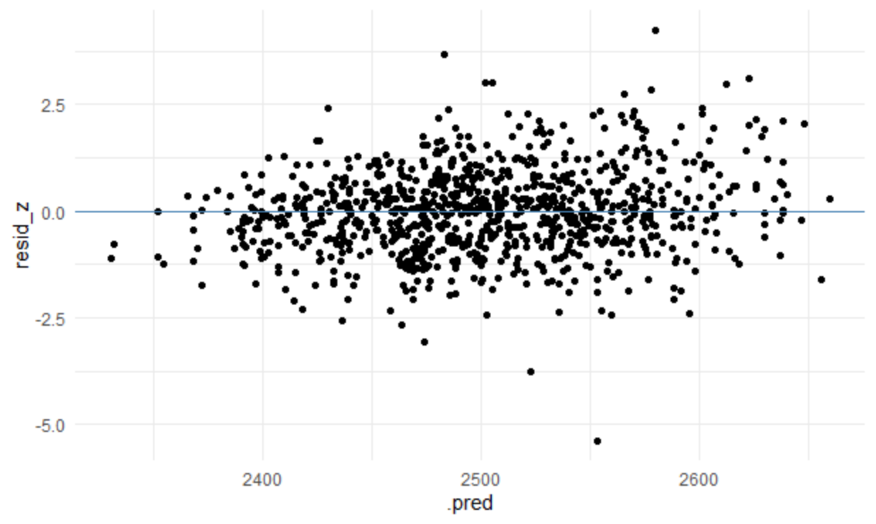
Residual plot
knn_reg_test_results %>%
select(`.predictions`) %>%
unnest(cols = `.predictions`) %>%
mutate(resid_z = scale(`.pred` - score)) %>%
ggplot(aes(`.pred`, resid_z)) +
geom_point() +
geom_hline(yintercept = 0, color = "steelblue")

Slide 67
KNN for Imputation

Slide 68
Imputation
Use information and relations among non-missing predictors to provide an estimate to fill in missing values
KNN is also used in feature engineering to impute missing values
Primarily when the data is small-moderate in size
Identifies the K (complete data) samples in the training data most similar to the missing value(s)
The average value of the predictor of interest is calculated of the K closest samples and used to replace the missing value

Slide 69
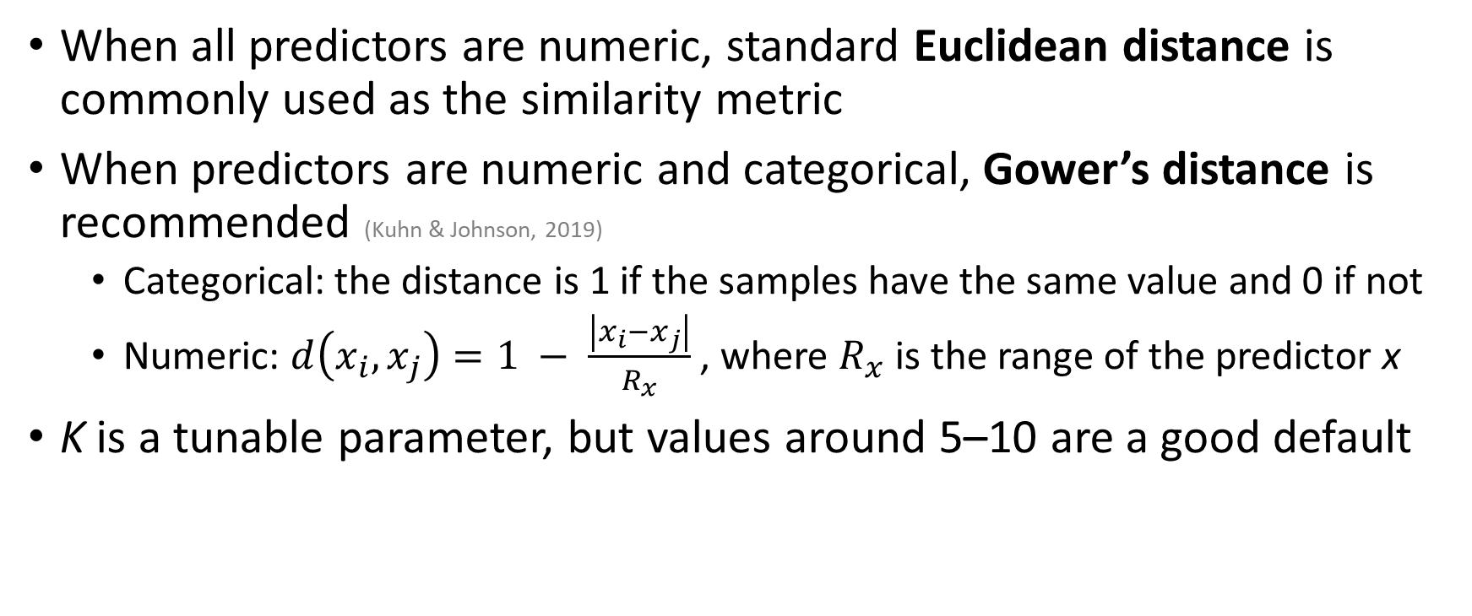
Imputation
When all predictors are numeric, standard Euclidean distance is commonly used as the similarity metric
When predictors are numeric and categorical, Gower’s distance is recommended (Kuhn & Johnson, 2019)
Categorical: the distance is 1 if the samples have the same value and 0 if not
Numeric: $d\left(x_{i},x_{j}\right)=1 − \frac{\left|x_{i}−x_{j}\right|}{R_{x}}$ , where $R_{x}$ is the range of the predictor x
K is a tunable parameter, but values around 5–10 are a good default

