Slide 1
Bias-variance Tradeoff
Data Splitting and Resampling
Joe Nese
Week 2, Class 1

Slide 2
Agenda
Understanding the bias-variance tradeoff
Data splitting and why it matters
Introduce resampling methods

Slide 3
Bias Variance Trade-off

Slide 4
Bias Variance Trade-off
The goal of machine learning is to predict results based on new (unseen) data
We use existing data to teach the machine how to predict results for new (unseen) data
We want the best predictions, and we generally do this by minimizing prediction error
Two types of prediction error:
Bias
Variance

Slide 5
Bias
The difference between the (average) prediction of our model and the true value we are trying to predict
This is equivalent to statistical bias
Gives us an idea how well a model fits the underlying structure of the data
A model with low bias is providing predictions close to “truth”
A model with high bias systematically ignores relevant details in the data
Notes:
Might want to note (at least verbally) that it doesn’t have to be the average difference (e.g., MAE is median difference), but that it often is. You can not that I’ll talk about this more later.

Slide 6
Variance
The variability of a model prediction for a given data point
A measure of the variability of predictions if we repeat the model multiple times with small differences in the data
The more the model fits to small differences in data, the higher the variance
Highly flexible models are more prone to higher variance
Highly flexible models are more prone to overfitting to the (training) data
Results in very good performance measures, BUT
Poor generalizability to new (unseen) data

Slide 7

Root Mean Square Error (RMSE)
$$RMSE =\sqrt{\frac{1}{n}\sum_{i=1}^{n}{{\left(y_{i}−{\hat{y}}_{i}\right)}^{2} }}$$
predicted outcome
outcome

Slide 8

Mean Square Error (MSE)
$$MSE= \frac{1}{n}\sum_{i=1}^{n}{{\left(y_{i}−{\hat{y}}_{i}\right)}^{2} }$$
$$Estimated MSE= σ^{2}+{\left(Model Bias\right)}^{2}+Model Variance$$
variance of residuals
this is the “noise” in the data
(unaffected by modeling)

Slide 9
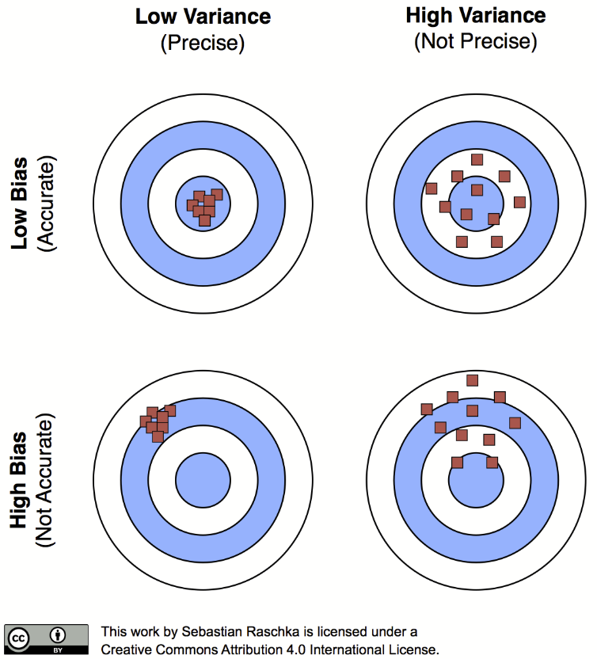
One way to look at it

Slide 10
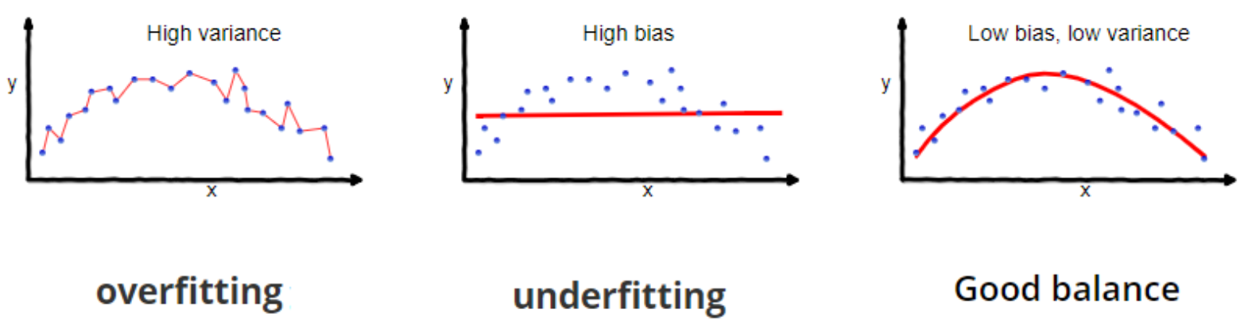
General idea
…but really, you’re not getting at variance without multiple model fits
https://towardsdatascience.com/understanding-the-bias-variance-tradeoff-165e6942b229

Slide 11
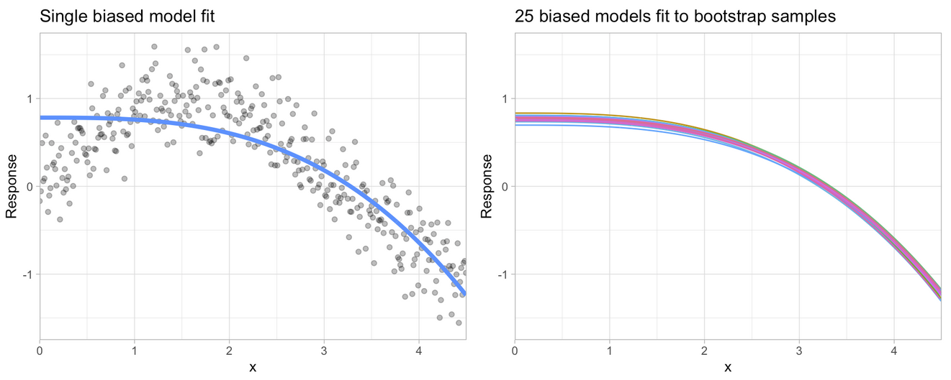
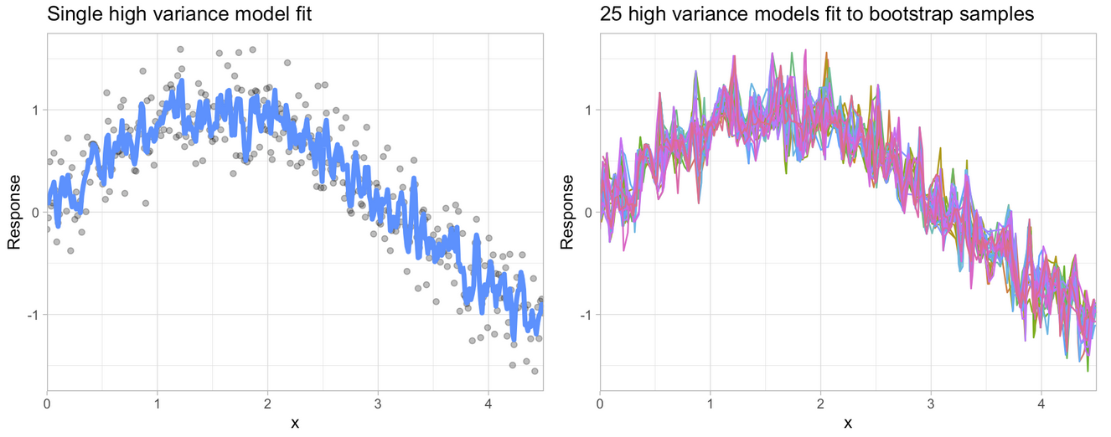
Bias
Variance
Figures from HOML

Slide 12
Properties of selected models
High Bias – Low Variance
Hi Variance – Low Bias
Linear models
Linear regression
Logistic regression
Partial least squares (PLS)
k-nearest neighbor
decision trees
gradient boosting machines
neural networks
Figures from HOML
Notes:
Might also note that regularization methods can help reduce overfitting for the more complicated models to help balance this (i.e., reduce the variance while maintaining pretty good bias)

Slide 13
Bias Variance Trade-off
There is a tradeoff between a model’s ability to minimize bias AND variance
Understanding how different sources of error lead to bias and variance helps us improve the data fitting process resulting in more accurate models
Bias – difference between the (average) prediction of our model and the true value we are trying to predict
Variance – variability of a model prediction for a given data point
Implies fitting a model multiple times to different data

Slide 14
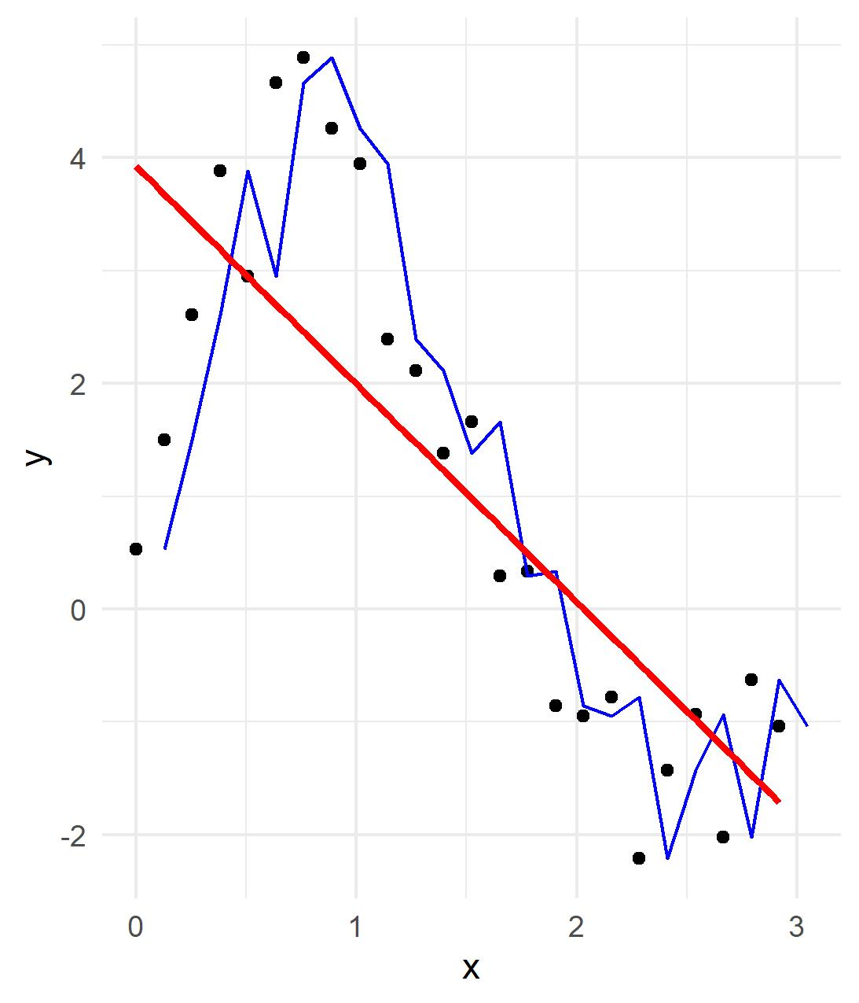
“Simple” model
low variance because the model would not change with new data from the same population
under-fit
high bias (distance from data)
More “complex” model
high variance because small changes to the data would change the model fit
over-fit

Slide 15
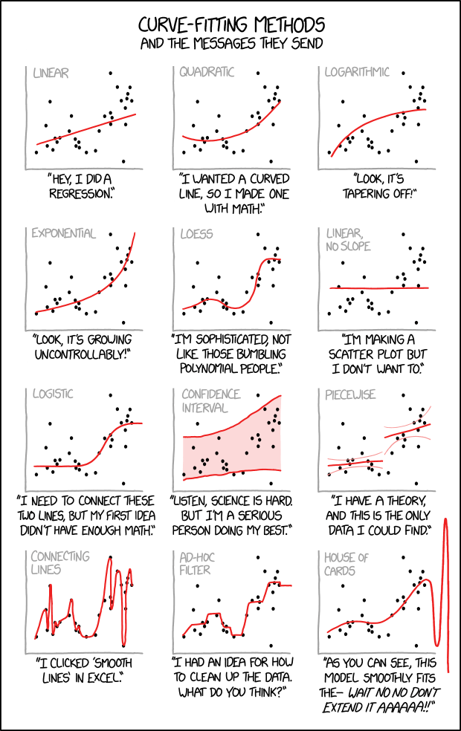

Slide 16
Data Splitting

Slide 17
Data Splitting
The goal of machine learning is to predict results based on new (unseen) data
“The best way to measure a model's performance at predicting new data is to predict new data.” – paraphrasing/quoting multiple experts
The simplest way to do this is to split our data into two parts:
Training set
Test set
We then fit a model to the training data and predict the results of the test set

Slide 18
Data splitting
We can do anything we want to the training set
train our algorithms, tune hyperparameters, compare models, and all of the other activities required to choose a final model
We do nothing with the test set until we have finalized our model using from the training set
Data leakage is using ANY part of the test set in our training set
Using the test set during our modeling process
Pre-processing or feature engineering the full data (training and test sets together)
Time series design, when the outcome of one series is used in the prediction of the next

Slide 19
Data
Training set
Test
set
Data
Training
Test

Slide 20

{rsample}
math_split <- initial_split(math)
math_train <- training(math_split)
math_test <- testing(math_split)
A good rule is to make these the first lines of your ML project code
These three functions are meant to be used in conjunction
Notes:
Just a style preference but I don’t even pull the test data until I’m ready to do something with it

Slide 21
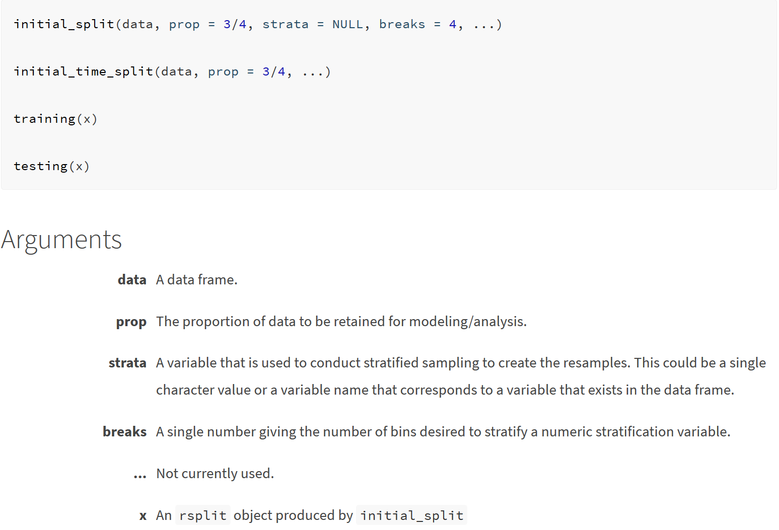
initial_split() help documentation

Slide 22
Let’s take a look at initial_split()
math <- read_csv(here::here("data", "edld-654-spring-2020", "train.csv")) %>% as_tibble()
set.seed(210)
(math_split <- initial_split(math))
<142070/47356/189426>
math_split %>% training() %>% nrow() / nrow(math)
[1] 0.7500026
names(math_split)
[1] "data" "in_id" "out_id" "id"
class(math_split)
[1] "rsplit" "mc_split"
Notes:
If you’re using `read_csv` I don’t’ think you should need `%>% as_tibble()`?
Also, I’m assuming you’ll have them follow along here? I would.

Slide 23
Additional arguments
The default is simple random assignment, with:
75% to the training set, and
25% to the test set
A general guideline is somewhere between 60%/40% & 80%/20%.
Spending too much in training (e.g., > 80%) may mean poor predictive performance. It may fit the training data very well, but is not generalizable (overfitting).
Spending too much in testing (e.g., > 40%) may mean poor assessment of model parameters (underfitting).
If you have a lot of data, you may see little predictive benefit of using the entire data, but an increase in computational time.
If you have more features/predictors than rows, you may need a larger sample size to identify consistent signals in the features.
split_data <- initial_split(ames, prop = .70)

Slide 24
Let’s take a look at prop
set.seed(210)
(math_split70 <- initial_split(math, prop = .70))
<132599/56827/189426>
math_split70 %>% training() %>% nrow() / nrow(math)
[1] 0.7000042

Slide 25
Additional arguments
As opposed to simple random assignment, you can use stratified sampling to ensure the training and test sets have similar outcome (Y) distributions/proportions (equal to that of the full data set). Helps ensure a balanced representation of the response distribution in both the training and test sets.
Especially useful if:
the continuous outcome is not normally distributed (skewed)
stratified sampling will segment outcome into quantiles and randomly sample from each
the categorical outcome has substantial unbalanced classes (e.g., 6% HS dropout, 94% graduate)
split_data <- initial_split(ames, strata = Sales_Price)

Slide 26
Let’s take a look at strata
Not a great example because we’re stratifying by a predictor and not the outcome but…
math_split %>%
training() %>%
janitor::tabyl(ethnic_cd)
ethnic_cd n percent
A 5885 0.04142324
B 3148 0.02215809
H 34537 0.24309847
I 1848 0.01300767
M 8930 0.06285634
P 1077 0.00758077
W 86645 0.60987541
math_split %>%
testing() %>%
janitor::tabyl(ethnic_cd)
ethnic_cd n percent
A 1810 0.038221134
B 1002 0.021158882
H 11345 0.239568376
I 594 0.012543289
M 2965 0.062610862
P 353 0.007454177
W 29287 0.618443281
math_split_strat <- initial_split(math, strata = ethnic_cd)
math_split_strat %>%
training() %>%
janitor::tabyl(ethnic_cd)
ethnic_cd n percent
A 5718 0.040247765
B 3114 0.021918772
H 34465 0.242591680
I 1841 0.012958401
M 8910 0.062715563
P 1067 0.007510382
W 86955 0.612057436
math_split_strat %>%
testing() %>%
janitor::tabyl(ethnic_cd)
ethnic_cd n percent
A 1977 0.041747614
B 1036 0.021876848
H 11417 0.241088774
I 601 0.012691106
M 2985 0.063033195
P 363 0.007665343
W 28977 0.611897120

Slide 27
Resampling

Slide 28
We split – now what?
Again, we NEVER use the test set until we have a “final model”
And “the best way to measure a model's performance at predicting new data is to predict new data”
So how do we measure model performance during the training phase? What new data do we predict?
Just re-predicting the training set is not ideal
biases results - may well predict training set but won’t generalize to new data
no measure of variance if we only have one measure of performance (based on predicting the training set)
We resample training set

Slide 29
Data
Training set
Test
set

Slide 30
Resampling
Training set

Slide 31
Resampling
Training set
…
Resample 01
Resample 02
Resample k
Analysis
Assessment
Analysis
Assessment
Analysis
Assessment
Training:Test::Analysis:Assessment
-OR-
Analysis functions like the Training set
Assessment functions like the Test set

Slide 32
Resampling
Data
Training set
Test
set
…
Resample 01
Resample 02
Resample k
Analysis
Assessment
Analysis
Assessment
Analysis
Assessment

Slide 33
(Confusing) Terms
Data
aka
holdout set
Training set
Test
set
…
Resample 01
Resample 02
Resample k
Analysis
Assessment
Analysis
Assessment
Analysis
Assessment
aka
validation
test
evaluation
holdout
aka
training

Slide 34
Common Resampling Methods
k-fold cross-validation
Probably the most common resampling method for model evaluation and model selection in applied ML
Monte Carlo cross-validation
Bootstrapping
Others (most not discussed here)
Leave one out cross validation (LOOCV)
Rolling origin forecasting – for time series data
632 and 632+ methods
Maximum dissimilarity sampling

Slide 35
k-fold cross-validation (k-fold CV)
We randomly split the training data into k distinct samples ("folds") of (approximately) equal size
10-fold CV
k = 10
Within each fold, a random 10% of training data are sampled for the assessment set
The 10% assessment sample is completely different for each fold
Each observation (row) serves in one and only one assessment sample
The remaining 90% of the training data serve as the analysis set in the fold

Slide 36
10-fold CV
 | Assessment
 | Analysis
 | Fold01 | Fold02 | Fold03 | Fold04 | Fold05 | Fold06 | Fold07 | Fold09 | Fold09 | Fold10
01
02
03
04
05
06
07
08
09
10

Slide 37
k-fold CV
5-fold CV
k = 5
Within each fold, a random 20% of training data are sampled for the assessment set
The 20% assessment sample is completely different for each fold
Each observation (row) serves in one and only one assessment sample
The remaining 80% of the training data serve as the analysis set in the fold

Slide 38
5-fold CV
 | Assessment
 | Analysis
 | Fold01 | Fold02 | Fold03 | Fold04 | Fold05
01
02
03
04
05
06
07
08
09
10

Slide 39
Results
Fold01
We fit our model on the Fold01 analysis set (leaving out the assessment set)
We apply our resulting model parameters to predict the assessment set
We get our performance measures (objective functions)
We repeat this process until we've predicted all k assessment sets
The final performance is the average performance measure across the k folds

Slide 40
 | Fold01 | Fold02 | Fold03 | Fold04 | Fold05 | Fold06 | Fold07 | Fold09 | Fold09 | Fold10
01
02
03
04
05
06
07
08
09
10
 | ↓ | ↓ | ↓ | ↓ | ↓ | ↓ | ↓ | ↓ | ↓ | ↓
performance measure | RMSE | RMSE | RMSE | RMSE | RMSE | RMSE | RMSE | RMSE | RMSE | RMSE
Average RMSE
(variance)

Slide 41
k-fold CV suggestions
Larger values of k:
produce less bias (because the difference between a fold and the training set decreases)
more computationally intensive
10 folds is a good rule-of-thumb
Leave-one-out is the most extreme resampling technique
Use n - 1 to predict each row
10-fold CV performed comparably to LOOCV (Molarino, 2005)
Has more variability compared to other resampling methods (bootstrapping)
Repeating k-fold CV can improve the accuracy of the estimates while maintaining small bias (Molarino, 2005; Kim, 2009)
10-fold CV repeated 5 times = 50 models/performance measures
Particularly useful for smaller data sets
For large training sets, variance and bias issues are less of a concern
Notes:
Might want to explicitly mention (perhaps verbally) that repeated CV is not the same thing as just upping the number of folds. So in this example not the same thing as 50-fold CV. Also that it helps reduce wild variabilitiy between folds because you’re essentially getting a more complete estimate of the overall between-fold variability (i.e., the variance distribution).

Slide 42
vfold_cv()
data = your training set
v = number of folds (default = 10)
repeats = number of repeats (default = 1)
strata = variable to conduct stratified sampling to create the folds
breaks = the number of bins desired to stratify a numeric stratification variable

Slide 43
vfold_cv()
set.seed(210)
(cv_splits <- vfold_cv(math_train))
# 10-fold cross-validation
# A tibble: 10 x 2
splits id
<named list> <chr>
1 <split [127.9K/14.2K]> Fold01
2 <split [127.9K/14.2K]> Fold02
3 <split [127.9K/14.2K]> Fold03
4 <split [127.9K/14.2K]> Fold04
5 <split [127.9K/14.2K]> Fold05
6 <split [127.9K/14.2K]> Fold06
7 <split [127.9K/14.2K]> Fold07
8 <split [127.9K/14.2K]> Fold08
9 <split [127.9K/14.2K]> Fold09
10 <split [127.9K/14.2K]> Fold10

Slide 44
cv_splits$splits[[1]]
<127863/14207/142070>
cv_splits$splits[[1]] %>%
assessment()
# A tibble: 14,207 x 40
id gndr ethnic_cd attnd_dist_inst~ attnd_schl_inst~ enrl_grd calc_admn_cd tst_bnch tst_dt migrant_ed_fg
<dbl> <chr> <chr> <dbl> <dbl> <dbl> <lgl> <chr> <chr> <chr>
1 36 F W 2048 422 8 NA 3B 5/16/~ N
2 52 F W 1944 161 8 NA 3B 5/23/~ N
3 61 M H 1901 1322 8 NA 3B 5/16/~ N
4 69 M H 2183 934 8 NA 3B 5/21/~ N
5 70 M H 2053 1773 7 NA G7 5/3/2~ N
6 72 M W 2057 480 7 NA G7 5/15/~ N
7 80 M H 1974 235 7 NA G7 5/15/~ N
8 115 M W 2041 380 8 NA 3B 5/18/~ N
9 221 F W 2183 1312 7 NA G7 4/18/~ N
10 230 M B 2180 847 8 NA 3B 4/24/~ N
# ... with 14,197 more rows, and 30 more variables: ind_ed_fg <chr>, sp_ed_fg <chr>, tag_ed_fg <chr>,
# econ_dsvntg <chr>, ayp_lep <chr>, stay_in_dist <chr>, stay_in_schl <chr>, dist_sped <chr>,
# trgt_assist_fg <chr>, ayp_dist_partic <chr>, ayp_schl_partic <chr>, ayp_dist_prfrm <chr>,
# ayp_schl_prfrm <chr>, rc_dist_partic <chr>, rc_schl_partic <chr>, rc_dist_prfrm <chr>, rc_schl_prfrm <chr>,
# partic_dist_inst_id <dbl>, partic_schl_inst_id <dbl>, lang_cd <chr>, tst_atmpt_fg <chr>,
# grp_rpt_dist_partic <chr>, grp_rpt_schl_partic <chr>, grp_rpt_dist_prfrm <chr>, grp_rpt_schl_prfrm <chr>,
# score <dbl>, classification <dbl>, ncessch <dbl>, lat <dbl>, lon <dbl>

Slide 45
vfold_cv()
cv_splits$splits[[1]]
<127863/14207/142070>
cv_splits$splits[[1]] %>%
analysis() %>%
nrow()
[1] 127863
cv_splits$splits[[1]] %>%
assessment() %>%
nrow()
[1] 14207
analysis
assessment
Notes:
Maybe add one more arrow noting that the third number there is the total?

Slide 46
Monte Carlo Cross-Validation
For each split, a random sample (without replacement) is taken with a specified proportion going into the analysis set and the rest going to the assessment set
The splitting procedure is conducted a specified number times
The number of splits must be large enough have adequate precision
Like k-fold CV, a model is created on the analysis set and the assessment set is used to evaluate the model, and the average of the results across resamples are used to estimate future performance
As opposed to k-fold CV, MC CV produces resamples that are likely to contain overlap

Slide 47
10-fold CV
 | Assessment
 | Analysis
 | Fold01 | Fold02 | Fold03 | Fold04 | Fold05 | Fold06 | Fold07 | Fold09 | Fold09 | Fold10
01
02
03
04
05
06
07
08
09
10

Slide 48
Monte Carlo CV (10 times)
 | Assessment
 | Analysis
 | Resample01 | Resampl02 | Resample03 | Resample04 | Resample05 | Resample06 | Resample07 | Resample08 | Resample09 | Resample10
01
02
03
04
05
06
07
08
09
10

Slide 49
mc_cv()
data = your training set
prop = proportion going to the analysis set (default = .75)
times = number of times to repeat the sample (default = 25)
strata = variable to conduct stratified sampling to create the folds
breaks = the number of bins desired to stratify a numeric stratification variable (default = 4)

Slide 50
mc_cv()
(mc_splits <- mc_cv(math_train))
# # Monte Carlo cross-validation (0.75/0.25) with 25 resamples
# A tibble: 25 x 2
splits id
<list> <chr>
1 <split [106.6K/35.5K]> Resample01
2 <split [106.6K/35.5K]> Resample02
3 <split [106.6K/35.5K]> Resample03
4 <split [106.6K/35.5K]> Resample04
5 <split [106.6K/35.5K]> Resample05
6 <split [106.6K/35.5K]> Resample06
7 <split [106.6K/35.5K]> Resample07
8 <split [106.6K/35.5K]> Resample08
9 <split [106.6K/35.5K]> Resample09
10 <split [106.6K/35.5K]> Resample10
# ... with 15 more rows

Slide 51
mc_cv()
nrow(math_train)
[1] 142070
mc_splits$splits[[1]]
<106553/35517/142070>
mc_splits$splits[[12]]
<106553/35517/142070>
mc_splits$splits[[25]]
<106553/35517/142070>
analysis(mc_splits$splits[[1]]) %>% nrow() / nrow(mc_splits$splits[[1]]$data)
[1] 0.7500035

Slide 52
bootstrapping
A bootstrap sample is a simple random sample that is the same size as the training set where the data are sampled with replacement
So after a row is selected for inclusion in the subset, it’s still available for further selection
Each bootstrap sample is likely to contain duplicate values
Analysis set
On average, 63.21% of the original sample ends up in a bootstrap sample
Assessment set
Those rows not selected in a bootstrap sample are considered out-of-bag (OOB)

Slide 53
Sampled: | 0 | 1 | 2 | 3
Assessment
Analysis
 | B01 | B02 | B03 | B04 | B05 | B06 | B07 | B09 | B09 | B10
01
02
03
04
05
06
07
08
09
10

Slide 54
Results
B01
We fit our model on the B01 analysis set (leaving out the assessment set)
We apply our resulting model parameters to predict the assessment set
We get our performance measures (loss functions)
We repeat this process until we've predicted all B assessment sets
The final performance is the average performance measure across the B sets

Slide 55
Bootstrap notes
Bootstrap tends to have less variability in the error measure compared to k-fold CV
But because of replacement, bootstrap has more bias (similar to k = 2)
This is problematic when the training set is small, and less so as the sample increases (n ≥ 1,000)

Slide 56

bootstraps()
data = your training set
times = number of bootstrap samples (default = 25)
strata = variable to conduct stratified sampling to create the folds
breaks = the number of bins desired to stratify a numeric stratification variable
apparent = enables the option of an additional resample where the analysis and assessment data sets are the same as the original data set. This can be required for some types of analysis of the bootstrap results.

Slide 57
bootstraps()
> (boot_splits <- bootstraps(math_train))
# Bootstrap sampling
# A tibble: 25 x 2
splits id
<list> <chr>
1 <split [142.1K/52.1K]> Bootstrap01
2 <split [142.1K/52.2K]> Bootstrap02
3 <split [142.1K/52.2K]> Bootstrap03
4 <split [142.1K/52.4K]> Bootstrap04
5 <split [142.1K/52.3K]> Bootstrap05
6 <split [142.1K/52.2K]> Bootstrap06
7 <split [142.1K/52.2K]> Bootstrap07
8 <split [142.1K/52.5K]> Bootstrap08
9 <split [142.1K/52.3K]> Bootstrap09
10 <split [142.1K/52.4K]> Bootstrap10
# ... with 15 more rows

Slide 58
bootstraps()
nrow(math_train)
[1] 142070
boot_splits$splits[[1]]
<142070/52088/142070>
boot_splits$splits[[12]]
<142070/52447/142070>
boot_splits$splits[[25]]
<142070/52149/142070>

Slide 59
Leave-one-out (LOO) cross-validation
Uses one data point in the original set as the assessment data and all other data points as the analysis set
A LOO resampling set has as many resamples as rows in the original data set

Slide 60

loo_cv()
> (loo_splits <- loo_cv(sample_n(math_train, 10000)))
# Leave-one-out cross-validation
# A tibble: 10,000 x 2
splits id
<named list> <chr>
1 <split [10K/1]> Resample1
2 <split [10K/1]> Resample2
3 <split [10K/1]> Resample3
4 <split [10K/1]> Resample4
5 <split [10K/1]> Resample5
6 <split [10K/1]> Resample6
7 <split [10K/1]> Resample7
8 <split [10K/1]> Resample8
9 <split [10K/1]> Resample9
10 <split [10K/1]> Resample10
# ... with 9,990 more rows
> loo_splits$splits[[1]]
<9999/1/10000>
> loo_splits$splits[[12]]
<9999/1/10000>
> loo_splits$splits[[101]]
<9999/1/10000>

Slide 61
Quick summary
High variance models are more prone to overfitting, and resampling is critical to reduce this risk
Many models that are capable of achieving good generalization performance have lots of hyperparameters that control the level of model complexity (i.e., the tradeoff between bias and variance)
We’ll be talking more about this in the coming weeks

Slide 62
Next time
Lab 1
Readings

Slide 63
Lab 1

