Slide 1
Penalized Regression
Ridge, Lasso, Elastic net
Joe Nese
Week 4, Class 1

Slide 2
Agenda
Introduce penalized regression
Model tuning

Slide 3
Penalized Regression
(AKA Regularized Regression)

Slide 4
Let’s revisit linear regression
What’s good
Parsimonious
Interpretable results
Coefficients are unbiased (given standard assumptions)
Because they minimize the sum-of-squared errors (SSE)
Lowest variance (of all unbiased linear techniques)

Slide 5
Let’s revisit linear regression
What’s not so good
Sensitive to highly correlated predictors – multicollinearity
Including irrelevant predictors may hurt model performance
Model fit is influenced by “outliers” because it wants to minimize SSE
Although we can model nonlinearity by adding terms to the model - x² or log(x)
This may not capture the relationship between predictors and outcome
Adds predictors to the model (problematic with many predictors fewer observations)

Slide 6
Penalized Regression
Regression coefficients are unbiased because the model minimizes SSE
But it turns out that adding a little bias to the coefficients can substantially decrease variance, resulting in a smaller MSE and better prediction of unseen data
How do add bias to the coefficients?
Add a penalty to the SEE if the coefficients become too large
Basically: penalize the model for coefficients as they move away from zero
In order to have a large coefficient, a predictor will need to have a large impact on the model fit

Slide 7
Penalized Regression
How does a penalty help?
Shrinking our coefficients toward zero reduces the model's variance (think of model where all coefficients are equal to zero – no variance)
The optimal penalty will balance reduced variance with increased bias
Particularly useful for dealing with multicollinearity

Slide 8
Penalized Regression Models
Ridge Regression (Hoerl, 1970)
lasso (Tibshirani, 1996)
Elastic net (Aou & Hastie, 2005)
AKA
Regularized Regression
Shrinkage methods

Slide 9
Max’s Feat Engineering book, 7.3.2
Applied ML slides. Part 5, 23-26

Slide 10

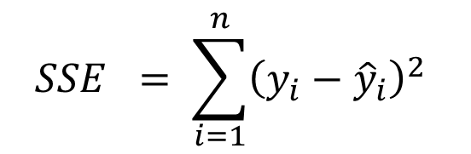

Ridge Regression
$$+ λ\sum_{j=1}^{P}{β_{j}^{2}}$$
Penalize the model for coefficients as they move away from zero unless there is a proportional reduction in the SSE
L₂ penalty = second-order penalty (squared coefficients)
As the penalty (λ) increases, the coefficients shrink toward 0 (at different rates)
λ = 0; linear regression
A new set of coefficients will be produced for each value of λ
$$SSE = \sum_{i=1}^{n}{{\left(y_{i}−{\hat{y}}_{i}\right)}^{2} }$$
$$L_{2}$$
squared coefficients
penalty

Slide 11
Penalized Regression
Scale matters
The units of the predictors can substantially affect results
The scale of predictors doesn’t affect SSE, but does affect the coefficients
Think of coefficient interpretation for meters vs. kilometers
Ridge regression will pay a larger penalty for meters
So we need to put all predictors on the same scale prior to analysis
Center and scale all predictors
(x - mean(x)) / sd(x)

Slide 12
Ridge Regression
Shrinks the coefficients of correlated predictors toward each other (rather than allowing one to be wildly positive and the other wildly negative)
Many less-important predictors get pushed toward zero which helps identify the important predictors in our data
Shrinks coefficients toward 0, but will never equal 0, no matter how large the penalty
A coefficient equal to 0 would, of course, be dropped from the model
That would be automatic feature selection!
That would be nice!
lasso models do this
Least Absolute Shrinkage and Selection Operator

Slide 13


lasso - Least Absolute Shrinkage and Selection Operator
$$+ λ\sum_{j=1}^{P}{\left|β_{j}\right|}$$
Penalize the model for coefficients as they move away from zero unless there is a proportional reduction in the SSE
L₁ penalty = absolute coefficients
As the penalty (λ) increases, the coefficients shrink toward 0 (at different rates)
Allows coefficients equal to 0
$$SSE = \sum_{i=1}^{n}{{\left(y_{i}−{\hat{y}}_{i}\right)}^{2} }$$
$$L_{1}$$
absolute coefficients
penalty

Slide 14


Ridge and lasso
Both equally penalize overestimating and underestimating a coefficient
No free lunch
Ridge
Lasso
$$λ\sum_{j=1}^{P}{β_{j}^{2}}$$
$$λ\sum_{j=1}^{P}{\left|β_{j}\right|}$$
L₂ penalty
Larger errors are worse
Tends to shrinks coefficients of correlated predictors toward each other
Extreme example: for P identical predictors, each has a coefficient of 1/P the size as one modeled by itself
Helps if you want to keep all predictors in your model and reduce the noise of less influential variables (e.g., smaller data sets with severe multicollinearity)
L₁ penalty
Additional error is equally bad everywhere
Tends to just choose one predictor and not model the others
Helps find the predictors with the largest (and most consistent) coefficients in data with many predictors

Slide 15
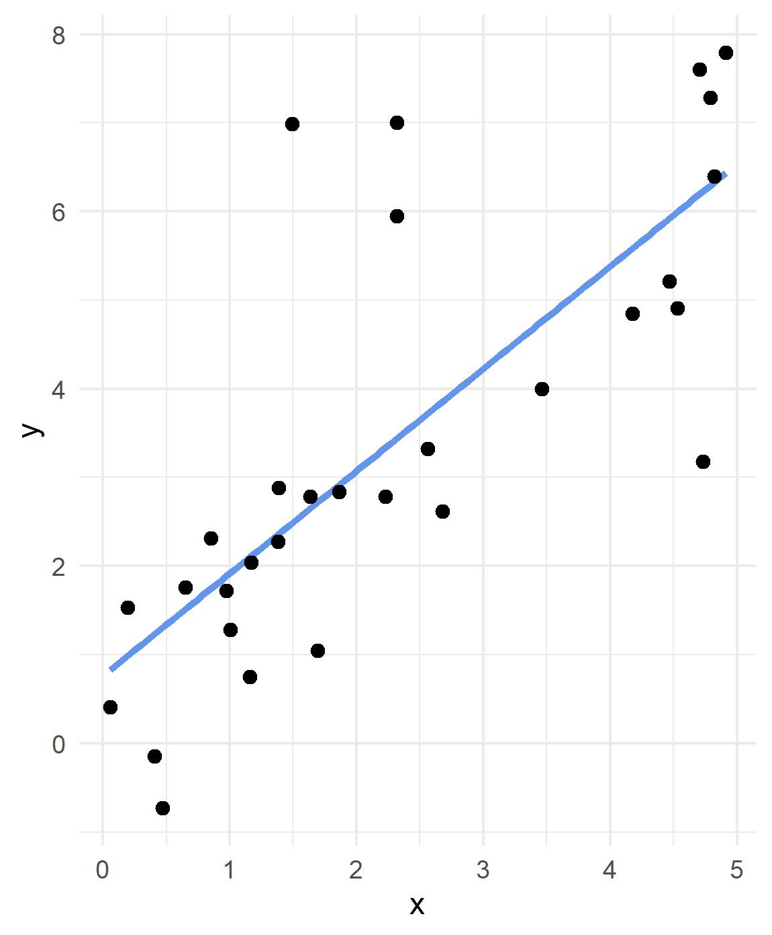
Code credit to Ed Rubin

Slide 16
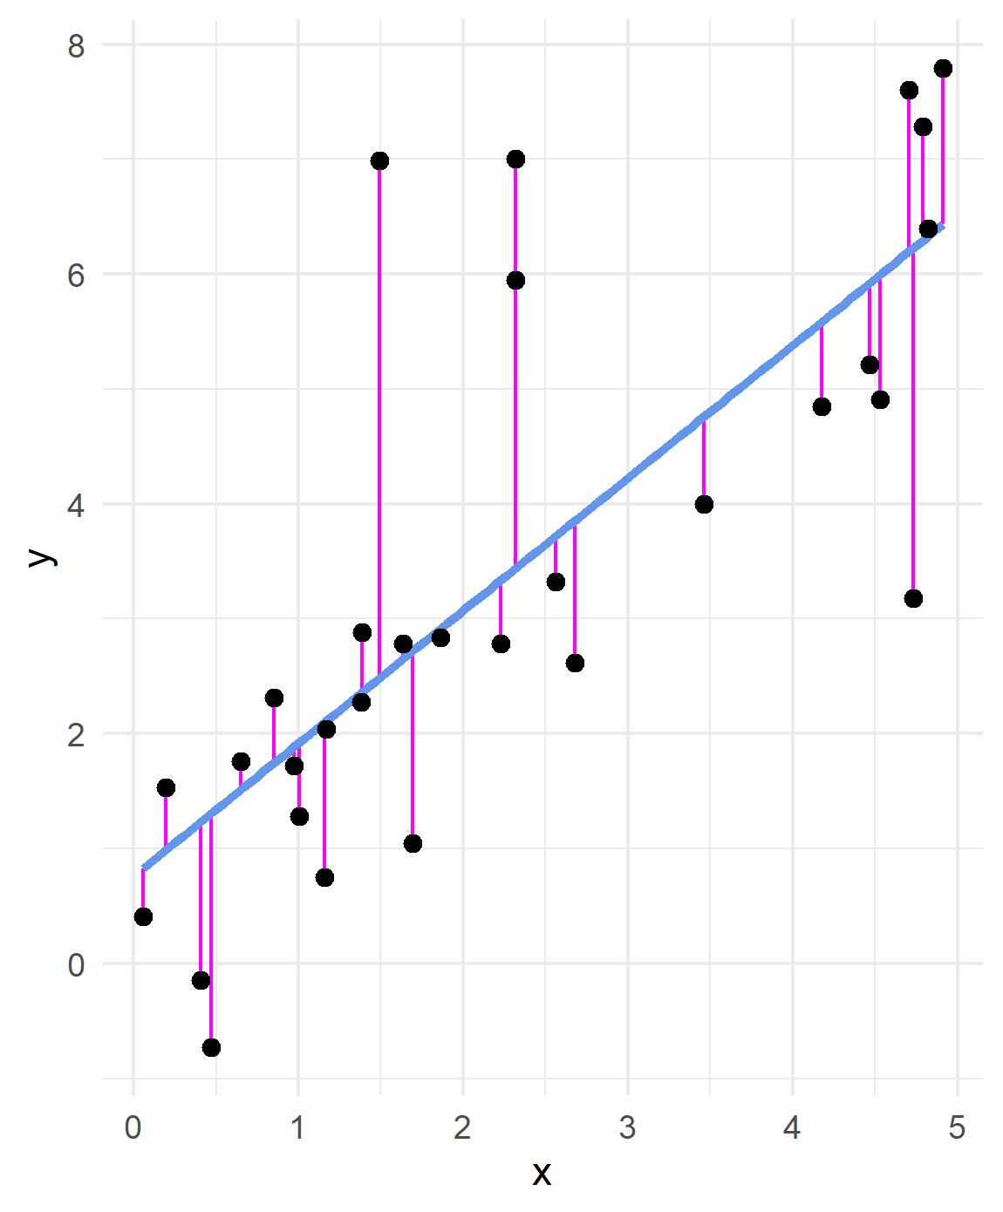
L₂ loss function

Slide 17
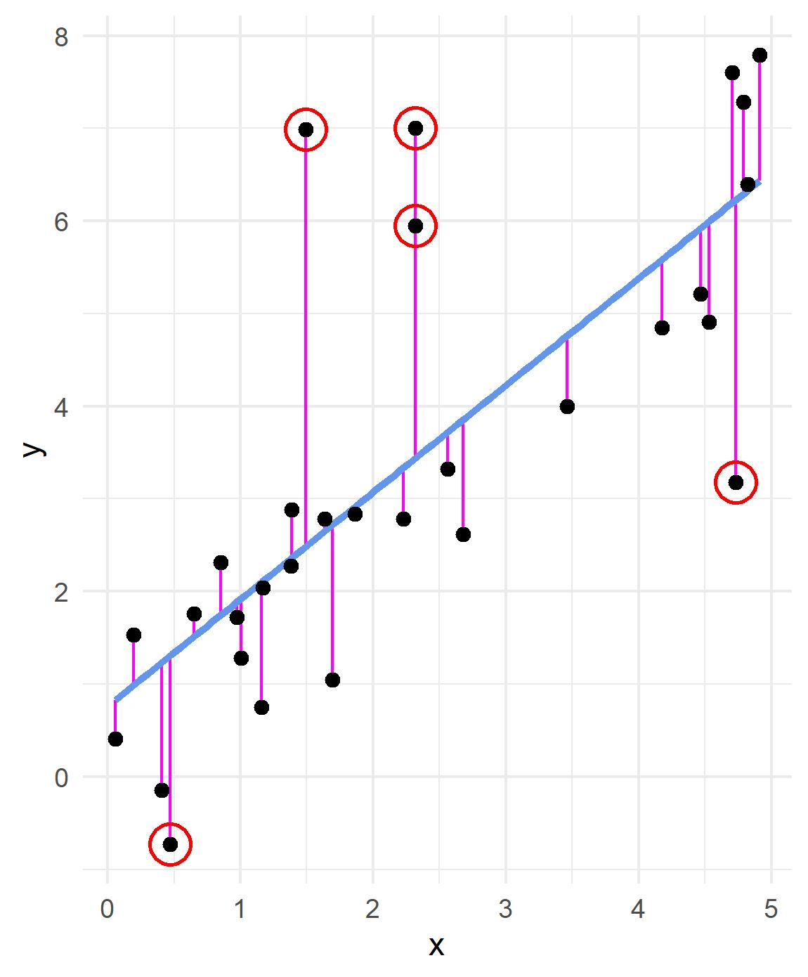


L₂ loss function
$$Σ_{i}{\left(y_{i}−{\hat{y}}_{i}\right)}^{2}$$
(4.5) ²
20.25
4.5
L₁ loss function
$$Σ_{i}\left|y_{i}−{\hat{y}}_{i}\right|$$
|4.5|
4.5

Slide 18

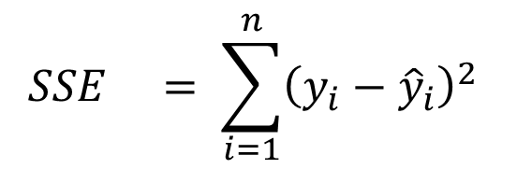

Elastic net
$$+ λ\sum_{j=1}^{P}{β_{j}^{2}}$$
$$+ λ\sum_{j=1}^{P}{\left|β_{j}\right|}$$
Combines the two types of penalties
Enables effective regularization with ridge penalty (L₂)
Offers feature selection with lasso penalty (L₁)
Better able to handle multicollinearity
$$SSE = \sum_{i=1}^{n}{{\left(y_{i}−{\hat{y}}_{i}\right)}^{2} }$$
Enet

Slide 19

{parsnip}
List of models
https://tidymodels.github.io/parsnip/articles/articles/Models.html
We’ll be using glmnet for our penalized regression models

Slide 20
linear_reg()
mode = can only be “regression,” not “classification”
penalty = An non-negative number representing the total amount of regularization. This can be a combination of L1 and L2 (depending on the value of mixture)
mixture = A number between zero and one (inclusive) that represents the proportion of L1 regularization (the lasso)
ridge = mixture = 0; no L1
lasso = mixture = 1; completely L1 (and no ridge)

Slide 21
Missing data
Penalized regression cannot handle missing data
Can either delete or impute
For simplicity here, we are just going to delete
math <- math <- read_csv(here::here("data", "edld-654-spring-2020", "train.csv")) %>%
as_tibble()
math <- math %>%
drop_na(lat, econ_dsvntg) %>%
mutate_at(vars(enrl_grd, econ_dsvntg), list(~as.factor(.)))

Slide 22
# 1 - Initial Split
set.seed(210)
math_split <- initial_split(math)
math_train <- training(math_split)
math_test <- testing(math_split)
# 2 - Resample
set.seed(210)
cv_splits <- vfold_cv(math_train)

Slide 23
Before we continue…
We need to center and scale our continuous predictors
This is part of data preprocessing, or feature engineering
“the process of creating representations of data that increase the effectiveness of a model” (Kuhn & Johnson, 2019)
Very quick preview of next week’s topic and the {recipes} package
Center: average is subtracted from the predictor’s individual values
All predictors will have a mean of zero
Scale: divide a variable by the standard deviation
All predictors have a standard deviation of one

Slide 24

{recipes}
penreg_rec <-
recipe(
formula = score ~ enrl_grd + econ_dsvntg + lat + lon,
data = math_train
) %>%
step_dummy(all_nominal()) %>%
step_normalize(lat, lon)

Slide 25
{recipes}
penreg_rec <-
recipe(
formula = score ~ enrl_grd + econ_dsvntg + lat + lon,
data = math_train
) %>%
step_dummy(all_nominal()) %>%
step_normalize(lat, lon)
defines outcome and predictors

Slide 26
{recipes}
penreg_rec <-
recipe(
formula = score ~ enrl_grd + econ_dsvntg + lat + lon,
data = math_train
) %>%
step_dummy(all_nominal()) %>%
step_normalize(lat, lon)
Catalogs the names and types of each variable.
Informs recipe() what is numeric and what is nominal

Slide 27
{recipes}
penreg_rec <-
recipe(
formula = score ~ enrl_grd + econ_dsvntg + lat + lon,
data = math_train
) %>%
step_dummy(all_nominal()) %>%
step_normalize(lat, lon)
Converts nominal data into dummy variables
all_nominal() is a helper function

Slide 28
{recipes}
penreg_rec <-
recipe(
formula = score ~ enrl_grd + srt_tst_typ, + lat + lon,
data = math_train
) %>%
step_dummy(all_nominal()) %>%
step_normalize(lat, lon)
Normalizes (centers and scales) lat and lon, which is necessary for penalized regression
Could also use:
step_center(lat, lon)
step_scale(lat, lon)

Slide 29
# 3 - Set Model
## Ridge
mod_ridge <- linear_reg() %>%
set_engine("glmnet") %>%
set_mode("regression") %>% # redundant; just setting a habit
set_args(penalty = .1, # we set the penalty = .1
mixture = 0) # specifies a ridge regression model

Slide 30
# 3 - Set Model
## lasso
mod_lasso <- linear_reg() %>%
set_engine("glmnet") %>%
set_mode("regression") %>% # redundant; just setting a habit
set_args(penalty = .1, # we set the penalty = .1
mixture = 1) # specifies a lasso model

Slide 31
# 3 - Set Model
## Elastic net
mod_enet <- linear_reg() %>%
set_engine("glmnet") %>%
set_mode("regression") %>% # redundant; just setting a habit
set_args(penalty = .1, # we set the penalty = .1
mixture = .7) # specifies 70% L1 penalty (lasso) # and 30% L2 penalty (ridge)

Slide 32
# 4 - Fit the models
## Ridge
fit_ridge <- tune::fit_resamples(
mod_ridge,
preprocessor = penreg_rec,
resamples = cv_splits,
metrics = yardstick::metric_set(rmse), # default is rmse & rsq
control = tune::control_resamples(verbose = TRUE,
save_pred = TRUE))

Slide 33
## Ridge
fit_ridge %>%
tune::collect_metrics()
# A tibble: 1 x 5
.metric .estimator mean n std_err
<chr> <chr> <dbl> <int> <dbl>
1 rmse standard 102. 10 0.351

Slide 34
## Ridge
fit_ridge %>%
tune::collect_metrics(summarize = FALSE)
# A tibble: 10 x 4
id .metric .estimator .estimate
<chr> <chr> <chr> <dbl>
1 Fold01 rmse standard 101.
2 Fold02 rmse standard 101.
3 Fold03 rmse standard 101.
4 Fold04 rmse standard 99.3
5 Fold05 rmse standard 103.
6 Fold06 rmse standard 103.
7 Fold07 rmse standard 102.
8 Fold08 rmse standard 103.
9 Fold09 rmse standard 101.
10 Fold10 rmse standard 102.

Slide 35
## lasso
fit_lasso <- tune::fit_resamples(
mod_lasso,
preprocessor = penreg_rec,
resamples = cv_splits,
metrics = yardstick::metric_set(rmse),
control = tune::control_resamples(verbose = TRUE,
save_pred = TRUE))
fit_lasso %>%
collect_metrics()
# A tibble: 1 x 5
.metric .estimator mean n std_err
<chr> <chr> <dbl> <int> <dbl>
1 rmse standard 101. 10 0.356

Slide 36
## Elastic net
fit_enet <- tune::fit_resamples(
mod_enet,
preprocessor = penreg_rec,
resamples = cv_splits,
metrics = yardstick::metric_set(rmse),
control = tune::control_resamples(verbose = TRUE,
save_pred = TRUE))
fit_enet %>%
collect_metrics()
# A tibble: 1 x 5
.metric .estimator mean n std_err
<chr> <chr> <dbl> <int> <dbl>
1 rmse standard 101. 10 0.356

Slide 37
collect_metrics(fit_ridge)
# A tibble: 1 x 5
.metric .estimator mean n std_err
<chr> <chr> <dbl> <int> <dbl>
1 rmse standard 102. 10 0.351
collect_metrics(fit_lasso)
# A tibble: 1 x 5
.metric .estimator mean n std_err
<chr> <chr> <dbl> <int> <dbl>
1 rmse standard 101. 10 0.356
collect_metrics(fit_enet)
# A tibble: 1 x 5
.metric .estimator mean n std_err
<chr> <chr> <dbl> <int> <dbl>
1 rmse standard 101. 10 0.356

Slide 38
Penalized regression
Thus far we have used penalty = .1 (λ)
Choosing a good value for the penalty is very important
Too small a penalty and our model is essentially OLS
Too large a penalty and we shrink all our coefficients too close to zero
So how can we find an optimal value?
Model tuning

Slide 39
Model tuning
regular grids

Slide 40

{tune}
Facilitates the tuning of hyper-parameters the tidymodels packages
Hyperparameters (tuning parameters) control the complexity of some ML models (and the bias-variance trade-off)
Hyperparameters cannot be directly estimated from the data
Some models have many tuning parameters (e.g., boosted trees)
We use cross-validation to find the optimal tuning parameter values with either:
grid search - predefined values
iterative search - where each iteration finds novel tuning parameter values to evaluate

Slide 41
tune()
A placeholder for hyper-parameters to be "tuned“
tnr_ridge <- linear_reg() %>%
set_engine("glmnet") %>%
set_args(penalty = tune(),
mixture = 0)

Slide 42
tnr_ridge <- linear_reg() %>%
set_engine("glmnet") %>%
set_args(penalty = tune(),
mixture = 0)
penalty() # from the {dials} package
Amount of Regularization (quantitative)
Transformer: log-10
Range (transformed scale): [-10, 0]

Slide 43
grid search
Set a pre-defined set of tuning parameter values and evaluate their performance so that the best values can be used in the final model
For models with more than one tuning parameter, the grid is multidimensional.
Using resampling to evaluate each distinct parameter value combination to get estimates of how well each performs
Calculate results and model performance, and use the “best” tuning parameter combination to fit to the entire training set

Slide 44
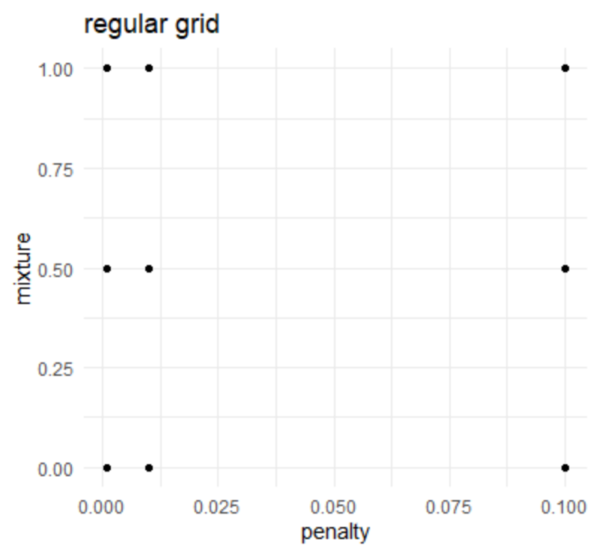
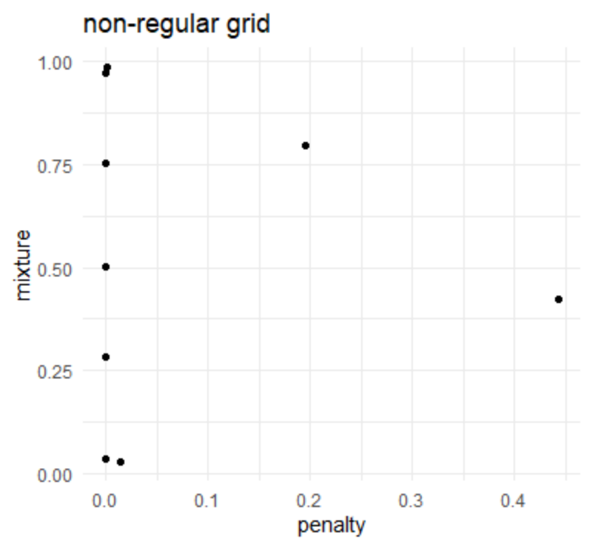

Slide 45
Regular grids
Usually a combination of vectors of tuning parameter values
The number of values don't have to be the same per parameter
The values can be regular on a transformed scale (e.g. log-10 for penalty)
Quantitative and qualitative parameters can be combined
As the number of parameters increases, so does the burden of dimensionality
Thought to be inefficient but not in all cases
Bad when performance plateaus over a range of one or more parameters
Kuhn (2019)

Slide 46
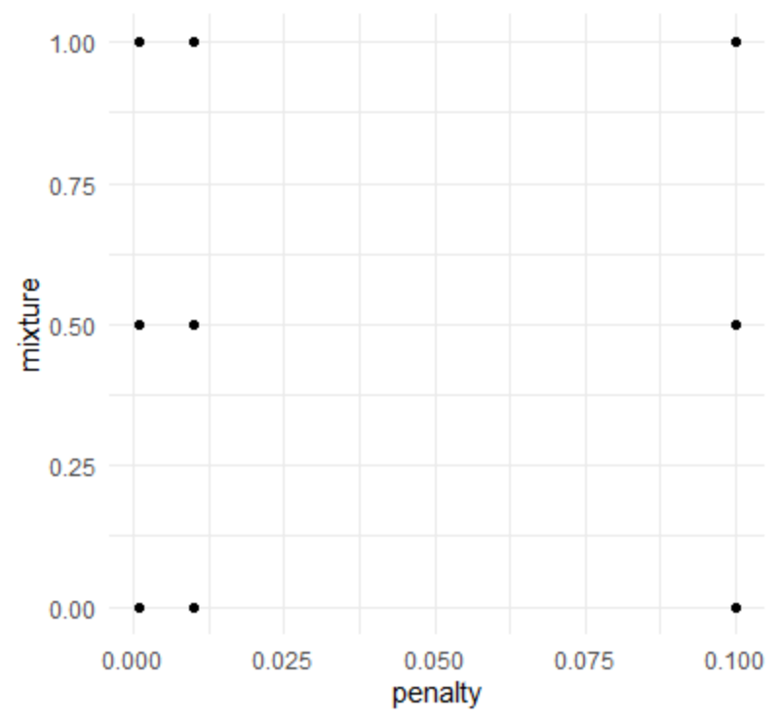
regular grid example
base::expand.grid(
penalty = c(.001, .01, .1),
mixture = c(0, .5, 1))
penalty mixture
1 0.001 0.0
2 0.010 0.0
3 0.100 0.0
4 0.001 0.5
5 0.010 0.5
6 0.100 0.5
7 0.001 1.0
8 0.010 1.0
9 0.100 1.0

Slide 47
grid_regular()
penalty() # from the {dials} package
Amount of Regularization (quantitative)
Transformer: log-10
Range (transformed scale): [-10, 0]
grid_regular(penalty())
# A tibble: 3 x 1
penalty
<dbl>
1 0.0000000001
2 0.00001
3 1
grid_regular(penalty(), levels = 10)
# A tibble: 10 x 1
penalty
<dbl>
1 0.0000000001
2 0.00000000129
3 0.0000000167
4 0.000000215
5 0.00000278
6 0.0000359
7 0.000464
8 0.00599
9 0.0774
10 1

Slide 48
tune_grid()
A version of fit_resamples() that performs a grid search for the best combination of tuned hyperparameters
tune_grid(
object,
preprocessor,
resamples,
...,
param_info = NULL,
grid = 10,
metrics = NULL,
control = control_grid()
)

Slide 49
tune_grid()
A version of fit_resamples() that performs a grid search for the best combination of tuned hyperparameters
tune_grid(
object,
preprocessor,
resamples,
...,
param_info = NULL,
grid = 10,
metrics = NULL,
control = control_grid()
)
a {parsnip} model or workflow()

Slide 50
tune_grid()
A version of fit_resamples() that performs a grid search for the best combination of tuned hyperparameters
tune_grid(
object,
preprocessor,
resamples,
...,
param_info = NULL,
grid = 10,
metrics = NULL,
control = control_grid()
)
A traditional model formula or a recipe()

Slide 51
tune_grid()
A version of fit_resamples() that performs a grid search for the best combination of tuned hyperparameters
tune_grid(
object,
preprocessor,
resamples,
...,
param_info = NULL,
grid = 10,
metrics = NULL,
control = control_grid()
)
Either:
a data frame of tuning combinations (have columns for each parameter being tuned and rows for tuning parameter candidates)
a positive integer (number of candidate parameter sets to be created automatically)

Slide 52
ridge_tune_mod <- linear_reg() %>%
set_engine("glmnet") %>%
set_args(penalty = tune(),
mixture = 0)
penreg_grid <- grid_regular(penalty(), levels = 10)
ridge_tune_mod_results <- tune::tune_grid(
ridge_tune_mod,
preprocessor = penreg_rec,
resamples = cv_splits,
grid = penreg_grid,
metrics = yardstick::metric_set(rmse),
control = tune::control_resamples(verbose = TRUE,
save_pred = TRUE)
)

Slide 53
ridge_tune_mod <- linear_reg() %>%
set_engine("glmnet") %>%
set_args(penalty = tune(),
mixture = 0)
penreg_grid <- grid_regular(penalty(), levels = 10)
ridge_tune_mod_results <- tune::tune_grid(
ridge_tune_mod,
preprocessor = penreg_rec,
resamples = cv_splits,
# grid = penreg_grid,
metrics = yardstick::metric_set(rmse),
control = tune::control_resamples(verbose = TRUE,
save_pred = TRUE)
)
equivalent to

Slide 54
Results: Tuned ridge regression
ridge_tune_mod_results %>%
collect_metrics()
# A tibble: 10 x 6
penalty .metric .estimator mean n std_err
<dbl> <chr> <chr> <dbl> <int> <dbl>
1 0.0000000001 rmse standard 102. 10 0.351
2 0.00000000129 rmse standard 102. 10 0.351
3 0.0000000167 rmse standard 102. 10 0.351
4 0.000000215 rmse standard 102. 10 0.351
5 0.00000278 rmse standard 102. 10 0.351
6 0.0000359 rmse standard 102. 10 0.351
7 0.000464 rmse standard 102. 10 0.351
8 0.00599 rmse standard 102. 10 0.351
9 0.0774 rmse standard 102. 10 0.351
10 1 rmse standard 102. 10 0.351

Slide 55
Let’s make a regular grid
(enet_params <- parameters(penalty(), mixture()))
Collection of 2 parameters for tuning
id parameter type object class
penalty penalty nparam[+]
mixture mixture nparam[+]
enet_grid <- grid_regular(enet_params, levels = c(10, 5))
# A tibble: 50 x 2
penalty mixture
<dbl> <dbl>
1 0.0000000001 0
2 0.00000000129 0
3 0.0000000167 0
4 0.000000215 0
5 0.00000278 0
6 0.0000359 0
7 0.000464 0
8 0.00599 0
9 0.0774 0
10 1 0
# ... with 40 more rows
This is 50 models per fold = 500 models!

Slide 56
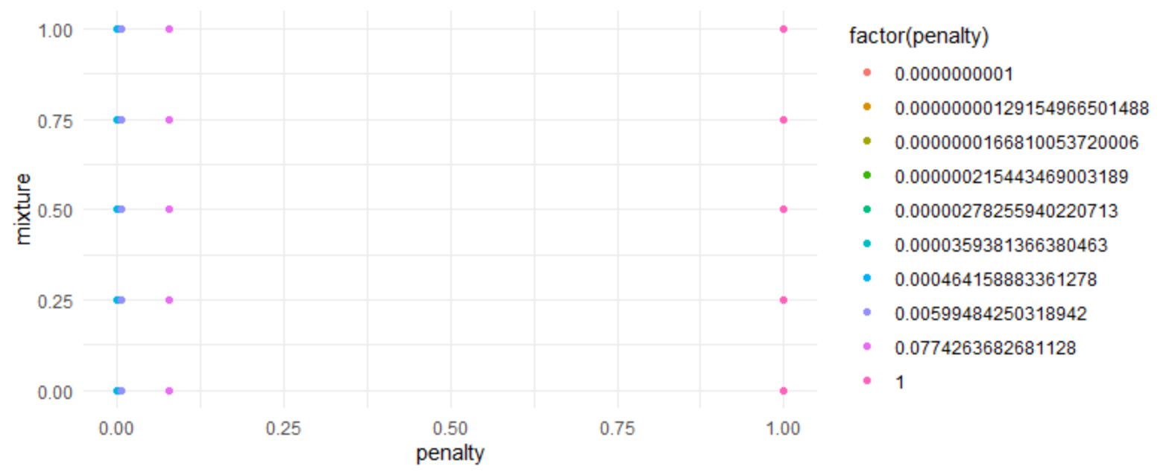
options(scipen = 999)
unique(enet_grid$penalty)
[1] 0.00000000010000 0.00000000129155 0.00000001668101 0.00000021544347
[5] 0.00000278255940 0.00003593813664 0.00046415888336 0.00599484250319
[9] 0.07742636826811 1.00000000000000
unique(enet_grid$mixture)
0.00 0.25 0.50 0.75 1.00
enet_grid %>%
ggplot(aes(penalty, mixture, color = factor(penalty))) +
geom_point()

Slide 57
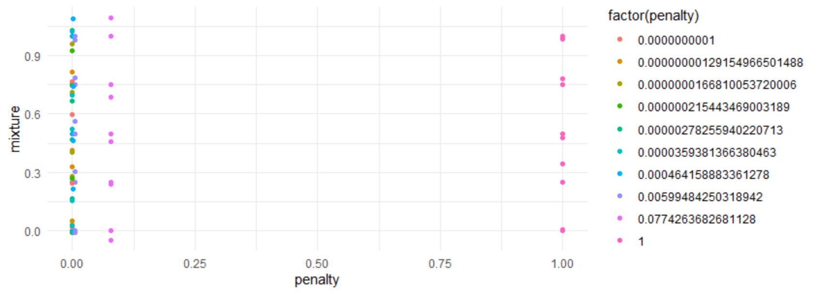
options(scipen = 999)
unique(enet_grid$penalty)
[1] 0.00000000010000 0.00000000129155 0.00000001668101 0.00000021544347
[5] 0.00000278255940 0.00003593813664 0.00046415888336 0.00599484250319
[9] 0.07742636826811 1.00000000000000
unique(enet_grid$mixture)
0.00 0.25 0.50 0.75 1.00
enet_grid %>%
ggplot(aes(penalty, mixture, color = factor(penalty))) +
geom_point() +
geom_jitter()

Slide 58
options(scipen = 999)
unique(enet_grid$penalty)
[1] 0.00000000010000 0.00000000129155 0.00000001668101 0.00000021544347
[5] 0.00000278255940 0.00003593813664 0.00046415888336 0.00599484250319
[9] 0.07742636826811 1.00000000000000
unique(enet_grid$mixture)
0.00 0.25 0.50 0.75 1.00
enet_grid %>%
ggplot(aes(penalty, mixture, color = factor(penalty))) +
geom_point()

Slide 59
Quick recap
enet_params <- parameters(penalty(), mixture())
enet_grid <- grid_regular(enet_params, levels = c(10, 5))
Make new tuned model
enet_tune_mod <- linear_reg() %>%
set_engine("glmnet") %>%
set_args(penalty = tune(),
mixture = tune())
Fit tuned model with tune_grid()
enet_tune_mod_results <- tune_grid(
enet_tune_mod,
preprocessor = penreg_rec,
resamples = cv_splits,
grid = enet_grid,
# metrics = yardstick::metric_set(rmse),
control = tune::control_resamples(verbose = TRUE,
save_pred = TRUE)
)

Slide 60
Results: Tuned elastic net regression
collect_metrics(enet_tune_mod_results)
# A tibble: 100 x 7
penalty mixture .metric .estimator mean n std_err
<dbl> <dbl> <chr> <chr> <dbl> <int> <dbl>
1 0.0000000001 0 rmse standard 102. 10 0.351
2 0.0000000001 0 rsq standard 0.229 10 0.00217
3 0.0000000001 0.25 rmse standard 101. 10 0.357
4 0.0000000001 0.25 rsq standard 0.230 10 0.00220
5 0.0000000001 0.5 rmse standard 101. 10 0.357
6 0.0000000001 0.5 rsq standard 0.230 10 0.00220
7 0.0000000001 0.75 rmse standard 101. 10 0.357
8 0.0000000001 0.75 rsq standard 0.230 10 0.00220
9 0.0000000001 1 rmse standard 101. 10 0.357
10 0.0000000001 1 rsq standard 0.230 10 0.00220
# ... with 90 more rows
50 models x 2 metrics (rmse, rsq) = 100

Slide 61
show_best()
enet_tune_mod_results %>%
show_best(metric = "rmse", n = 5)
# A tibble: 5 x 7
penalty mixture .metric .estimator mean n std_err
<dbl> <dbl> <chr> <chr> <dbl> <int> <dbl>
1 0.0000000001 0.25 rmse standard 101. 10 0.357
2 0.00000000129 0.25 rmse standard 101. 10 0.357
3 0.0000000167 0.25 rmse standard 101. 10 0.357
4 0.000000215 0.25 rmse standard 101. 10 0.357
5 0.00000278 0.25 rmse standard 101. 10 0.357

Slide 62
select_best()
tnr_enet_results %>%
select_best(metric = "rmse")
# A tibble: 1 x 2
penalty mixture
<dbl> <dbl>
1 0.0000000001 0.25

Slide 63
Final fit!
# Select best tuning parameters
enet_best <- enet_tune_mod_results %>%
select_best(metric = "rmse")
# Finalize your model using the best tuning parameters
enet_mod_final <- enet_tune_mod %>%
finalize_model(enet_best)
# Finalize your recipe using the best turning parameters
enet_rec_final <- penreg_rec %>%
finalize_recipe(enet_best)
# Run your last fit on your initial data split
enet_test_results <- last_fit(
enet_mod_final,
preprocessor = enet_rec_final,
split = math_split)
#Collect metrics
enet_test_results %>%
collect_metrics()
# A tibble: 2 x 3
.metric .estimator .estimate
<chr> <chr> <dbl>
1 rmse standard 101.
2 rsq standard 0.235
This will spend your test set…
SO DON’T DO THIS UNLESS YOU ARE CERTAIN
OF YOUR MODELLING PROCESS
ABSOLUTELY CERTAIN!
These are the prediction measures you can reasonably expect

Slide 64
Quick comparison
Resampled fit
show_best(enet_tune_mod_results, metric = "rmse", n = 1) %>%
bind_rows(show_best(enet_tune_mod_results, metric = "rsq", n = 1)) %>%
select(`.metric`, `.estimator`, mean)
# A tibble: 2 x 3
.metric .estimator mean
<chr> <chr> <dbl>
1 rmse standard 101.
2 rsq standard 0.230
Final fit
enet_test_results %>%
collect_metrics()
# A tibble: 2 x 3
.metric .estimator .estimate
<chr> <chr> <dbl>
1 rmse standard 101.
2 rsq standard 0.235

Slide 65

Name the package
initial_split()
set.seed(210)
math_split <- initial_split(math)

Slide 66
Name the package
training()
testing()
math_train <- training(math_split)
math_test <- testing(math_split)

Slide 67
Name the package
vfold_cv()
set.seed(210)
cv_splits <- vfold_cv(math_train)

Slide 68
Name the package
recipe()
step_*()
penreg_rec <-
recipe(
score ~ enrl_grd + econ_dsvntg + lat + lon,
data = math_train
) %>%
step_dummy(all_nominal()) %>%
step_normalize(lat, lon)

Slide 69
Name the package
linear_reg()
set_engine()
set_mode()
set_args()
mod_ridge <- linear_reg() %>%
set_engine("glmnet") %>%
set_mode("regression") %>%
set_args(penalty = .1,
mixture = 0)

Slide 70
Name the package
fit_resamples()
fit_resamples(
penreg_rec,
model = mod_ridge,
resamples = cv_splits,
metrics = yardstick::metric_set(rmse),
control = tune::control_resamples(verbose = TRUE,
save_pred = TRUE)
)

Slide 71
Name the package
tune_grid()

Slide 72
Next time

Slide 73
Bias
The difference between the (average) prediction of our model and the true value we are trying to predict
Note bias here refers to statistical bias
Gives us an idea how well a model fits the underlying structure of the data
A model with high bias systematically ignores relevant details in the data

Slide 74
Variance
The variability of a model prediction for a given data point
A measure of the variability predictions if we repeat the model multiple times with small differences in the data
The more the model fits to small differences in data, the higher the variance
High variance models are more prone to overfitting to the data
Highly flexible models run the risk of over overfitting to the (training) data
Results in very good performance measures, BUT
Poor generalizability to new (unseen) data

