Slide 1
Same Source, Three Orders of Magnitude
A 2026 reprise of Shortridge's compiler benchmark, co-authored with an LLM
Karl Glazebrook · Swinburne University of Technology
with analysis assistance from Claude Sonnet 4.7 (Anthropic) · ADASS 2026, Perth
1×
10×
10²×
10³×
10⁴×
10⁵×
Each dot is one of the 131 test variants (run22), on a log scale of time relative to hand-written arm64 assembler
Notes:
~30 s. Title. Each dot on this slide is one of the 131 benchmark variants, coloured by tier, on a log axis — the whole talk is about why they spread across five and a half decades.

Slide 2
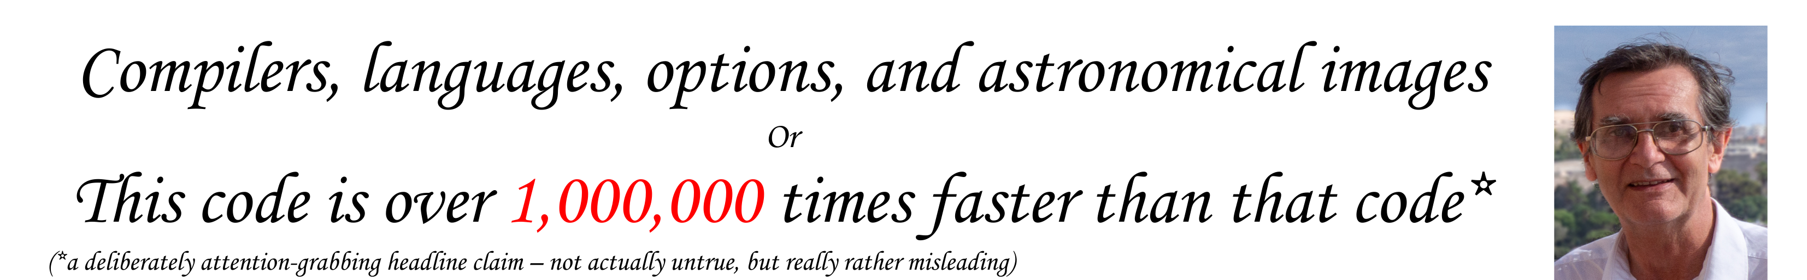
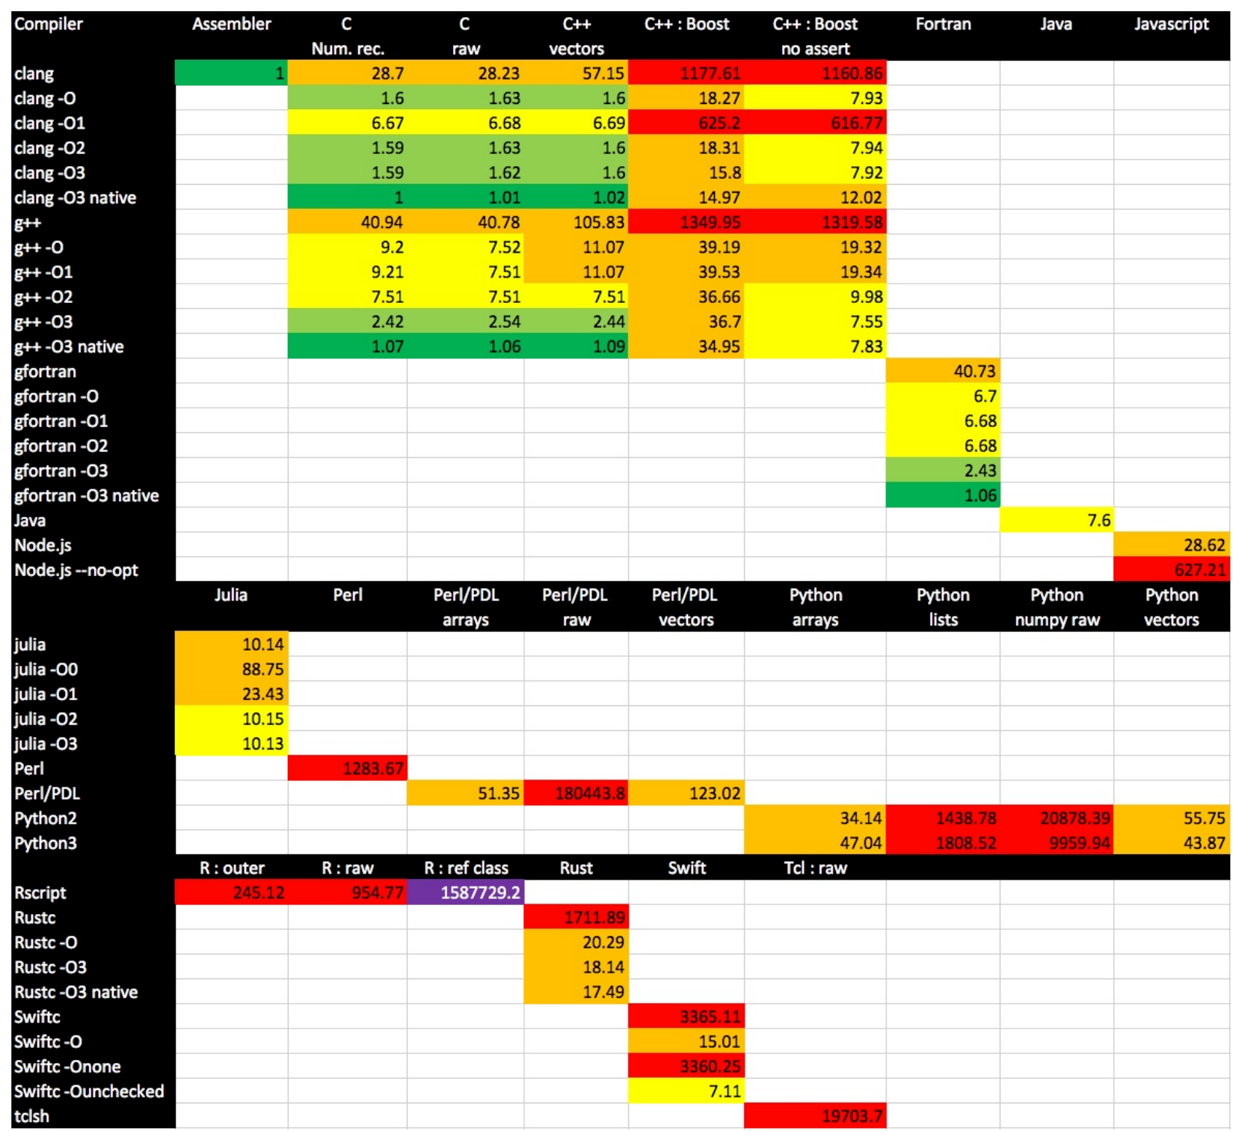
Where this started: Keith Shortridge, ADASS 2019
12 languages, one deliberately trivial kernel
Fastest to slowest: more than a million-fold
Compiler options alone: nearly 500× in one program
Conference feedback went straight back in: numba, a Julia tweak, Rust idioms
for (int iy = 0; iy < ny; iy++)
for (int ix = 0; ix < nx; ix++)
Out[iy][ix] = In[iy][ix] + ix + iy;
// 2000 × 10 floats: it times how a language reaches an element
Source: K. Shortridge, ADASS 2019, paper P9-17, poster and full write-up (Nov 2019) · github.com/KnaveAndVarlet/ADASS2019
Notes:
~45 s. Keith's poster and paper (P9-17). The million-fold headline, with his own asterisk: 'deliberately attention-grabbing'. One trivial kernel, so what you measure is how each language reaches an array element. Note how ADASS feedback improved his own study within weeks. Say thanks to Keith here, and again at the end.

Slide 3
Where I came in: 2019 → 2024
2019
2022
Jan 2024
PDL and numpy one-liners
I sent Keith the one-line “arrays” forms for PDL and numpy; he credits both in his write-up. He already doubted his PDL raw test.
Keith writes arm64 assembler
A hand-written NEON kernel for Apple Silicon (August 2022).
PDL::PP and compiler flags
No optimise 9.3 s, -O1 2.9 s, -O2/-O3 2.2 s on my M1. Keith sends the assembler kernel: the 1.00 reference for 2026.
# PDL “arrays”, 2019
$Out .= $In + sequence($Nx)
+ sequence($Ny)->dummy(0,1);
“The improvements you get over C are marginal and not worth the effort.”
Keith, on his assembler kernel (email, Jan 2024)
Declared bias: I wrote PDL (1996).
Notes:
~1 min. The personal thread. 2019: the one-line arrays tricks Keith credits me for. He already wrote that ->slice element access was 'emphatically not the way PDL should be used' (hold that for later). 2022: Keith's arm64 assembler. Jan 2024: our emails about PDL::PP optimisation flags; he sent me the assembler, which became the 1.00 reference.

Slide 4
Then Claude Code: seven days in April 2026
25 Apr
Cloned the 2019 suite: 58 of 104 tests pass. “The goal is maximum coverage.”
26–27 Apr
Assembler becomes 1.00. PDL::PP, Ruby (YJIT from source), Bun, Deno
28–29 Apr: “a bit mad”
Go, LuaJIT, C#, Crystal, OCaml, J, PyPy, Zig, SBCL, Haskell… INTERCAL: “PROGRAMMER IS OVERLY POLITE”
“Do #1 to #7 please and then we will stop :)”
29 Apr – 1 May
Report, audit rounds, PDL fix, run22 frozen, one-command toolchain rebuild
7
23
~1,060
29
days
benchmark runs
of my prompts
language families
Notes:
~1 min. Then Claude Code arrived and I used it to port the suite to a few more languages, for fun. Day one: 58 of 104 tests passing on this Mac. By day five, 29 families and 131 tests. My own message: 'Do #1 to #7 please and then we will stop'. We did not stop. Then the report, audits, the PDL fix and a reproducible toolchain. Prompt count is from the transcript to 30 April.

Slide 5
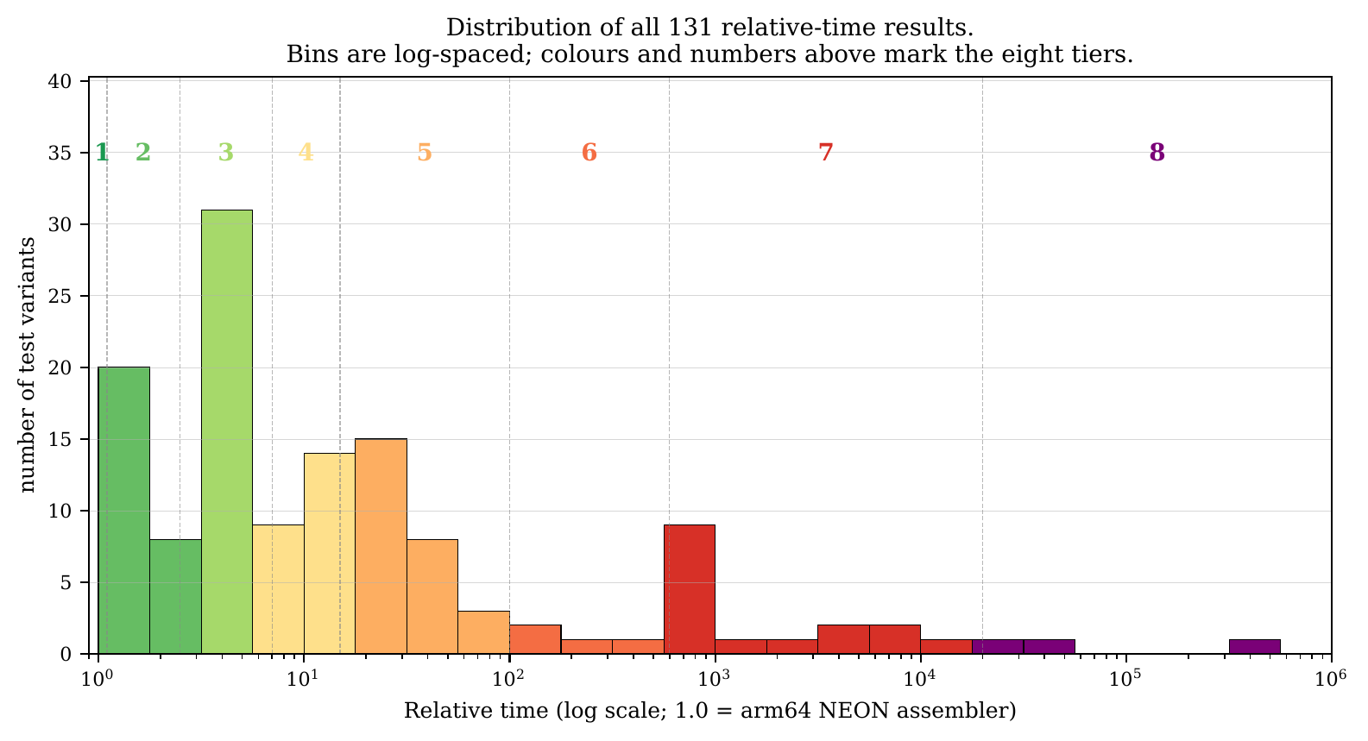
The 2026 suite at a glance
29
language families
16 new since 2019
131
variants
131 / 131 pass (run22)
4.8 × 10⁵
1.00 = Keith's hand-written arm64 NEON kernel. Tier 3 (2.5–7×) is the crowd: 41 of 131.
range
1.00 up to the R reference class at 481,009
Notes:
~45 s. 29 families, 131 variants, all passing in run22, the frozen reference. The range is 4.8e5 rather than Keith's million, partly from the new reference and partly the PDL correction. Most compiled languages pile up in tier 3.

Slide 6
Same Python source, three orders of magnitude
915×
from one decorator: numpy element loop 2,883 → numba 3.15
17.8×
from swapping the interpreter: CPython lists 644 → PyPy 36.2
Notes:
~1.5 min. THE headline slide. Same element-loop source throughout, except the grey bar, which is the vectorised rewrite for comparison. The default pattern for someone told 'use numpy' — looping over numpy elements — is the worst: 4.5x slower than plain lists. One @njit decorator: 915x. Swapping the interpreter for PyPy: 17.8x. The choice that matters most is the runtime, not the language.

Slide 7
Runtime and idiom matter more than language
Within one language: 2–3 orders of magnitude
Across compiled languages: under 10×
Octave
loop 46,705
→
vectorised 57.5
813×
PDL
raw 9,207
→
PDL::PP 5.47
1,683×
Python
numpy loop 2,883
→
numba 3.15
915×
Ruby
3.3 755
→
+ YJIT 284
2.7×
Notes:
~1 min. Left: inside one language, the runtime or idiom spans two to three orders of magnitude (Ruby's YJIT gain is the modest one). Right: across the compiled languages the whole spread is under 7x, on a linear axis. Pick your runtime and idiom carefully; the language matters less.

Slide 8
Runtimes new to the suite (not new technology)
In Keith's 2019 study
Old technology, first time here
Genuinely post-2019
Java (HotSpot JIT)
3.70
LuaJIT (2005)
7.59
Deno (2020)
24.4
Node.js (V8)
25.9
PyPy (2007)
36.2
Ruby YJIT (2021)
284
Julia
1.17
C# .NET JIT
5.31
Bun (2023)
12.3
numba
3.15
SBCL typed
10.6
.NET native AOT (2023)
5.39
J
8.24
LuaJIT at 7.59 beats safe Rust -O3 (12.0) and Swift -O (18.1). Bun is about 2× Node. Julia runs the same loop shape as Python's list loop at 1.17 against 644.
Notes:
~1.5 min. Why 'new'? New to this benchmark, not new technology. Java, V8, Julia and numba were all in Keith's 2019 study. LuaJIT and PyPy are old, just never measured here. Genuinely newer than 2019: Deno, Ruby YJIT, Bun, .NET native AOT. Don't claim V8's optimiser makes Node fast here: Node --no-opt is 26.5, almost the same. If asked: CPython 3.13's experimental JIT isn't tested; run22 used Python 3.12.7.

Slide 9
Three small surprises
1. PyPy + numpy
2. PDL raw, done properly
3. SBCL type declarations
22,015
103,570 → 9,207
167 → 10.6
609× slower than PyPy on plain lists, and 7.6× slower than CPython + numpy. Every numpy call crosses PyPy's C-extension layer. Use one or the other.
->at / ->set instead of ->slice: about 11× faster. Flagged by Keith in 2019, fixed in 2026. The LLM ran the old code and reported “PDL is just slow”.
15.7× from type declarations alone. Same lesson as numba: give the compiler the types.
Each is a choice of configuration or idiom, not of language.
Notes:
~1.5 min. 1: PyPy plus numpy is the slowest mainstream Python setup: pick one. 2 (keep it brief): the PDL raw test now uses PDL's element-access primitives. 103,570 was the 2019 code run on this machine (run19); 9,207 in run22. Keith himself flagged ->slice in 2019. The LLM didn't spot it. 3: SBCL, 15.7x from type declarations.

Slide 10




What the LLM did well
Porting at scale
16 new families in about four days, each kernel adapted to the language's idioms. J came out in 9 lines, with no hints from me.
Environment wrangling
PyPy's python3 symlink hijacked 7 numpy tests; conda's Octave shipped its own perl and python; GHC and Ruby baked install paths into 235 files.
The whole pipeline
Figures, the 131-row appendix and a 20-page report, all regenerated from one frozen log.
Reproducibility
One script rebuilds every toolchain in 7.5 minutes; a fresh re-run passed 131/131.
Notes:
~1.5 min. A partner, not a search bar. Weeks of porting done in days. The unglamorous bulk was the environment: tools hijacking each other's python, perl and gfortran. It also kept the report tied to one log, and made the whole toolchain reproducible.

Slide 11
What it didn't do, and the audit loop
Missed the PDL problem
Ran the 2019 code faithfully and accepted 103,570 as “PDL is just slow”.
Write or update
report and figures
Silent drift
Fixed the prose but not the table, or the reverse. The audits caught 14 errors in the first four rounds: Crystal 3.21 → 3.67, F# 6.85 → 7.21, an OCaml ratio of “18×” that was 13×.
Re-check
every number vs run22.log
Criticise
a second LLM audits
No sense of what's interesting
Asked what to add, it gave a long, flat list; choosing was my job. My verdict on one abstract draft: it “would appeal only to an LLM not a human”.
INTERCAL died of an arm64 bug in its own runtime: a toolchain failure, not the LLM's.
Notes:
~1.5 min. Honesty about limits. It did not catch the PDL problem: domain expertise did. Its worst habit is silent numerical drift, which is why we ran an audit loop with a second LLM as critic, about seven rounds. It generates; the author curates. INTERCAL is the joke, not evidence: C-INTERCAL's arm64 va_arg bug breaks even hello.i.

Slide 12
What to tell a working astronomer
1
2
3
Try @njit first
PyPy for pure Python only
Don't loop over numpy
Before rewriting a hot loop in C, add one numba decorator.
Never with numpy: it is the slowest mainstream setup here.
Element-by-element numpy is 4.5× slower than plain lists.
4
5
6
PDL: ->at, ->set, or PP
Apple Silicon is fine
Audit your LLM co-author
For speed, broadcast or use PDL::PP. Don't slice single elements.
No language here pays an arm64 penalty.
An audit loop, plus your own domain expertise.
Notes:
~1 min. The corridor version: if your inner loop is slow, try @numba.njit before Cython or C. PyPy only for pure Python. Don't iterate over numpy elements. In PDL, use ->at and ->set. Apple Silicon is settled. An LLM co-author works with an audit loop and domain expertise.

Slide 13
Thank you, Keith
and thank you all. Questions?
Original suite: github.com/KnaveAndVarlet/ADASS2019
2026 suite, report, logs and this talk: github.com/karlglazebrook/ADASS2026
Notes:
Thank Keith first and by name. The 2026 material is in the ADASS2026 folder of the fork.

Slide 14
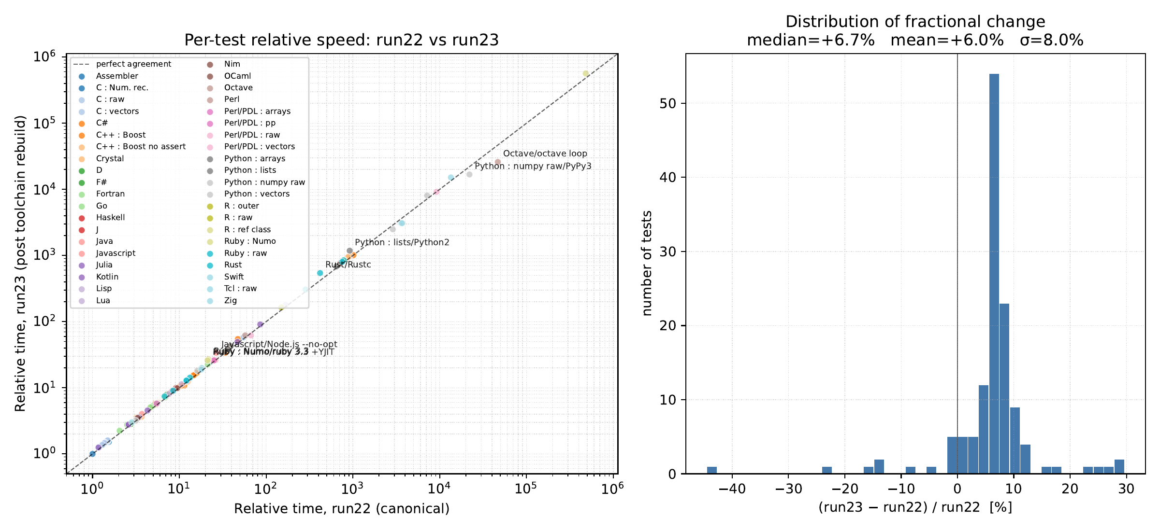
Backup: reproducibility, run22 vs run23
After a full toolchain rebuild all 131 tests passed again. The fast tiers agree within noise; slow entries moved (Octave loop −44%, Rust unoptimised +30%, Ruby Numo +22–25%).

Slide 15
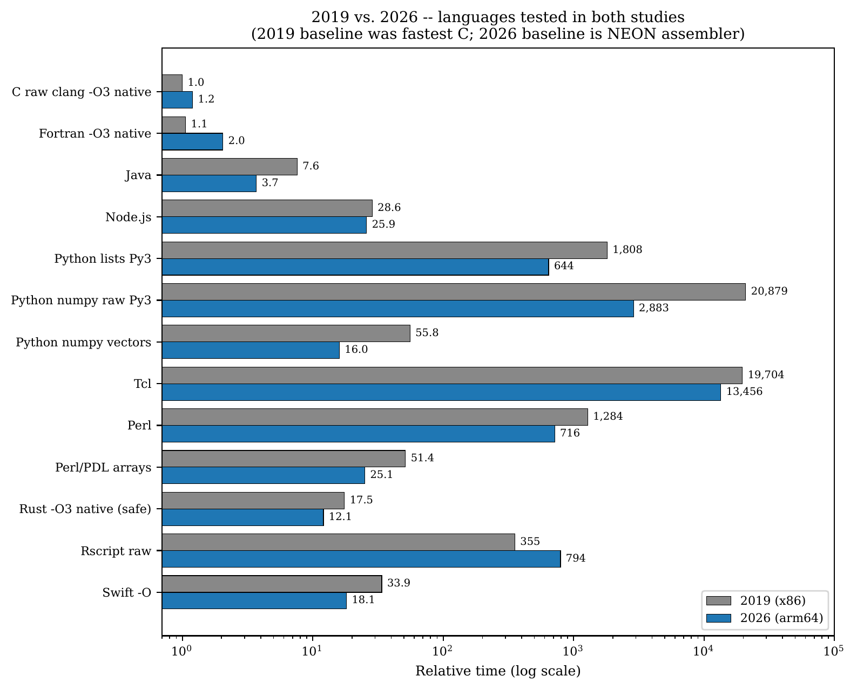
Backup: 2019 vs 2026, and caveats
Different hardware: x86 with AVX in 2019, arm64 with NEON now
The assembler reference drifts about 10% between runs, rescaling everything
Python 2.7 runs under Rosetta (x86_64 conda build)
All numbers from one frozen run: run22, 30 April 2026

Slide 16
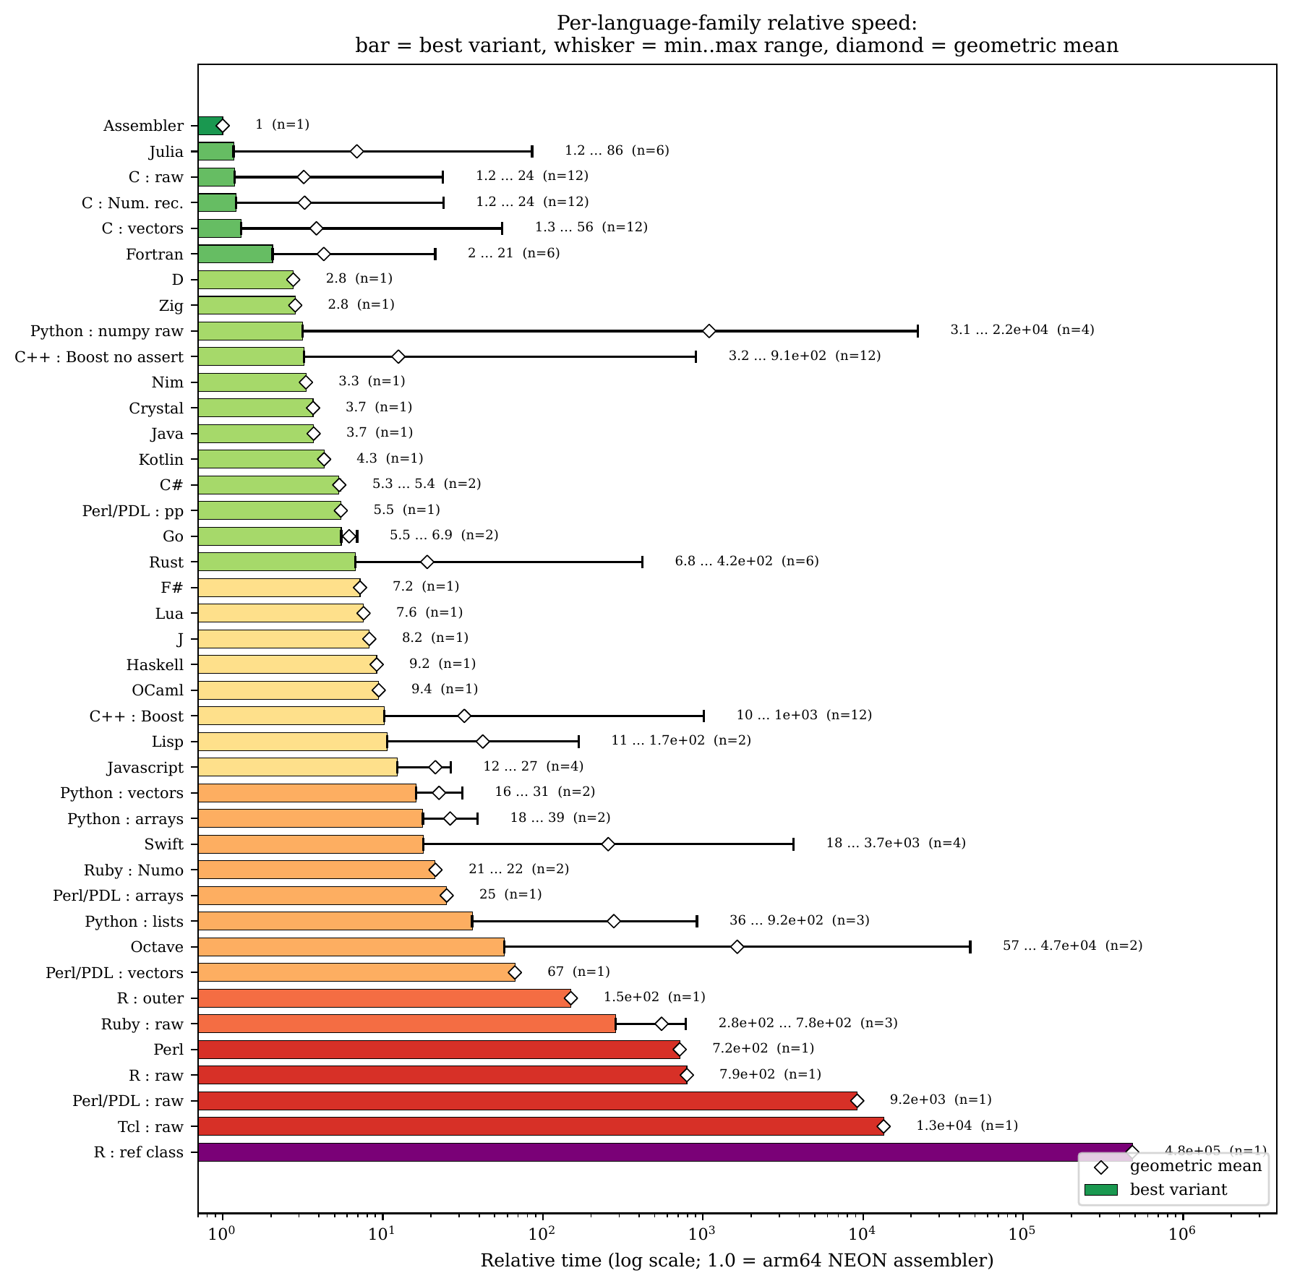
Backup: every family at a glance
Bar = best variant; whisker = range across that family's variants; diamond = geometric mean.

