Slide 1
Same Source, Three Orders of Magnitude
A 2026 reprise of Shortridge's compiler benchmark, co-authored with an LLM
Karl Glazebrook · Swinburne University of Technology
with analysis assistance from Claude Sonnet 4.7 (Anthropic) · ADASS 2026, Perth
1×
10×
10²×
10³×
10⁴×
10⁵×
Each dot is one of the 131 test variants (run22), on a log scale of time relative to hand-written arm64 assembler
Notes:
~30 s. Title. Each dot on this slide is one of the 131 benchmark variants, coloured by tier, on a log axis — the whole talk is about why they spread across five and a half decades.

Slide 2
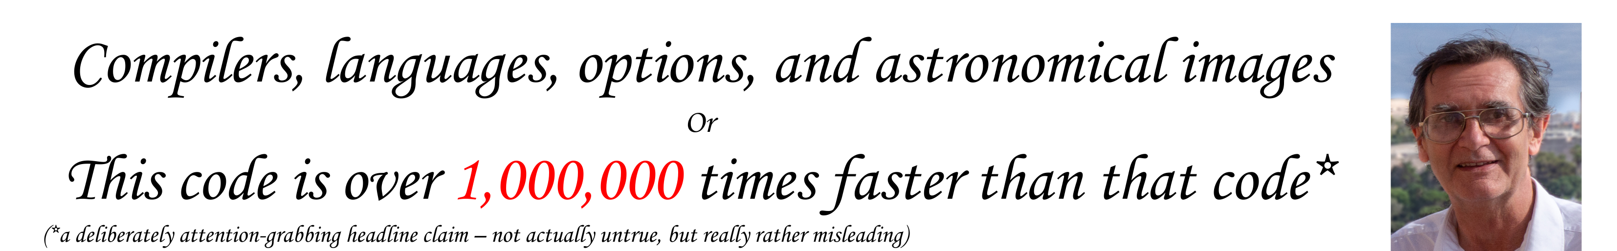
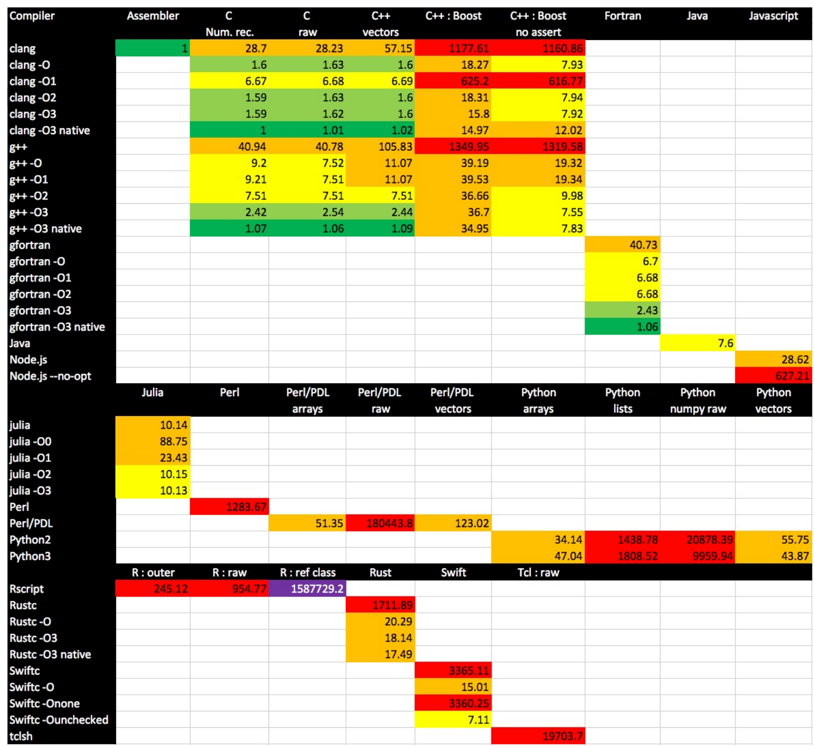
Where this started: Keith Shortridge, ADASS 2019
12 languages, one deliberately trivial kernel
Fastest to slowest: more than a million-fold
Compiler options alone: nearly 500× in one program
Conference feedback went straight back in: numba, a Julia tweak, Rust idioms
for (int iy = 0; iy < ny; iy++)
for (int ix = 0; ix < nx; ix++)
Out[iy][ix] = In[iy][ix] + ix + iy;
// 2000 × 10 floats
B(x, y) = A(x, y) + x + y
Source: K. Shortridge, ADASS 2019, paper P9-17, poster and full write-up (Nov 2019) · github.com/KnaveAndVarlet/ADASS2019
Notes:
~45 s. Keith's poster and paper (P9-17). The million-fold headline, with his own asterisk: 'deliberately attention-grabbing'. One trivial kernel, so what you measure is how each language reaches an array element. Note how ADASS feedback improved his own study within weeks. Say thanks to Keith here, and again at the end.

Slide 3
Where I came in: 2019 → 2024
2019
2022
Jan 2024
PDL and numpy one-liners
I sent Keith one-line whole-array forms for both PDL and numpy (below); he credits both in the code. He already doubted his PDL element-lookup test.
Keith writes arm64 assembler
A hand-written NEON kernel for Apple Silicon (August 2022).
PDL::PP and compiler flags
No optimise 9.3 s, -O1 2.9 s, -O2/-O3 2.2 s on my M1. Keith sends the assembler kernel: the 1.00 reference for 2026.
What is PDL?
The Perl Data Language: fast n-dimensional numeric arrays for Perl, with the loops in compiled C. Perl's answer to IDL and numpy.
Whole-array maths with broadcasting; PDL::PP for writing your own C kernels inline.
# PDL, csubpdlary.pl: 25.1×
$Output .= $Input
+ sequence($Nx)
+ sequence($Ny)->dummy(0,1);
# numpy, csubnpna.py: 17.8×
out[:] = ina
+ numpy.arange(nx)[NA,:]
+ numpy.arange(ny)[:,NA]
“The improvements you get over C are marginal and not worth the effort.”
Keith, on his assembler kernel (email, Jan 2024)
Declared bias: I wrote PDL (1996).
Notes:
~1 min. The personal thread. PDL in one breath: the Perl Data Language, n-dimensional arrays for Perl with the loops in C — what numpy is to Python, started in 1996. 2019: the one-line arrays tricks Keith credits me for. He already wrote that ->slice element access was 'emphatically not the way PDL should be used' (hold that for later). 2022: Keith's arm64 assembler. Jan 2024: our emails about PDL::PP optimisation flags; he sent me the assembler, which became the 1.00 reference.

Slide 4
Then Claude Code: seven days in April 2026
25 Apr
Cloned the 2019 suite: 58 of its 103 tests pass. “The goal is maximum coverage.”
26–27 Apr
All 103 of Keith's tests pass. Then extend: assembler becomes 1.00; PDL::PP, Ruby (YJIT from source), Bun, Deno
28–29 Apr: “a bit mad”
Go, LuaJIT, C#, Crystal, OCaml, J, PyPy, Zig, Common Lisp, Haskell… INTERCAL: “PROGRAMMER IS OVERLY POLITE”
Claude then offered a ranked list of what to add next. Me:
“Do #1 to #7 please and then we will stop :)”
#1–#7: F#, PyPy + numpy, C# ahead-of-time, D, Nim, Octave, Kotlin
29 Apr – 1 May
Report, audit rounds, PDL fix, run22 frozen, one-command toolchain rebuild
A test is one language with one compiler, runtime or option setting (e.g. C, clang -O3), built, run and timed by Keith's Run.py.
7
23
~1,060
27
days
benchmark runs
of my prompts
languages
Notes:
~1 min. Then Claude Code arrived and I used it to port the suite to a few more languages, for fun. Day one: 58 of Keith's 103 tests passing on this Mac; all 103 by the next day (run2), none ever dropped. Only the x86 assembler had to be swapped for Keith's arm64 one. Then we extended it: 28 new tests. By day five, 27 languages and 131 tests. My own message: 'Do #1 to #7 please and then we will stop'. We did not stop. Then the report, audits, the PDL fix and a reproducible toolchain. Prompt count is from the transcript to 30 April.

Slide 5
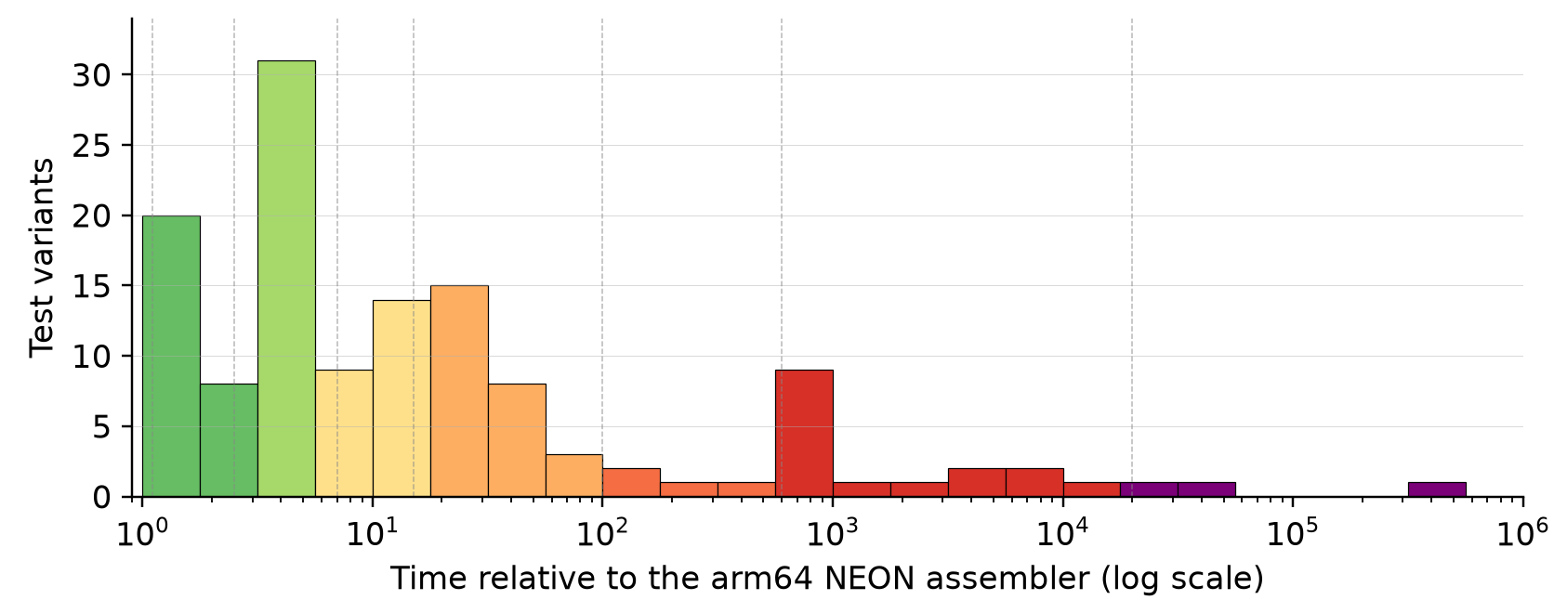
The 2026 suite at a glance
27
native
arrays
interpreted
languages
15 new since 2019
131
variants
131 / 131 pass (run22)
4.8 × 10⁵
Native code, 1–15×
Compiled to machine code ahead of time or by a good JIT: C, Fortran, Julia, D, Zig, Java, C#, Go, LuaJIT, Haskell. Also numba and PDL::PP, which compile the loop for Python and Perl.
Whole arrays, half measures, 15–100×
One whole-array expression in numpy, PDL, Numo or Octave; JavaScript engines; Swift -O; PyPy on lists; C or Fortran with no optimisation.
Interpreted element lookup, 100× up
An interpreter touching one element at a time: Python lists, Perl, Ruby, R, Tcl, numpy or PDL lookup. Purple tail: a library boundary crossed per element.
range
1.00 up to the R reference class at 481,009
Reference: 1.00 = Keith's hand-written arm64 NEON assembler. Best C: 1.19 (clang -O3 -march=native).
Notes:
~1 min. Reference first: 1.00 is Keith's hand-written NEON assembler; the best C is 1.19, so a good C compiler gets within 20% of hand-written assembler (the 1.19 test is labelled g++ in Run.py, but g++ on macOS is Apple clang; the clang-named run is 1.20). 27 languages, 15 of them new, counted the way Keith counted his 12 (C/C++ as one, Perl/PDL as one). 131 variants, all passing in run22, the frozen reference. The range is 4.8e5 rather than Keith's million, partly from the new reference and partly the PDL correction. Three peaks. CLICK: native code, 1 to 15x, where tier 3 (2.5 to 7x) is the crowd, 41 of 131. CLICK: whole-array expressions and half measures, 15 to 100x. CLICK: an interpreter doing element lookup, the spike near 600 to 1,000x, with a purple tail where every element crosses a library boundary.

Slide 6
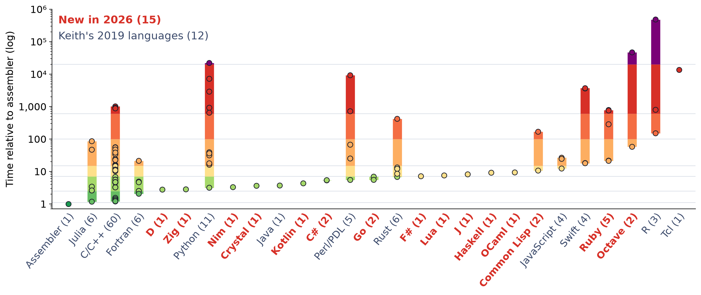
Every language, from its best variant to its worst
Red labels: the 15 languages new in 2026, mostly one variant each. The long bars are Keith's option sweeps (C/C++ alone has 60 variants) and changes of idiom: Python, PDL, Octave, R. Bars and dots are coloured by tier, green 1 to purple 8; (n) is the number of variants.
Notes:
~45 s. One column per language, counted the way Keith counted his 12, sorted by each language's best variant. Dots are variants; the bar spans best to worst. The new languages mostly have a single, optimised variant, so they sit as single dots in tiers 3 and 4: D and Zig right behind C and Fortran. The tall bars are where the story is: the same language spanning three to five decades depending on compiler flags, runtime or idiom. Figure from talk/make_language_ranges.py, reading run22.

Slide 7
One kernel, the 15 new languages, and Keith's C for reference
C (Keith's, reference) csub.cpp
1.20
D csubraw.d
2.76
Zig csubraw.zig
2.84
Nim csubraw.nim
3.31
for (int Iy = 0; Iy < Ny; Iy++) {
for (int Ix = 0; Ix < Nx; Ix++) {
Out[Iy * Nx + Ix] = In[Iy * Nx + Ix] + Ix + Iy;
}
}
foreach (iy; 0 .. ny) {
auto rowIn = inp[iy];
auto rowOut = outp[iy];
immutable fiy = cast(double) iy;
foreach (ix; 0 .. nx) {
rowOut[ix] = rowIn[ix] + cast(double) ix + fiy;
}
}
while (iy < ny) : (iy += 1) {
const row_in = in[iy];
const row_out = out[iy];
var ix: usize = 0;
while (ix < nx) : (ix += 1) {
row_out[ix] = row_in[ix] +
@as(f64, @floatFromInt(ix)) +
@as(f64, @floatFromInt(iy));
}
}
for iy in 0 ..< ny:
let fiy = float64(iy)
for ix in 0 ..< nx:
outp[iy][ix] = inp[iy][ix] + float64(ix) + fiy
Crystal csubraw.cr
3.67
Kotlin csubraw.kt
4.30
C# csubraw.cs
5.31
Go csubraw.go
6.91
ny.times do |iy|
row_in = ina[iy]
row_outp = outp[iy]
nx.times do |ix|
row_outp[ix] = row_in[ix] + ix.to_f64 + iy.to_f64
end
end
for (iy in 0 until ny) {
val rowIn = inp[iy]
val rowOut = outp[iy]
val fiy = iy.toDouble()
for (ix in 0 until nx) {
rowOut[ix] = rowIn[ix] + ix.toDouble() + fiy
}
}
for (int iy = 0; iy < ny; iy++) {
double[] rowIn = inp[iy];
double[] rowOut = outp[iy];
for (int ix = 0; ix < nx; ix++) {
rowOut[ix] = rowIn[ix] + ix + iy;
}
}
for iy := 0; iy < ny; iy++ {
rowIn := in[iy]
rowOut := out[iy]
for ix := 0; ix < nx; ix++ {
rowOut[ix] = rowIn[ix] + float64(ix) + float64(iy)
}
}
F# csubraw.fs
7.21
Lua (LuaJIT) csubraw.lua
7.59
J csubraw.ijs
8.24
Haskell csubraw.hs
9.16
for iy in 0 .. ny - 1 do
let rowIn = inp.[iy]
let rowOut = out.[iy]
let fiy = float iy
for ix in 0 .. nx - 1 do
rowOut.[ix] <- rowIn.[ix] + float ix + fiy
local function subr(ina, nx, ny, out)
for iy = 0, ny - 1 do
local row_in = ina[iy + 1]
local row_out = out[iy + 1]
for ix = 0, nx - 1 do
row_out[ix + 1] = row_in[ix + 1] + ix + iy
end
end
end
subr =: 3 : 0
shp =. $ y
y + (i. {. shp) +/ i. {: shp
)
forM_ [0 .. ny - 1] $ \iy -> do
let !fiy = fromIntegral iy
forM_ [0 .. nx - 1] $ \ix -> do
v <- unsafeRead ina (iy * nx + ix)
unsafeWrite out (iy * nx + ix) (v + fromIntegral ix + fiy)
OCaml csubraw.ml
9.44
Lisp (SBCL), typed csubraw-typed.lisp
10.63
Ruby + YJIT csubraw.rb
284
Octave, loop csubraw.m
46,705
for iy = 0 to ny - 1 do
let row_in = Array.unsafe_get in_arr iy in
let row_out = Array.unsafe_get out_arr iy in
let fiy = float_of_int iy in
for ix = 0 to nx - 1 do
Array.unsafe_set row_out ix
(Array.unsafe_get row_in ix +. float_of_int ix +. fiy)
done
done
(dotimes (iy ny)
(declare (type fixnum iy))
(let ((fiy (coerce iy 'double-float)))
(declare (type double-float fiy))
(dotimes (ix nx)
(declare (type fixnum ix))
(setf (aref out-arr iy ix)
(+ (aref in-arr iy ix)
(coerce ix 'double-float)
fiy)))))
def subr(ina, nx, ny, out)
ny.times do |iy|
row_in = ina[iy]
row_out = out[iy]
nx.times do |ix|
row_out[ix] = row_in[ix] + ix + iy
end
end
end
for r = 1:nrpt
for iy = 0:ny-1
for ix = 0:nx-1
out(iy+1, ix+1) = ina(iy+1, ix+1) + ix + iy;
end
end
end
Notes:
~30 s, let it land. Each of the 15 languages new in 2026, plus Keith's own C kernel as the reference, pulled verbatim from its source file in the repo (file names on the cards) and highlighted; the chip is its run22 time relative to the assembler. The same element-lookup kernel throughout, except J, which says it as one whole-array expression. Ordered fastest first: D and Zig sit just behind C; Octave's loop is at the far end, 46,705. Most of the 2026 ports are 64-bit doubles against Keith's 32-bit floats (the precision caveat later). Keith's 12 languages are on a backup slide.

Slide 8
Same Python source, three orders of magnitude
915×
from one decorator: numpy element loop 2,883 → numba 3.15
17.8×
@numba.jit
def subr(ina,nx,ny,out):
for iy in range(ny):
for ix in range(nx):
out[iy,ix] = ina[iy,ix] + ix + iy
The whole change:
one line, “@numba.jit”
csubnp-numba.py, lines 113–117
from swapping the interpreter: CPython lists 644 → PyPy 36.2
Notes:
~1.5 min. THE headline slide. Same element-loop source throughout, except the grey bar, which is the vectorised rewrite for comparison. The default pattern for someone told 'use numpy' — looping over numpy elements — is the worst: 4.5x slower than plain lists. One @numba.jit decorator, the red line on the slide, from Keith's own csubnp-numba.py: 915x. Swapping the interpreter for PyPy: 17.8x. The choice that matters most is the runtime, not the language.

Slide 9
Runtime and idiom matter more than language
Within one language: 2–3 orders of magnitude
Across compiled languages: under 10×
Octave
loop 46,705
→
vectorised 57.5
813×
PDL
lookup 9,207
→
PDL::PP 5.47
1,683×
Python
numpy loop 2,883
→
numba 3.15
915×
Ruby
3.3 755
→
+ YJIT 284
2.7×
Caveat: the C, Fortran, Julia and Java kernels use 32-bit floats; the D, Zig, Nim, Crystal and Go ports use 64-bit, which halves the values per NEON instruction.
Notes:
~1 min. Precision caveat, say it briefly: Keith's compiled kernels and the assembler are single precision; the 2026 ports of D, Zig, Nim, Crystal and Go (and C#, F#, Kotlin, OCaml, Haskell, Lisp) are double. NEON holds 4 floats or 2 doubles per register, so part of the spread here may be precision, not language. To fix after the conference. Also: Octave vectorised builds its index vectors once, outside the timed loop; numpy and PDL arrays rebuild them per call. Left: inside one language, the runtime or idiom spans two to three orders of magnitude (Ruby's YJIT gain is the modest one). Right: across the compiled languages the whole spread is under 7x, on a linear axis. Pick your runtime and idiom carefully; the language matters less.

Slide 10
Runtimes new to the suite (not new technology)
In Keith's 2019 study
Old technology, first time here
Genuinely post-2019
Java (HotSpot JIT)
3.70
LuaJIT (2005)
7.59
Deno (2020)
24.4
Node.js (V8)
25.9
PyPy (2007)
36.2
Ruby YJIT (2021)
284
Julia
1.17
C# .NET JIT
5.31
Bun (2023)
12.3
numba
3.15
Lisp (SBCL), typed
10.6
.NET native AOT (2023)
5.39
J
8.24
LuaJIT at 7.59 beats safe Rust -O3 (12.0) and Swift -O (18.1). Bun is about 2× Node. Julia runs the same loop shape as Python's list loop at 1.17 against 644.
Notes:
~1.5 min. Why 'new'? New to this benchmark, not new technology. Java, V8, Julia and numba were all in Keith's 2019 study. LuaJIT and PyPy are old, just never measured here. Genuinely newer than 2019: Deno, Ruby YJIT, Bun, .NET native AOT. Don't claim V8's optimiser makes Node fast here: Node --no-opt is 26.5, almost the same. If asked: CPython 3.13's experimental JIT isn't tested; run22 used Python 3.12.7.

Slide 11

Three small surprises
1. PyPy + numpy
2. PDL element lookup
3. Lisp type declarations
22,015
103,570 → 9,207
167 → 10.6
FAST + FAST ≠ FASTER
->at / ->set instead of ->slice: about 11× faster. Flagged by Keith in 2019, fixed in 2026. The LLM ran the old code and reported “PDL is just slow”.
Common Lisp, compiled by SBCL (Steel Bank Common Lisp): 15.7× from type declarations alone. Same lesson as numba: give the compiler the types.
609× SLOWER THAN PYPY ALONE
Also 7.6× slower than CPython + numpy. Use one or the other.
Photo: Gare Montparnasse, 1895 (public domain)
Each is a choice of configuration or idiom, not of language.
“Element lookup” is what Keith's harness calls “raw”: read and write the array one element at a time, A[iy][ix].
Notes:
~1.5 min. 1: PyPy plus numpy is the slowest mainstream Python setup: 609x slower than PyPy on plain lists and 7.6x slower than CPython + numpy. Pick one. 2 (keep it brief): the PDL element-lookup test (Keith's 'raw') now uses PDL's element-access primitives. 103,570 was the 2019 code run on this machine (run19); 9,207 in run22. Keith himself flagged ->slice in 2019. The LLM didn't spot it. 3: Common Lisp with the SBCL compiler (Steel Bank Common Lisp, the main open-source native-code Lisp), 15.7x from type declarations.

Slide 12





What the LLM did well
Porting at scale
15 new languages in about four days, each kernel adapted to the language's idioms. J came out in 9 lines, with no hints from me.
Environment wrangling
PyPy's python3 symlink hijacked 7 numpy tests; conda's Octave shipped its own perl and python; GHC and Ruby baked install paths into 235 files.
The whole pipeline
Figures and the 131-row appendix, all regenerated from one frozen log.
Decent first drafts
Of the 21-page report, and of this deck. Not of the abstract: I rewrote that one, as it “would appeal only to an LLM not a human”.
Reproducibility
One script rebuilds every toolchain in 7.5 minutes; a fresh re-run passed 131/131.
Notes:
~1.5 min. A partner, not a search bar. Weeks of porting done in days. The unglamorous bulk was the environment: tools hijacking each other's python, perl and gfortran. It also kept the report tied to one log, and made the whole toolchain reproducible. Its first drafts of the report and of these slides were decent; its abstract was not, and I rewrote it.

Slide 13
What it didn't do, and the audit loop
Missed the PDL problem
Ran the 2019 code faithfully and accepted 103,570 as “PDL is just slow”. I caught it.
Write or update
report and figures
Silent drift
Fixed the prose but not the table, or the reverse. ChatGPT's audits caught it (examples in the backup slides).
No sense of what's interesting
Asked what to add, it gave a long, flat list; choosing was my job.
Re-check
every number vs run22.log
Criticise
ChatGPT audits
I didn't write the ports
Unlike Keith, I trusted the LLM's code. His write-up shows how much layout and idiom matter, and I can't vouch that each port is what an expert would write.
Future work: expert and multi-LLM review of the kernels themselves, not just the numbers.
Notes:
~1.5 min. Honesty about limits. It did not catch the PDL problem: domain expertise did. Its worst habit is silent numerical drift, which is why we ran an audit loop with ChatGPT as critic, about seven rounds (the exact ChatGPT model wasn't recorded). The big caveat: unlike Keith, I did not write the ported code; I trusted it. Keith's 53-page write-up is full of obscure gotchas and alternative ways to structure the same loop in one language, the kind of thing an expert in that language would spot. How expert is the LLM in Zig or OCaml or J? I don't know. One example we know about: the 2026 ports use 64-bit doubles where Keith's kernels use 32-bit floats. Future work: have experts, and other LLMs, review the kernels themselves. If asked about INTERCAL: it compiled, but C-INTERCAL's runtime has an arm64 va_arg bug that breaks even hello.i.

Slide 14
What to tell a working astronomer
1
2
3
Try numba first
PyPy for pure Python only
Don't loop over numpy
Before rewriting a hot loop in C, add one decorator: @numba.jit.
Never with numpy: it is the slowest mainstream setup here.
Element-by-element numpy is 4.5× slower than plain lists.
4
5
6
PDL: ->at, ->set, or PP
Apple Silicon is fine
Audit your LLM co-author
For speed, broadcast or use PDL::PP. Don't slice single elements.
Every toolchain ran natively on arm64, except Python 2.7, which runs translated by Rosetta 2.
An audit loop for the numbers; domain experts for the code.
Notes:
~1 min. The corridor version: if your inner loop is slow, try @numba.jit before Cython or C. PyPy only for pure Python. Don't iterate over numpy elements. In PDL, use ->at and ->set. Apple Silicon is settled. An 'arm64 penalty' would be a toolchain with no native arm64 build, running translated by Rosetta 2, or a compiler that generates weaker code for arm64 than for x86. Here only Python 2.7 (an x86_64 conda build) runs under Rosetta; INTERCAL's runtime failed outright on an arm64 calling-convention bug. An LLM co-author works with an audit loop and domain expertise.

Slide 15
Thank you, Keith
and thank you all. Questions?
Original suite: github.com/KnaveAndVarlet/ADASS2019
2026 suite, report, logs and this talk: github.com/karlglazebrook/ADASS2026
Notes:
Thank Keith first and by name. The 2026 material is in the ADASS2026 folder of the fork.

Slide 16
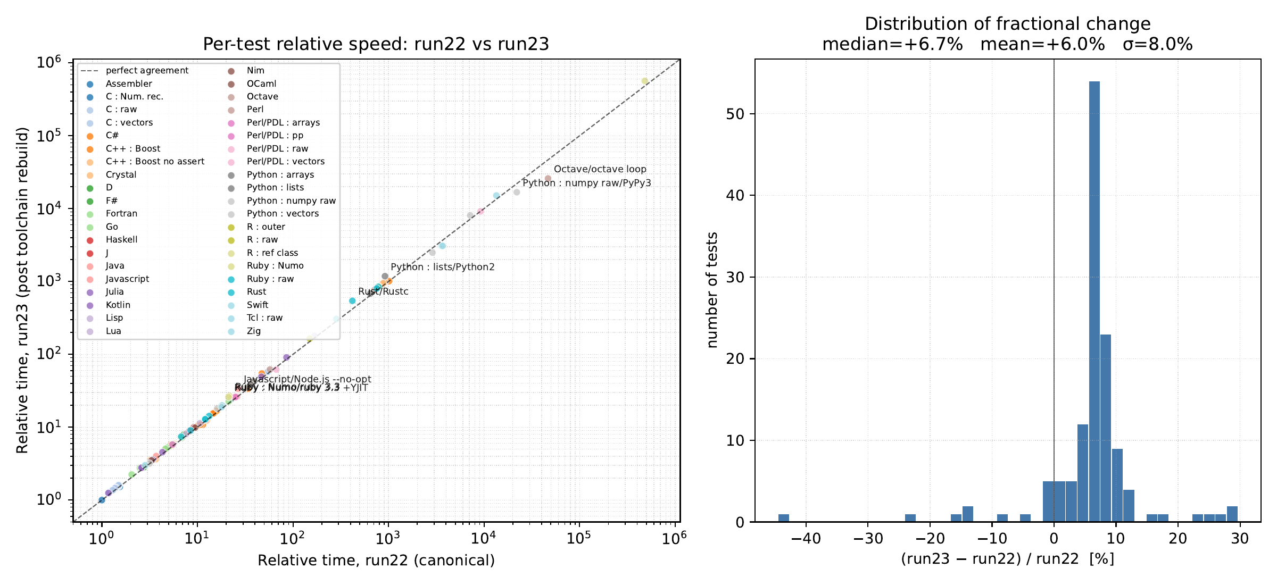
Backup: reproducibility, run22 vs run23
After a full toolchain rebuild all 131 tests passed again. The fast tiers agree within noise; slow entries moved (Octave loop −44%, Rust unoptimised +30%, Ruby Numo +22–25%).

Slide 17
Backup: Keith's 2019 times against 2026, test by test
89 of 101 tests sit below the line: relatively faster in 2026 than in 2019.
Both studies rescaled to the same test, C element lookup with clang -O3 native, because the 2019 reference was x86 AVX and the 2026 one is arm64 NEON.
PDL element lookup (red) changed code, so it is not a like-for-like point.
2019 values: Keith's own Run.py summary in his Nov 2019 write-up (report/shortridge2019_summary.txt).
Notes:
Each point is one test that exists in both studies, matched by its Run.py name. Caveats if asked: different hardware (x86 AVX in 2019, arm64 NEON now); the reference drifts about 10% between runs; Python 2.7 runs under Rosetta 2 here.

Slide 18
Backup: what the ChatGPT red team caught
Stale numbers
About 25 numbers in the prose came from older runs after the reference moved: Crystal 3.21 → 3.67, numba 2.91 → 3.15. F# 6.85 → 7.21 even crossed into tier 4.
Mis-tiering
D, Zig, Crystal, Nim, Rust and OCaml listed in tier 2: none are. “Tier 6 is the most populous”: it had 5 entries against tier 3's 38.
Wrong ratios
“PyPy is 650× slower than CPython”: it is about 8×. The 650× was PyPy + numpy against PyPy lists. An OCaml “18×” was 13×.
Overclaims
A “million-fold spread” in 2026 that is under half a million (4.8 × 10⁵).
Wrong comparisons
“J beats every array library”: PDL::PP was faster. “Octave has the biggest gap within one language”: PDL's was bigger.
Counting
“Eleven new languages” that were sixteen. (Fifteen, counted strictly as Keith did: that one we only noticed this week.)
About 7 rounds, 14 errors in the first four: claims that didn't match the log. Nobody reviewed the code.
Notes:
I pasted each draft of the report into ChatGPT (model not recorded) and asked it to attack it; Claude then fixed and re-checked every number against run22.log. Typical catches: numbers left over from older runs after the reference moved by ~10%, tier assignments that contradicted the tier table, ratios computed against the wrong baseline, and rhetorical overclaims. Some of these claims are from earlier runs and drafts; the numbers on this slide are what the audits flagged at the time. The pattern: the LLM is fluent and confident, and checking against the raw log is not optional. And the audits only checked claims against the log; nobody checked the kernels.

Slide 19
Backup: Keith's 12 languages from 2019
Assembler (arm64 NEON) cnrsub_arm.s
1.00
C (Numerical Recipes) cnrsub.cpp
1.22
Fortran cfsub.f
2.05
IxLoop:
ldp q17,q18,[x14],#64
ldp q19,q20,[x15],#64
fadd.4s v17,v17,v7
⋮
stp q17,q18,[x16],#64
stp q19,q20,[x17],#64
subs x13,x13,#1
b.ne IxLoop
void subr (float* In[], int Nx, int Ny, float* Out[])
{
⋮
for (int Iy = 0; Iy < Ny; Iy++) {
for (int Ix = 0; Ix < Nx; Ix++) {
Out[Iy][Ix] = In[Iy][Ix] + Ix + Iy;
}
}
}
subroutine sub (In,Nx,Ny,Out)
⋮
do Iy = 1,Ny
do Ix = 1,Nx
Out(Ix,Iy) = In(Ix,Iy) + Ix + Iy
end do
end do
end
Python + numba csubnp-numba.py
3.15
Julia csub.jl
3.40
Java csub.java
3.70
@numba.jit
def subr(ina,nx,ny,out):
for iy in range(ny):
for ix in range(nx):
out[iy,ix] = ina[iy,ix] + ix + iy
function subr!(in,nx,ny,out)
for iy = 1:ny
for ix = 1:nx
out[ix,iy] = in[ix,iy] + ix + iy
end
end
return
end
public static void subr(float in[][],int nx,int ny,float out[][]) {
int ix,iy;
for (iy = 0; iy < ny; iy++) {
for (ix = 0; ix < nx; ix++) {
out[iy][ix] = in[iy][ix] + iy + ix;
}
}
}
Rust crssub.rs
12.04
Swift cstest.swift
18.14
JavaScript (Node.js) cjstest.js
25.88
for iy in 0..ny {
for ix in 0..nx {
output_array[iy][ix] = input_array[iy][ix] + (ix + iy) as f32;
}
}
func Subr (Input: Array<Array<Float>>, Nx: Int, Ny : Int,
Output: inout Array<Array<Float>>) {
for Iy in 0...Ny-1 {
for Ix in 0...Nx-1 {
Output[Iy][Ix] = Input[Iy][Ix] + Float(Ix + Iy)
}
}
}
function subr(inp,nx,ny,out) {
for (var iy = 0; iy < ny; iy++) {
for (var ix = 0; ix < nx; ix++) {
out[iy][ix] = inp[iy][ix] + ix + iy;
}
}
}
R (outer) csubouter.r
150
PDL element lookup (->at, ->set) csubpdl.pl
9,207
Tcl ctest.tcl
13,456
csub <- function(ina,nx,ny) {
return (ina + outer(1:nx,1:ny,'+'))
}
sub csub {
my ($Input,$Nx,$Ny,$Output) = @_;
for (my $iy=0; $iy < $Ny; $iy++) {
for (my $ix=0; $ix < $Nx; $ix++) {
$Output->set($ix, $iy, $Input->at($ix, $iy) + $ix + $iy);
}
}
}
proc subr { inary nx ny outary } {
⋮
for {set iy 0} {$iy < $ny} {incr iy} {
for {set ix 0} {$ix < $nx} {incr ix} {
set inelem $in($iy,$ix)
set out($iy,$ix) [expr $inelem + $ix + $iy]
}
}
}
Notes:
One kernel from each of Keith's 12 languages (C/C++ and Perl/PDL as one each), pulled verbatim from the 2019 sources and timed in run22. The PDL element-lookup card is the corrected ->at/->set form. R uses outer(), one whole-array expression.

Slide 20
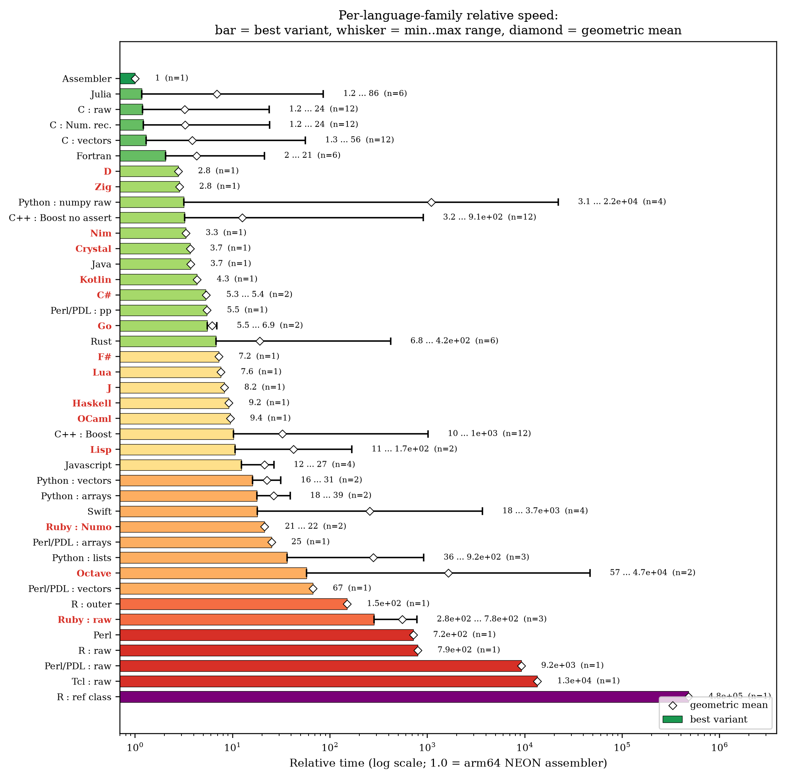
Backup: every family at a glance
Bar = best variant; whisker = range across that family's variants; diamond = geometric mean. Red labels: languages new in 2026.

