Slide 1
UX Design Project
Handwritten Character Recognition
AI Workshop
竭卓妮 工41 2014010882

Slide 2
PART/01
Data Description

Slide 3
PART/01 Background
Character recognition is a classic pattern recognition problem for which researchers have worked since the early days of computer vision.
With today's omnipresence of cameras and scanners, the applications of automatic character recognition are broader than ever. For Latin script, this is largely considered a solved problem in constrained situations, such as images of scanned documents containing common character fonts and uniform background. However, hand-written character recognition remains a problem, probably because of the hand-written data’s complex and diverse attributes and the need of large samples.

Slide 4
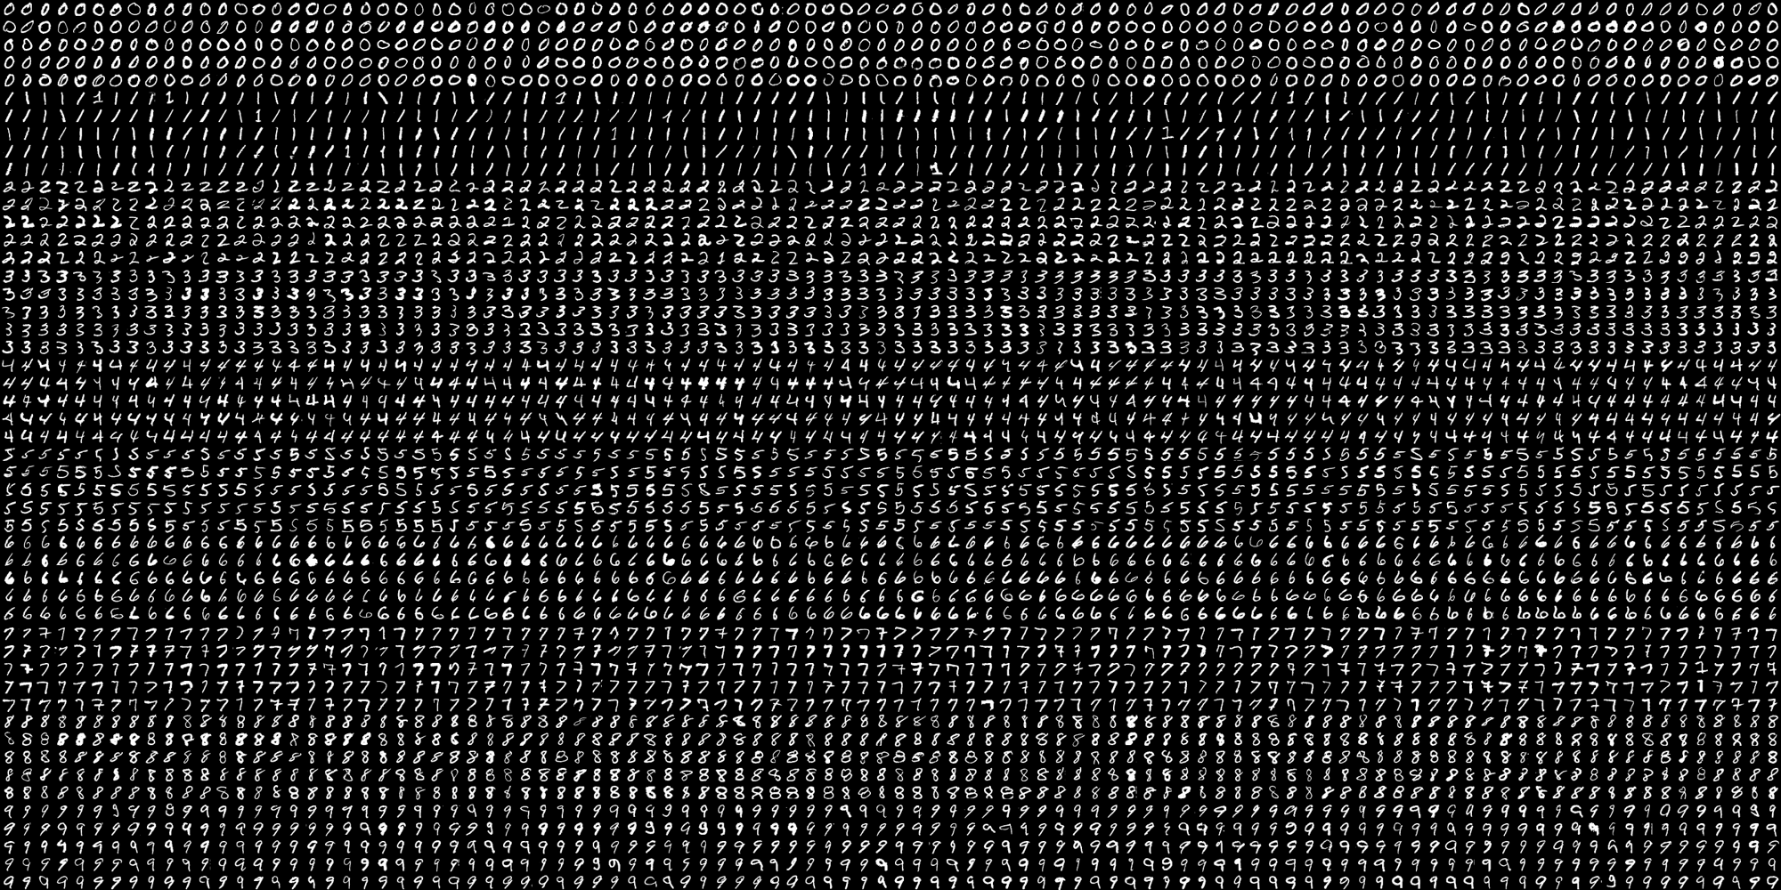
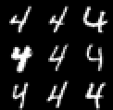
PART/01 Dataset (1)
Handwritten digits: 0-9, each 500 samples, each digit is a 20*20 image, stored in .png file
Obtained from OpenCV sample data.

Slide 5
PART/01 Dataset (2)
Hand-written Letters
Attribute Information
1. lettr capital letter (26 values from A to Z) 2. x-box horizontal position of box (integer) 3. y-box vertical position of box (integer) 4. width width of box (integer) 5. high height of box (integer) 6. onpix total # on pixels (integer) 7. x-bar mean x of on pixels in box (integer) 8. y-bar mean y of on pixels in box (integer) 9. x2bar mean x variance (integer) 10. y2bar mean y variance (integer) 11. xybar mean x y correlation (integer) 12. x2ybr mean of x * x * y (integer) 13. xy2br mean of x * y * y (integer) 14. x-ege mean edge count left to right (integer) 15. xegvy correlation of x-ege with y (integer) 16. y-ege mean edge count bottom to top (integer) 17. yegvx correlation of y-ege with x (integer)
Obtained from UCI Machine Learning Repository

Slide 6
PART/02
Methods Introduction

Slide 7
PART/02 Pipeline
Extracting Relevant Features
We break down the entire image into sub blocks of equal size, and reform the structure of the image feature vector.
Image Pre-processing
The aim of this step is to obtain clear character images devoid of any noise of a fixed dimension
k-Nearest Neighbor
In pattern recognition, the k-nearest neighbors algorithm (k-NN) is a non-parametric method used for classification and regression.
Cross Validation
Assess how the results of the recognition model will generalize to an independent data set

Slide 8
PART/02 Methods
Pre-processing and feature extraction
Download libraries and build OpenCV environment.
For dataset 1, split this image into 5000 different digits. For each digit, we convert it to grayscale and flatten it into a single row with 400 pixels, and get their features.
For dataset 2, read the labels and construct feature vectors.
Train kNN models
The idea is to search for closest match of the test data in feature space.
Currently kNN method performs pretty good in hand-written data recognition
Cross-validation
Use 10-Fold cross-validation and get the accuracy scores.
Accuracy is the most intuitive performance measure and it is simply a ratio of correctly predicted observation to the total observations.

Slide 9
PART/03
Accuracy & Reflections

Slide 10
PART/03 Accuracy reports
Digit Recognition
One digit: first 250 train, second 250 test
91.8%
Digit Recognition
Use 10-fold cross-validation Get average
89.1%
Letter Recognition
take first 10000 data as training samples
and remaining 10000 as test samples
93.2%

Slide 11
PART/02 Reflections
One option improve accuracy is to add more data for training.
Instead of loading training data everytime, we had better save it. We can do this with the help of some Numpy functions like np.savetxt, np.savez, np.load etc.
We can try more feature descriptors such as Histogram of Oriented Gradients (HoG). This algorithm tackles the problem of effectively describing an image in terms of certain extracted features. HoG assumes that there is a constant number of cardinal directions in which a line can lie, within a sub-image block. Ref: https://gilscvblog.com/2013/08/18/a-short-introduction-to-descriptors/
Instead of just using kNN, which is the most common method, we can try training a Neural Network.

Slide 12
THANKS
谢谢观赏
Thanks ☺

