Slide 1
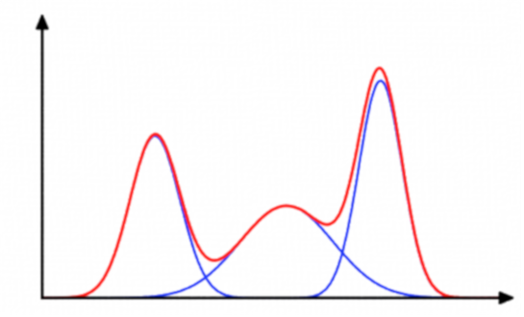
Gaussian Mixture Models and EM Algorithm
Directed Reading Program
Karla González

Slide 2
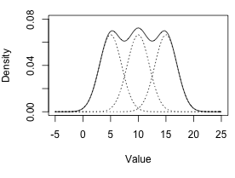
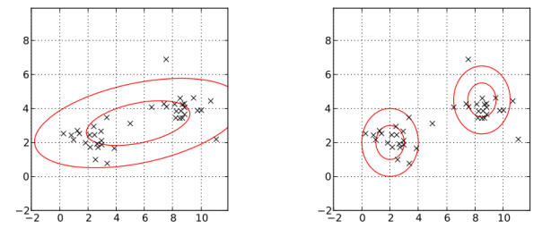
Fitting the Data
How do we know how to fit the data?
Unimodal vs Multimodal
Top image: Gaussian mixture model of three (3) normal distributions
Bottom Left: Data fit with one Gaussian distribution
Bottom Right: Data fit with Gaussian mixture model of two (2) components

Slide 3

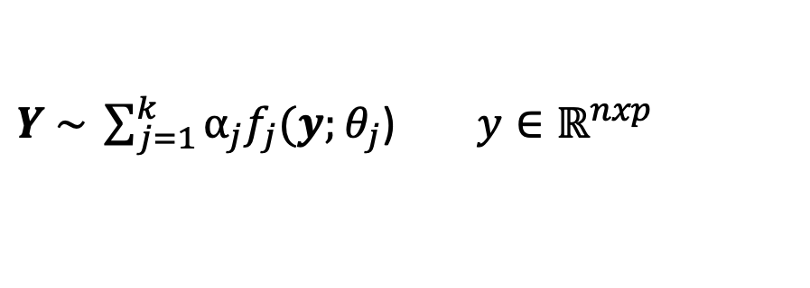


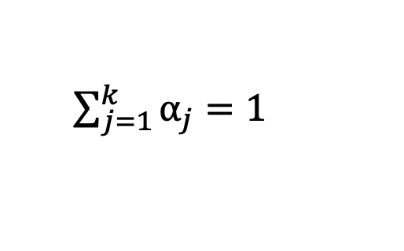
Finite Mixture Model
Data:
$$Y=(Y_{1},…,Y_{n})$$
Finite Mixture Model:
$Y \sim \sum_{j=1}^{k}{⍺_{j}f_{j}(y;θ_{j}}$) $y∈ℝ^{nxp}$
Definitions:
$$φ=(α_{1},…,α_{k−1},θ_{1},…, θ_{k})$$
$${ f}_{j}(y;θ_{j})$$
$\sum_{j=1}^{k}{⍺_{j}=1}$

Slide 4
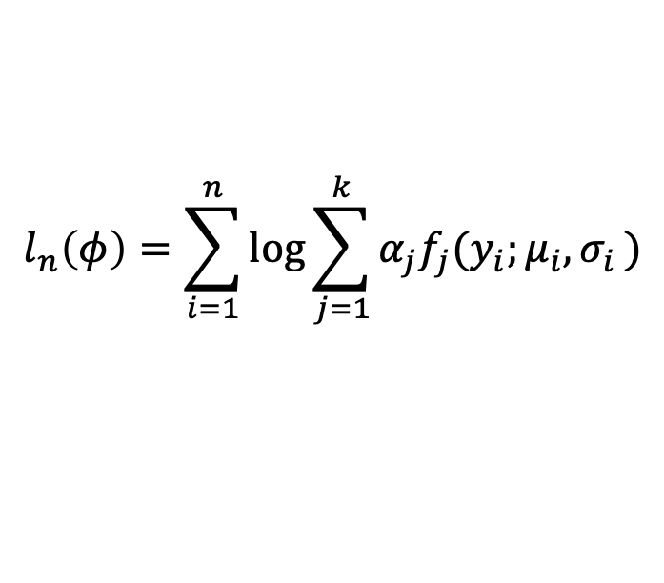


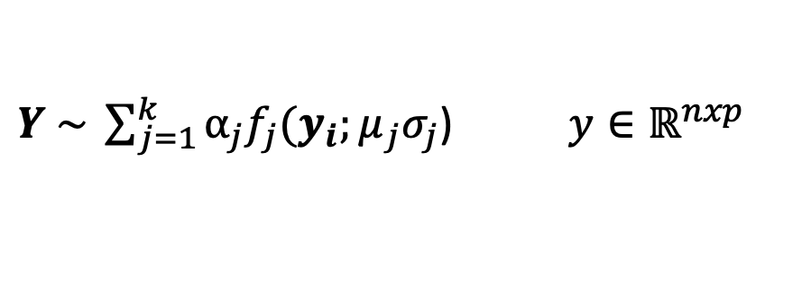
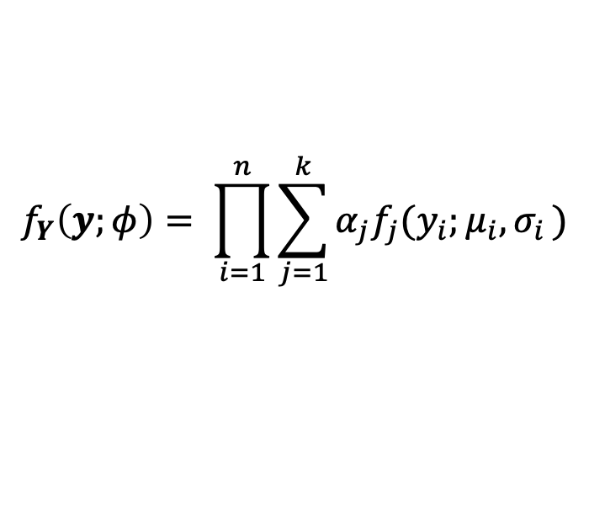

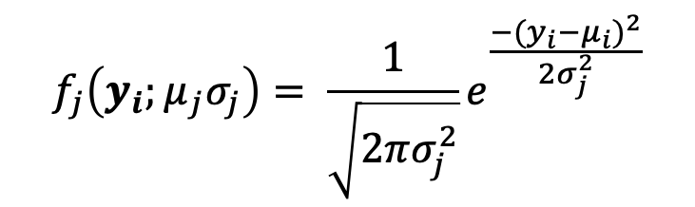
Gaussian Mixture Model
Data:
$$Y=(Y_{1},…,Y_{n})$$
$Y \sim \sum_{j=1}^{k}{⍺_{j}f_{j}(y_{i};μ_{j}σ_{j}}$) $y∈ℝ^{nxp}$
Recall:
$$f_{j}\left(y_{i};μ_{j}σ_{j}\right)= \frac{1}{\sqrt{2πσ_{j}^{2}}}e^{\frac{−(y_{i}−{μ_{i})}^{2}}{2σ_{j}^{2}}}$$
$$φ=(α_{1},…,α_{k−1},μ_{1}, …,μ_{k}, σ_{1},…{,σ}_{k})$$
Likelihood and Log-likelihood:
$$f_{Y}\left(y;φ\right)= \prod_{i=1}^{n}{\sum_{j=1}^{k}{α_{j}f_{j}(y_{i};μ_{i}{,σ}_{i})}}$$
$$l_{n}\left(φ\right)=\log{f_{Y}\left(y;φ\right)}$$
$$l_{n}\left(φ\right)=\sum_{i=1}^{n}{\log{\sum_{j=1}^{k}{α_{j}f_{j}(y_{i};μ_{i}{,σ}_{i})}}}$$

Slide 5
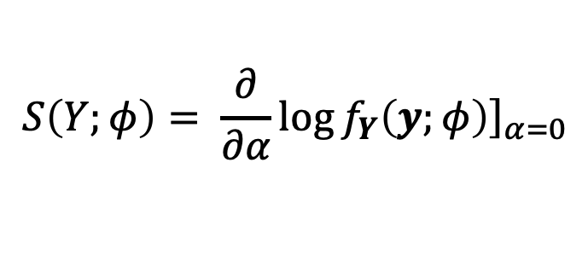
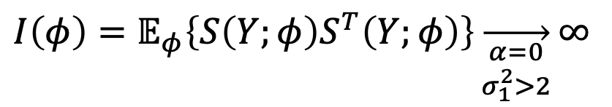
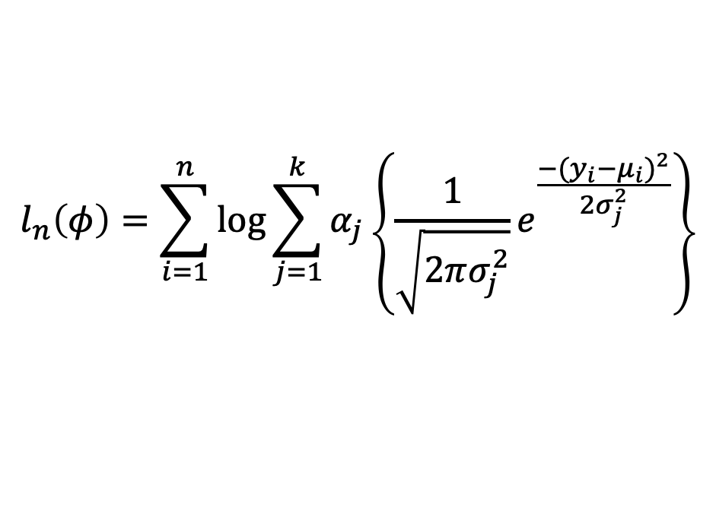
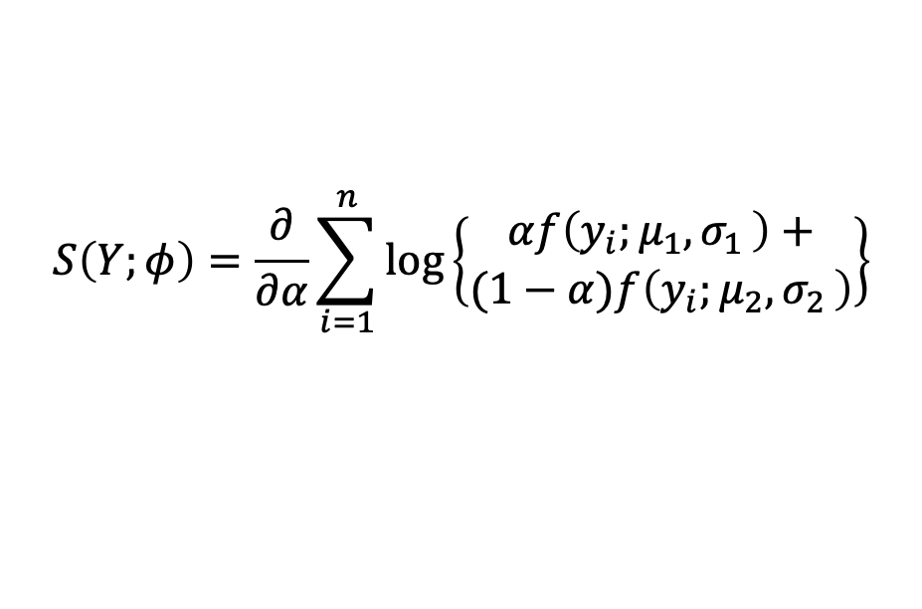
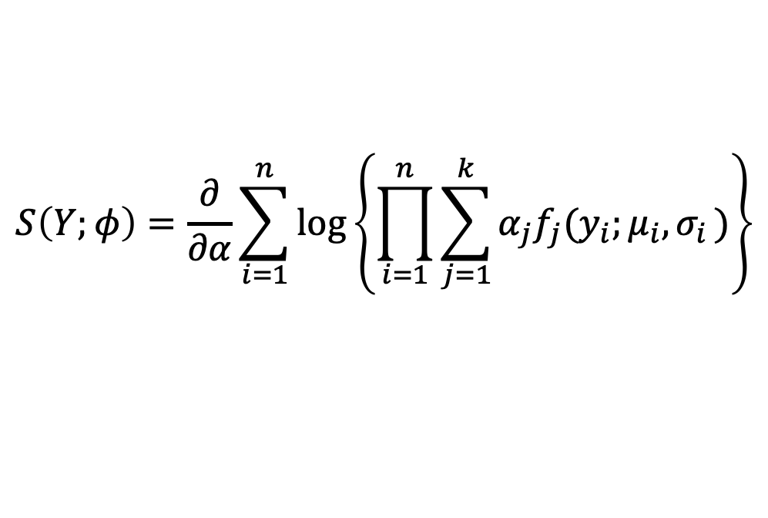

Challenges that arise…
Log-likelihood:
Assuming a two component GMM:
$$l_{n}\left(φ\right)=\sum_{i=1}^{n}{\log{\sum_{j=1}^{k}{α_{j}\left\{\frac{1}{\sqrt{2πσ_{j}^{2}}}e^{\frac{−(y_{i}−{μ_{i})}^{2}}{2σ_{j}^{2}}}\right\}}}}$$
$$S\left(Y;φ\right)=\frac{∂}{∂α}\sum_{i=1}^{n}{\log\left\{\begin{aligned}αf\left(y_{i};μ_{1}{,σ}_{1}\right)+ \\ (1−α)f\left(y_{i};μ_{2}{,σ}_{2}\right)\end{aligned}\right\}}$$
Score Function and Fisher Information
$$S\left(Y;φ\right)= \frac{∂}{∂α}{\left.\log{f_{Y}\left(y;φ\right)}\right]}_{α=0}$$
$I\left(φ\right)=𝔼_{φ}\left\{S\left(Y;φ\right)S^{T}\left(Y;φ\right)\right\}\overset{→}{\begin{aligned}α=0 \\ σ_{1}^{2}>2\end{aligned}}∞$
$I\left(φ\right)=𝔼_{φ}\left\{S\left(Y;φ\right)S^{T}\left(Y;φ\right)\right\}$
$$S\left(Y;φ\right)=\frac{∂}{∂α}\sum_{i=1}^{n}{\log\left\{\prod_{i=1}^{n}{\sum_{j=1}^{k}{α_{j}f_{j}(y_{i};μ_{i}{,σ}_{i})}}\right\}}$$

Slide 6
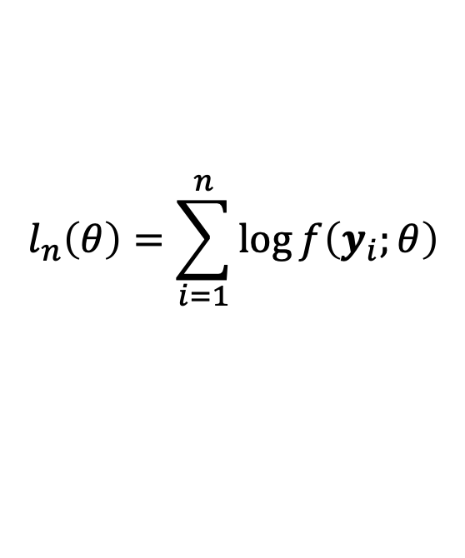
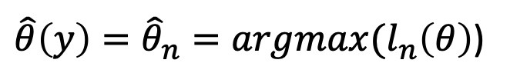
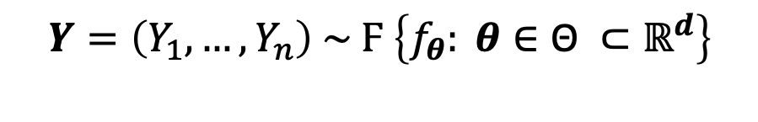
Maximum Likelihood Estimator
Log-likelihood:
$$l_{n}\left(θ\right)=\sum_{i=1}^{n}{\log{f\left(y_{i};θ\right)}}$$
MLE:
$$Y=\left(Y_{1},…,Y_{n}\right) \sim Ϝ \left\{f_{θ}: θ∈\text{Θ} ⊂ℝ^{d}\right\}$$
$\hat{θ}\left(y\right)={\hat{θ}}_{n}=argmax(l_{n}\left(θ\right)$)
The two pivotal properties of the MLE is its consistency and its asymptotic normality.

Slide 7
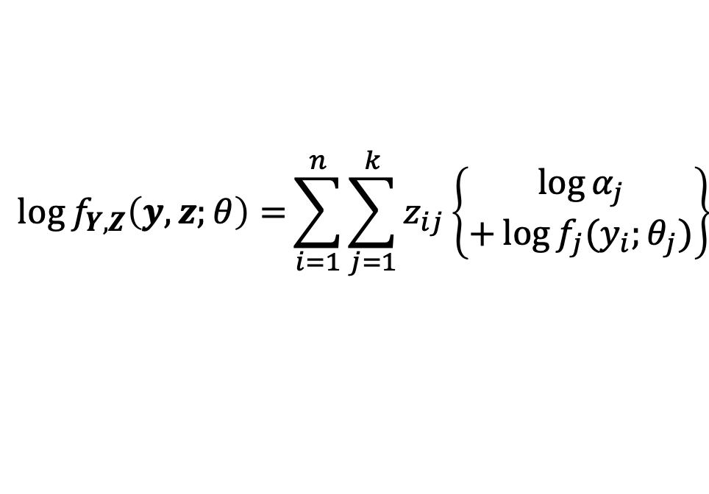
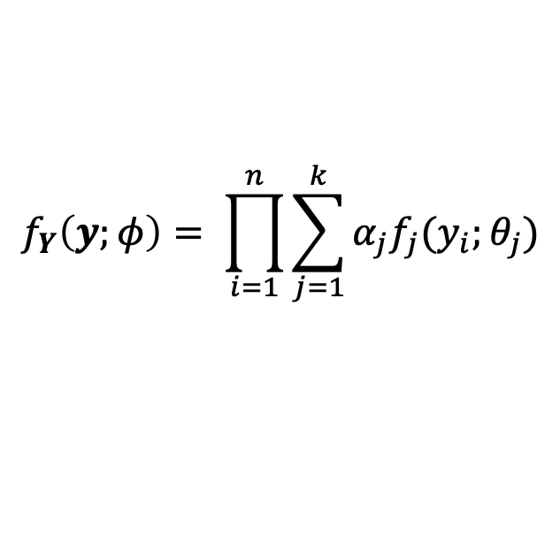
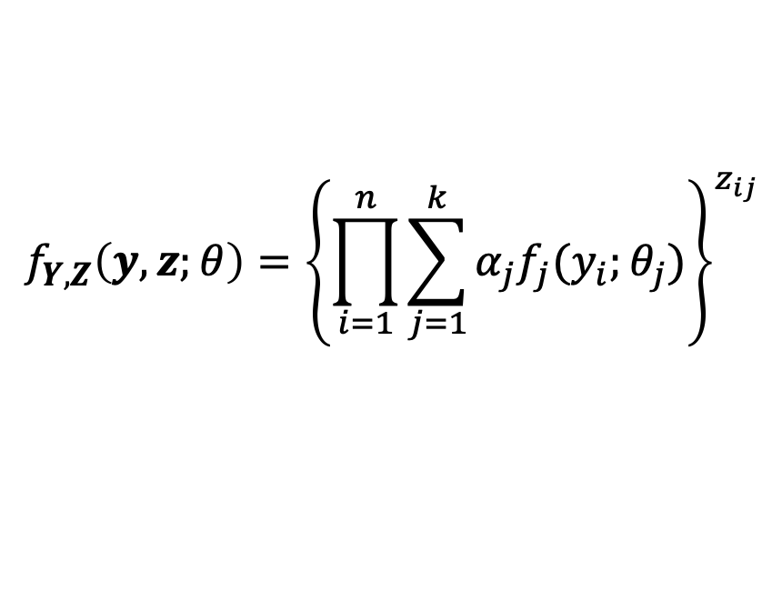


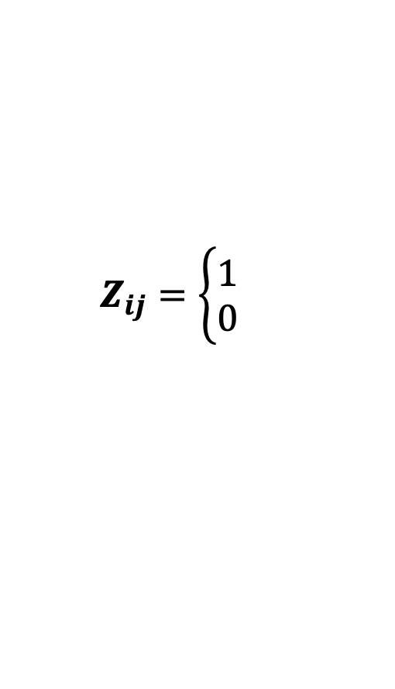
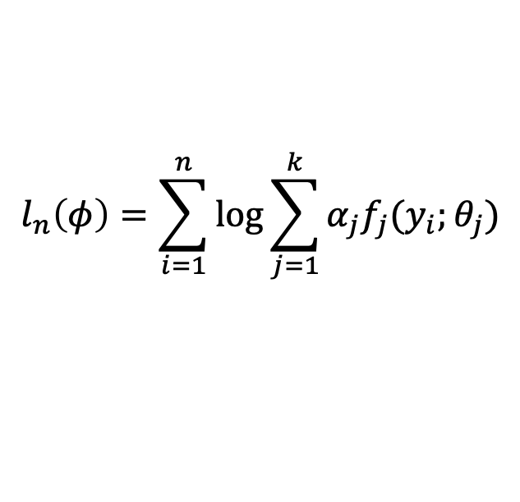
Fitting Mixture Models
Unobserved Data:
$$Z_{i}=(Z_{i1},…,Z_{ik})$$
$$Z_{i}\sim Multinomial(1;α_{1},…,α_{k})$$
Pdf of (Y,Z):
$$Z_{ij}=\left\{\begin{aligned}1 \\ 0 \end{aligned}\right.$$
Belongs to the jth sub-population
else
Log-likelihood of incomplete data:
$$f_{Y}\left(y;φ\right)= \prod_{i=1}^{n}{\sum_{j=1}^{k}{α_{j}f_{j}(y_{i};θ_{j})}}$$
$$l_{n}\left(φ\right)=\sum_{i=1}^{n}{\log{\sum_{j=1}^{k}{α_{j}f_{j}(y_{i};θ_{j})}}}$$
Rewritten with complete data:
$$f_{Y,Z}\left(y,z;θ\right)={\left\{\prod_{i=1}^{n}{\sum_{j=1}^{k}{α_{j}f_{j}(y_{i};θ_{j})}}\right\}}^{z_{ij}}$$
$$\log{f_{Y,Z}\left(y,z;θ\right)=}\sum_{i=1}^{n}{\sum_{j=1}^{k}{z_{ij}}}\left\{\begin{aligned}\log{α_{j}} \\ +\log{f_{j}(y_{i};θ_{j}})\end{aligned}\right\}$$

Slide 8
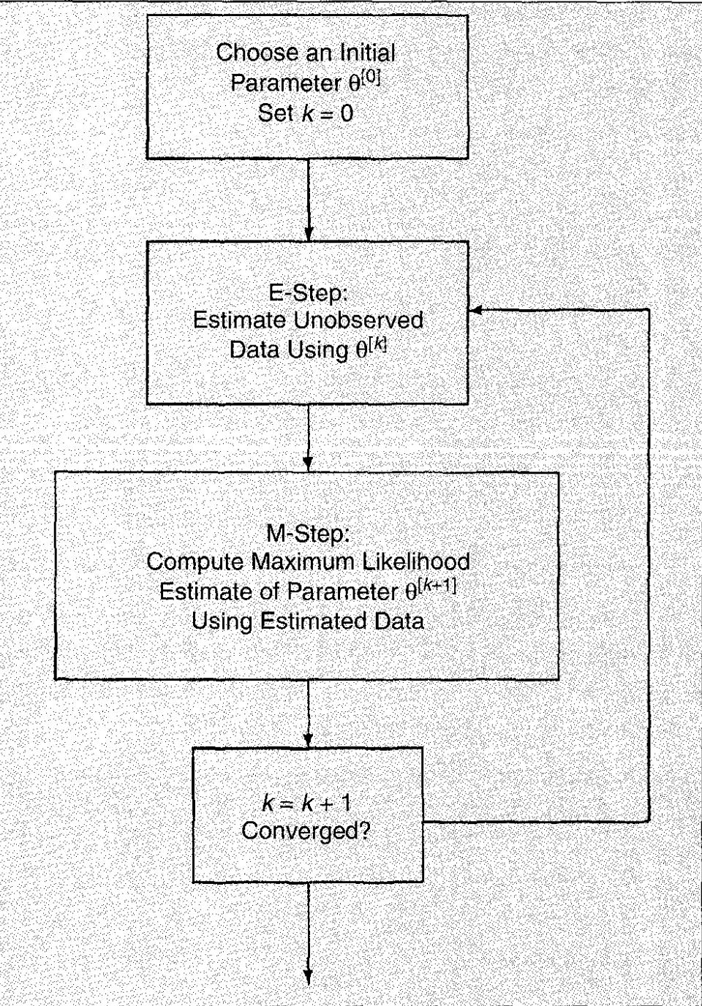
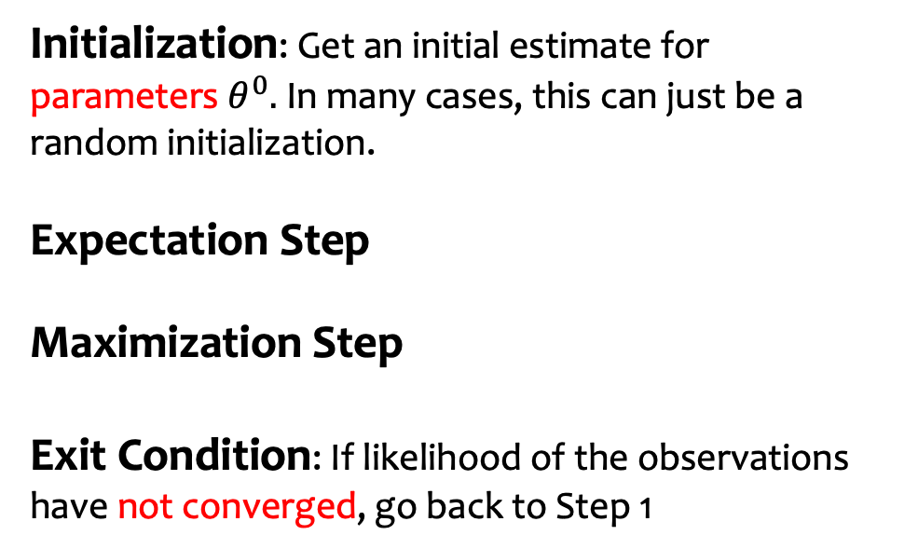
Overview of the EM algorithm
Initialization: Get an initial estimate for parameters $θ^{0}.$In many cases, this can just be a random initialization.
Expectation Step
Maximization Step
Exit Condition: If likelihood of the observations have not converged, go back to Step 1

Slide 9
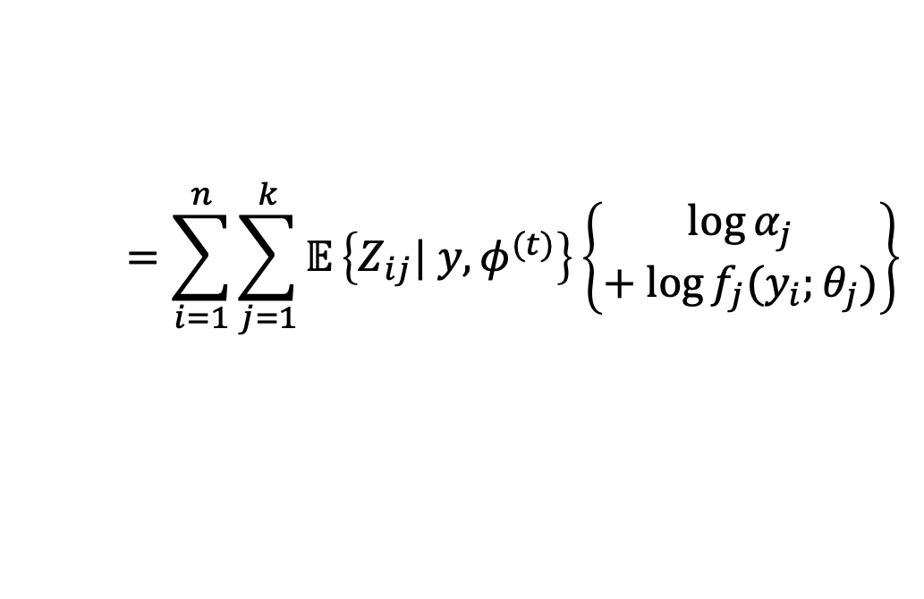
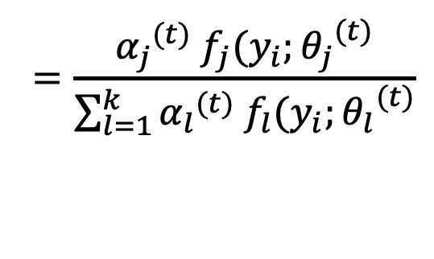

E-Step : Expectation
Compute:
$$Q_{n}\left(φ;φ^{(t)}\right)={𝔼_{Z|Y,θ}\left[\log{f_{Y,Z}\left(y,z;θ\right) | Y=y;φ^{(t)}}\right]}$$
$$=\sum_{i=1}^{n}{\sum_{j=1}^{k}{𝔼}}\left\{Z_{ij}| y,φ^{(t)}\right\}\left\{\begin{aligned}\log{α_{j}} \\ + log{f_{j}(y_{i};θ_{j}})\end{aligned}\right\}$$
$$𝔼\left\{Z_{ij}| y,φ^{(t)}\right\}{=w_{j}\left(y_{i};φ^{\left(t\right)}\right)}$$
$$=\frac{{α_{j}}^{(t)} f_{j}(y_{i};{θ_{j}}^{(t)}}{\sum_{l=1}^{k}{{α_{l}}^{(t)} f_{l}(y_{i};{θ_{l}}^{(t)}}}$$

Slide 10
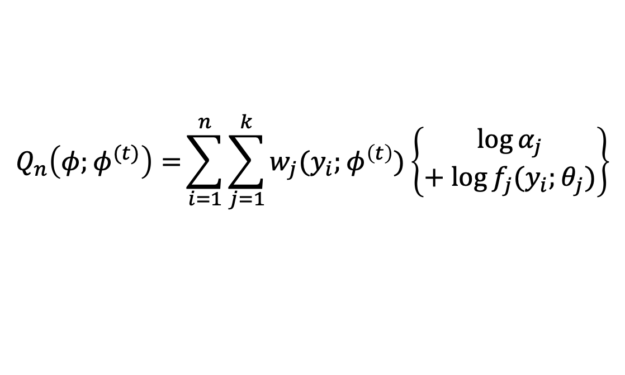

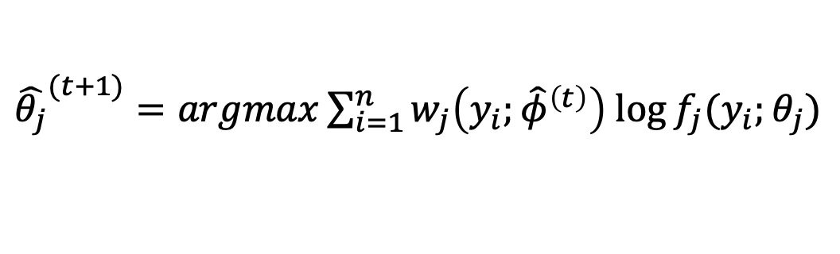
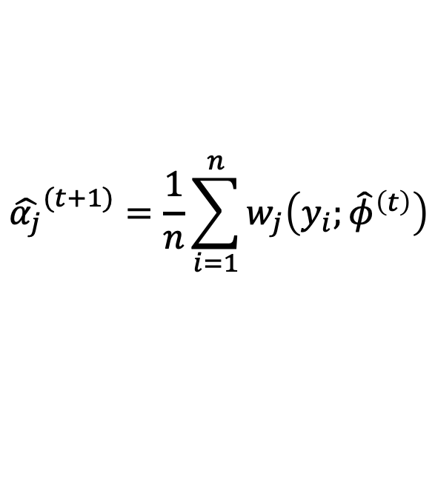
M-Step : Maximization
What we want:
Compute:
Updated parameter estimates:
$${φ^{(t+1)}=argmaxQ}_{n}\left(φ;φ^{(t)}\right)$$
$$Q_{n}\left(φ;φ^{(t)}\right)={\sum_{i=1}^{n}{\sum_{j=1}^{k}{w_{j}(y_{i};φ^{\left(t\right)})}}\left\{\begin{aligned}\log{α_{j}} \\ + log{f_{j}(y_{i};θ_{j}})\end{aligned}\right\}}$$
$${\hat{α_{j}}}^{(t+1)}=\frac{1}{n}\sum_{i=1}^{n}{w_{j}\left(y_{i};{\hat{φ}}^{\left(t\right)}\right)}$$
${\hat{θ_{j}}}^{(t+1)}=argmax\sum_{i=1}^{n}{w_{j}\left(y_{i};{\hat{φ}}^{\left(t\right)}\right)}$ $\log{f_{j}(y_{i};θ_{j})}$

Slide 11
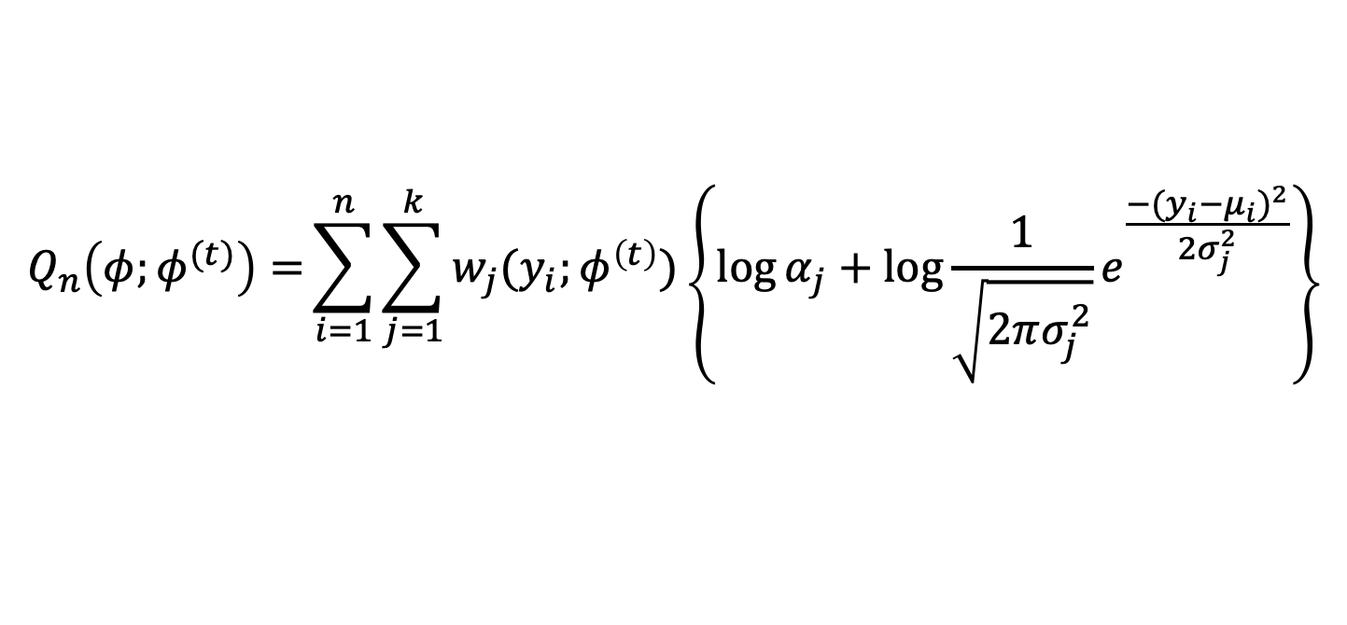

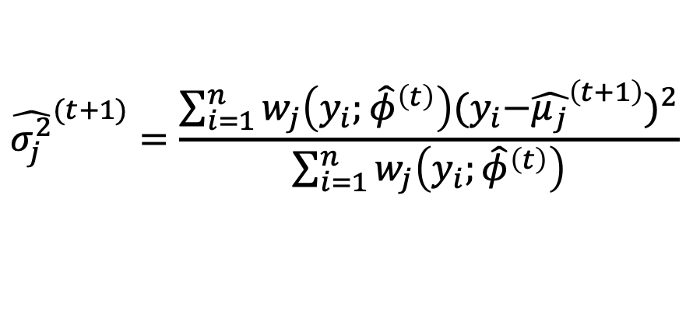
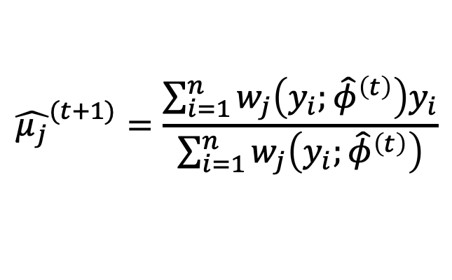
M-Step : Gaussian Mixture Model
What we want:
Compute:
Updated parameter estimates:
$${φ^{(t+1)}=argmaxQ}_{n}\left(φ;φ^{(t)}\right)$$
$$Q_{n}\left(φ;φ^{(t)}\right)={\sum_{i=1}^{n}{\sum_{j=1}^{k}{w_{j}(y_{i};φ^{\left(t\right)})}}\left\{\log{α_{j}}+\log{\frac{1}{\sqrt{2πσ_{j}^{2}}}e^{\frac{−(y_{i}−{μ_{i})}^{2}}{2σ_{j}^{2}}}}\right\}}$$
$${\hat{σ_{j}^{2}}}^{(t+1)}=\frac{\sum_{i=1}^{n}{w_{j}\left(y_{i};{\hat{φ}}^{\left(t\right)}\right){{(y}_{i}−{\hat{μ_{j}}}^{\left(t+1\right)})}^{2}}}{\sum_{i=1}^{n}{w_{j}\left(y_{i};{\hat{φ}}^{\left(t\right)}\right)}}$$
$${\hat{μ_{j}}}^{(t+1)}=\frac{\sum_{i=1}^{n}{w_{j}\left(y_{i};{\hat{φ}}^{\left(t\right)}\right)y_{i}}}{\sum_{i=1}^{n}{w_{j}\left(y_{i};{\hat{φ}}^{\left(t\right)}\right)}}$$

