Slide 1
Workshop Overview
Fred Richardson
Babel OP3 Tech Transition Workshop
Feb 16, 2017

Slide 2
Overview
Three OP3 KWS systems covered today:
Baseline system – Kaldi
Performer systems – Babelon and LORELEI
Special focus today on Kaldi and PySpeech
Overview of Kaldi by Sanjeev
Overview of PySpeech by Dave and Jeff Farris
Tech transition status update
Preliminary results on Javanese and Pashto
Final systems will be ready by end of March

Slide 3
OP3 Babel Delivery
DELIVERY
 | BP | OP1 | OP2 | OP3
Practice Languages | Cantonese | Assamese | Cebuano | Amharic
 | Pashto | Bengali | Kazakh | Dholuo
 | Tagalog | Haitian Creole | Kurdish | Guarani
 | Turkish | Lao | Lithuanian | Igbo
 |  | Zulu | Telugu | Javanese
 |  |  | Tok Pisin | Mongolian
 |  |  |  | Pashto (revisited)
Surprise Language | Vietnamese 4 weeks | Tamil 3 weeks | Swahili 2 weeks | Georgian 1 week
Transcribed Training Data | FLP: 80 hours LLP: 10 hours | FLP: 60 hours LLP: 10 hours | FLP: 40 hours VLLP: 3 hours | FLP: 40 hours
Pron Lexicon | YES | YES | NO | NO
Channel Conditions | Mixed Env | Mixed Env | Mixed Env | Mixed Env
 | Telephone | Telephone | Telephone | Telephone
 |  | 2 Microphone | 2 Microphones | 7 Microphones
ATWV Target | 0.3 or greater | 0.3 or greater | 0.3 or greater | 0.6 or greater
WER Target | N/A | N/A | N/A | 50% or less
3

Slide 4
System Feature Comparison
Feature | Baseline (Kaldi) | Performer
Multi-lingual DNN training |  | ✓
Web scraping tool |  | ✓
Web LM training |  | ✓
System training | ✓ | ✓
KWS decoding | ✓ | ✓
Notes:
Features not in baseline system may be in Kaldi
Kaldi and performer systems do not require a dictionary

Slide 5
Obtaining Systems and Data
Kaldi and a few other tools are open source
Babelon, LORELEI and PySpeech are not
Babelon and LORELEI obtained through MOU with IARPA
Babel data obtained through Data Agreement with IARPA
PySpeech obtained through Dave and Jeff Farris
More details on this process at the end!

Slide 6
Babel System MOU
MOU (Memorandum of Understanding) with IARPA must be in place to acquire Babel systems.
POC for MOU:
Primary: Dr. Carl Rubino (Babel PM)
email: carl.rubino@iarpa.gov
301-851-7563 (office)
Secondary: Dr. Lee Knauss (Chief Technology Transition)
email: lee.knauss@iarpa.gov
301-851-7475 (office)
POC for System Access (till March 31, 2017):
Mr. Frederick (Fred) Richardson
email: frichard@ll.mit.edu
781-981-3626 (office)
6
Notes:
Classification
Classification
6

Slide 7
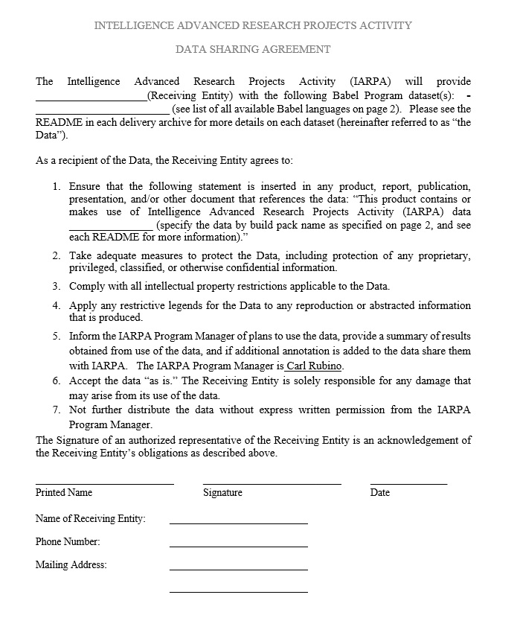
Babel Data Agreement
POC for Data Agreement:
Primary: Dr. Carl Rubino
email: carl.rubino@iarpa.gov
301-851-7563 (office)
Secondary: Dr. Lee Knauss
email: lee.knauss@iarpa.gov
301-851-7475 (office)
7
Notes:
Classification
Classification
7

Slide 8
PySpeech, Kaldi and Babler
NOT Included in Babel final system delivery:
Kaldi Open Source Toolkit:
POC: Dr. Sanjeev Khudanpur
email: khudanpur@jhu.edu
410-516-7024 (office)
PySpeech system (Tech Transfer Sharing Agreement with NSA):
POC: Mr. Dave Farris/Mr. Jeff Farris
email: dcfarri@tycho.ncsc.mil;jjfarr2@tycho.ncsc.mil
301-688-9289/301-688-9172
“Babler” web scraping tool
POC: Gideon Mendels
email: gm2597@columbia.edu
8
Notes:
Classification
Classification
8

Slide 9
★ Tutorial Feedback 
Please e-mail feedback to Yenda: jtrmal@gmail.com
Start:
What should be added to the tutorial?
Stop:
What should be removed from the tutorial?
Continue:
What should stay in the tutorial?

