Slide 1
Speech Recognition and Keyword Spotting
Fred Richardson
Babel OP3 Tech Transition Workshop
February 16, 2016

Slide 2

Automatic Speech Recognition (ASR)
Goal of ASR is low error rate transcription of speech
Attaining this goal has required expensive resources
1000’s of hours of transcribed audio
But even then there are still problems
Difficult noise or channel conditions
New words, proper names or locations
Babel delivery systems use 80 hours of data (40 transcribed)
Speech Recognition
Transcription
Comment ça va?
Speech Signal

Slide 3
Automatic Speech Recognition (ASR)
Generally three parts to ASR technology
Gathering and defining data sets
System building
Training models
Tuning systems (i.e. on dev data)
Decoding
Defining lexicon
Building grammar
Decoding data
Each stage has multiple steps associated with it
All of this is important for keyword spotting

Slide 4

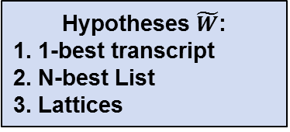
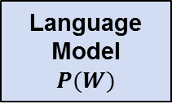

Anatomy of an ASR Decoder
General approach to ASR is statistical
Find the most likely transcript W for the speech data X:
$$\tilde{W}=\underset{W}{argmax}{P(W|X)}$$
With Bayes rule we break this into two parts $P\left(X | W\right)$ and $P(W)$:
$$P\left(W | X\right)=\frac{P\left(X | W\right)P(W)}{P(X)} \sim P\left(X | W\right)P(W)$$
Hypotheses $\tilde{W}$:
1. 1-best transcript
2. N-best List
3. Lattices
ASR Decoder
Acoustic Model
$$P(X|W)$$
Language Model
$$P(W)$$
Speech Signal

Slide 5
ASR System Output
Performance is measured in word error rate (WER)
Errors are insertions, deletions and substitutions
Word error rate is ratio of errors to ground truth
TRUTH: SHE TOOK ONE *** STEP (4 words)
HYPO: ** TOOK ONE AND SLEPT
ALIGN: DEL COR COR INS SUB (3 errors)
3 errors and 4 ground truth words = ¾ or 75% WER
With 1-best transcription you are stuck with this
N-best output is slightly better – you might be able to re-rank
TOOK ONE AND SLEPT
BOOKED ONE STOP
SHE TOOK ONE STEP Can we get this?
SHE BROOKED NO STEP
HE TOOK ONE STOP

Slide 6
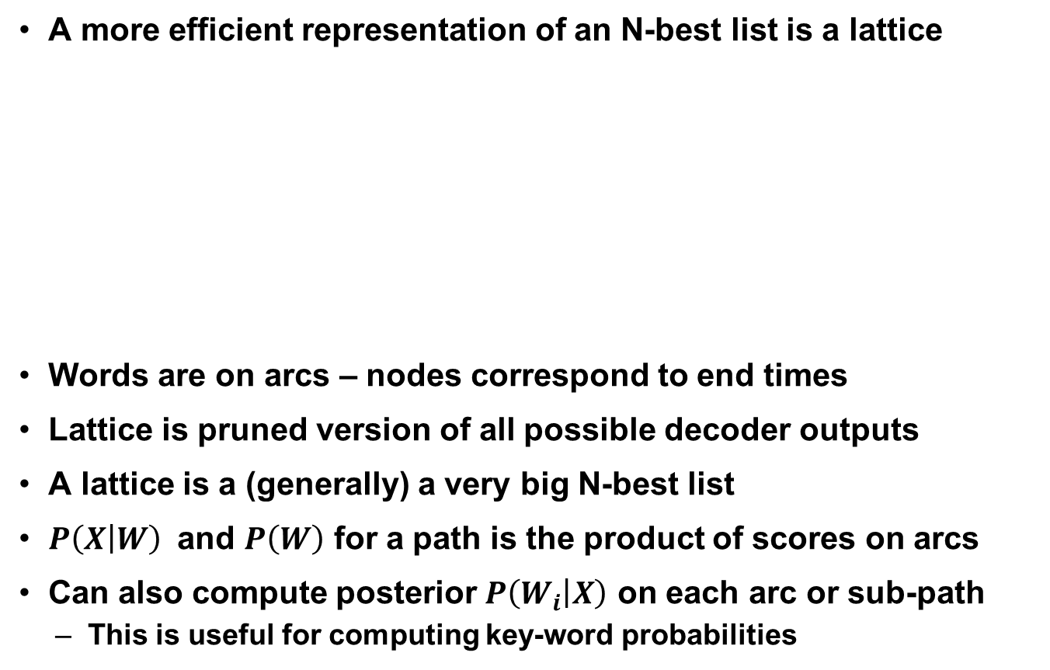
ASR Search Space
A more efficient representation of an N-best list is a lattice
Words are on arcs – nodes correspond to end times
Lattice is pruned version of all possible decoder outputs
A lattice is a (generally) a very big N-best list
$P\left(X | W\right)$ and $P\left(W\right)$ for a path is the product of scores on arcs
Can also compute posterior $P\left(W_{i} | X\right)$ on each arc or sub-path
This is useful for computing key-word probabilities
Time

Slide 7


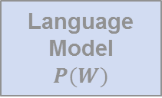
Acoustic Model
General approach to ASR is statistical
Find the most likely transcript W for the speech data X
$$\tilde{W}=\underset{W}{argmax}{P(W|X)}$$
With Bayes rule we break this into two parts $P\left(X | W\right)$ and $P(W)$:
$$P\left(W | X\right)=\frac{P\left(X | W\right)P(W)}{P(X)} \sim P\left(X | W\right)P(W)$$
Hypotheses $\tilde{W}$:
1. 1-best transcript
2. N-best List
3. Lattices
ASR Decoder
Acoustic Model
$$P(X|W)$$
Language Model
$$P(W)$$
Speech Signal

Slide 8
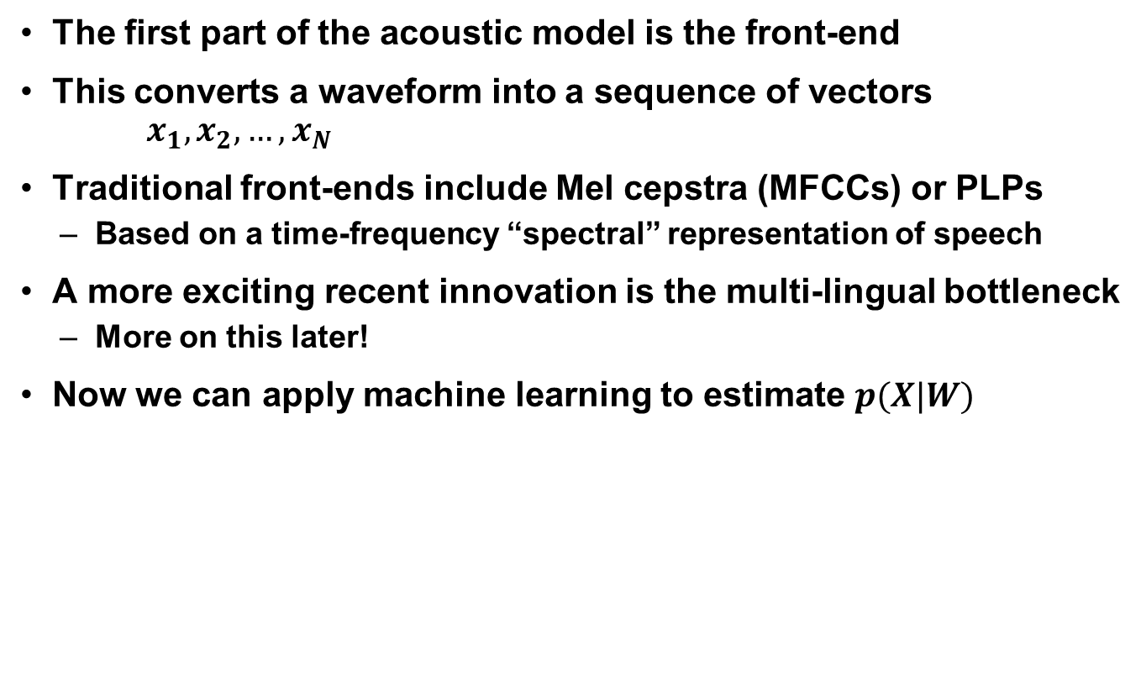

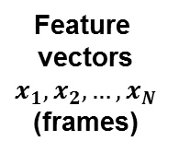

Front End
The first part of the acoustic model is the front-end
This converts a waveform into a sequence of vectors $x_{1},x_{2},…,x_{N}$
Traditional front-ends include Mel cepstra (MFCCs) or PLPs
Based on a time-frequency “spectral” representation of speech
A more exciting recent innovation is the multi-lingual bottleneck
More on this later!
Now we can apply machine learning to estimate $p(X|W)$
Front end:
Feature extraction
Acoustic Model:
$$p(x_{i}|u)$$
$$p(X|W)$$
Feature
vectors
$$x_{1},x_{2},…,x_{N}$$
(frames)
Speech Signal

Slide 9
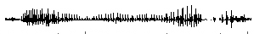
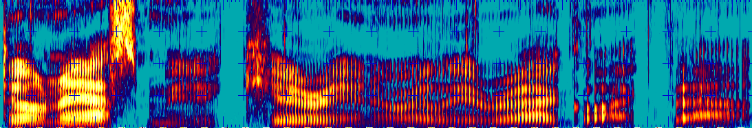
Feature Extraction
Measure the time evolution of the vocal tract via a series of short-time (20ms) spectral analyses – 100 feature vecs/sec
...
Mag.
Freq.
Fourier Transform
Magnitude
Frequency (Hz)
Time (sec)
Notes:
Briefly describe how automatic systems extract spectral information from speech signal using Fourier transform of sliding window over continuous speech. (Same technique as used for speech and language recognition).

Slide 10
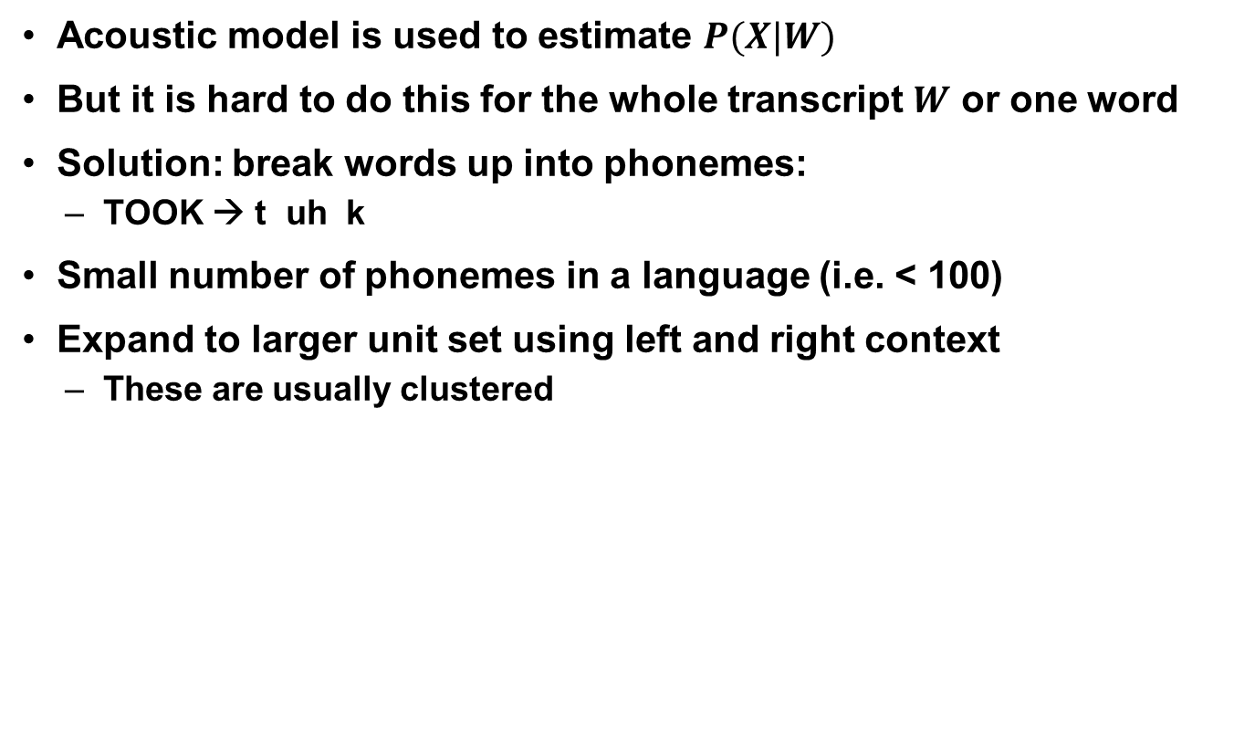
Acoustic Model
Acoustic model is used to estimate $P(X|W)$
But it is hard to do this for the whole transcript $W$ or one word
Solution: break words up into phonemes:
TOOK → t uh k
Small number of phonemes in a language (i.e. < 100)
Expand to larger unit set using left and right context
These are usually clustered
Front end:
Feature extraction
Acoustic Model:
$$p(x_{i}|u)$$
$$p(X|W)$$
Feature
vectors
$$x_{1},x_{2},…,x_{N}$$
(frames)
Speech Signal

Slide 11
Lexicon
ASR systems require word pronunciation lexicons
In the past this was another expensive resource
Dictionaries were constructed manually using linguistic knowledge
Pronunciations were created for all training and decoding words
Automatic pronunciation generation is sometimes possible
But not always – for example Cantonese or Mandarin
Model-based approach:
A model is trained using an existing pronunciation dictionary
New pronunciations are generated automatically using the model
Mapping approach:
Letters or “graphemes” are mapped to phonemes
Requires user-defined mapping rules
Does not require an existing pronunciation dictionary
Babel delivery systems use mapping approach

Slide 12
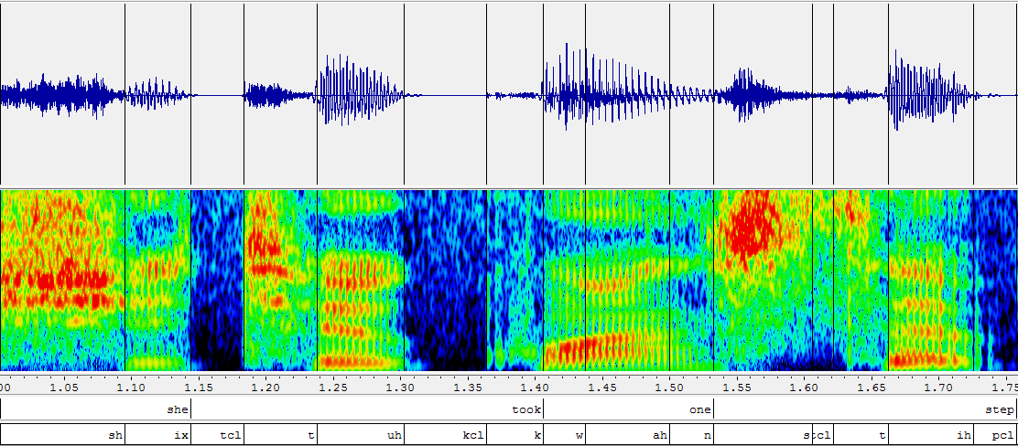



Acoustic Model
Feature vectors or frames are “scored” using an acoustic model
That is, the AM produces $p\left(x_{i} | u\right)$ for a single frame
Now we need to combine these to score the whole word
took
t
uh
k
$$x_{i}$$
AM
$$p\left(x_{i} | u\right)$$

Slide 13

Acoustic Model
The lattice can contain HMM acoustic model scores on arcs
Scores can be at the word or phone level (or both)
For scoring a path – a sequence of arcs – we need the language model
$$p\left(x_{i}^{},…,x_{j}^{} | \text{TOOK}\right)$$
Time

Slide 14


Language Model
General approach to ASR is statistical
Find the most likely transcript W for the speech data X
$$\tilde{W}=\underset{W}{argmax}{P(W|X)}$$
With Bayes rule we break this into two parts $P\left(X | W\right)$ and $P(W)$:
$$P\left(W | X\right)=\frac{P\left(X | W\right)P(W)}{P(X)} \sim P\left(X | W\right)P(W)$$
Hypotheses $\tilde{W}$:
1. 1-best transcript
2. N-best List
3. Lattices
ASR Decoder
Acoustic Model
$$P(X|W)$$
Language Model
$$P(W)$$
Speech Signal

Slide 15
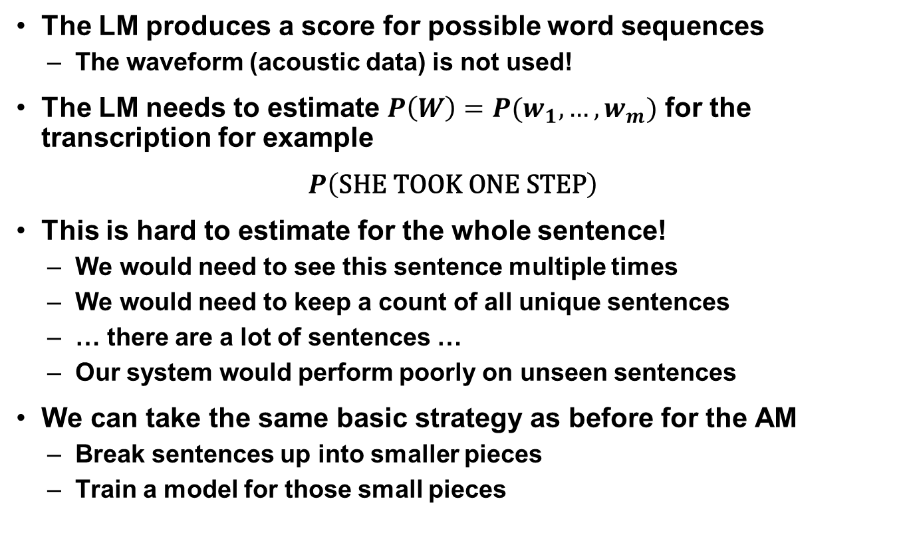
Language Model
The LM produces a score for possible word sequences
The waveform (acoustic data) is not used!
The LM needs to estimate $P\left(W\right)=P(w_{1}, …, w_{m})$ for the transcription for example
$$P\left(\text{SHE} \text{TOOK} \text{ONE} \text{STEP}\right)$$
This is hard to estimate for the whole sentence!
We would need to see this sentence multiple times
We would need to keep a count of all unique sentences
… there are a lot of sentences …
Our system would perform poorly on unseen sentences
We can take the same basic strategy as before for the AM
Break sentences up into smaller pieces
Train a model for those small pieces

Slide 16
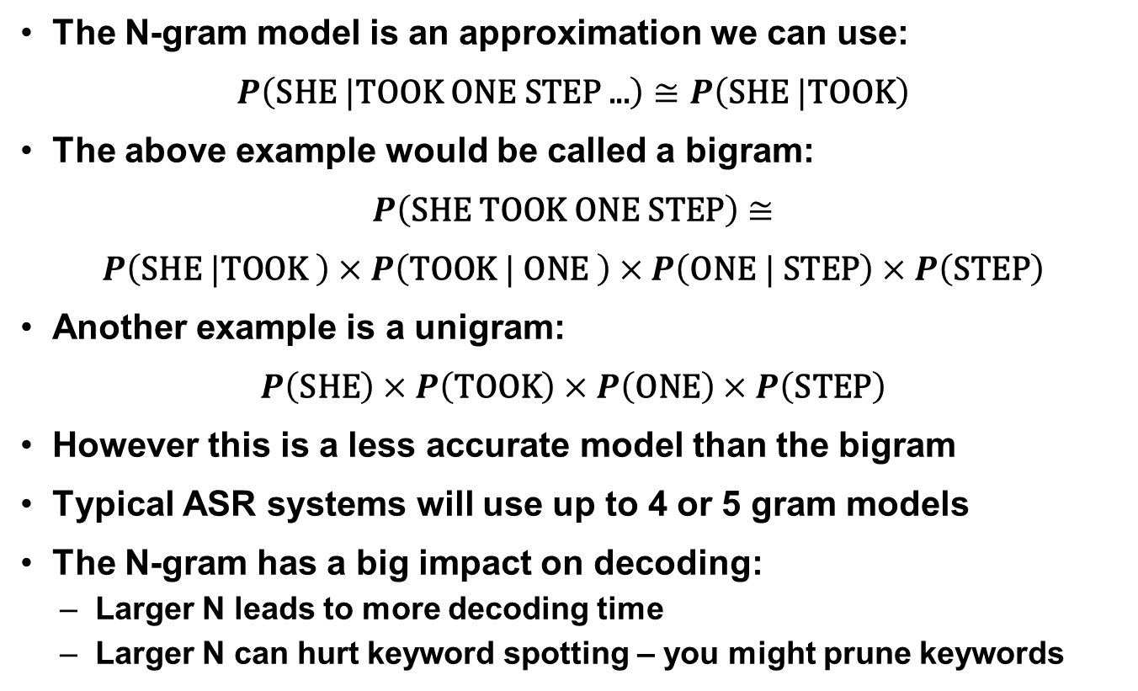
Language Model
The N-gram model is an approximation we can use:
$$P\left(\text{SHE} |\text{TOOK} \text{ONE} \text{STEP}\text{ ...}\right)≅P\left(\text{SHE} |\text{TOOK}\right)$$
The above example would be called a bigram:
$$P\left(\text{SHE} \text{TOOK} \text{ONE} \text{STEP}\right)≅$$
$$P\left(\text{SHE} |\text{TOOK} \right)×P\left(\text{TOOK} | \text{ONE} \right)×P\left(\text{ONE} | \text{STEP}\right)×P\left(\text{STEP}\right)$$
Another example is a unigram:
$$P\left(\text{SHE}\right)×P\left(\text{TOOK}\right)×P\left(\text{ONE}\right)×P\left(\text{STEP}\right)$$
However this is a less accurate model than the bigram
Typical ASR systems will use up to 4 or 5 gram models
The N-gram has a big impact on decoding:
Larger N leads to more decoding time
Larger N can hurt keyword spotting – you might prune keywords

Slide 17

Language Model
The lattice can contain language model scores:
The type of language model impacts lattice size
Example: all arcs following “TOOK” have to be the word “ONE”
The N-gram lattice expansion can be very big (hard for N>3)
The lattice can also be rescored with an N-gram (easier for N>3)
$$P\left(\text{TOOK} | \text{ONE}\right)$$
Time

Slide 18

ASR Decoder
General approach to ASR is statistical
Find the most likely transcript W for the speech data X
$$\tilde{W}=\underset{W}{argmax}{P(W|X)}$$
With Bayes rule we break this into two parts $P\left(X | W\right)$ and $P(W)$:
$$P\left(W | X\right)=\frac{P\left(X | W\right)P(W)}{P(X)} \sim P\left(X | W\right)P(W)$$
Hypotheses $\tilde{W}$:
1. 1-best transcript
2. N-best List
3. Lattices
ASR Decoder
Acoustic Model
$$P(X|W)$$
Language Model
$$P(W)$$
Speech Signal

Slide 19

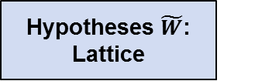
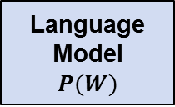

ASR Decoder
ASR decoders combines language and acoustic models
$$p\left(x_{s},…,x_{e} | \text{TOOK}\right)P(\text{TOOK}|\text{ONE})$$
Decoding grammar determines allowable sequences of words
Two things determine the grammar:
The language model
The lexicon
Acoustic Model
$$P(X|W)$$
ASR Decoder
Hypotheses $\tilde{W}$:
Lattice
Speech Signal
Language Model
$$P(W)$$
Grammar
Lexicon

Slide 20
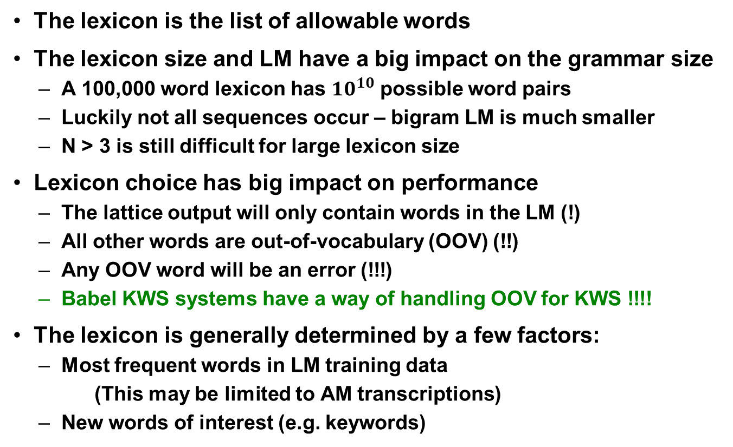
ASR Decoder: Lexicon
The lexicon is the list of allowable words
The lexicon size and LM have a big impact on the grammar size
A 100,000 word lexicon has $10^{10}$ possible word pairs
Luckily not all sequences occur – bigram LM is much smaller
N > 3 is still difficult for large lexicon size
Lexicon choice has big impact on performance
The lattice output will only contain words in the LM (!)
All other words are out-of-vocabulary (OOV) (!!)
Any OOV word will be an error (!!!)
Babel KWS systems have a way of handling OOV for KWS !!!!
The lexicon is generally determined by a few factors:
Most frequent words in LM training data
(This may be limited to AM transcriptions)
New words of interest (e.g. keywords)

Slide 21
ASR Decoder: Grammar
The grammar size determines the search space
Speed / performance trade-off:
A bigger LM can lower word error rate
But also increase grammar size
Other factors also control decoding time:
Pruning low scoring lattice paths
This also impacts performance
Bigger Grammar | Smaller Grammar
Bigger lattices | Smaller lattices
Lower error rate | Higher error rate
Slower decode | Faster decoder
More RAM | Less RAM

Slide 22

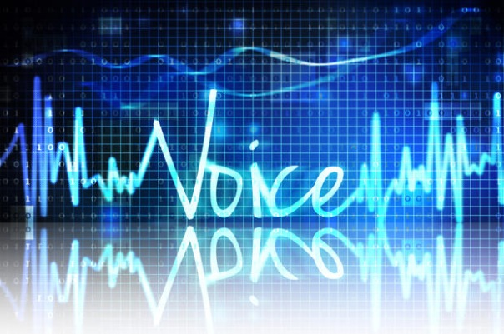

PART 2: Training
Training requires a lot of data resources
Acoustic model needs transcribed speech recordings
Language model requires text samples for the language
You may need a pronunciation dictionary
(which covers lexicon and all transcripts)

Slide 23
Acoustic Model Training
Acoustic model training has steep computational requirements
The acoustic model also requires transcribed audio data
More data leads to higher performance (100’s to 1000’s hours)
Pronunciations can be generated automatically
Works for a certain set of languages
Used after second period of Babel program
Babel delivery systems include this
For many languages you will need a dictionary
New words need manually constructed pronunciations
New generation of acoustic models are neural network based
Babel system include multi-lingual bottleneck features
There are also new recurrent neural network architectures

Slide 24
Acoustic Model Training
Training involves time aligning transcripts to waveforms
Early training stages determine start and end time for phone
Alignments are then “ground truth” for later stages
Neural network training uses phone alignments
Some models require decoding the training data
The models are then trained to correct decoding errors
she
took
one
step
uh
k
w
n
s
ih
p
sh
ix
t
ah
t

Slide 25
Language Model Training
A language model requires text samples of data in the language
The text data should be appropriate for the task:
Example: conversational speech
Transcripts of conversations better model the task
In some cases only the AM transcriptions are available
This is a small amount of text data
Can use special techniques to find more relevant data
Babel deliveries provide web-scraping tools:
Can add N-grams to the LM and words to the lexicon
Can update LM and lexicon using more relevant data for a language
Types of language models include
N-gram models
Recurrent neural network language models (RNN-LMs)

Slide 26
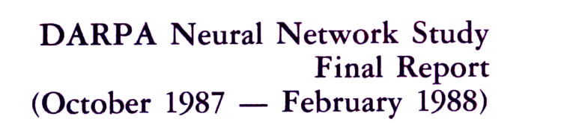


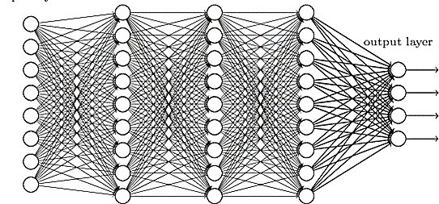
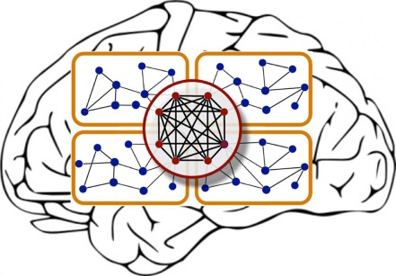
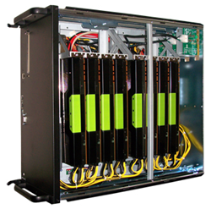

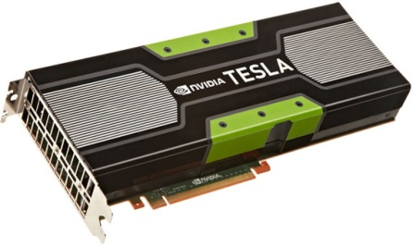

PART 3: Deep Learning
Speech Recognition
> 30% (2012)
Data
Hardware
Deep Neural Network
Software
Notes:
Deep learning has processed data in a way that was not possible.
Go back to the 1980’s. Rich Lippman was involved in a 1987 DARPA study to evaluate the use of neural networks
Add Lippman reference

Slide 27
Deep Neural Network (DNN) Overview
Neural networks are not accurate models of the brain
But they are statistical models*
Prior to 2006, it was difficult to train deep neural networks
(“deep” means > 2 hidden layers)
Hidden Layers ( > 2)
Deep Neural Network
Input
Output
*Mike D. Richard and Richard P. Lippmann, "Neural Network Classifiers Estimate
Bayesian a Posteriori Probabilities," Neural Computation, 3, 461-483,1992
Notes:
Move “what has changed…” to 4.5

Slide 28
DNN for ASR
Currently, DNN target labels come from AM alignments
Input is typically a large window of speech
A DNN predicts unit at middle of window
took
t
uh
k
DNN
p(unit|x)
x
Notes:
BEFORE: add Generic BNF “representation learning” slide
ALSO: add i-vector classifier slide (delete generic slide)
Example slide: add next neural network to this somehowe
Think about adding BNF to this or following slide
Include ML-BNF possibly on new slide

Slide 29
Bottleneck Features (BNFs)
We can take advantage of the abstraction:
A narrow bottleneck can be used to reduce dimensionality
First part of network is used for feature extraction
Last part of network is a simple classifier
Feature Extraction
Simple Classifier
Bottleneck
Layer
Input
…
…
…
…
Notes:
Mention big impact of this technique
!!! Mention abstraction at lower layers!!!!

Slide 30
Multi-Lingual Bottleneck Features (ML-BNFs)
Universal language independent BNF phonetic feature
Approach: use same extraction layers but change output
Feature extraction is jointly trained across languages
Babel deliveries include multi-lingual bottleneck training:
Stacked
Input
Feature Extraction
Bottleneck
Layer
English
Units
…
…
Tagalog
Units
…
…
Notes:
This comes ASR BNF example

Slide 31
PART 4: Keyword Spotting (KWS)
Goal of keyword system is to find phrases in speech
The user defines (or adds) keywords of interest
Babel systems can handle new (OOV) words!
Good performance requires a modest amount of training data
Babel delivery systems used 40 hours of transcribed audio
Output is a list of keywords, start times and scores
Good performance = high scoring keywords occur at reported time
Keyword System
Keyword hits
“ONE STEP” 1.40 sec scr=+7.0
“SHE TOOK” 1.00 sec scr=+5.0
“BOOKED ONE STOP” 1.10 sec scr=-5.0
Speech Signal
Keyword List

Slide 32
KWS System Architecture
Keyword systems use traditional ASR systems as front ends
The ASR system is run once to generate indices
Two indices: in-vocabulary (IV) and out-of-vocabulary (OOV)
User defined keyword search used to query indices
Changing keyword lists does not require re-decode!
KWS front-end
Lattices
KWS back-end
ASR Decoder
IV index
Indexer
IV Query
KWS
Output
OOV index
OOV Query
AM, LM Lexicon
Speech Signal
Keyword list

Slide 33
Keyword Search
User defined keywords may include OOV words
Keyword systems handle this using a special index and search
This is included in Babel system deliveries
The system splits the keyword list into two parts:
IV keywords and OOV keywords
Decoder creates two indices:
The IV index is based on word lattices
The OOV index typically use grapheme or syllable lattices
Pronunciations for OOV words are generated automatically
For example using word to grapheme mapping
The OOV index is queried using the new mapping
OOV KWS is in general less accurate
There are limitations in the language model you can use
Babel program has made great progress in tackling this problem

Slide 34
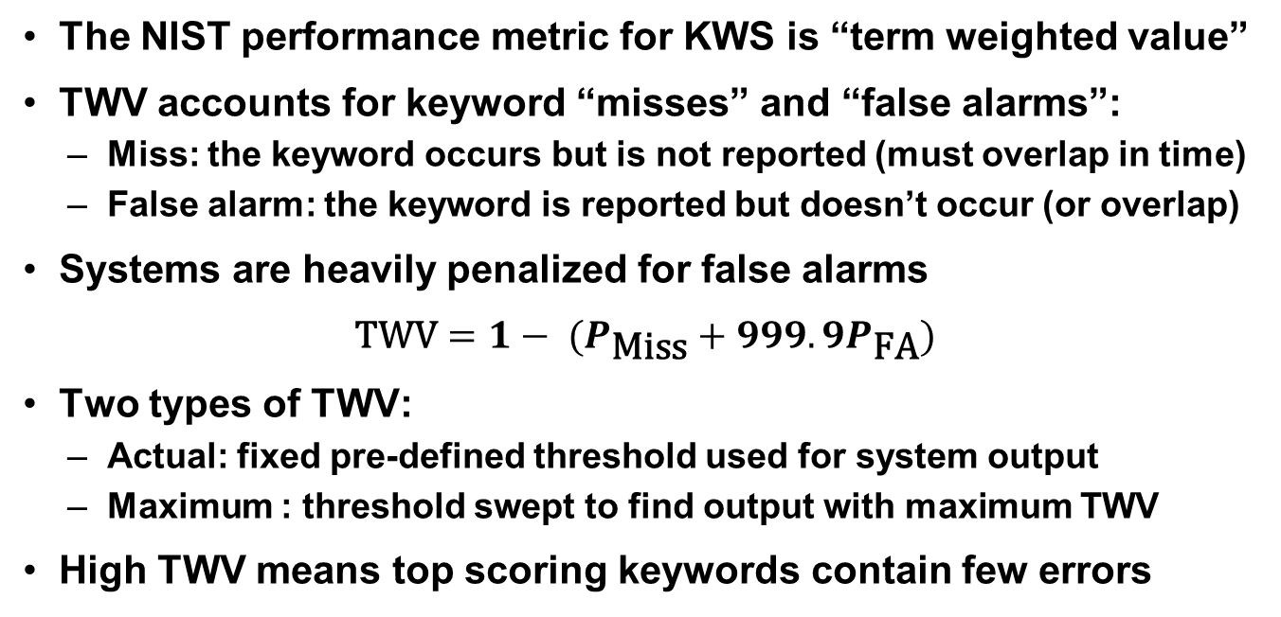
Keyword Performance Metric (TWV)
The NIST performance metric for KWS is “term weighted value”
TWV accounts for keyword “misses” and “false alarms”:
Miss: the keyword occurs but is not reported (must overlap in time)
False alarm: the keyword is reported but doesn’t occur (or overlap)
Systems are heavily penalized for false alarms
$$\text{TWV}=1− (P_{\text{Miss}}+999.9P_{\text{FA}})$$
Two types of TWV:
Actual: fixed pre-defined threshold used for system output
Maximum : threshold swept to find output with maximum TWV
High TWV means top scoring keywords contain few errors

Slide 35
Keyword Output Example
Example: keyword list includes:
“she took”, “one step”, “booked one stop”
she
took
one
step
Threshold
0.5
1.5
2.5
3.5
she took +2
Miss
Miss
she took +1
FA
booked one stop +2
FA
FA
one step +3
FA
FA
FA
one step +2
Miss
Miss
#FA
3
2
1
#Mis
2
2

Slide 36
Improving Performance
Better feature extraction
You can re-train the multi-lingual BNF using more (relevant) data
Better acoustic model training
Getting more transcribed speech data is expensive
Can transform existing data and train a channel-robust DNN
Better language model training and/or better lexicon
This is relatively cheap – just need more text data samples
Better lexicon:
Same as above – can use more text data
Can also use existing OOV keywords (they become IV)
NOTES:
All of the above changes will only apply to new decoding runs
(does not change old index outputs)
1 and 2 also require re-training the acoustic model

Slide 37
Summary of Delivery Technologies
Deliveries include state-of-the-art KWS systems
FLP systems: 80 hours of data with 40 hours transcribed
Decoding produces indices – save these on disk
Decode once and query multiple times
This includes querying with unknown (OOV) words!
You can re-train the language model with more data (Web text)
You can change the lexicon to try to reduce OOV
Both only take effect for new decoding runs
Deliveries include web-scraping tools for pulling more data
Deliveries require one or more GPUs for DNN training
Deliveries require a compute cluster running Sun Grid Engine
Small smoke test can be run on a single machine

