Slide 1

Member vs Casual Ridership Analysis
In order to inform stakeholders to develop effective marketing strategies
Karl Madl (Oct. 2021)

Slide 2
Background
Cyclistic is bicycle rideshare company used by casual riders and people with annual memberships. The goal is to identify key differences between these groups and patterns in casual riding so that stakeholders can be well informed and make smart decisions about the next marketing campaign, aimed at converting casual riders into members.

Slide 3



3 Key Differences
WHEN
HOW LONG
WHERE

Slide 4
WHEN
Seasonal, weekly, and daily breakdowns of when members and casual riders are using Cyclistic bikes.
Seasonal, weekly, and daily breakdowns of when members and casual riders are using Cyclistic bikes.

Slide 5
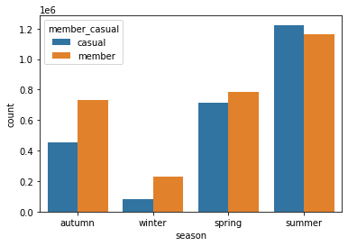
WHEN
Members
Casual Riders
Autumn: 25.0%
Winter: 7.9%
Spring: 27.1%
Summer: 40.0%
Autumn: 18.4%
Winter: 3.3%
Spring: 28.7%
Summer: 49.6%

Slide 6
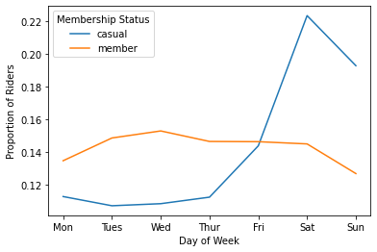
WHEN
Overwhelmingly, casual riders use our bikes most often on weekends
41% of all casual riders on Saturday and Sunday
56% from Friday through Sunday
Members consistently ride throughout the week, dipping on Sundays

Slide 7
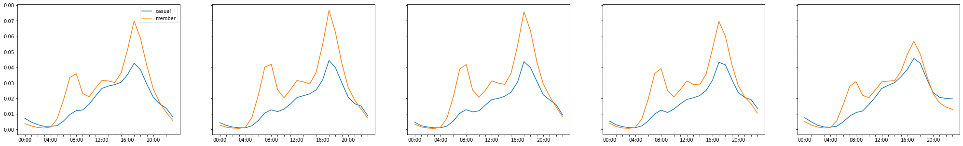
WHEN
Monday Tuesday Wednesday Thursday Friday
Most casual riding during the week occurs in the late afternoon and evening, with 44% of all
weekday casual riding occurring between 3pm and 7pm.
The consistency of riding during the week, with peaks around 7am and 5pm, suggests that
members use our bikes to make their regular commute.

Slide 8
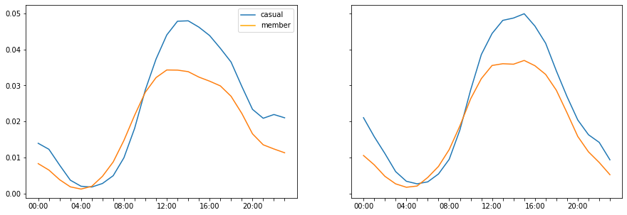
WHEN
Saturday Sunday
Weekend riding data shows members and casual riders use bikes at the same time, but with
casual riders far outnumbering members.
Ridership reaches a peak between Noon and 1pm, with 65% of the day’s casual riders embarking
between 10am and 6pm

Slide 9
Casual riders do far more riding in the summer than any other month (49.6%) and hardly any in winter (3.3%)
Casual riders ride far more on weekends than during the week (41-56% of all casual)
During the week, casual riders mostly ride in the early evening (44%)
On weekends, casual riders ride mostly from late morning to early evening (65%)
WHEN

Slide 10
3 Key Differences
WHEN
HOW LONG
WHERE

Slide 11
HOW LONG
Comparing the time difference between the start and end of each ride, converted to minutes.

Slide 12
HOW LONG
Issues with the Data:
Some rides have beginning and ending timestamps that suggested a negative amount of time on the bike.
Some timestamps revealed abnormally long ride times (over 30 days).

Slide 13
HOW LONG
Luckily, these issues don’t impact the summary of the data very much.
Most of these issues likely came from an error in recording or transcribing. We have an opportunity to better our data collection.
Due to the uncertainty of error source, impossibility of their legitimacy, and low impact on the distribution, all negative ride lengths have been excluded from examination.

Slide 14
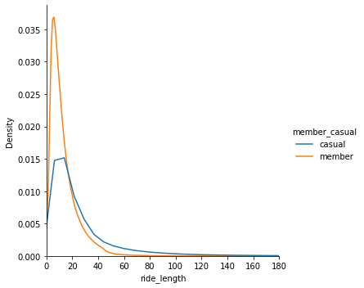
HOW LONG
This casual rider distribution is very positively skewed. Members are slightly skewed.

Slide 15
HOW LONG
The average time spent per ride for casual riders is twice that for our annual members.
Casual Riders: 28.1 minutes
Annual Members: 13.3 minutes

Slide 16
HOW LONG
The median time per ride is also higher among casual riders.
Casual Riders: 16.4 minutes
Annual Members: 9.9 minutes

Slide 17
3 Key Differences
WHEN
HOW LONG
WHERE

Slide 18
WHERE

