Slide 1


NATting Else Matters: Evaluating IPv6 Access Control Policies in Residential Networks
Karl Olson, Jack Wampler, Fan Shen, and Nolen Scaife
University of Colorado - Boulder
Notes:
Hello, I am Karl Olson, a PhD Student at the University of Colorado – Boulder and today I will be introducing our work titled NATting Else Matters: Evaluating IPv6 Access Control Policies in Residential Networks.

Slide 2
Background
Consumer Gateways Operation Defined by IPv4 NAT, Continued Common Behavior Under IPv6 Unclear
IPv4
Ubiquitous Presence
Default-Deny Security Architecture
Commonality Across Manufacturers/Devices
Standard Consumer Expectation
1 Host:1 IP = Easy System Identification
IPV6
UNCLEAR!
Notes:
If you’re running an IPv4 network in your home, you’re almost assuredly running NAT. For a consumer, this ubiquitous presence provides both a default security posture, through NAT’s default-deny ingress filtering, and a common operational familiarity across manufacturers, due to the mandatory need for address translation.
With IPv6, this standardized behavior is no longer assured. For example, you may continue to operate a gateway in a manner similar to IPv4 NAT by using IPv6 Translation, or you could have a Firewall, or potentially nothing at all. As a consumer, there is no great way to know what is going on or how these changes impact you.
Worse, ISPs can enable IPv6 overnight. If your router and devices prioritize v6 traffic, you could find yourself in a position where yesterday your devices were behind a NAT gateway and today they’re exposed to the open Internet.

Slide 3
Problem
IPv6 Default Behavior Not Well Defined for Consumer Gateways.
IPv6 not restricted to a single operational model.
RFCs do not SPECIFY IPv6 operation in consumer gateways.
Recommendations are not guarantees. Open to interpretation.
Community tension on Open-Model vs. Closed-Model Architectures.
No defined policy on how to handle address scopes.
Takeaway: Traditional method of plug and play gateway operation no longer provides an assured security baseline.
Notes:
One problem here is that RFCs do not precisely define how IPv6 should be implemented within consumer gateways. Instead, they often only provide recommendations that IPv6 be implemented in a way that is familiar to the consumer, ie similar to IPv4 NAT.
But how do you implement something familiar for a vastly different protocol which affords global addressing, the ability to provide end-to-end reachability, and use of multiple address scopes within a single device? Further, there is no specification on whether a device should operate in a closed model, similar to NAT, or with an open end-to-end model.
Instead these decisions are left to the gateway manufacturers to decide.
What that leaves us is in the best case scenario, is we could potentially have all manufacturers would arrive to a single, homogenous operational model for IPv6 defined by firewalls and uniform default security policies. In the worst case scenario, we have no idea what these devices are doing or how they operate.
The only way to know for certain is to assess a gateway yourself, which is an unlikely solution for most consumers.

Slide 4
How do manufacturers reconcile these operational differences in practice? What are the potential impacts or pitfalls for the consumer?
Notes:
So in our work we aim to answer the following two big questions: 1 )How do manufacturers reconcile these operational differences that IPv6 potentially introduces, and 2) what are the potential impacts or pitfalls a consumer may experience with IPv6 operation.

Slide 5
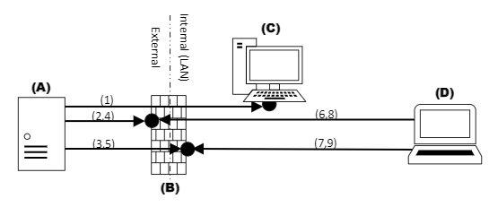
Measurement Setup
10 gateways representing ~25% of market share (by manufacturer)
Assess user controls, mechanisms and default security policies for IPv6
Assess from both trusted and untrusted vantages
Notes:
To do this, we selected 10 commonly deployed gateways and tested them in a real-world configuration within a consumer premises operating IPv6.
First, we reviewed and documented the default configuration of each device by assessing the administrative menus, configuration options, and finally their operation.
For the operational assessment we scanned each gateway from two vantages, one from the internal trusted side of a customer’s network looking outward, and a second series of scans from an external vantage connecting inward.
Each scan assessed open services, filtering behavior, and overall device response with firewalls enabled, disabled and under changes to the various configuration options provided.

Slide 6
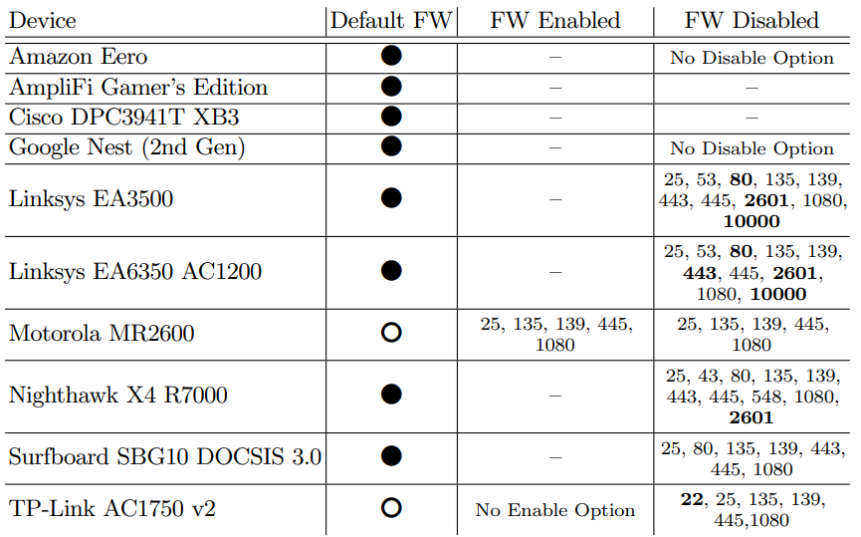
Results
Understanding a Gateway’s Default Policy is Left To Individual Consumer Analysis
TP-Link AC1750 is the top selling router on Amazon.com – IPv6 Enabled by default, but no mechanism available to control access (No FW for IPv6).
Bolded ports responded with banner of service from external scan.
*Findings were disclosed to TP Link and Motorola for their default open posture prior to publication. Motorola has since addressed our concerns in a security update. TP Link has not responded.
Notes:
What we find in our assessment is a diverse range of default configurations and gateway operation surrounding IPv6. Particularly, we find that manufacturers have chosen in a few cases to implement the open model architecture for IPv6 as the default configuration rather than a well defined firewall which we mark here with the white circles.
In the most egregious example we witnessed, The TP-link Archer AC1750 provided both a default IPv6 operation while completely lacking any form of a IPv6 firewall altogether. In this worse case scenario a user’s devices would be directly exposed to the Internet without any notification, as they for us. This is also, unfortunately, the top selling router on Amazon.com.
A second point of concern we discovered is that when these devices were operated in the open model (by disabling the FW using the RFC mandated toggle mechanism), both external and internal interfaces of the gateway were globally addressed and reachable from an external client.
Now, typically in an IPv4 NAT network this internal interface is assumed to operate in a trusted internal boundary and commonly hosts device administrative portals, hole punching agents, or other configuration mechanisms to ease consumer burden. Now each of these mechanisms were exposed to the open internet.

Slide 7
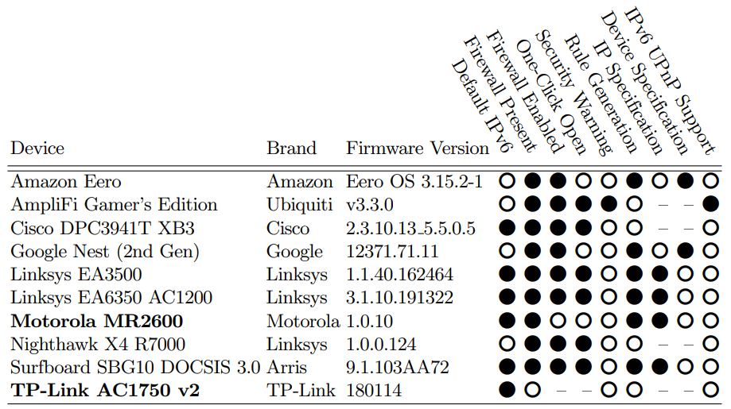
Results
Unlike with IPv4, There Is No Standard Operation For IPv6
Devices rarely warn a consumer about security pitfalls (eg. Opening firewall)
Mechanisms to implement security policy vary: per-device, per-IP, or no mechanism available at all.
Many gateways run IPv6 by default, potentially exposing users and devices.
Consumers rarely refine or update systems.
Default configuration typically==operational configuration.
Notes:
The methods to implement a refined policy to address these exposures are challenging at best. For example, some systems provide mechanisms to filter on a per-device basis, which captured all address scopes under IPv6 and applied the specified policy.
Other devices filter on a per-IP basis, leaving to the consumer to recognize that there are potentially many IPv6 IPs available on a system and that they must apply individual policies for each assigned IP, now this could be a be a near impossible task for devices that generate and use temporary IPv6 addresses on a constant basis.
Some systems provide no configuration options at all, relying instead on the manufacturer's default policy alone. In one case, the Ubiquiti Amplifi router provided no method to modify the system firewall policy. Instead, the only option was to disable (or open) the firewall completely in order to allow access to a device on the internal network. Uniquely, this was the only gateway we assessed that provided a warning to the consumer on the dangers surrounding the disabling the IPv6 firewall.
All of these unique device behaviors are in stark contrast to the near uniform operational behavior and configuration options found within IPv4 NAT on the same devices.

Slide 8
Takeaways
A single, defined operational model was not present in the gateways we observed.
Mechanisms to define IPv6 security policy fraught with pitfalls for the consumer.
Many IPv6 default configurations unnecessarily expose users and devices, contrary to the same device implementations for IPv4.
No way for a consumer to know how their device operates without doing a full assessment, an unlikely proposition.
Notes:
What all of this means for consumers is that the traditional plug and pray method of gateway operation no longer provides an assured level of baseline security. In fact, quite the opposite is true as numerous pitfalls and unintentional exposures exist in the gateways we assessed.
With the majority of consumers likely operating their devices in a default configuration, we cannot assume these users understand the paradigm shift IPv6 provides, or even have the desire to precisely maintain security policies within them. Therefore, it is upon both device manufacturers and standards organizations to quickly address this gap in security.
At the most basic level, a gateway should provide a secure default policy for IPv6 that is both familiar and simple to manage. While the IETF provides the exact same recommendation, there is no specified policy to force this behavior. The end result is what we see here, a cursory consideration of IPv6 operation that woefully ignores the impacts these shifts entail.

Slide 9
Future Work
Larger scale examination of IPv6 operation in consumer gateways (Globally deployed assessment).
UI/UX study to assess home security controls, mechanisms and consumer needs for IPv6.
Notes:
In future works, we assess the true scale of these exposures through large scale internet scanning mechanisms for IPv6. Based on this work, we suspect a number of IPv6 gateways expose consumer networks unexpectedly, leaving many devices accessible to the open internet.
What is not clear at this time is how a consumer will actually respond to these changes under IPv6. We propose a future study to assess both consumer awareness and methods to implement security controls as one method to help establish a common operational baseline and identify mechanisms that are clear and simple for consumers to operate.

Slide 10
Conclusion
Questions?
Notes:
We encourage you to further review our paper for additional takeaways, and security failures, which highlight the shortcomings of IPv6 operation within consumer gateways. We would now like to up open up for any questions you may have.

