Slide 1

National COVID-19 Resilience Study
Team: Fiji
Faculty Advisor: Aaron, Adam, Julia, Jeff, Yichao
Team Member: Junwei Luo (Team Lead)
Joseph Pasik
Song Zhao
Leon Zubkov
Date: 04/18/2020

Slide 2


_
BACKGROUND & goal
Gauging the resilience of various countries to the coronavirus pandemic by grouping them based on various aspects of their health system.
Closer look at medical
preparedness in relation to
COVID 19
Advance the understanding of the impact
Post COVID19 crisis market insight for investors
Forecast economic recovery

Slide 3
SCOPE
WHAT
HOW
Understanding
COLLECT, IDENTIFY, PREDICT
Nation’s resilience
Medical system factors
DATA ENGINEERING
FEATURE SELECTION
FRAMEWORK OF UNDERSTANDING
VISUALIZATION
RESEARCH ANALYSIS
CLUSTERING
OECD HEALTH DATA
FRAMEWORK
TIME-TRAVELING IMPLICATION

Slide 4

Measuring Metrics
SELECTION FROM 5 Categories with 46 Factors
SAMPLE FACTORS:
# of Physicians, Medical graduates, mri units, inpatient discharges, life expectancy at birth, alcohol consumption…
NURSES
1
HOSPITAL BEDS
2
DENSITY PER 1,000 POPULATION
DENSITY PER 1,0000 POPULATION
HEALTH EXPENDITURE
DOCTOR CONSULTATION
3
4
PER CAPITA
* OECD Health Statistics
*BASED ON THE STUDY OF INTERNATIONAL PROFILES OF HEALTHCARE SYSTEM

Slide 5
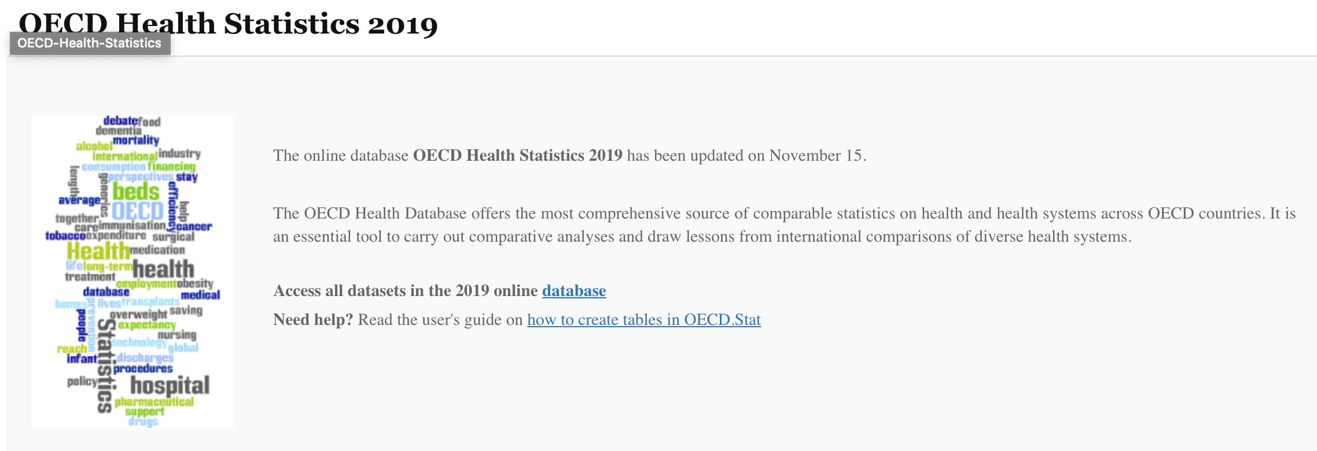
PROCESS
CLUSTER
DEVELOPMENT
WITH KMEANS
COLLECT DATA
DATA CELANUP
WEIGHTED CLUSTERING
Visualization
WORLD BANK
OECD
INTERNATIONAL PROFILES OF HEALTHCARE SYSTEM
ASSESS EACH COUNTRY’S DATA QUALITY
3D SCATTER PLOT

Slide 6
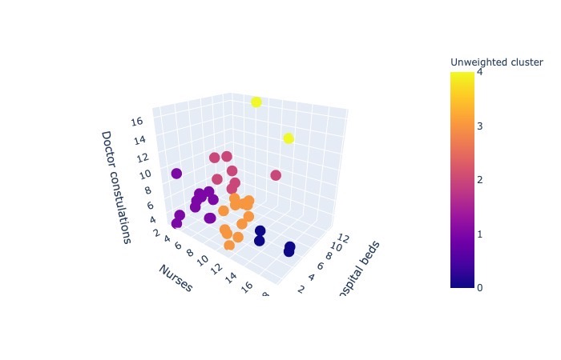
VISUALIZATION| FINDINGS|ANALYSIS
VISUALIZATION
ANALYSIS & FINDINGS
CONCLUSION
IMPROVEMENT

Slide 7
CONSTRAINS|IMPROVEMENTS
VISUALIZATION
ONGOING EVENT: DATA AVAILANILITY & RESOURCE
LIMITITION OF DATA AND TIME
ANALYSIS & FINDINGS
CONCLUSION
DIFFERENT FEATURES FOR FURTHER INSIGHTS
ALGORITHM METHOD
IMPROVEMENT
Notes:
1. Data availability (diabetes)

Slide 8
THANK YOU!
Adress:
School of International and Public Affairs, Columbia University
420 W 118th St #1410, New York, NY 10027
Phone:
(212) 854-5406
Website:
www.columbia.edu

Slide 9
PANEL Q&A

Slide 10
ADDENDUM
Research Reference
http://www.oecd.org/els/health-systems/health-data.htm
International Profiles of Health Care Systems

