Slide 1


projektni zadatak . Izrada WEB shopa
Tim BATMAN

Slide 2


Ivan Mušanović
Ivan Periša

Slide 3

Mentor: Luka Matković

Slide 4
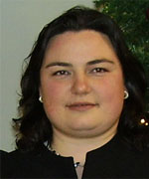
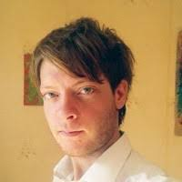
Frontend
Frontend
Frontend
Baze
Backend
Backend
Edo Begagić
Sonja Krišković
Tim BATMAN

Slide 5




