Slide 1

Containers – an introduction
Karl Podesta
Cloud Solutions Architect
Microsoft Ireland
Feb 2017

Slide 2
Contents
What is a container?
Why would you use containers?
Microsoft Windows Containers
Azure Container Service (ACS)
Container Day to Day – Images, Storage, Identity, Patching
Getting Started + Resources

Slide 3
What is a Container?
Application
Binaries + Libraries
Operating System
Hardware
Machine

Slide 4
What is a Container?
Application
Application
Bin + Libs
Bin + Libs
Application
OS (Guest)
OS (Guest)
Binaries + Libraries
Virtualisation (Hypervisor)
Operating System
OS (Host)
Hardware
Hardware
Machine
Virtual Machine
(HW Virtualisation)

Slide 5
What is a Container?
Application
Application
Bin + Libs
Bin + Libs
Application
OS (Guest)
OS (Guest)
Application
Application
Binaries + Libraries
Virtualisation (Hypervisor)
Bin + Libs
Bin + Libs
Operating System
OS (Host)
OS (Host)
Hardware
Hardware
Hardware
Machine
Virtual Machine
(HW Virtualisation)
Container
(OS Virtualisation)
A Container has namespace isolation (separate process space, files, network ports, resources)
Containers start in seconds, take only incremental mem + disk space, and many more instances of the application can run than with VMs

Slide 6
What is a Container?
Application
Application
Bin + Libs
Bin + Libs
Application
OS (Guest)
OS (Guest)
Application
Application
Binaries + Libraries
Virtualisation (Hypervisor)
Bin + Libs
Bin + Libs
OS (Host)
Docker (Container Management)
Operating System
OS (Host)
Hardware
Hardware
Hardware
Machine
Virtual Machine
(HW Virtualisation)
Container
(OS Virtualisation)
A Container has namespace isolation (separate process space, files, network ports, resources)
Containers start in seconds, take only incremental mem + disk space, and many more instances of the application can run than with VMs

Slide 7

Why would you use Containers?
CONTAINERIZE TRADITIONAL APPLICATIONS
Containerize for security, portability and efficiency
TRANSFORM MONOLITHIC TO MICROSERVICES
Look for shared services to transform
ACCELERATE NEW APPLICATIONS
Agile cloud native app development

Slide 8
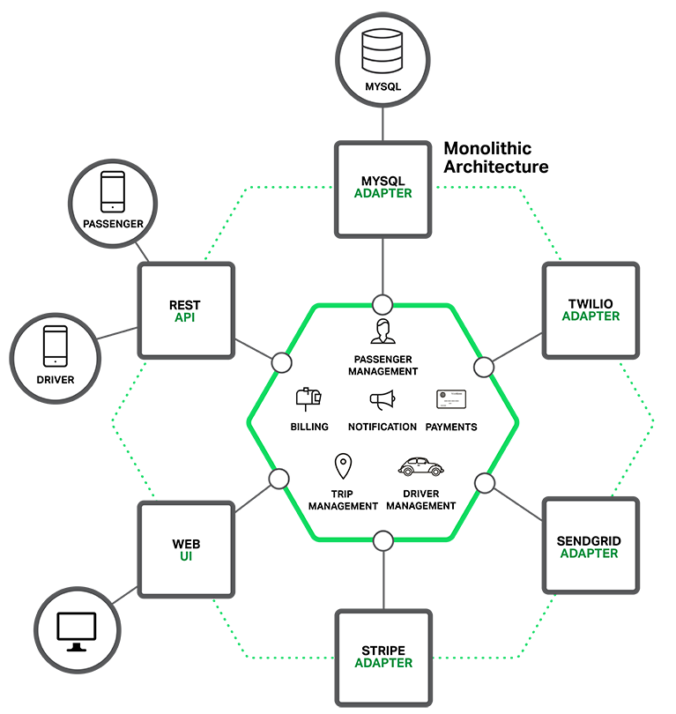
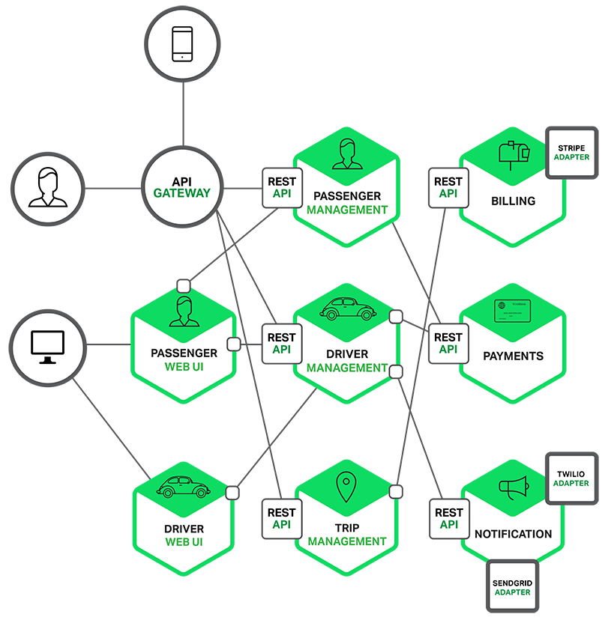
Why would you use Containers? (microservices)

Slide 9



Why would you use Containers?
Collaborative DevOps Approach - Docker containers as central to the process
OPERATIONS collaborates with DEVELOPERS to provide app metrics and insights.
DEVELOPERS build, test and update apps in Docker containers, using development environment, i.e., Visual Studio.
OPERATIONS automates deployment and monitors deployed apps from central Docker container repository.
DEVELOPERS push containers to central repository.

Slide 10
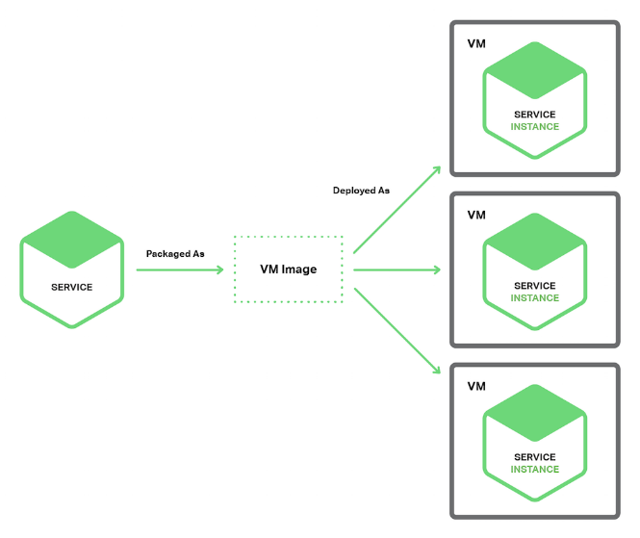
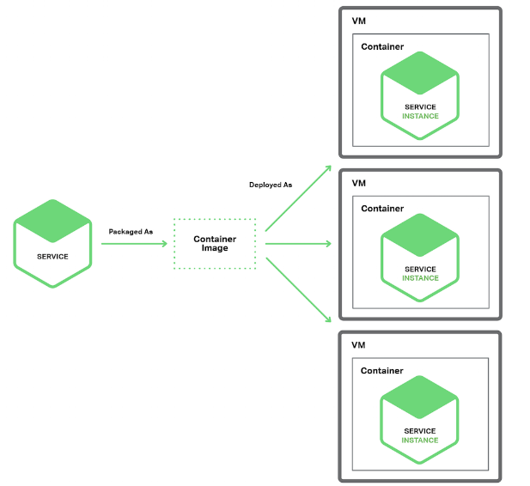
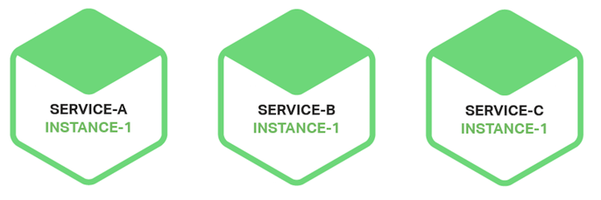
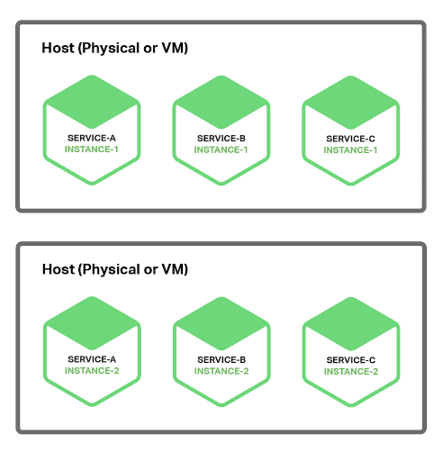
Why would you use Containers? (microservices)
More isolated* More efficient
Service Instance per Host/VM
Service Instance per Container
Multiple Service Instances per Host/VM
Serverless
Cloud Services
Docker, Openshift, Mesosphere
Service Fabric
Azure Functions
VM Scale Sets
CloudFoundry
AWS Lambda

Slide 11
What is a Container? (Docker Management)
}
Docker Universal Control Plane
Container
Development and
Management Toolset
Docker CLI and PowerShell
Docker
Swarm and Compose
Docker Image Registries
Microsoft Service Fabric
Kubernetes
Docker Engine
Operating System
Container Runtime

Slide 12
Windows Containers – (1) Server Containers
Host User Mode
System Processes
Session Manager
Container Management
Local Security Authority
Windows Server Container
Windows Server Container
Docker Engine
Etc…
System Processes
Application Process(es)
System Processes
Application Process(es)
Windows Kernel

Slide 13
Windows Containers – (2) Hyper-V Isolation
Host User Mode
System Processes
Hyper-V Isolation
Virtual Machine Specifically Optimized To Run a Container
Session Manager
Container Management
Local Security Authority
Windows Server Container
Windows Server Container
Docker Engine
Etc…
System Processes
Application Process(es)
System Processes
Application Process(es)
Windows Kernel
Windows Kernel
Hyper-V Hypervisor

Slide 14
Windows Containers – Startup Performance
NodeJS with Nano Server
Windows Server Container
Under 600 Milliseconds!
With Hyper-V Isolation
~1.75 seconds
A virtual machine takes ~3 seconds
NodeJS with Windows Server Core
Windows Server Container
~1 second
With Hyper-V Isolation
~3.3 seconds
A virtual machine takes ~5 seconds to over a min

Slide 15
Windows Containers – Density
NodeJS with Nano Server
Windows Server Container
First Container ~120MB
Additional Containers ~75MB
With Hyper-V Isolation
First Container ~340MB
Additional Containers ~150MB
NodeJS with Windows Server Core
Windows Server Container
First Container ~150MB
Additional Containers ~75MB
With Hyper-V Isolation
First Container ~555MB
Additional Containers ~280MB

Slide 16

Containers – Orchestration
Applications are typically comprised of multiple containers
Containers typically hosted across a cluster of nodes
Orchestration tooling automates this

Slide 17
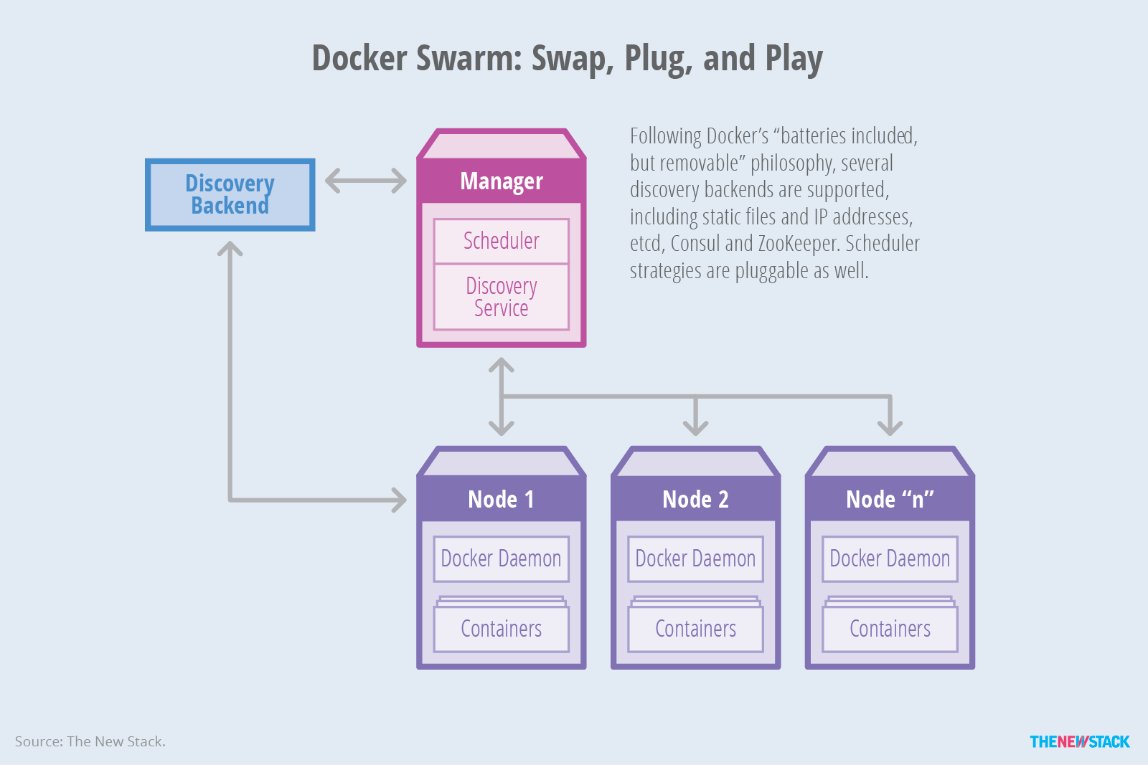
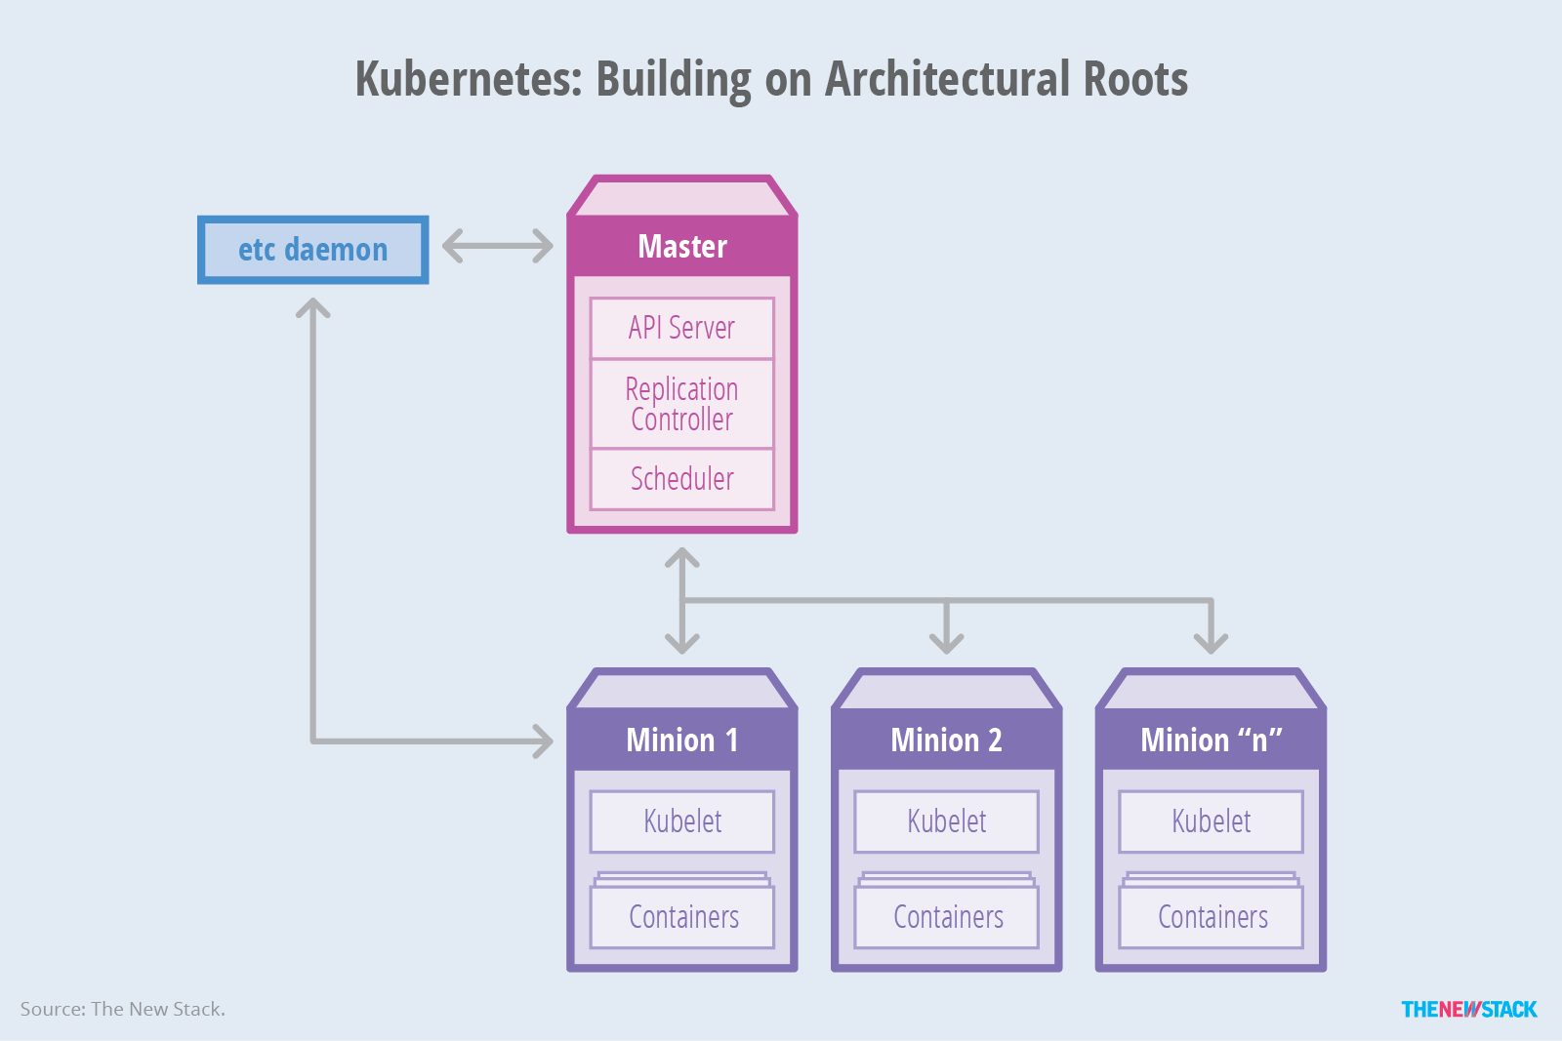
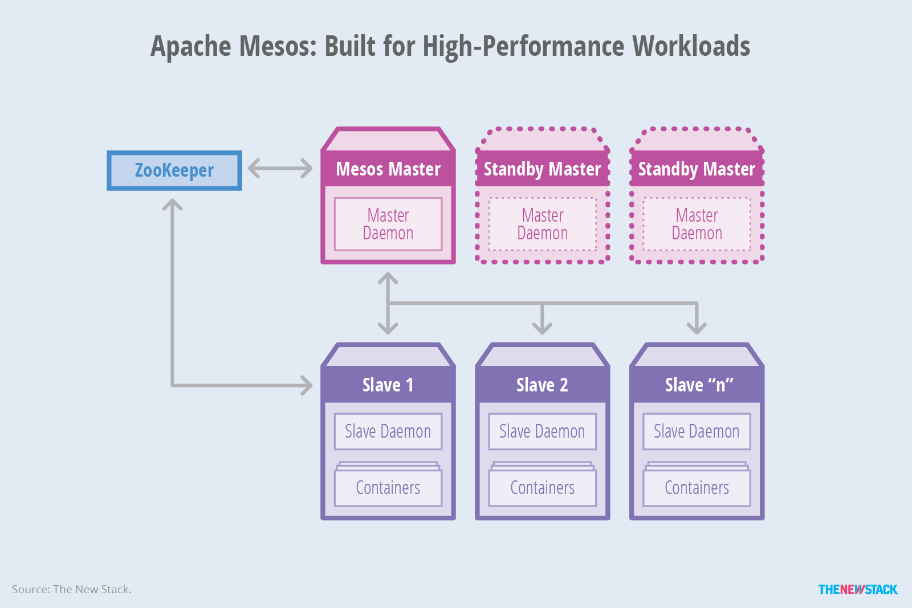
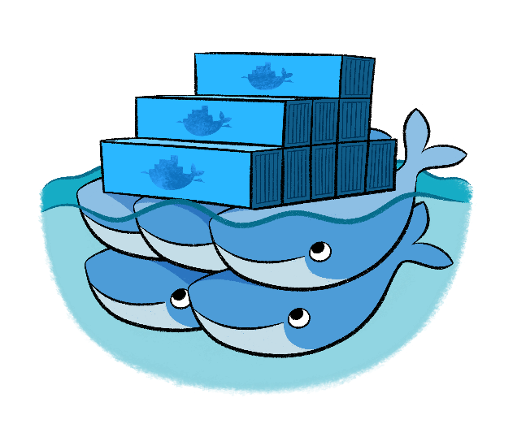
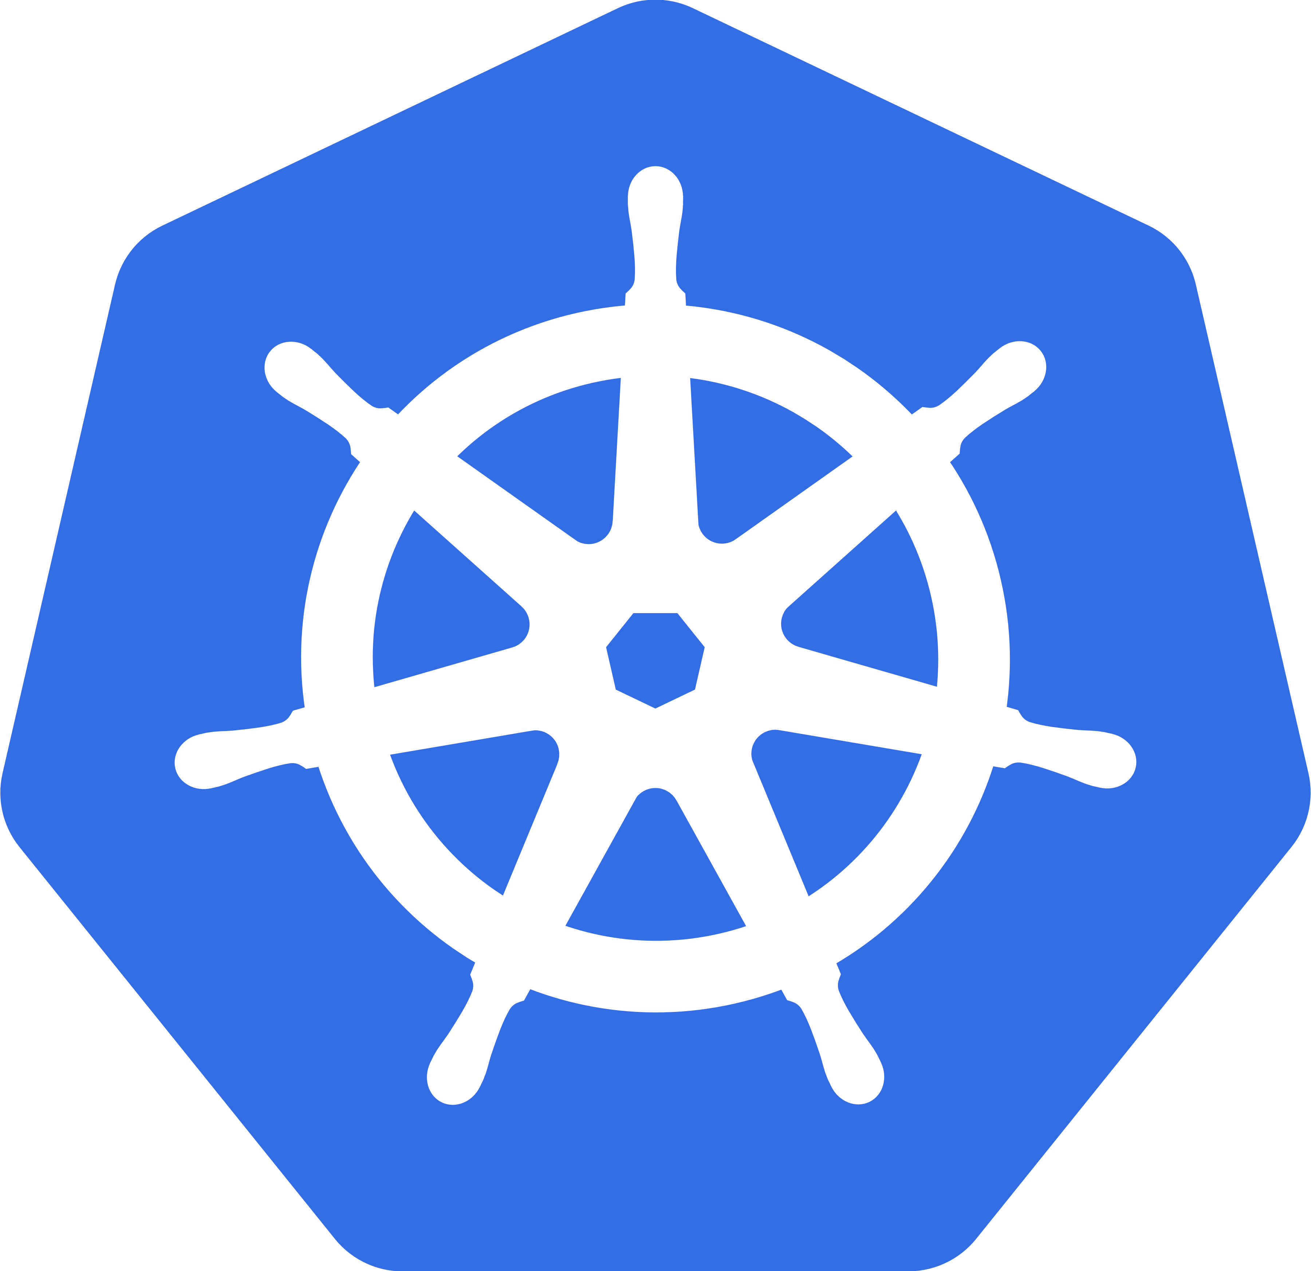
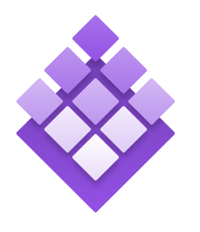
Containers – Orchestration Engines
Docker Swarm (Docker)
Kubernetes (Google)
DC/OS (Apache/Mesos)
Notes:
https://thenewstack.io/containers-container-orchestration/

Slide 18

Azure Container Service (ACS)
Azure
Standard Docker tooling & API support
Streamlined provisioning of Docker Swarm, DCOS, Kubernetes
Linux and Windows Server containers
Azure and Azure Stack
Swarm
DC/OS

Slide 19
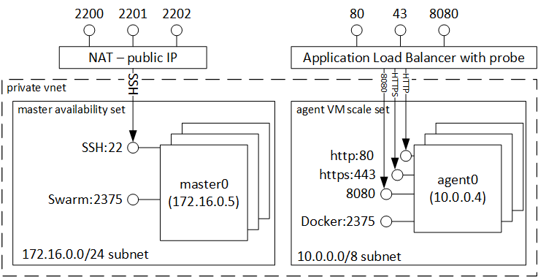
Azure Container Service (ACS) – e.g. Docker Swarm
Native Clustering for Docker
Serves the Docker API
Docker tools to transparently scale to multiple hosts on Azure Container Service (e.g. docker cli/compose, Jenkins)

Slide 20
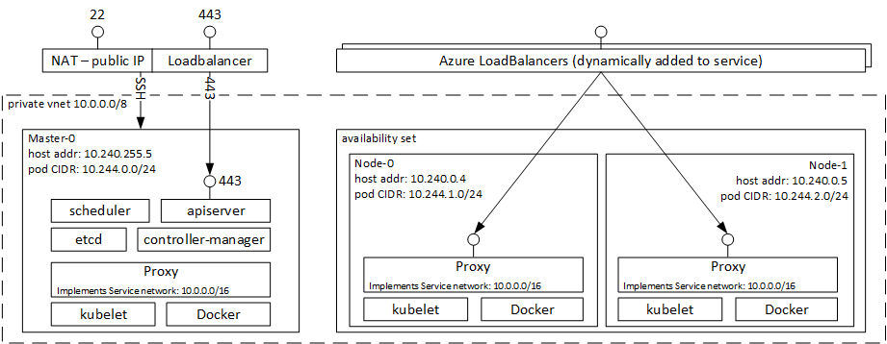
Azure Container Service (ACS) – e.g. Kubernetes
Open Source, production grade container orchestrator tool (originated at Google)
Rich Feature set: Horizontal Scaling, Service Discovery, Load Balancing, Secrets + Config Mgmt, API-based rollouts/rollbacks

Slide 21
Containers – Image Repositories
What is a registry?
Stores container images
Images are Pushed into a registry
Images are Pulled from a registry
Images are Searched for within a registry

Slide 22
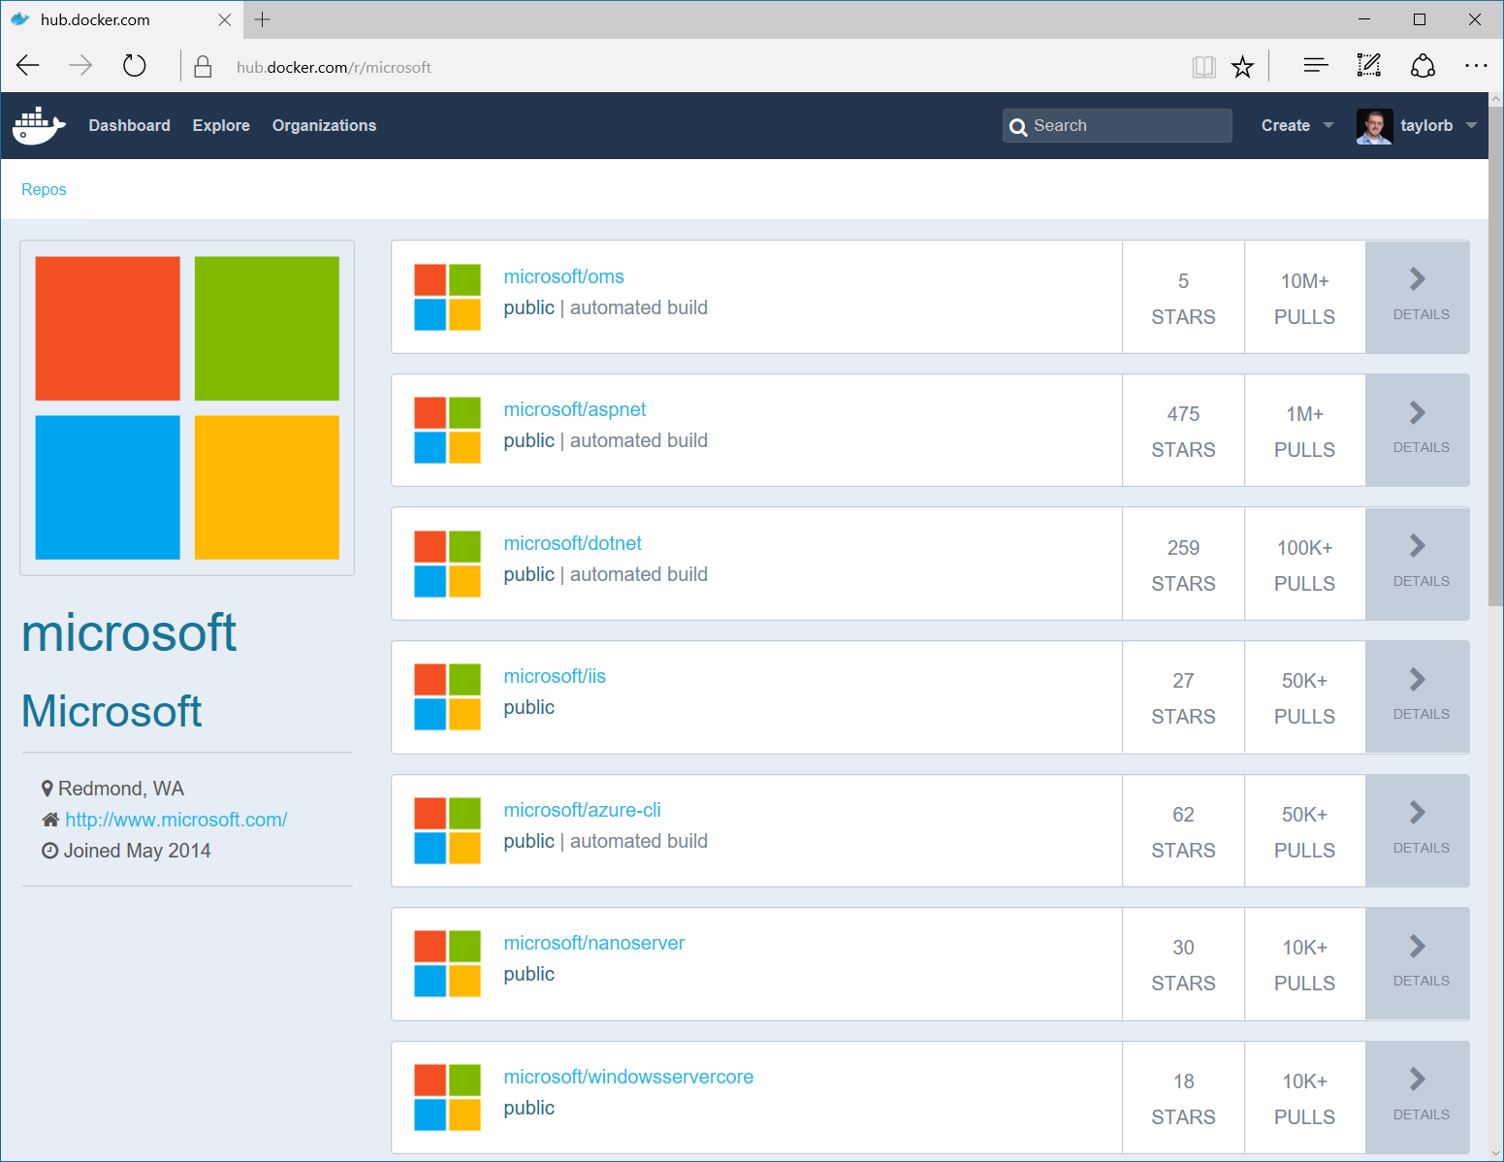
Containers – Image Repositories
Docker Hub and Docker Store
Public, Official and Private image repositories
Granular access controls with organization support
Automated image build support
Docker Trusted Registry
Enterprise Grade Private Registries
Runs on your infrastructure (on-prem or cloud)
Active Directory and Role Based Access Controls
Azure Container Registry
Store and manage container images across Azure deployments
Maintain Windows and Linux container images
Same API and Tools as Docker Hub/Store/Registry
Docker Registry
Open source foundation of Hub and DTR
Runs on your infrastructure (on-prem or cloud) as a container
https://docs.docker.com/registry and or https://github.com/docker/distribution

Slide 23
Containers – Storage & Volume Mapping
Running a Container
docker run –v d:\ContainerData:c:\data mycontiner
Image Contents
My Container
License.txt
PerfLogs
Program Files
Container View
Program Files (x86)
Users
Windows
Host Storage
License.txt
PerfLogs
Program Files
C:
D:
Program Files (x86)
Users
Windows
data
Container Host
Container Host
ContainerData

Slide 24

Containers – Identity
1) Use default accounts for services & tasks (LocalSystem, Network Service)
Image
IIS & ASP.Net
Running Container
Service: IIS
User:
LocalSystem
SQL Server
Domain\MyWebApp1$
Credential Spec
DefaultAccount: Domain\MyWebApp1$
3) Container connects using service account
2) Provide default service account to use when starting container

Slide 25

Containers – Patching & Updates
Update Container OS Image
Pull updated base image
Rebuild containers using dockerfiles
My Website
My Website
FROM iis
ADD mysite.htm inetpub\mysite.htm
IIS
IIS
FROM windowsservercore
RUN powershell –command Add-WindowsFeature Web-Server
KB123456 = new image on Docker Hub
10.0.14393.0
10.0.14393.1

Slide 26
Containers – Patching & Updates
Update as a new layer
Download update in container (ala run Windows Update in the container)
When container is stopped update is applied as a new layer
KB123456
My Website
My Website
Same Image
IIS
IIS
Same Image
Same Image
10.0.14393.0
10.0.14393.0

Slide 27
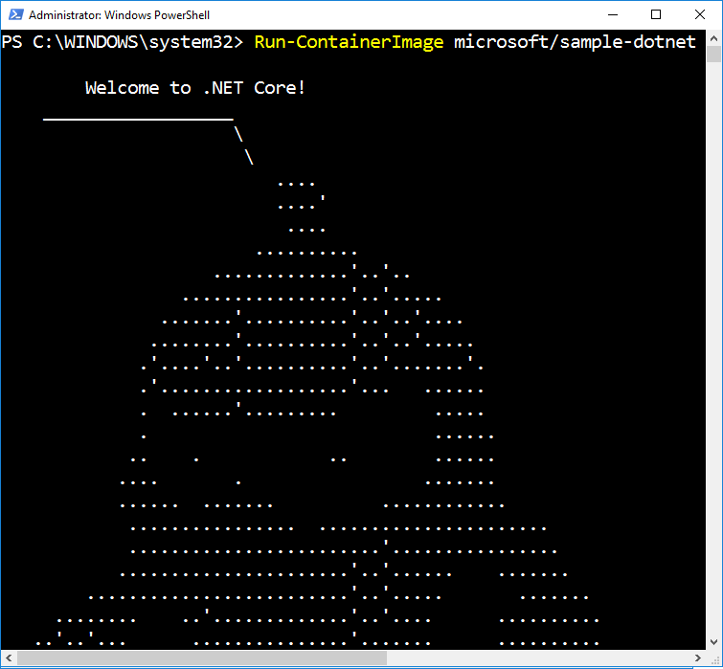
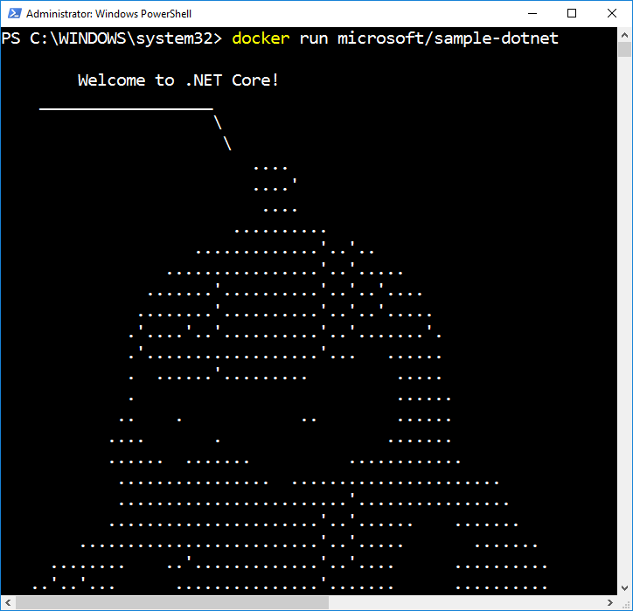
Getting Started – Actually running a container
Creates and Starts a New Container
Runtime options:
Name (network name and management name)
Interactive or Service
Network configuration
Resource management
Volume mappings
Isolation level

Slide 28
Getting Started - Some Resources
Containers at Microsoft:
https://microsoft.com/containers
Mark Russonovich’s Blog post explaining containers:
https://azure.microsoft.com/en-us/blog/containers-docker-windows-and-trends/
Community Links (Videos, Blogs):
https://docs.microsoft.com/en-gb/virtualization/windowscontainers/communitylinks

