Slide 1
.net samples

Slide 2
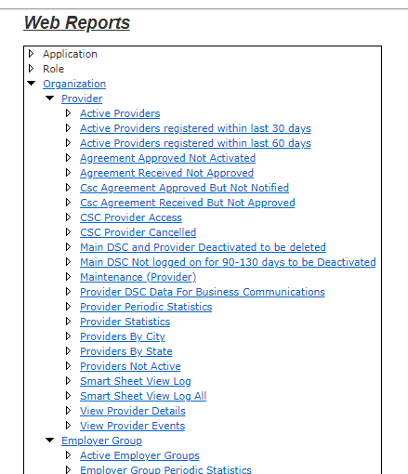
Web Reports - config stored in SQL with custom reporting building

Slide 3
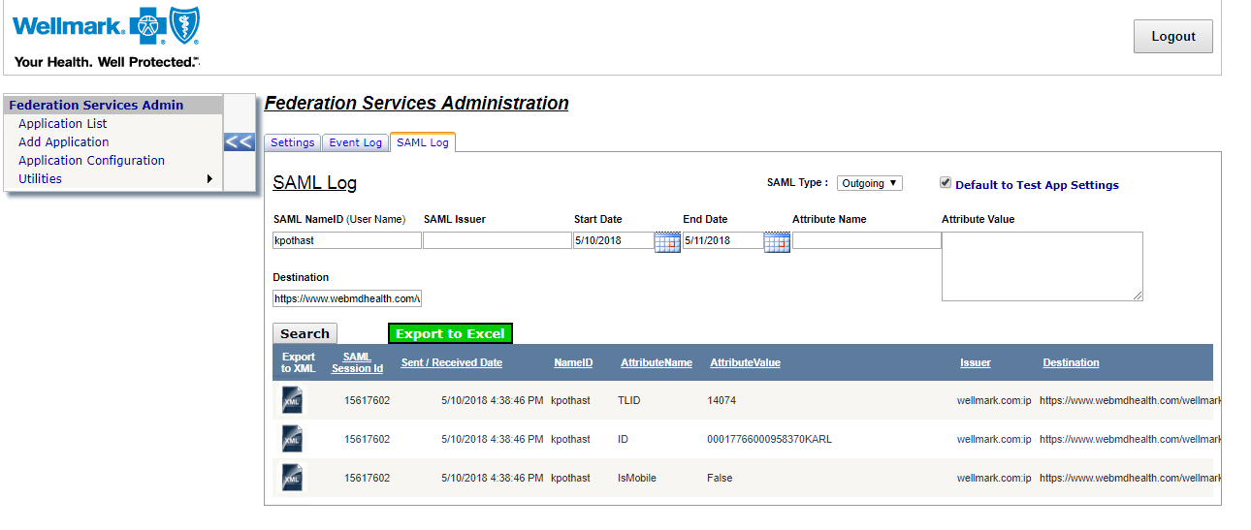
SAML 2.0 Outbound Log - vendor support report with export to Excel and XML

Slide 4
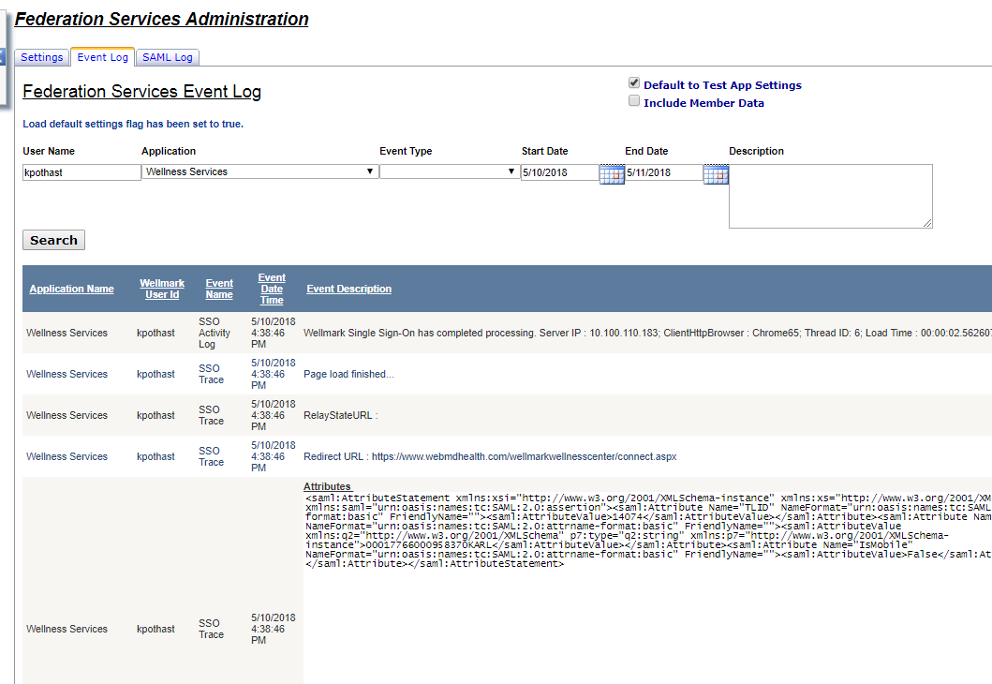
SSO Event Log - for quick user session troubleshooting

Slide 5
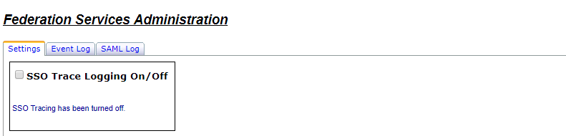
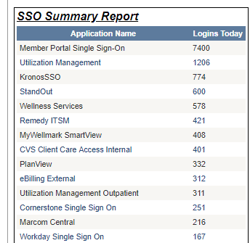
Dashboard page - turn on extended logging; daily summary report

Slide 6
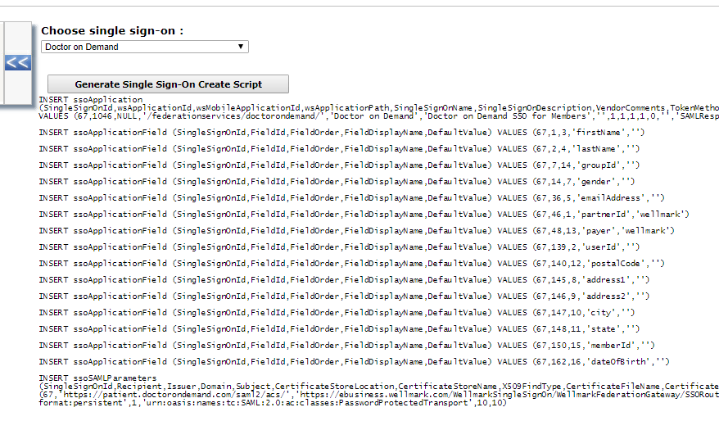
SQL Scripting - script an application

Slide 7
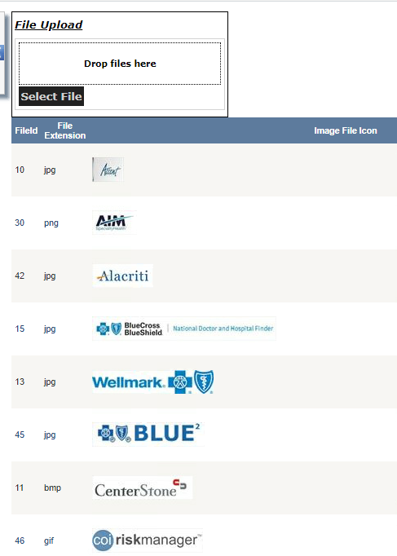
File upload - stored in SQL table as binary column

Slide 8
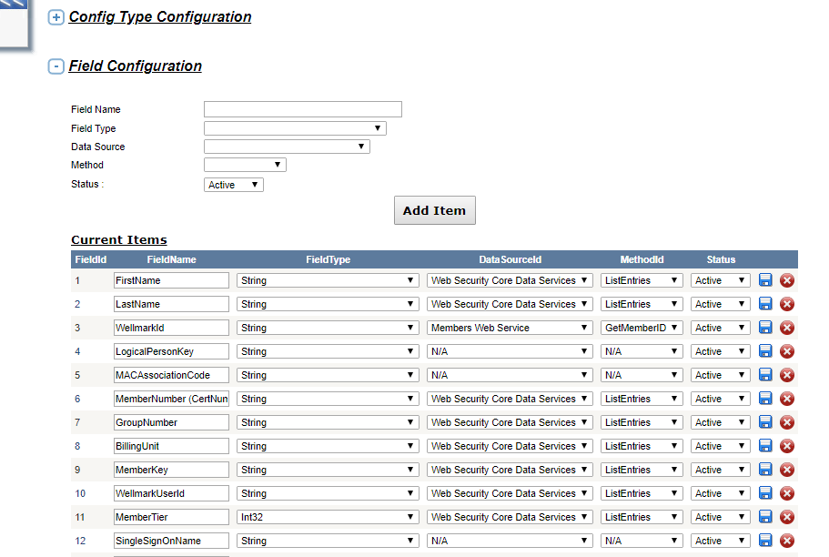
App Config Settings stored in SQL with editable grid

Slide 9
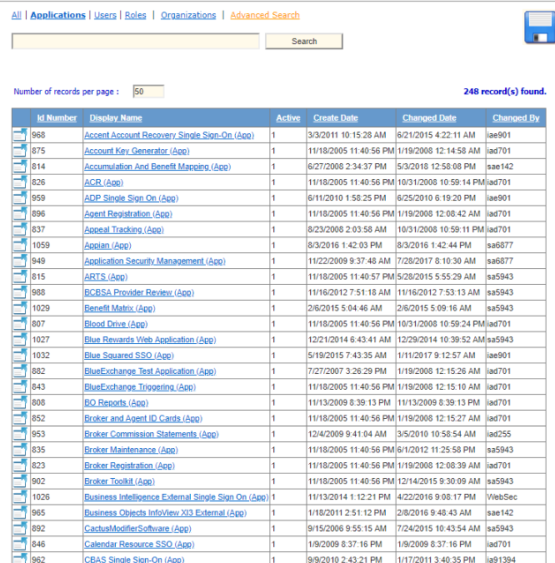
Asp.Net grid

Slide 10
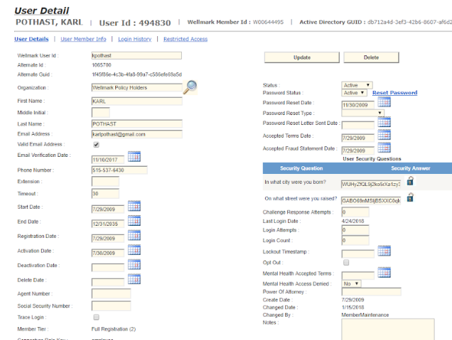
UI Detail Page

