Slide 1
Characterizing Aerospace Cost Estimate Dynamics: Distributional Metrics for Contextualizing Outcome Variability
Karl Roush
Georgia Institute of Technology
AIAA SciTech Forum [DE-12/DGE-09], 12-16 Jan 2026
Copyright © by Karl Roush
Published by the American Institute of Aeronautics and Astronautics, Inc., with permission.

Slide 2
Presentation Information
FINAL ID: AIAA-2026-1525 (Control ID: 4347349)
Session: DE-12/DGE-09, Emerging Design Methods and Digital Ecosystems
Scheduled: January 14, 2026 from 1:00 PM to 3:00 PM Eastern Time, in room Bayhill 23
Presentation Time: 1:20 PM to 1:40 PM
Presentation Duration: 20 minutes (reserve the last 5 minutes for questions and answers)

Slide 3
The Challenges of Cost Estimation
Cost estimates are fundamental to project planning, approval, and feasibility assessments.
The Reality
A cost estimate is a range of values that reflect the uncertainty and variability of a project.
Scope, inflation rates, execution, etc.
Represents a distribution of outcomes
Well understood, but conveying the extent of these models is often overlooked [1]
The Problem
Traditional metrics fail to capture the complexity of potential outcomes
Min, max, average
What about rare, impactful (outlier) events?
E.g. COVID-19
Outliers are more common in long-duration programs/projects

Slide 4
Rephrased as a research question:
How can the dynamic nature of cost estimates be communicated to account for rare events and the diversity of potential outcomes?”

Slide 5
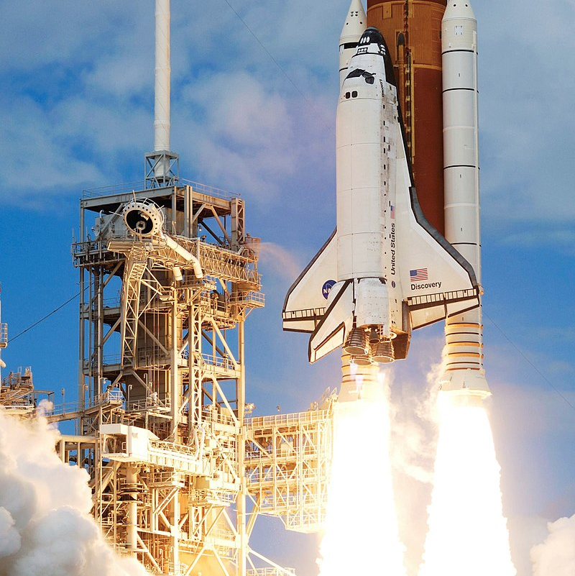
Case Study: Space Shuttle Program (SSP)
Large scale, long duration program with ample publicly available data
Elements of the Space Shuttle Program continue to influence modern day programs
Three core elements of the study
  Demonstrate the shortfalls of traditional metrics,
  Propose supplemental options,
  Compare two sets of metrics
“The primary objective of the Space Shuttle Program (SSP) is to provide a new space transportation capability that will
(a) reduce substantially the cost of space operations, and
(b) prove a future capability designed to support a wide range of scientific, defense, and commercial uses.”
Space Shuttle Program Request for Proposal No. 9-BC421-67-2-40P

Slide 6
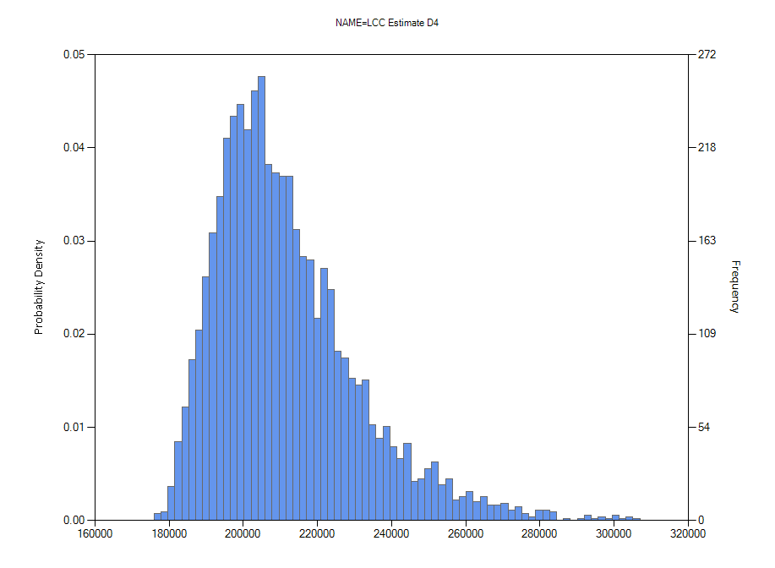
Traditional Metrics
Creating a cost estimate for the SSP is beyond the scope of this paper, data from [3]
This estimate reconstructs a Work Breakdown Structure for the SSP within NASA’s parametric cost estimating tool Project Cost Estimating Capability (PCEC).
Metric | $B (2024 dollars) | Limitation
Mean | $211.591 | Does not convey distribution shape.
Median | $208.098 | Ignores tail risks and outliers.
Minimum | $176.900 | Likely optimistic.
Maximum | $319.082 | Doesn't define the probability of this extreme.

Slide 7
Distributional Metrics
Spread, Shape, Risk Measurement

Slide 8


Measuring Spread
Coefficient of Variation (CV)
A scale-invariant metric to compare variability across different projects.
Higher CV indicates more spread relative to mean.
Suggests higher sensitivity to inputs (e.g. learning rates) for cost estimate
Index of Dispersion
(Variance-to-Mean Ratio)
Project specific value, useful for identifying clusters
Project specific due to units
1130 + 1230 lunch shows low CV but misses the two clusters
Can be used to identify specific WBS elements or project phases with high variability
Semi-Deviation
Variation is often not consistent across a distribution, semi-deviation and semi-variance allows for subset analysis.
See portfolio mgmt. for variability below a loss threshold [5][6]
Relevant to space programs due to Congressional notification if >30% of Agency Baseline Commitment
Median set as threshold for example
0.08896
$1,674.39
[𝑀 $2024]
$16,984
[𝑀 $2024]
Semidev(50)

Slide 9

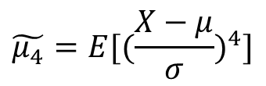
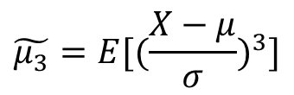
Measuring Shape
It is widely known that aerospace project costs tend to skew significantly upwards [7], these metrics enable a more precise description of the shaping.
Skew
Measures direction and magnitude of bias
Positive means higher costs
A strong positive skew may indicate numerous uncertainties and potential for significant cost overruns
Kurtosis
Describes the shape of a distribution’s tails relative to its overall shape
Higher kurtosis= higher probability of outliers
Informs both outlier cost planning and a validity check for the model
Std. normal distribution has $\tilde{μ_{4}}=3$
$$\tilde{μ_{3}}=E[{(\frac{X−μ}{σ})}^{3}]$$
1.20102
$$\tilde{μ_{4}}=E[{(\frac{X−μ}{σ})}^{4}]$$
2.08901

Slide 10
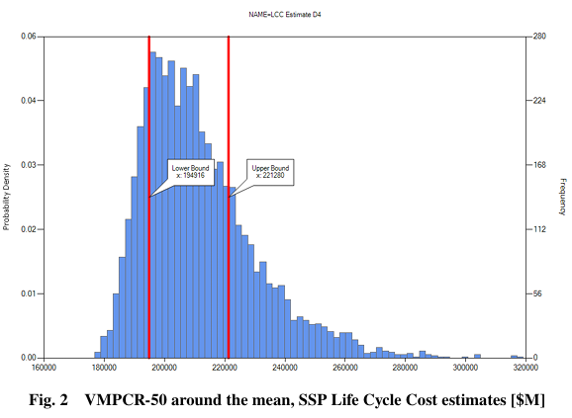
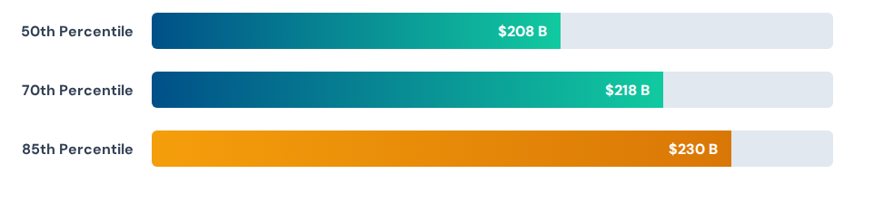
Measuring Risk (Data Proportions)
Percentile Ranges
Captures the proportion of the distribution falling below a certain value or a confidence level
50th and 70th percentiles recommended by NASA NPR 7120.5F [1]
Conservative recommendation is 85th
Can also determine the percentile contained around a value, e.g. the mean
"The SSP will cost $230B or less, with 85% confidence."

Slide 11
Measuring Risk (Outlier Presence)
Frequency of Exceedance
Quantifies the risk beyond a do not exceed level
Set a threshold -> calculate the exceedances
Alt. set the exceedances -> calculate threshold
Examples for the SSP
  Set threshold at most recent LCC est.
  Set exceedances at 5%
Z-Score
Converts a point to the number of standard deviations in relation to the mean
68-95-99.7 rule for characterizing extremeness [9-10]
in relation to z= [1, 2, 3]
Allows for placement of prior estimates within study
Consider the worst case Shuttle LCC estimate from the NASA commissioned 1972 Mathematica study:
$323.3B -> z= 5.9391
Example uses most recent LCC estimate
$254.5 B @ 3.5%
5% @ $248.9 B
$254.5 B -> z= 2.2808

Slide 12
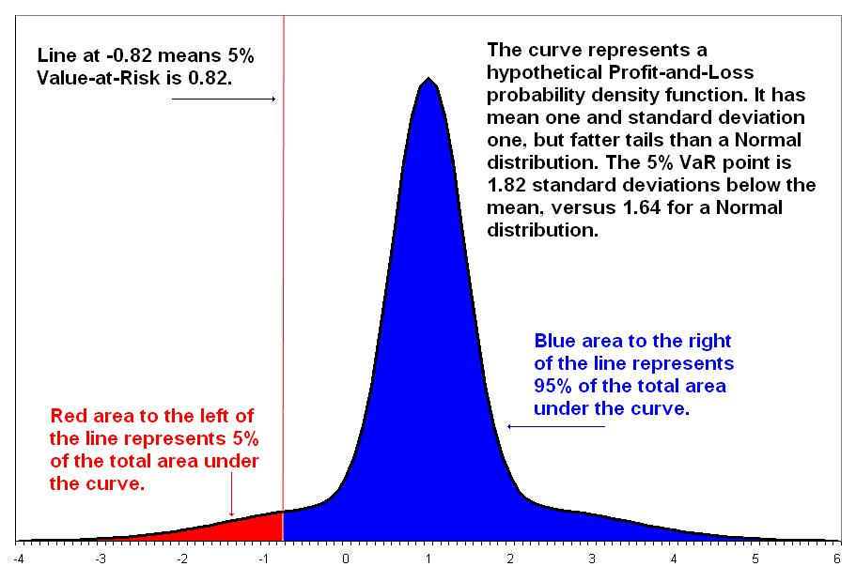

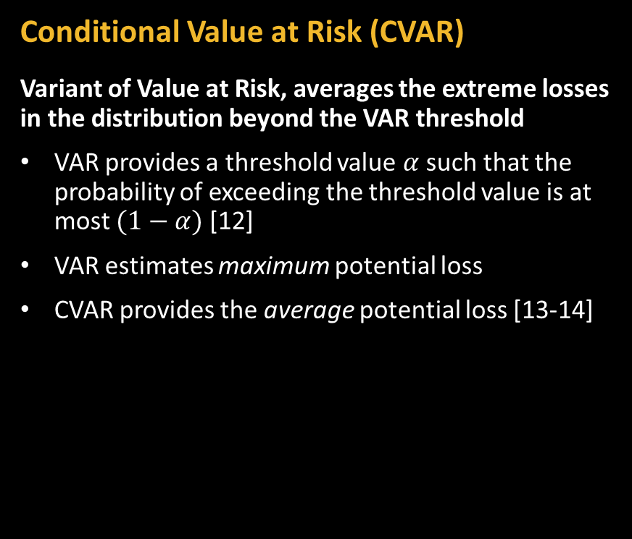
Measuring Risk (Outlier Impacts)
Conditional Value at Risk (CVAR)
Variant of Value at Risk, averages the extreme losses in the distribution beyond the VAR threshold
VAR provides a threshold value $α$ such that the probability of exceeding the threshold value is at most $(1−α)$ [12]
VAR estimates maximum potential loss
CVAR provides the average potential loss [13-14]
CVAR(5)= $262.6 B
CVAR(1)= $285.0 B

Slide 13
Traditional vs. Distributional

Slide 14
Distributional metrics offer a more nuanced view
Metric Category | Traditional Approach | Distributional Approach
Central Tendency | Mean: $211.6 B | 50th Percentile: $208.1 B 70th Percentile: $217.6 B 85th Percentile: $230.1 B
Spread | Min: $176.9 B Max: $319.1 B | CV: 0.089 Index of Dispersion (VMR): $1.67 B Semi-deviation from mean: $16.98 B
Shape | Not Captured | Skewness: 1.201 Kurtosis: 2.089
Risk Measures | "Cost is between $176.9 B and $319.1 B" | Z-score: A cost of $254.4B is 2.28 std. dev from the mean Freq. of exceedance: 3.5% chance of exceeding a budget of $254.4 B CVAR(5): Average cost in the worst 5% of cases is $262.6 B

Slide 15
Summary of Findings
Context is King: Traditional metrics (mean/min/max) overlook the dynamic nature of cost inputs and subsequent estimates.
Quantify the Tails: Distributional metrics (CVAR, Kurtosis) reveal insights into potential outliers and "Black Swan" events.
Robust Planning: Understanding the shape and spread of the cost distribution enables better reserve allocation for long-term O&S phases.
Enhanced Decision Making: Moving beyond single-point estimates allows for a comprehensive risk assessment framework.
The background for this work, its applications, and additional development are further explored in “Adapting the Past for Future Flight: Preliminary Design Framework for Long Duration O&S Aerospace Programs” [3]

Slide 17
This is a slide that can divide sections
This is an optional subhead

Slide 18
This is a pull-quote. Make sure to include a finishing quote at the end like this.”
– YOU CAN ALSO ADD AN ATTRIBUTION HERE

Slide 19
This is a headline for this slide
THIS IS A SUBHEAD – 22 pt
Body Copy placeholder information – 18pt
List information 1 – 18pt
List information 2 – 18pt
List information 3 – 18pt

Slide 20
This is a headline for this slide
This is example text. It’s base size should be 18pt; it can be size a bit larger, if needed.

