Slide 1
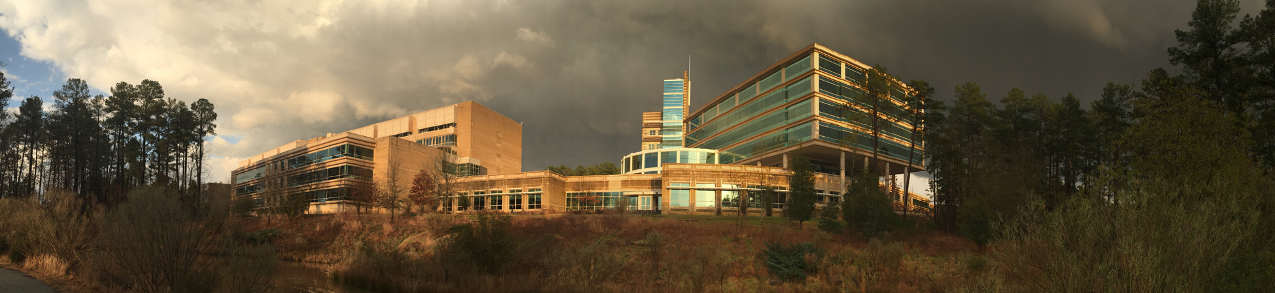
For internal EPA discussion only: not for redistribution
Leveraging R’s bookdown to publish
EIAG Technical Source Documents
Presented by: Karl Seltzer
EPA/OAR/OAQPS/AQAD/EIAG
United States Environmental Protection Agency
Office of Air and Radiation
Month Day, Year
Presentation to: TBD

Slide 2
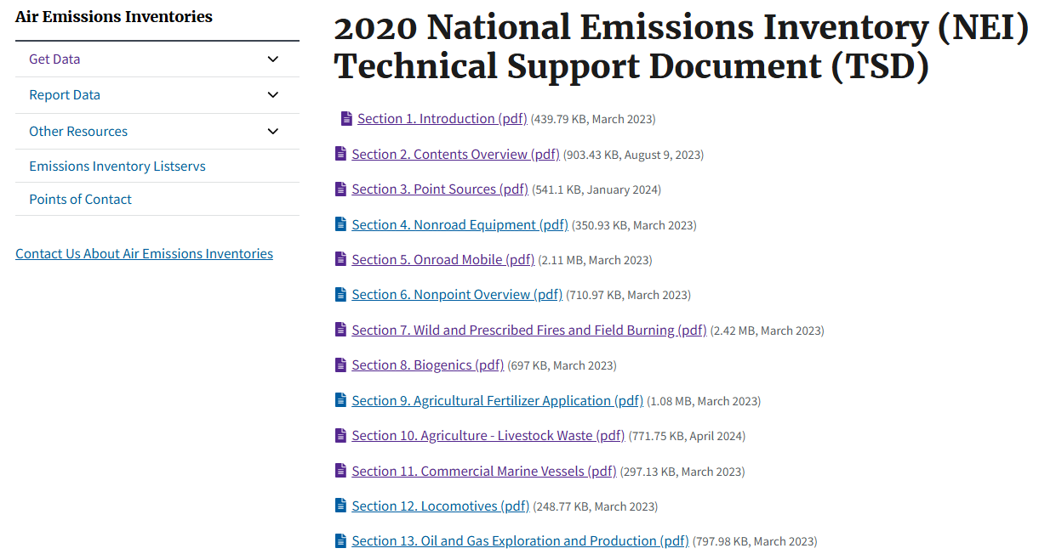
2020 NEI TSD
37 Sections in total; 37 individual PDFs

Slide 3
Limitations with existing TSDs
There are 37 sections and the TSD can only be searched in individual sections (because each section is a separate PDF).
Figures in TSD are fixed: to get a copy, one must take a screenshot.
Underlying data in figures are not readily available for external users. Data for older figures that have been carried forward for many years may be lost.
Updating tables with NEI year-specific data is time consuming.

Slide 4

Proposal
Leverage R’s bookdown to publish TSDs
R bookdown is a package that processes R Markdown files into multiple types of output formats (PDF/HTML).
It can create professional looking websites and printed documents (e.g., PDFs). The websites provide an interactive user experience and make the data/figures within the publication easily accessible.

Slide 5
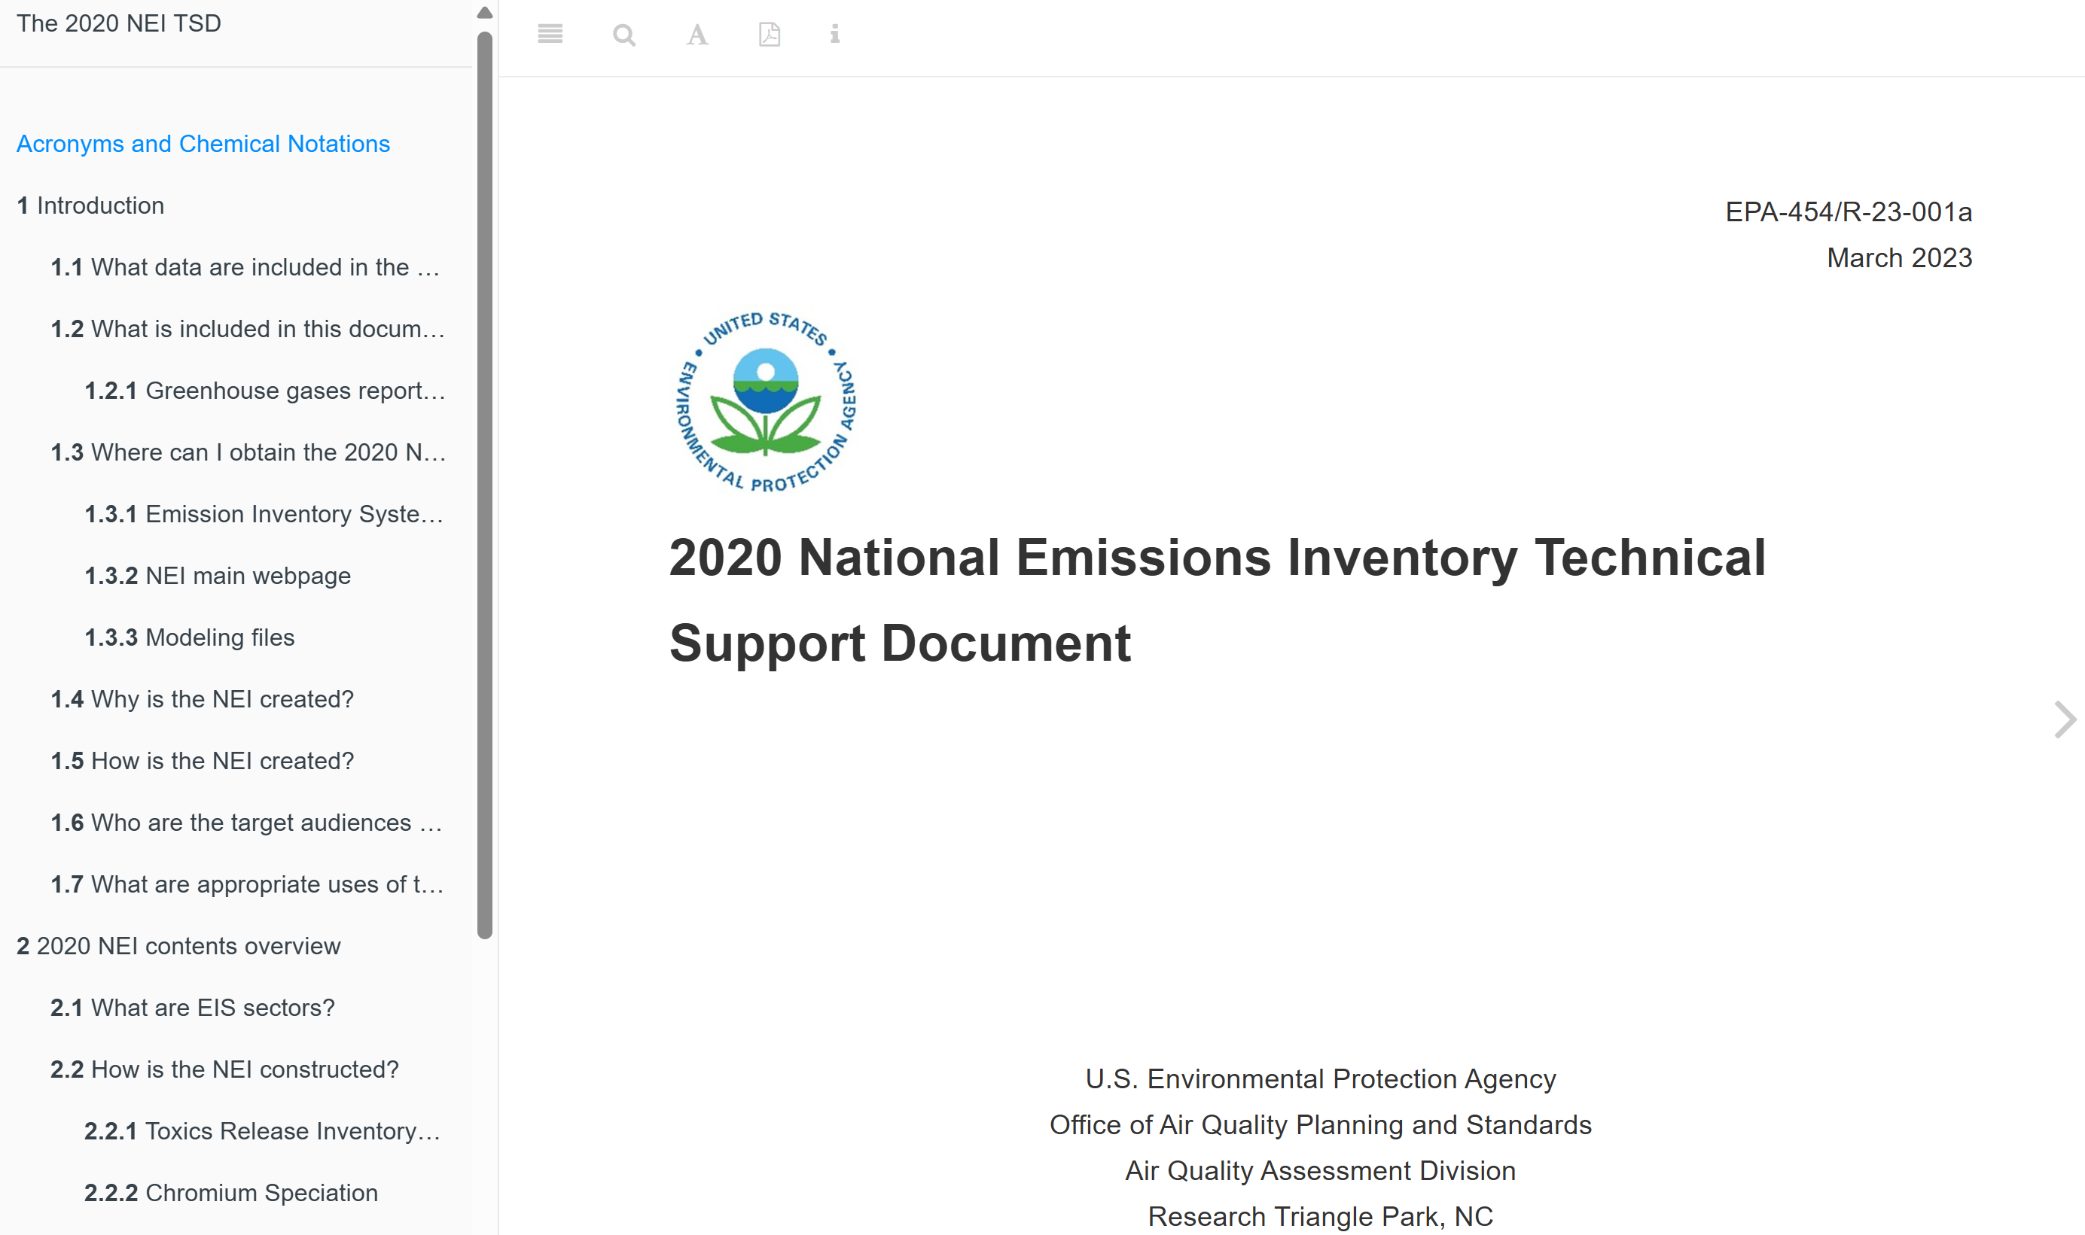
2020 NEI Mock-Up

Slide 6
2020 NEI Mock-Up
Links to full Table of Contents
Some additional FYI
Download full PDF
Change font, font size, background colors, etc.
Search full TSD
Arrows to change page

Slide 7
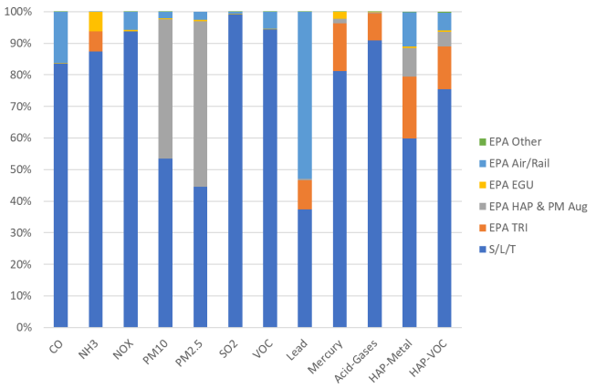
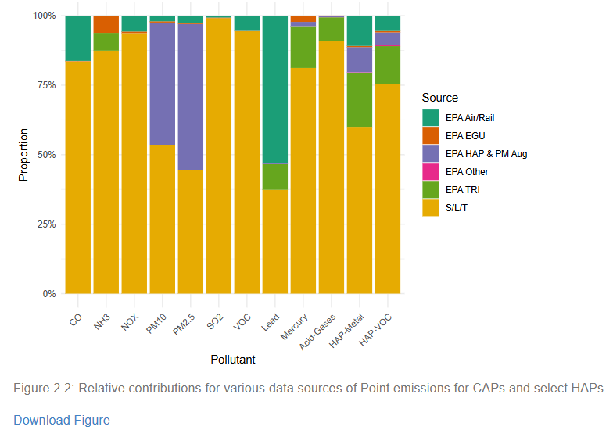
Figures
Existing 2020 NEI TSD
Proposed 2020 NEI TSD
Fixed and generated in Excel.
Fixed and generated in R. May be interactive in future.
Download figure link.
Underlying data easily available on ftp site or elsewhere (GitHub?).

Slide 8
DEMO

Slide 9

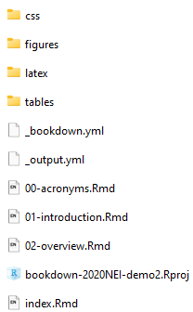
Getting Started
Software requirements: RStudio.
You may already have RStudio on your computer. If not, ask EISD.
I created an abbreviated version of the 2020 NEI TSD. This is the entirety of the files needed to do so:
Let’s go over each item…

Slide 10
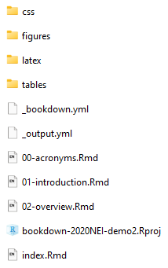
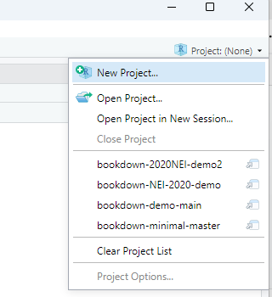
Files you likely do not need to alter
CSS files that are used to control the appearance and layout of web pages.
LaTeX files. The preamble.tex file controls some of the appearances of the output PDF (don’t adjust). More on the before_body.tex file later…
How to open project?
Controls the types of outputs generated when you “Build Book”.
R Project file.

Slide 11
Files you should minimally alter
LaTeX files. The before_body.tex file creates the title page of the output PDF. The library publication # and the document title needs to be updated for each publication.
The _bookdown.yml file is a configuration file that specifies global options and settings for building and compiling a book. For us, the order of the Rmd files to be used for the html and pdf (latex) compiles must be updated and specified.
The index.Rmd is typically the first Rmd file compiled when a book is built. In our setup, it is used to create the title page of the html (interactive) file. The library publication # and the document title needs to be updated for each publication.

Slide 12
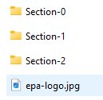
Files that will be significantly altered
For organizational purposes, I put all figures into a folder. Within the “figures” folder, I then have sub-folders for each section. The files in these folders are either (a) figures that are generated externally and used, data that is used by R to generate new figures, or the figures generated by R when you “Build Book.”
For organizational purposes, I put all tables into a folder. Within the “tables” folder, I then have sub-folders for each section. These files (xlsx or csv) are read in, and tables are automatically generated using bookdown.
A different Rmd (R Markdown) file is needed for each section of the document. For the 2020 NEI, that would be 37 Rmd files (+ errata).

Slide 13

FAQ
I’m generating a new document (e.g., a TSD). What do I need to do to get started?
Copy a base directory. We should discuss where these should be stored.
In /latex/before_body.tex, update the library publication # and the document title.
In index.Rmd, update the library publication # and the document title.
Create all the Rmd files needed for the publication (e.g., 00-acronyms.Rmd, 01-introduction.Rmd, etc.).
Update _bookdown.yml to reflect all the Rmd files needed for the publication (under rmd_files).
Click “Build Book” under “Build”:

Slide 14

FAQ
How do I enter a new table?
How do I enter a new figure?
EPA’s GenAI Chat Tool
I really recommend using it…
Here’s a link.
And more information.

Slide 15
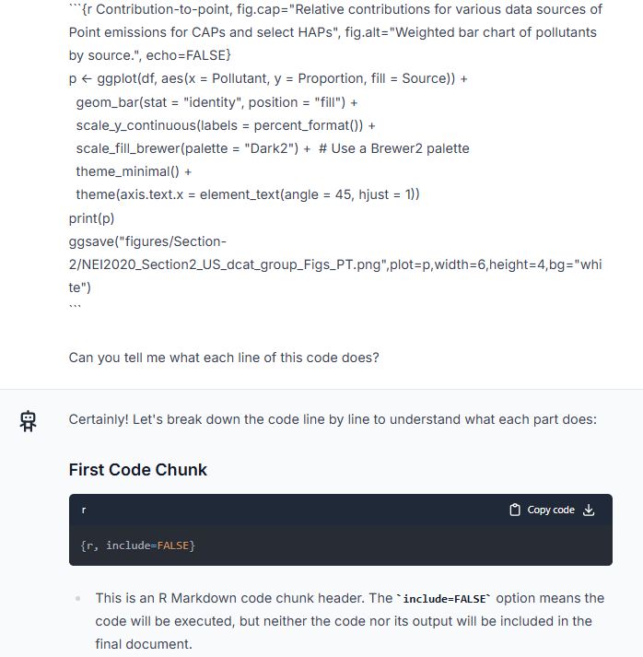
EPA’s GenAI Chat Tool
Here, I copy and paste whole parts of code to the chat tool and ask me what each line does.
It then proceeds to tell me, line-by-line.

Slide 16
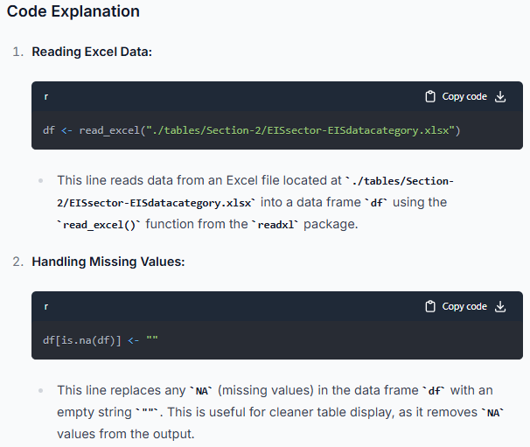
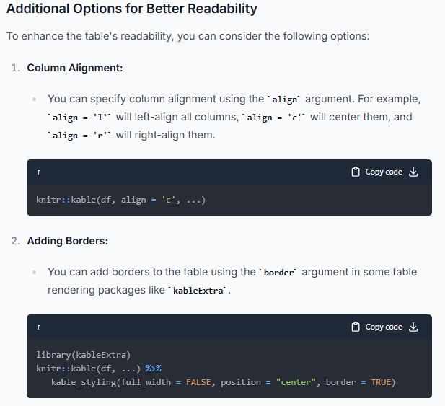
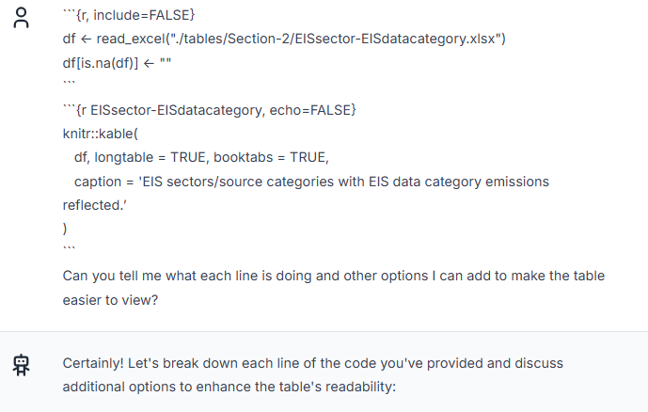
FAQ
How do I enter a new table?
My question and the initial response:
Explaining what each line does:
Providing me with more options:

Slide 17
FAQ
How do I enter a new figure?
```{r, include=FALSE}
df <- read_csv("./figures/Section-2/NEI2020_Section2_US_dcat_group_Figs_PT.csv")
# Explicitly set the order of the groups
df$Pollutant <- factor(df$Pollutant,levels= c("CO","NH3","NOX","PM10","PM2.5","SO2","VOC","Lead","Mercury","Acid-Gases","HAP-Metal","HAP-VOC"))
df <- df %>%
group_by(Pollutant) %>%
mutate(Proportion = Value / sum(Value))
```
```{r Contribution-to-point, fig.cap="Relative contributions for various data sources of Point emissions for CAPs and select HAPs", fig.alt="Weighted bar chart of pollutants by source.", echo=FALSE}
p <- ggplot(df, aes(x = Pollutant, y = Proportion, fill = Source)) +
geom_bar(stat = "identity", position = "fill") +
scale_y_continuous(labels = percent_format()) +
scale_fill_brewer(palette = "Dark2") + # Use a Brewer2 palette
theme_minimal() +
theme(axis.text.x = element_text(angle = 45, hjust = 1))
print(p)
ggsave("figures/Section-2/NEI2020_Section2_US_dcat_group_Figs_PT.png",plot=p,width=6,height=4,bg="white")
```

Slide 18
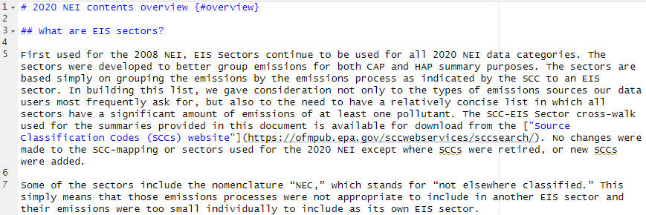
FAQ
How do I fill in Rmd files?
An R markdown file is just a text file. You can open it in Rstudio, notepad, or any other text editing software.
Headers are indicated using “#” symbols: # = header level 1, ## = header lever 2, etc.
The {#overview} allows the “overview” ID to be used later in the document (e.g., as a link).
This is how a hyperlink is added.

Slide 19
Conclusions
tbd

Slide 20
Thank you – any questions?

Slide 21
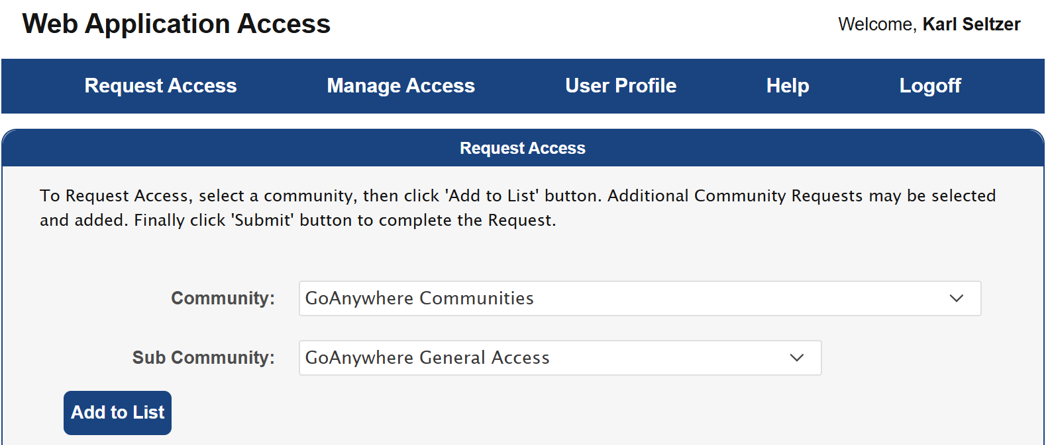
How to obtain access to GoAnywhere
GoAnywhere streamlines the exchange of data between EPA systems, colleagues, partners, research teams, tribes and support contractors.
FileZilla is a separate option that is also used by members of our Group.
To obtain access to WebAnywhere:
Go here.
Click “Request Access”
Community: “GoAnywhere Communities”
Sub Community: “GoAnywhere General Access”
Click “Add to List”
Click “Submit”

Slide 22
Example Stakeholder Requests
Heather Simon (EPA) on 8/28/25:
Can you provide a full list of which CB6 VOC species are emitted from US and Canadian wildfires?
Drew Gentner (Yale) on 8/26/25:
Data on “Metals and criteria pollutant emissions from residual/distillate fuel oil combustion in the 5 NYC counties and the Long Island counties in NY”

