Slide 1
CCSGPubs The SKCC Publication Application
Developed by Karl J. Smalley
2007 - Present
Presentation Created in March of 2016

Slide 2
CCSGPubs - Description
CCSGPubs is an application written in php. The application fetches publications from PubMed, stores them in a database and then renders them for a CCSG application with center members highlighted, program affiliations inserted and markings for intra/inter-programmatic publications. Center-wide, author or program-specific publication lists can be generated. We also have linked publications to a Journal Impact Factor table and are tracking inter-institutional publications for our consortium Cancer Center. The current application uses PostgreSQL as the backend database, however the code could easily be modified to MySQL, Oracle or other relational database engines.

Slide 3
CCSGPubs - History
Originally this was developed over the years into several smaller tools that were used separately:
php script to parse publications into database (2007).
java desktop application to assign Center Member Authors and their Associated Programs. There was also a java desktop application to maintain the Center Members and Program Affiliations under a few different program structure scenarios (2012).
A script which displayed a parameter menu for selecting option that would affect how and what publications were displayed by the rendering script and the rendering script itself (2007).

Slide 4
CCSGPubs - Current Version
Upon hearing that others in the NCI Cancer Center Community might be interested in a tool like this (early in 2016), very hastily (perhaps very, very hastily is better) the java parts of the application were converted to php and an application menu was built around all the php modules. A users table was added and also some update routines for some of the tables that were previously modified manually in pgAdmin.

Slide 5
CCSGPubs - How it works
The new incarnation of the application has a login in page (ldap authentication), with a user table (authorization). There are also routines for modifying the user table (added quickly, minimal error-checking, etc.). The main menu is where you get to all the functionality.

Slide 6
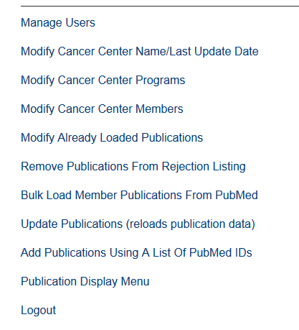
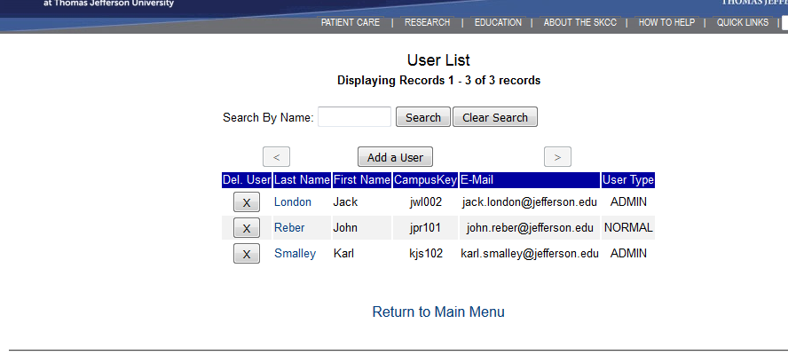
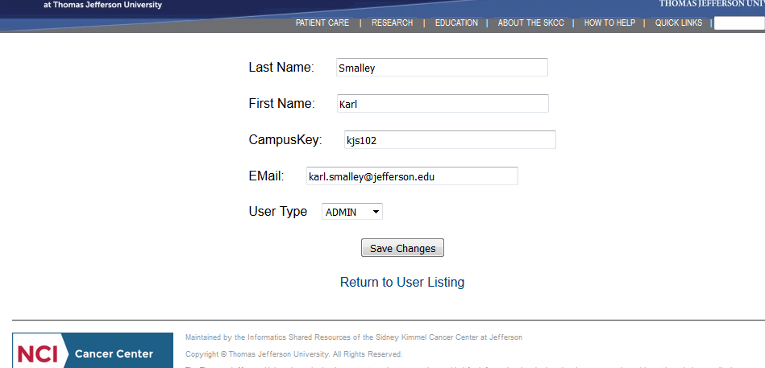
CCSGPubs - Main Menu
The Manage Users Function is very simple and was not part of the original application, but was added quickly and is quite unsophisticated even for a quick add-on module. There is “user selection” screen and a “modify user” screen. They are very simple and will appear next.

Slide 7
CCSGPubs - Main Menu

Slide 8
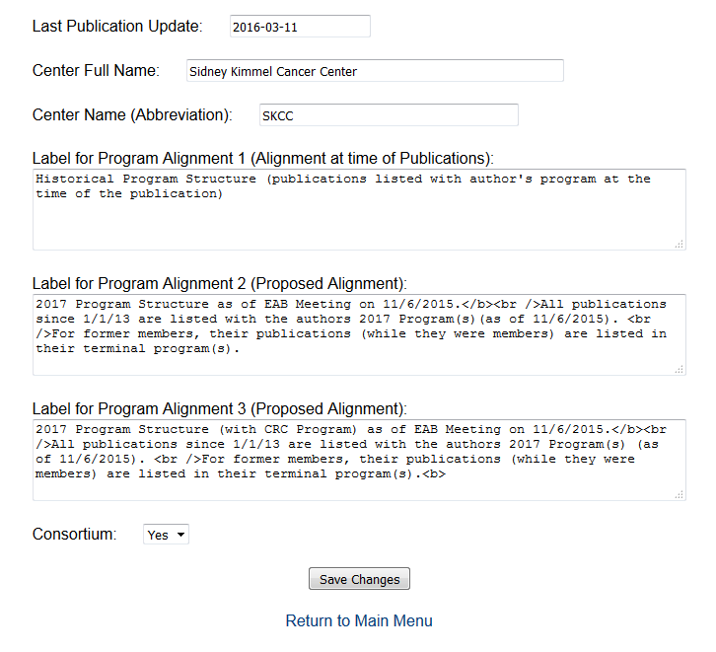
CCSGPubs - Center Name/Last Update
There are 3 possible program structures:
Historical: Member-Authors are listed in the program where they were at the time of the publication.
Proposed 1: Publications from a given data are aligned with a proposed structure (manually changed for now).
Proposed 2: Publications from a given data are aligned with an alternate proposed structure
Rationale: Site-visitors would prefer seeing all of John Doe’s publications in his current program listing and not seeing his older publications in the program where he was 2 years ago.
Also this would also match what one would do manually when compiling a list of publications for a program (except for presence of publications of departed member authors)

Slide 9
CCSGPubs - Main Menu

Slide 10
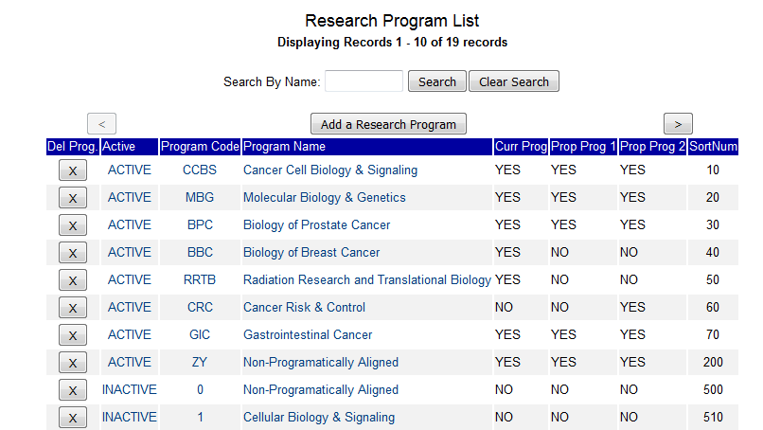
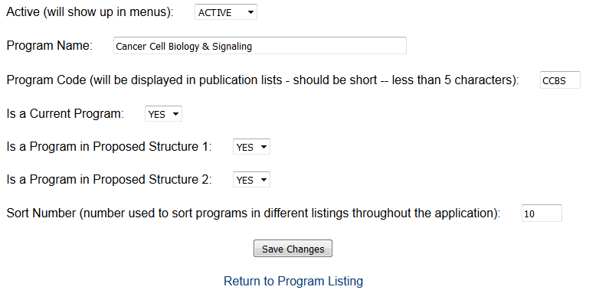
CCSGPubs - Center Programs

Slide 11
CCSGPubs - Main Menu

Slide 12
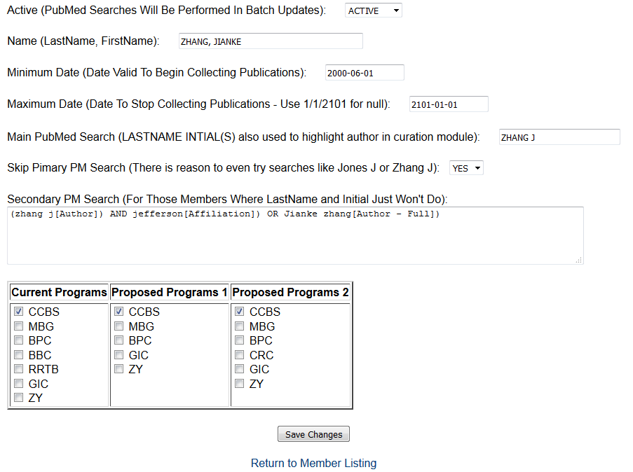
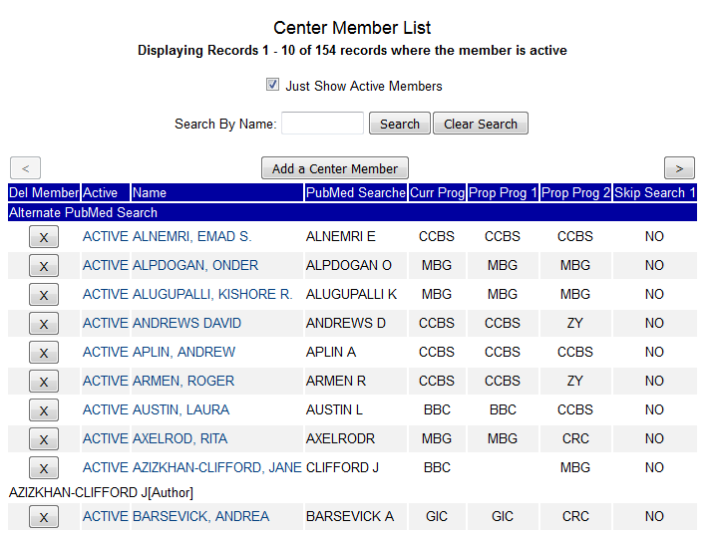
CCSGPubs - Center Members

Slide 13
CCSGPubs - Main Menu

Slide 14
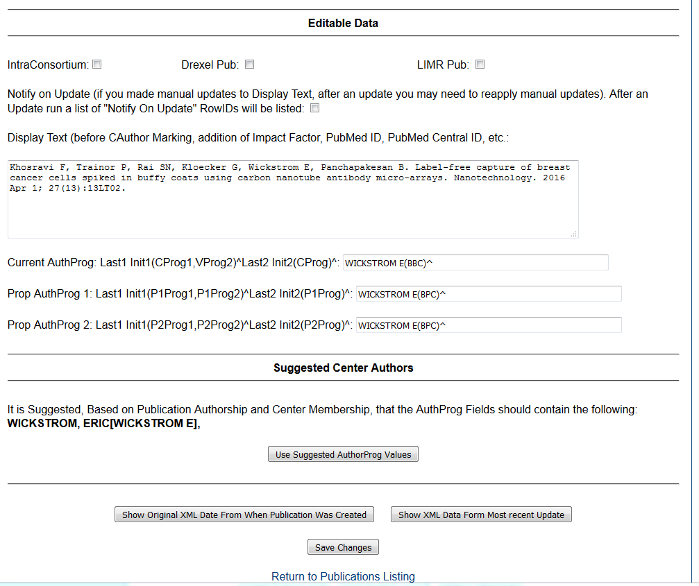
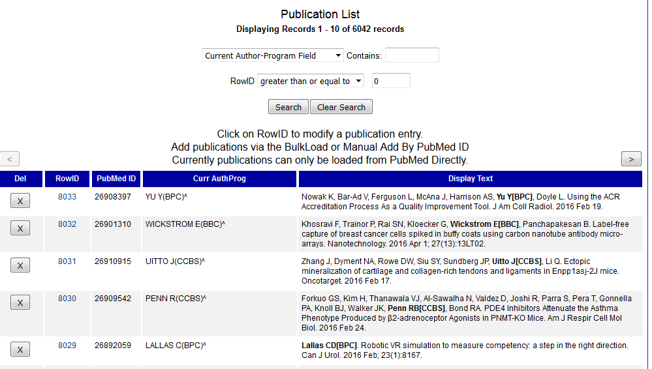
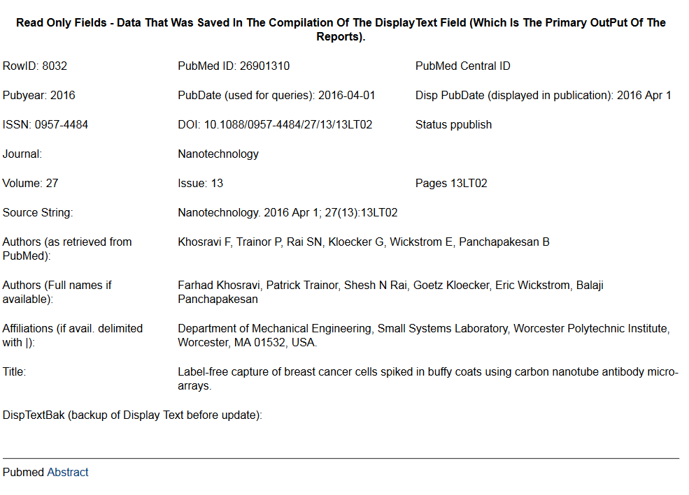
CCSGPubs - Modify Publications
Attempts to match
active members to
author listing

Slide 15
CCSGPubs - Main Menu
Allows you to undo a publication rejection (or several publication rejections) by providing a list of PubMed Ids

Slide 16
CCSGPubs - Bulk Load Publications
This option does one (or two) PubMed Searches for Active Center Members for a given period of time (default is last 3 months). A count of new (publications not already rejected and not already stored in the publication database) publications will be tallied. A link will be provided even for a zero count (in case you want to view rejected publications to make sure there was not one rejected by mistake). Clicking on the link will create a new tab or window where new publications will be displayed with the authors’ full names and affiliations if available. A link to the PubMed Abstract will also be provided for each publication. You will be given the option of rejecting or adding each new publication. By rejecting a publication for a given author, it will not be displayed again as a new publication the next time you run the bulk load. Currently we are running this weekly/bi-weekly and we still go back 3 months just in case an older (older by Publication Date but new to PubMed) publication slips in that we have not already reviewed. For Accepted publications you will be given the option of modifying them and adding member authors/program alignments. Upon processing added/rejected publications close window/or tab an proceed to
next Member.
The Rejection Process was key to enabling us to curate publications for 150 Members on a weekly basis and still ensure that an older publication (added late to PubMed) did not slip through the cracks.

Slide 17
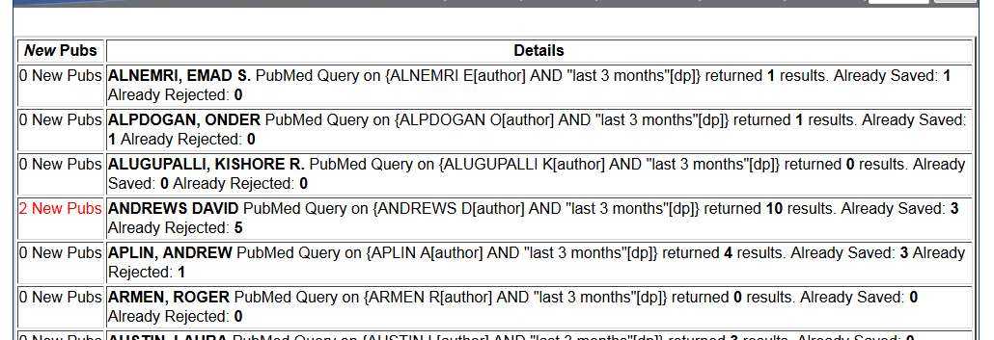
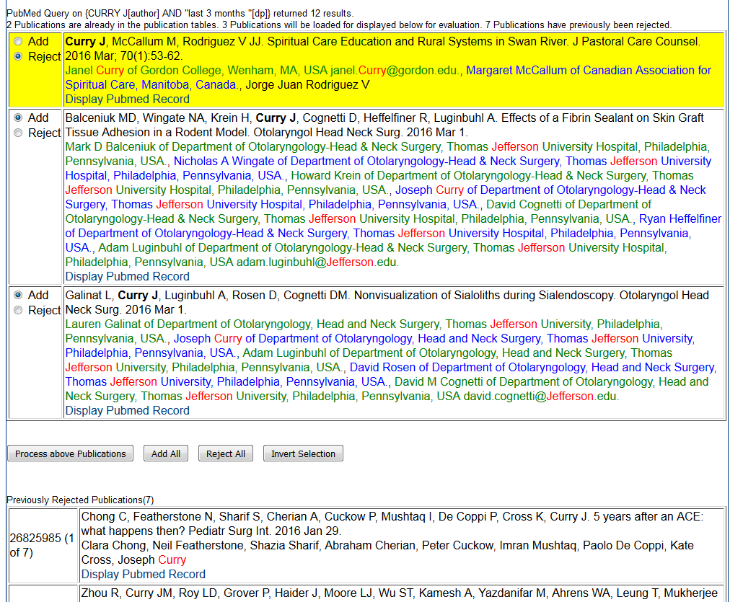
CCSGPubs - Bulk Load Publications

Slide 18
CCSGPubs - Main Menu
Requery PubMed for already saved publications for changes (page numbers added to “ahead of print” pubs.)
Allows you add a list of publications to the publication database by supplying a list of PubMed IDs.

Slide 19
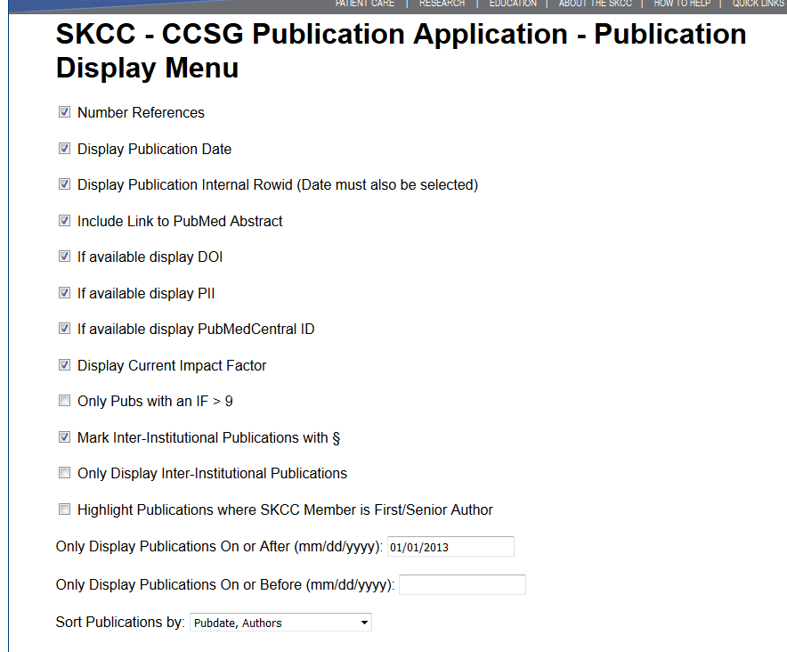
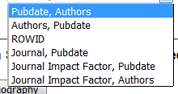
CCSGPubs - Publication Display Menu
Login not required to get to this page.
You can send url to anyone so they can see your center’s publications.
Sorting Options Are:

Slide 20
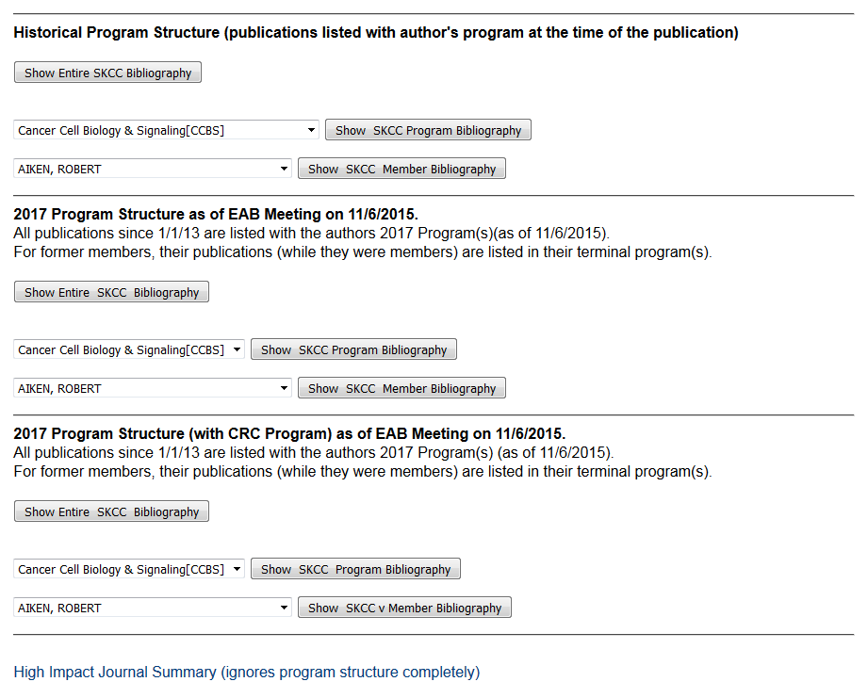
CCSGPubs - Publication Display Menu

Slide 21
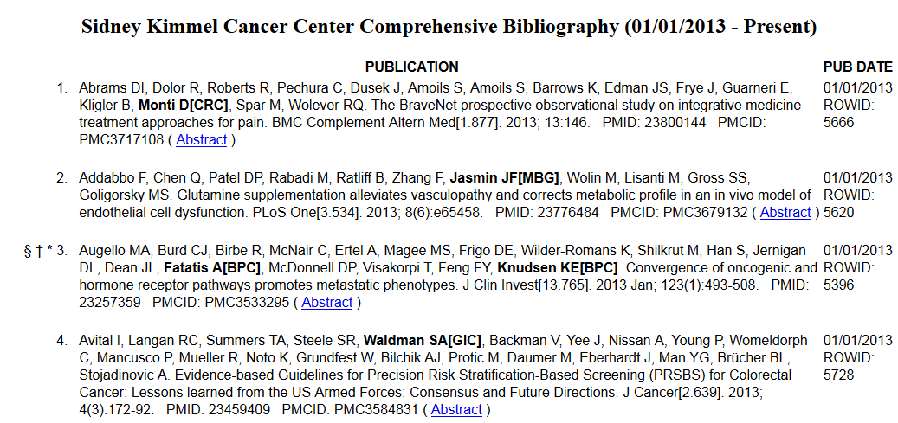
CCSGPubs - Rendering Module
+ - plus -- inter-programmatic publication (none in list above)
* - asterisks - intra-programmatic publication
† - dagger – High-impact journal (IF > 10) {optional}
‡ - double-dagger – Reasonably High-impact journal (IF > 9 but <= 10) {optional} (none above)
§ - section – Intra-consortium publication {optional}

Slide 22
CCSGPubs - Intra/Inter, Impact Factor
For author or center-wide listings:
a publication is considered inter-programmatic(+) if there is more than one member-author, more than one center program is involved and no one center program contains all the member-authors for this publication.
a publication is intra-programmatic(*) if any one program has more than one member-author.
For program listings:
a publication is considered inter-programmatic(+) if there is a member not from the currently selected program.
a publication is considered intra-programmatic(*) if there is more than one member from the currently selected program.
I’ve never really seen guidelines on this from NCI on intra/inter-programmatic publications – but the above system seems logical and it is the logic use to mark CCSG Publications.
Marking an Impact Factor > 9 (as well as 10) because several highly thought of Journals are in that range: PNAS, Cancer Research and Blood just to name a few.

Slide 23
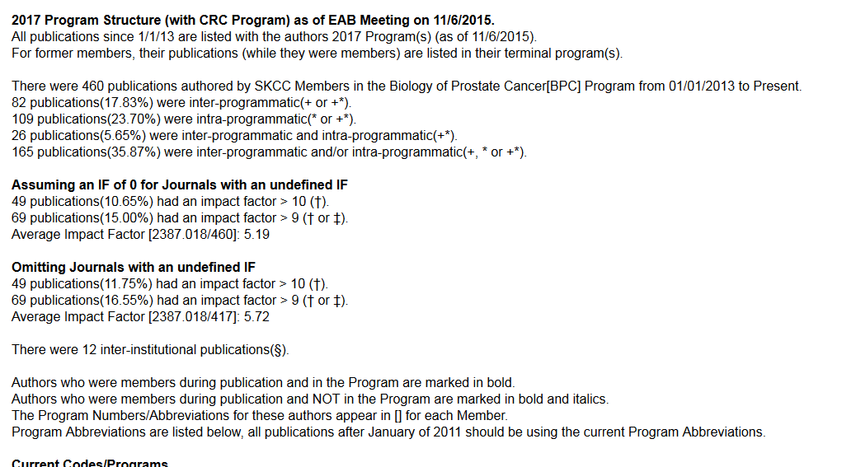
CCSGPubs - Summary Statistics

Slide 24
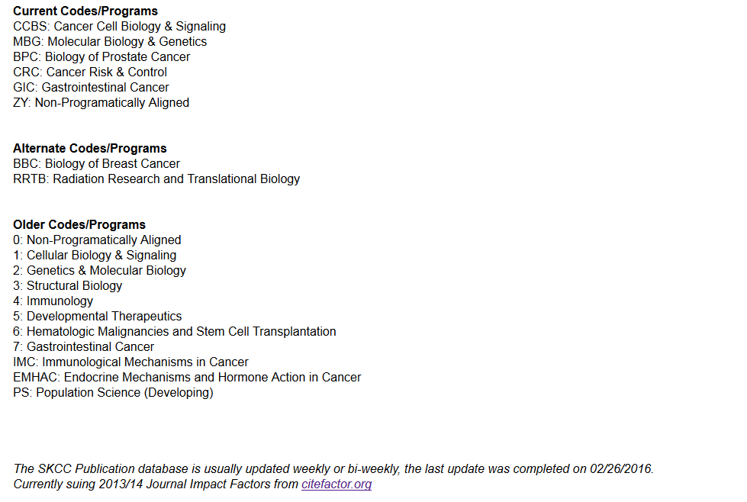
CCSGPubs - Program Legend

Slide 25
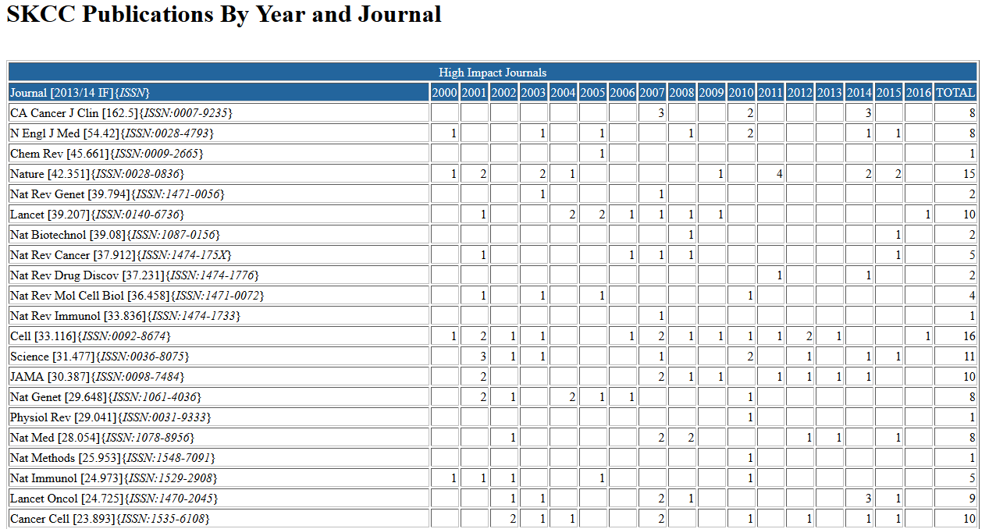
CCSGPubs - Journal Summary

Slide 26
CCSGPubs - Future Plans
Normalize publication table by removing authors and adding an author’s table to allow for more accurate member-author marking.
Modify the rendering program so that it generates the displayed text from the components on the fly. Allow for multiple reference formats instead of just the Uniform/NLM/ICMJE format.
PubMed is starting to include chapters and books, consider parsing them.
Allow for manual addition of non-PubMed publications.
Add a shared resource table and allow for publications to be linked to shared resources.
Centralizing and abstracting database functions into a library, so changing database engines could be relatively simple.

Slide 27
CCSGPubs - Locations
The SKCC CCSGPubs application is located at:
https://isley.kcc.tju.edu/ccsgpubs/
(requires login)
The SKCC CCSGPubs Publication Display Menu:
https://isley.kcc.tju.edu/ccsgpubs/pubmenu.php
(no login required)
The SKCC CCSGPubs Code Location on GitHub:
https://github.com/karlsmalley/ccsgpubs
YouTube Demo:
https://youtu.be/MxKcnTkIEYs

