Slide 1

A SMART SOFTWARE
FOR
DRONE
Charbel Aoun
MIA & GE Domains Icam - site de Toulouse
07 September 2020

Slide 2
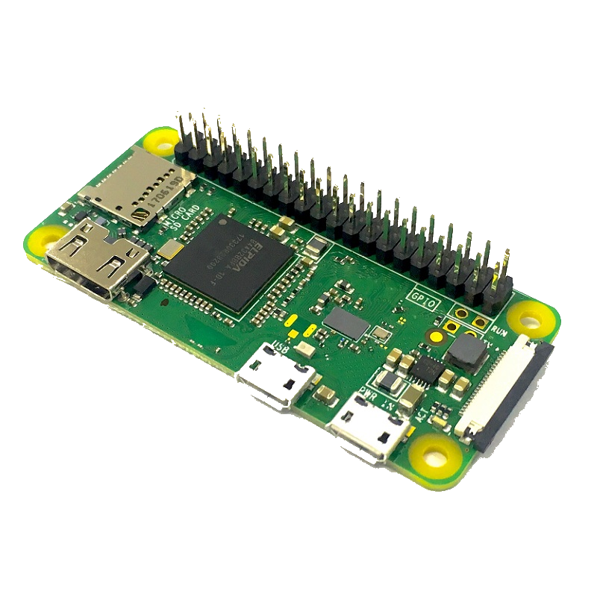
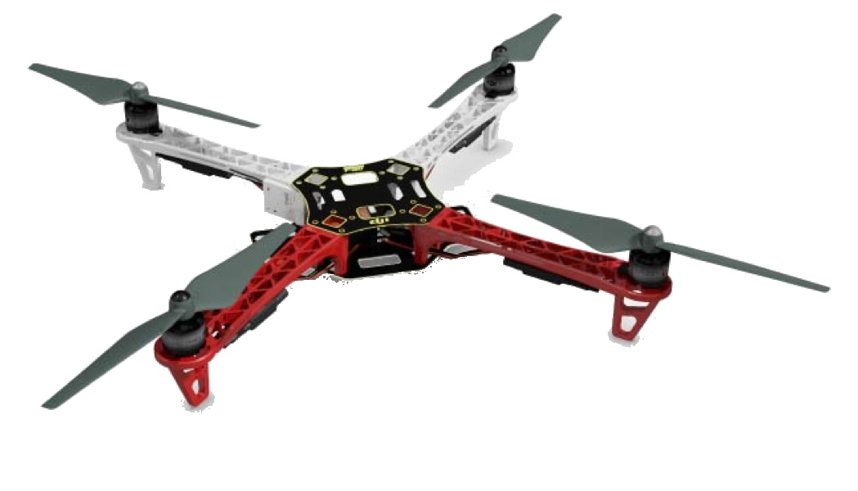
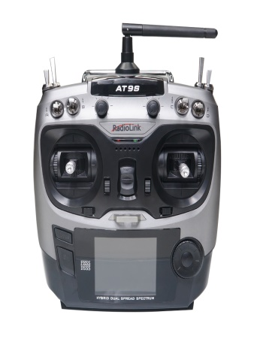

Objective
A Smart Program

Slide 3
Life Cycle
The phases are :
Start
Getting
Requirements
Analyzing & Designing
Developing
Activities???
Validating
& Testing
Implementing
End
Notes:
05/10/2020
Nom de la conférence XXX
3

Slide 4



Software Execution
dev1.icam.fr

Slide 5
The Drone’s Motions
The logical activities of Drone’s Motions (DM) are:
Tools ???
Start
Addresses Conversion to GPS Coordinates
Addresses Acquisition
Taking Off the Drone
Returning to Land on the Departure Site
Visiting Given Addresses
End
Notes:
05/10/2020
Nom de la conférence XXX
5

Slide 6



Tools (Hardware, Software & Human)
Embedded
4: Implemented
Our Scope is writing
Python Syntax
2 : GPS coordinates ?
1: Deploying
the software
3 : GPS coordinates
Notes:
05/10/2020
Nom de la conférence XXX
6

