Slide 1

CONSOLE-BASED Library Management System
Presentation by
Kārlis Ivars Braķis

Slide 2
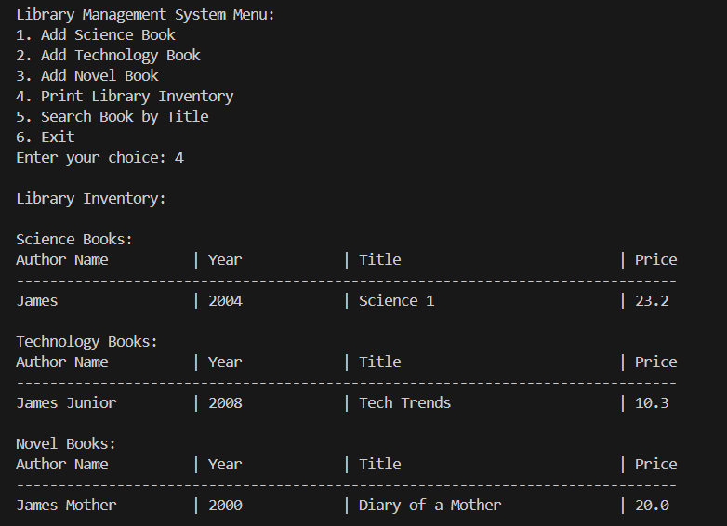
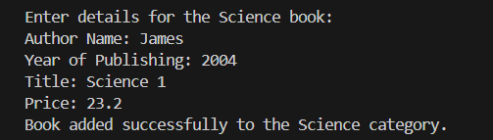
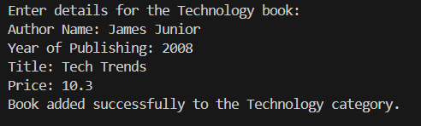
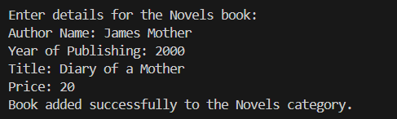
Output

Slide 3
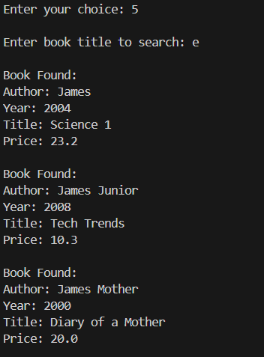
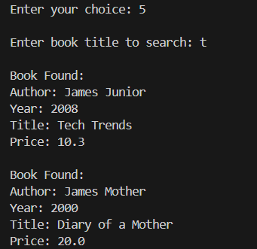
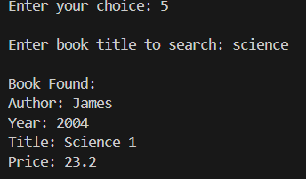
Search functionality

Slide 4
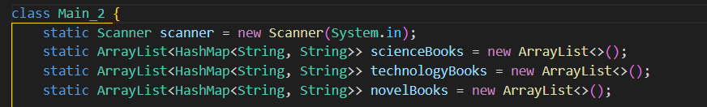
Main code parts
Each category is an ArrayList containing books represented as HashMaps

Slide 5
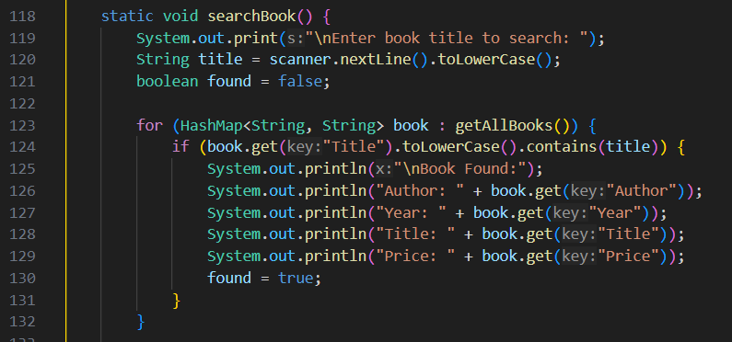
Main code parts
searchBook() method for finding books by title

Slide 6
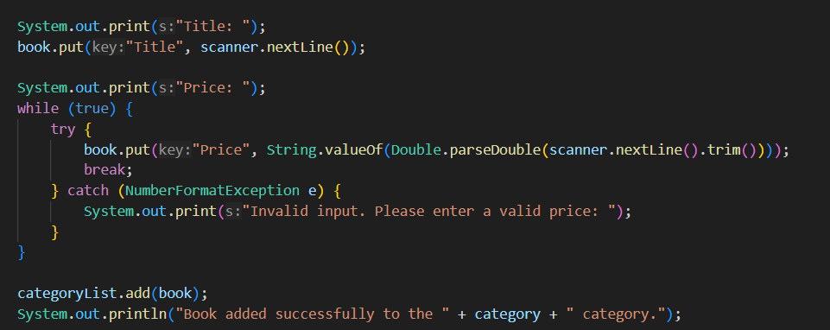
Main code parts
Simple error handling and while loop for invalid inputs

Slide 7
Why Use HashMaps Instead of a Single ArrayList?
Structured & Readable Each book has labeled attributes (Author, Year, Title, Price)
Easy Retrieval & Updates Access data using keys instead of relying on fixed positions
Scalable & Flexible Easily add new attributes (ISBN, Genre) without breaking the structure.
Efficient Search & Filtering Quickly find books using key-value lookups instead of looping through a list.

Slide 8
Thank you for listening! ANY QUESTIONS?

