Slide 1
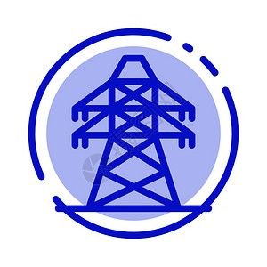
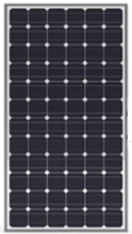

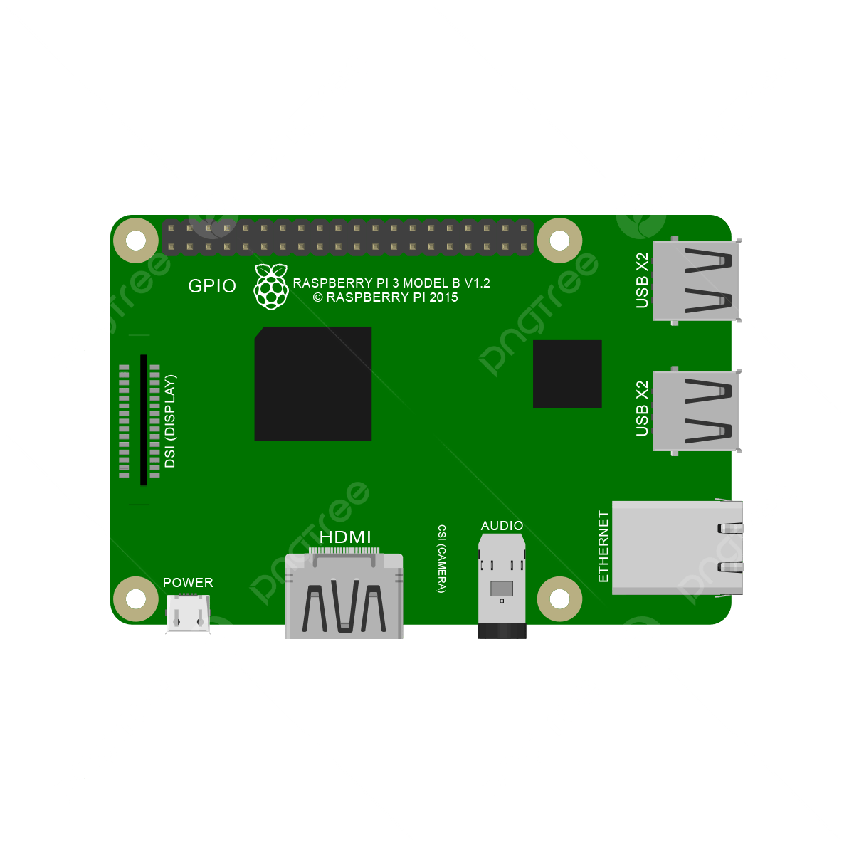



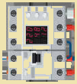

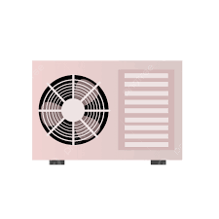
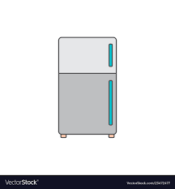
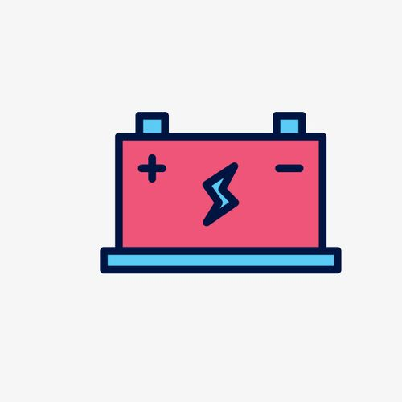

Generation
Energy Flexibility
Home/Customer Energy Management
Grid
Home Assistant
Micro
Inverter
Smart
Meter
home automation platform
110V AC Bus
Smart
Plug
Smart
Plug
Smart
Electric
Panel
PCS
Resource
Manager
BMS
ESS:
Power
Station
...
Consumption
Air
Conditioner
EV
Charger
Storage
Refrigerator
Notes:
2024-04-18

