Slide 1
1. Introduction
2. Memory Addressing
3. Processes
4. Interrupts and Exceptions
5. Kernel Synchronization
6. Timing Measurements
7. Process Scheduling
8. Memory Management
9. Process Address Space
10. System Calls
11. Signals
12. The Virtual Filesystem
13. I/O Architecture and Device Drivers
14. Block Device Drivers
15. The Page Cache
16. Accessing Files
17. Page Frame Reclaiming
18. The Ext2 and Ext3 Filesystems
19. Process Communication
20. Program Execution
Understanding
Linux Kernel
概念/Concepts !!!
理解 !!!
Notes:
2020-07-23

Slide 2
Instruction Set => HW
System Calls => Kernel
Language （人/阳） => Computer (Kernel/HW)
10.1 POSIX APIs and System Calls
10.2 System Call Handler and Service Routines
10.3 Entering and Exiting a System Call
10.4 Parameter Passing
10.5 Kernel Wrapper Routines

Slide 3
10.1 POSIX APIs and System Calls
software interrupt | wrapper routines | POSIX api
The converse is not true
The POSIX standard refers to APIs and not to system calls.

Slide 4
10.2 System Call Handler and Service Routines
system call number => system call dispatch table => system call handler.
additional parameters
exception handler:
• Saves the contents of most registers in the Kernel Mode stack.
• Handles the system call by invoking a corresponding C function called the system call service routine.
• Exits from the handler: the registers are loaded with the values saved in the Kernel Mode stack, and the CPU is switched back from Kernel Mode to User Mode.

Slide 5
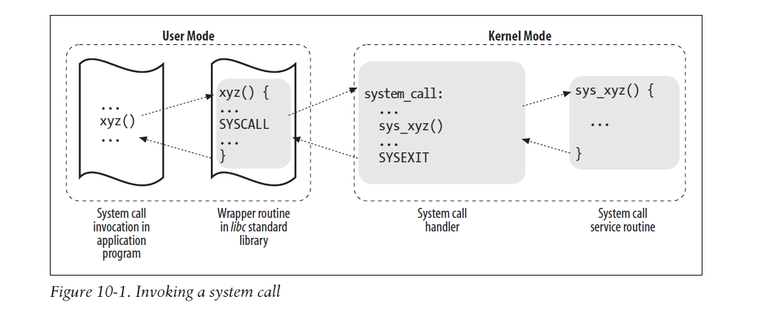

Slide 6
10.3 Entering and Exiting a System Call
Issuing a System Call via the int $0x80 Instruction
Issuing a System Call via the sysenter Instruction

Slide 7
10.4 Parameter Passing
The parameters of ordinary C functions are usually passed by writing their values in the active program stack (either the User Mode stack or the Kernel Mode stack).
Because system calls are a special kind of function that cross over from user to kernel land, neither the User Mode or the Kernel Mode stacks can be used.
Rather, system call parameters are written in the CPU registers before issuing the system call.
Accessing the Process Address Space
get_user( ) and put_user( ).

Slide 8
10.5 Kernel Wrapper Routines
Although system calls are used mainly by User Mode processes, they can also be invoked by kernel threads, which cannot use library functions.

