Slide 1
1. Introduction
2. Memory Addressing
3. Processes
4. Interrupts and Exceptions
5. Kernel Synchronization
6. Timing Measurements
7. Process Scheduling
8. Memory Management
9. Process Address Space
10. System Calls
11. Signals
12. The Virtual Filesystem
13. I/O Architecture and Device Drivers
14. Block Device Drivers
15. The Page Cache
16. Accessing Files
17. Page Frame Reclaiming
18. The Ext2 and Ext3 Filesystems
19. Process Communication
20. Program Execution
Understanding
Linux Kernel
概念/Concepts !!!
理解 !!!
Notes:
2020-08-01

Slide 2
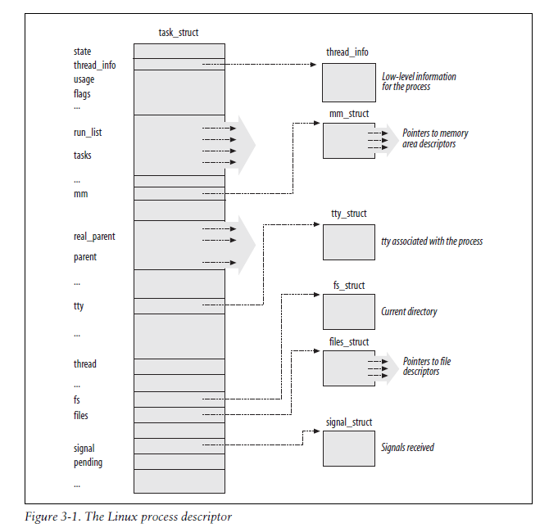

Slide 3
Signals were introduced by the first Unix systems to allow interactions between User Mode processes; the kernel also uses them to notify processes of system events. Signals have been around for 30 years with only minor changes. 经典/Classical
11.1 The Role of Signals
11.2 Generating a Signal
11.3 Delivering a Signal
11.4 System Calls Related to Signal Handling

Slide 4
11.1 The Role of Signals
Besides the regular signals described in this table, the POSIX standard has introduced a new class of signals denoted as real-time signals; their signal numbers range from 32 to 64 on Linux. They mainly differ from regular signals because they are always queued so that multiple signals sent will be received. On the other hand, regular signals of the same kind are not queued: if a regular signal is sent many times in a row, just one of them is delivered to the receiving process. Although the Linux kernel does not use real-time signals, it fully supports the POSIX standard by means of several specific system calls.
Signal generation
The kernel updates a data structure of the destination process to represent that a new signal has been sent.
Signal delivery
The kernel forces the destination process to react to the signal by changing its execution state, by starting the execution of a specified signal handler, or both.

Slide 5
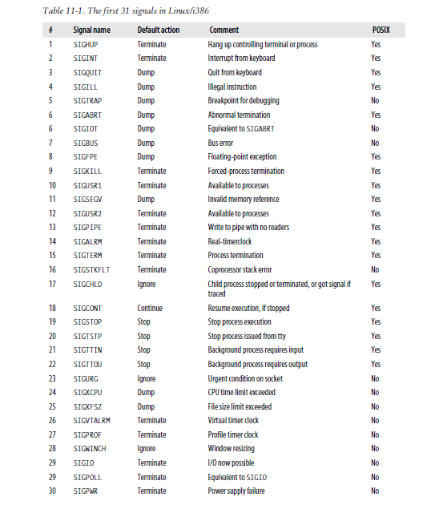


Slide 6
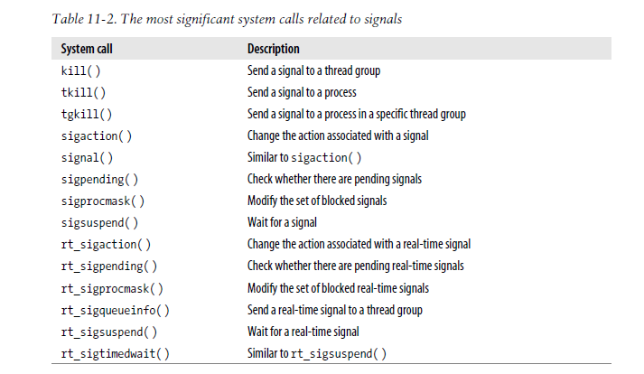

Slide 7
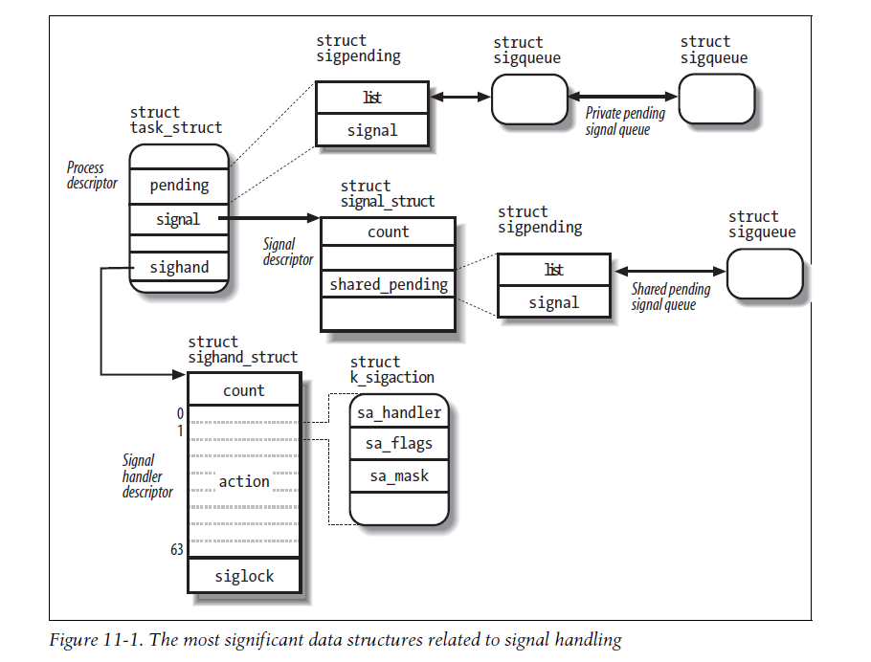

Slide 8
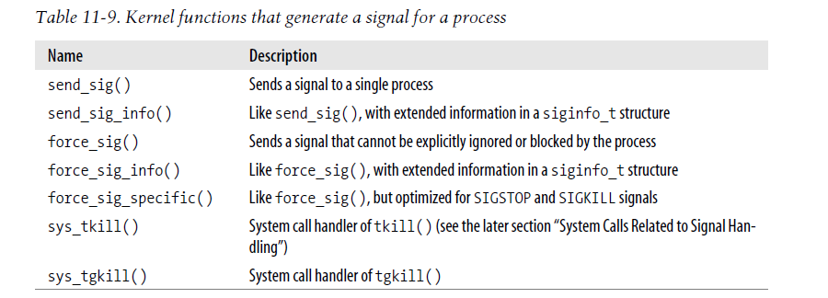
11.2 Generating a Signal

Slide 9
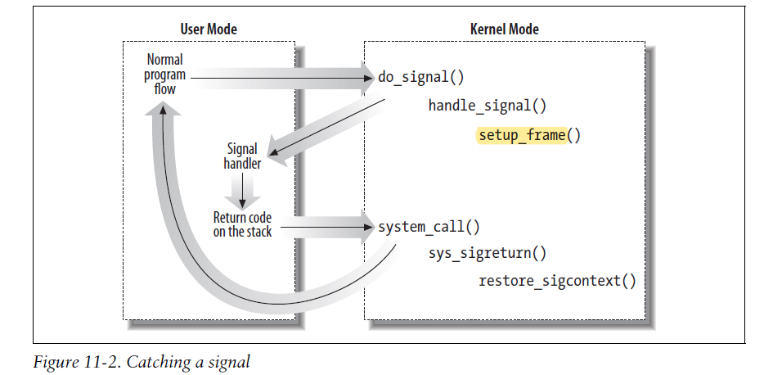
11.3 Delivering a Signal
Executing the Default Action for the Signal
Catching the Signal
Reexecution of System Calls

Slide 10
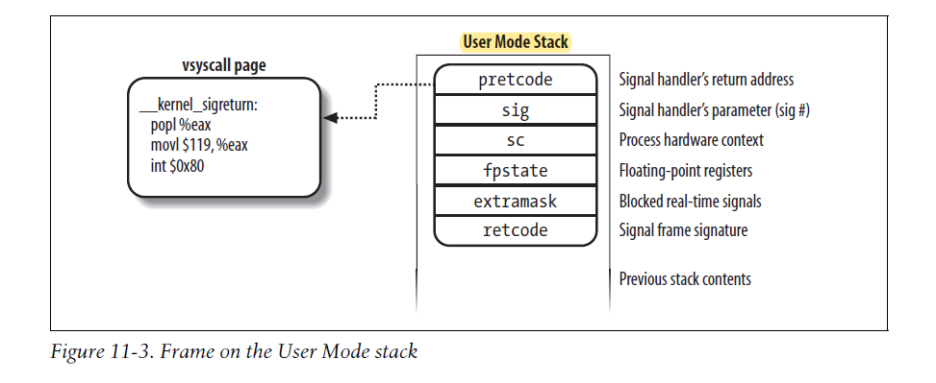

Slide 11
11.4 System Calls Related to Signal Handling
The kill( ) System Call
The tkill( ) and tgkill( ) System Calls
Changing a Signal Action
Examining the Pending Blocked Signals
Modifying the Set of Blocked Signals
Suspending the Process
System Calls for Real-Time Signals

