Slide 1
1. Introduction
2. Memory Addressing
3. Processes
4. Interrupts and Exceptions
5. Kernel Synchronization
6. Timing Measurements
7. Process Scheduling
8. Memory Management
9. Process Address Space
10. System Calls
11. Signals
12. The Virtual Filesystem
13. I/O Architecture and Device Drivers
14. Block Device Drivers
15. The Page Cache
16. Accessing Files
17. Page Frame Reclaiming
18. The Ext2 and Ext3 Filesystems
19. Process Communication
20. Program Execution
Understanding
Linux Kernel
概念/Concepts !!!
理解 !!!
Notes:
2020-08-01

Slide 2
静态 vs 动态 枪 vs 子弹 电视 vs VCD
12.1 The Role of the Virtual Filesystem (VFS)
12.2 VFS Data Structures
12.3 Filesystem Types
12.4 Filesystem Handling
12.5 Pathname Lookup
12.6 Implementations of VFS System Calls
12.7 File Locking

Slide 3
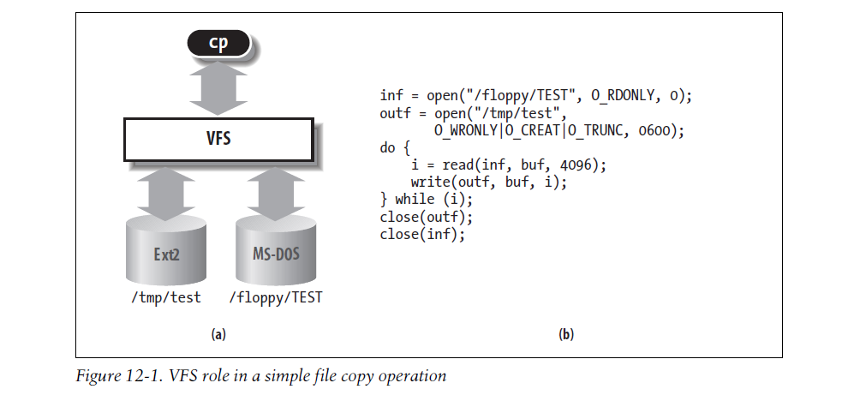
12.1 The Role of the Virtual Filesystem (VFS)
Notes:
ioctl

Slide 4
1、The Common File Model
native filesystem
each directory is regarded as a file
directories are not files， to construct on the fly
Such files exist only as objects in kernel memory
ioctl( ). a pointer sys_read( ) service routine
as object-oriented, a data structure and the methods that operate on it. C++
The superblock object - filesystem control block stored on disk.
The inode object - general information about a specific file. inode number
The file object - the interaction between an open file and a process.
The dentry object - the linking of a directory entry

Slide 5
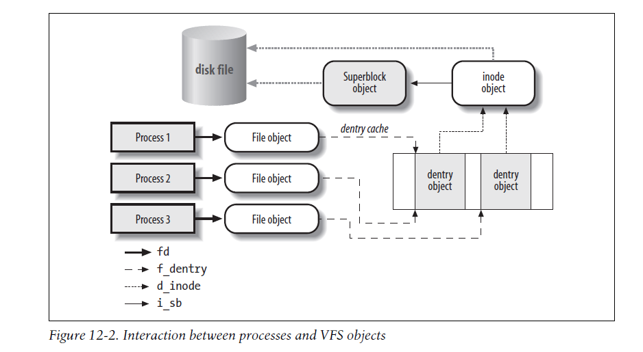

Slide 6
2、System Calls Handled by the VFS
filesystems, regular files, directories, and symbolic links.
device files （/proc） and pipes
socket( ), connect( ), and bind( ), refer to sockets and are used to implement networking.
kernel service routines
VFS is a layer(wrapper) between application programs and specific filesystems.
in some cases, a file operation can be performed by the VFS itself, without invoking a lower-level procedure.
the VFS could be considered a “generic” filesystem that relies, when necessary, on specific ones.

Slide 7
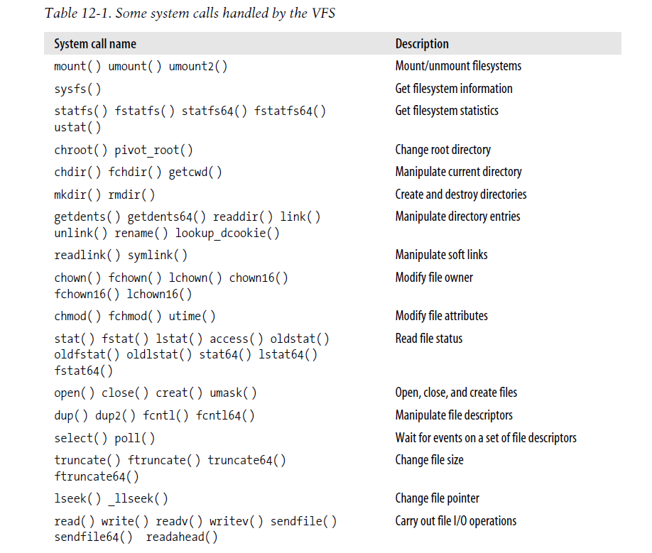
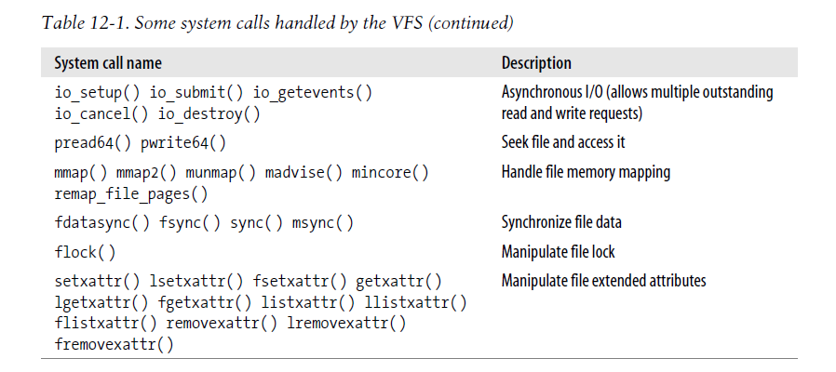

Slide 8
12.2 VFS Data Structures
Superblock Objects
Inode Objects
File Objects
dentry Objects
The dentry Cache
Files Associated with a Process

Slide 9
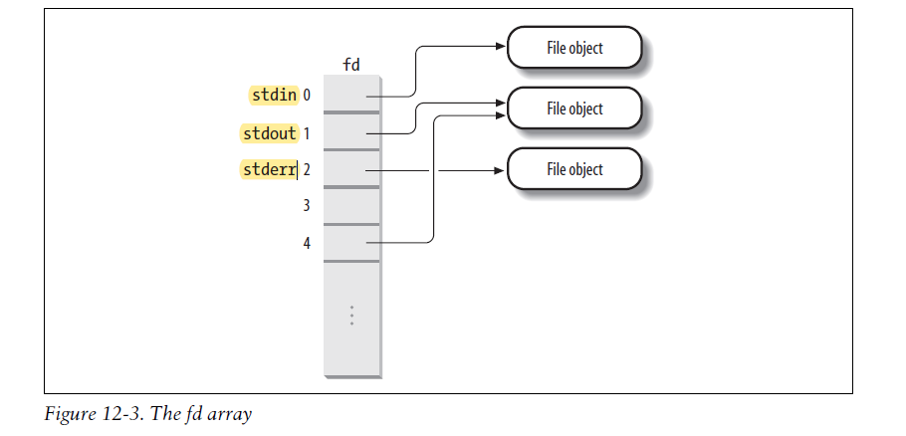

Slide 10
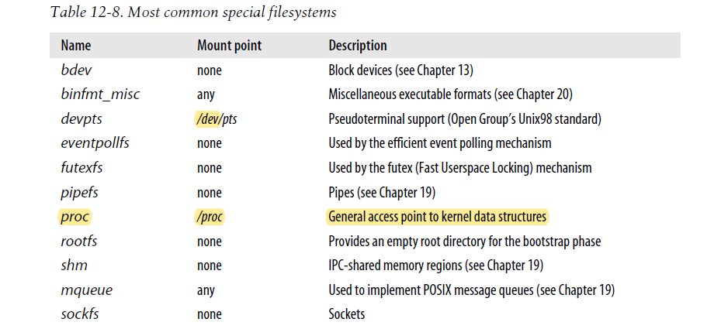
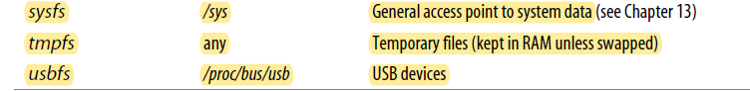
12.3 Filesystem Types
1、Special Filesystems

Slide 11
2、Filesystem Type Registration
EXT2, EXT3,MS-DOS, FAT, NTFS, NFS
12.4 Filesystem Handling
system’s root filesystem
mount point
1、Namespaces
pathname
2、Filesystem Mounting
3、Mounting a Generic Filesystem
4、Mounting the Root Filesystem
5、Unmounting a Filesystem

Slide 12
12.5 Pathname Lookup
1、Standard Pathname Lookup
2、Parent Pathname Lookup
3、Lookup of Symbolic Links

Slide 13
12.6 Implementations of VFS System Calls
1、The open( ) System Call
2、The read( ) and write( ) System Calls
3、The close( ) System Call

Slide 14
12.7 File Locking
When a file can be accessed by more than one process, a synchronization problem occurs.
fcntl( ) system call
It is possible to lock an arbitrary region of a file (even a single byte) or to lock the whole file (including data appended in the future). Because a process can choose to lock only a part of a file, it can also hold multiple locks on different parts of the file.
advisory locking vs mandatory locking
shared read locks vs exclusive write locks.
Several processes may have read locks on some file region, but only one process can have a write lock on it at the same time.

Slide 15
1、Linux File Locking
Linux supports all types: advisory and mandatory locks
2、File-Locking Data Structures
3、FL_FLOCK Locks
4、FL_POSIX Locks

