Slide 1
1. Introduction
2. Memory Addressing
3. Processes
4. Interrupts and Exceptions
5. Kernel Synchronization
6. Timing Measurements
7. Process Scheduling
8. Memory Management
9. Process Address Space
10. System Calls
11. Signals
12. The Virtual Filesystem
13. I/O Architecture and Device Drivers
14. Block Device Drivers
15. The Page Cache
16. Accessing Files
17. Page Frame Reclaiming
18. The Ext2 and Ext3 Filesystems
19. Process Communication
20. Program Execution
Understanding
Linux Kernel
相对比较纯软件
概念/Concepts !!!
理解 !!!
Notes:
2020-07-23

Slide 2
Book "Linux Device Drivers"
13.1 I/O Architecture 硬件视角
13.2 The Device Driver Model 软件视角
13.3 Device Files
13.4 Device Drivers
13.5 Character Device Drivers

Slide 3
13.1 I/O Architecture
buses
system bus
PCIe (Peripheral Component Interconnect)，ISA, EISA, MCA, SCSI, and USB
the same computer includes several buses of different types,
bridges
the frontside bus， the backside bus
host bridge
I/O bus

Slide 4
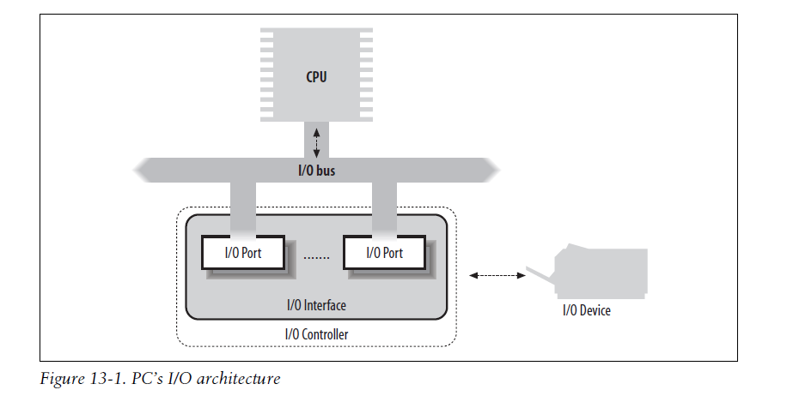

Slide 5
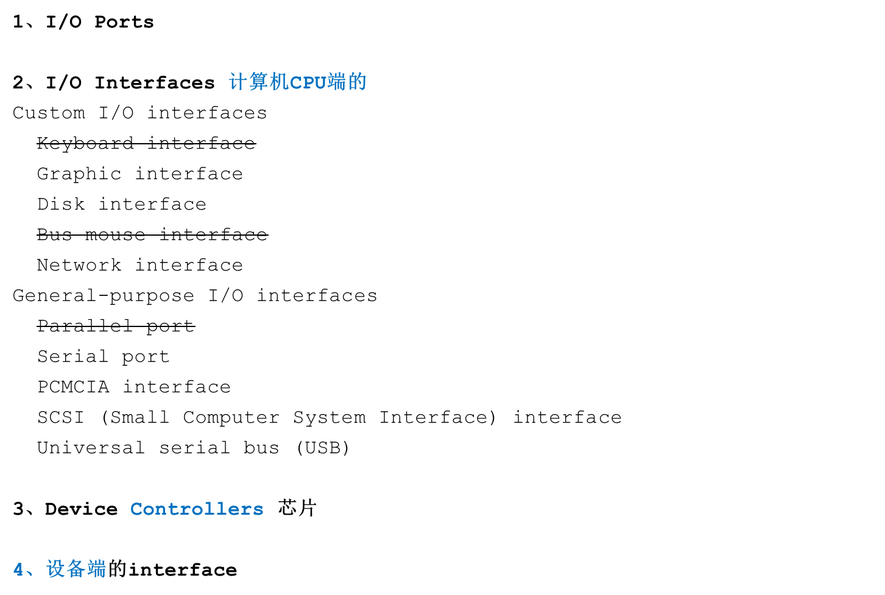

Slide 6
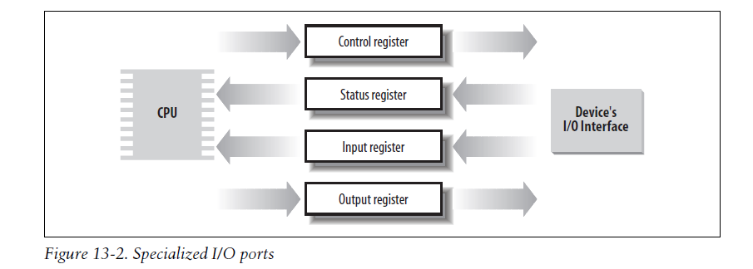
I/O Interfaces ports/registers/io mapped memory locations 计算机CPU端的

Slide 7
13.2 The Device Driver Model
1、The sysfs Filesystem
2、Kobjects
3、Components of the Device Driver Model
Devices
Drivers
Buses
Classes

Slide 8
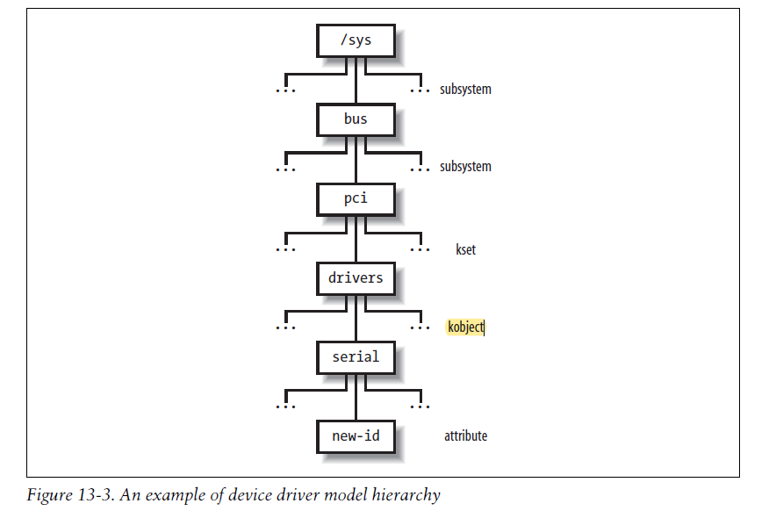

Slide 9
13.3 Device Files
Unix-like operating systems are based on the notion of a file （socket), I/O devices are treated as special files called device files; thus, the same system calls used to interact with regular files on disk can be used to directly interact with I/O devices.
block device or character device randomly
Network cards are a notable exception to this schema, because they are hardware
devices that are not directly associated with device files.
Inode, device identifier type: major number specific device: minor number
The mknod( ) system call is used to create device files. It receives the name of the device file, its type, and the major and minor numbers as its parameters. Device files are usually included in the /dev directory. Notice that character and block devices have independent numbering, so block device (3,0) is different from character device (3,0).

Slide 10
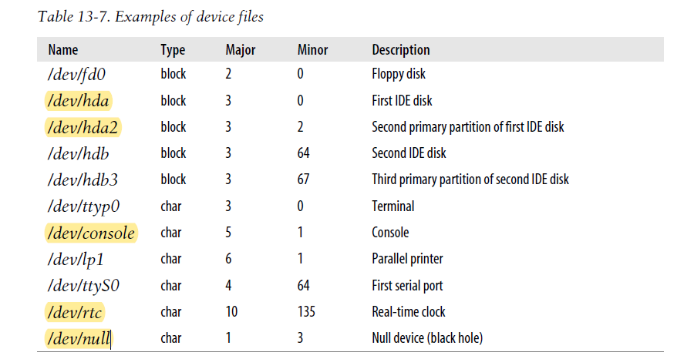
hardware device, physical, logical portion
fictitious logical device

Slide 11
1、User Mode Handling of Device Files
udev device hot plugging, the kernel spawns a new process
2、VFS Handling of Device Files 子系统间的关联
device driver

Slide 12
13.4 Device Drivers
A device driver is the set of kernel routines.
1、Device Driver Registration
2、Device Driver Initialization 区别
allocating precious resources: irq, memory/buffer
usage counter
3、Monitoring I/O Operations
polling mode vs interrupt mode
4、Accessing the I/O Shared Memory Linear vs Physical address
5、Direct Memory Access (DMA)
bus master vs memory arbiter
peripheral can act as bus master, disk
6、Levels of Kernel Support
1) No support at all 用户态 允许直接访问 interface的 ports/registers ioperm()
2) Minimal support
3) Extended support

Slide 13
13.5 Character Device Drivers
1、Assigning Device Numbers
2、Accessing a Character Device Driver
3、Buffering Strategies for Character Devices

Slide 14
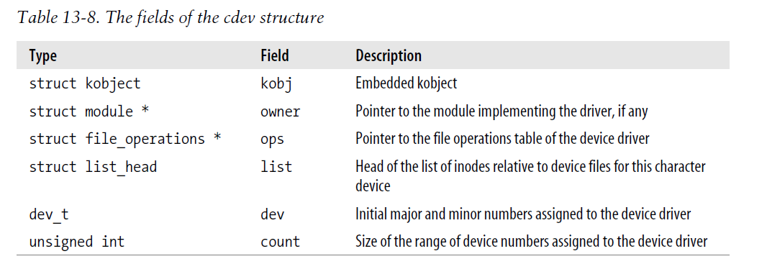
character device driver descriptor

