Slide 1

1. Introduction
2. Memory Addressing
3. Processes
4. Interrupts and Exceptions
5. Kernel Synchronization
6. Timing Measurements
7. Process Scheduling
8. Memory Management
9. Process Address Space
10. System Calls
11. Signals
12. The Virtual Filesystem
13. I/O Architecture and Device Drivers
14. Block Device Drivers
15. The Page Cache
16. Accessing Files
17. Page Frame Reclaiming
18. The Ext2 and Ext3 Filesystems
19. Process Communication
20. Program Execution
进程相关/CPU/MEM/硬件
文件系统相关/IO/软件
Notes:
2020-08-04

Slide 2
Process vs File System
Memory: 一部分放内核，处理另外一部分内存 ！
FS: 一部分放文件系统，处理另外一部分空间 ！
解耦： 相互依赖 vs 顺序时间
disk, key: disparity, CPU/bus/RW vs 几 mS disk speed
move heads 很慢 ！ 读写 tens of megabytes per second 很快 ！
block I/O subsystem

Slide 3
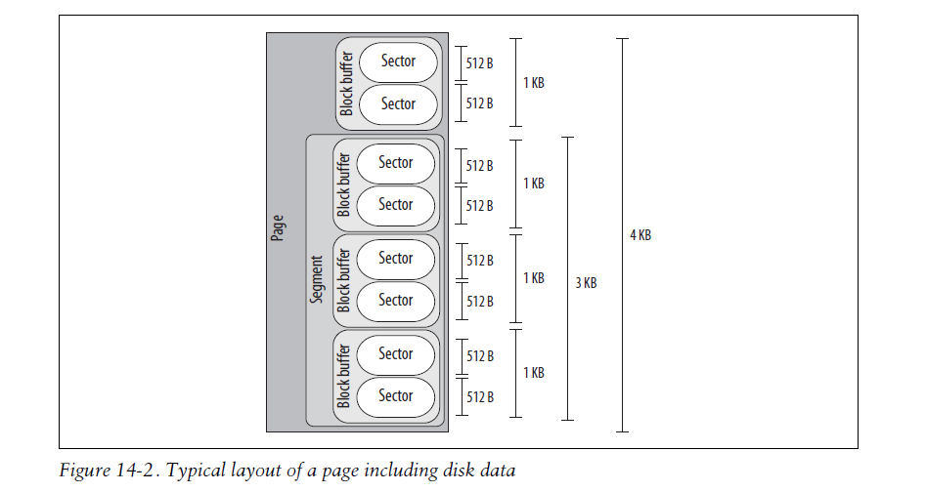

Slide 4
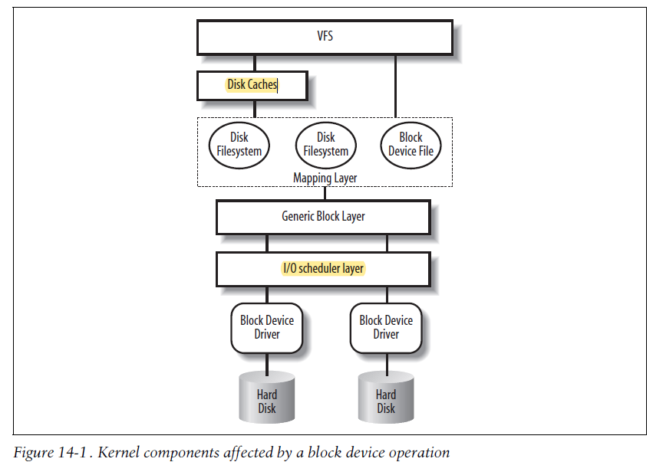
Disk Caches
Requests Queue
类似 Process
Scheduling
Merge, Elevator
Device Command

Slide 5
14.1 Block Devices Handling IO Subsystem
14.2 The Generic Block Layer 多个不同块设备的封装 # VFS是不同文件系统的封装
14.3 The I/O Scheduler
14.4 Block Device Drivers # 还有一套与它配合的机制/组件
14.5 Opening a Block Device File
Read, write, close, ...

