Slide 1

1. Introduction
2. Memory Addressing
3. Processes
4. Interrupts and Exceptions
5. Kernel Synchronization
6. Timing Measurements
7. Process Scheduling
8. Memory Management
9. Process Address Space
10. System Calls
11. Signals
12. The Virtual Filesystem
13. I/O Architecture and Device Drivers
14. Block Device Drivers
15. The Page Cache
16. Accessing Files
17. Page Frame Reclaiming
18. The Ext2 and Ext3 Filesystems
19. Process Communication
20. Program Execution
进程/CPU/MEM/硬件
文件系统/IO/软件
Notes:
2020-08-05

Slide 2
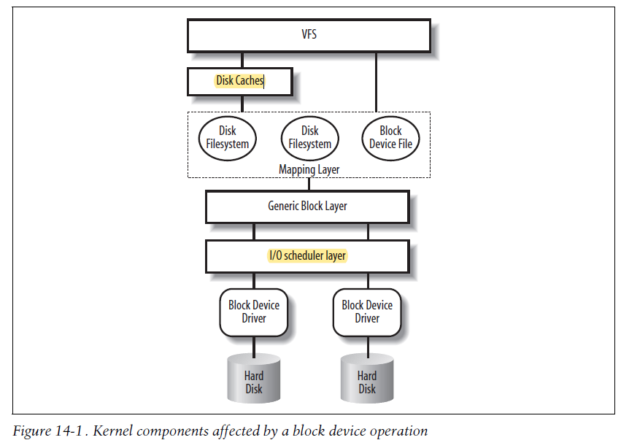
Disk Caches
Requests Queue
类似 Process
Scheduling
Merge, Elevator
Device Command

Slide 3
regular files vs block device files
how each read ends with the desired data delivered to a User Mode process and how each write ends with data marked ready for transfer to disk.
Ways to access a file:
1) Canonical mode
O_SYNC and O_DIRECT
(however, the kernel is always allowed to return fewer bytes than requested!)
2) Synchronous mode
This flag affects only the write operation
(read operations are always blocking)
3) Memory mapping mode
mmap() system call to map the file into memory.
4) Direct I/O mode
bypassing the page cache
5) Asynchronous mode
not blocking

Slide 4
16.1 Reading and Writing a File
16.2 Memory Mapping
16.3 Direct I/O Transfers
16.4 Asynchronous I/O

Slide 5
16.1 Reading and Writing a File
Reading a file is page-based.
For writing, the file size could increase.
Read-ahead consists of reading several adjacent pages of data of a regular file or block device file before they are actually requested.
Writing Dirty Pages to Disk

Slide 6
16.2 Memory Mapping
“Memory Regions”
Shared vs Private
Memory Mapping vs IPC Shared Memory ?
1、Memory Mapping Data Structures
2、Creating a Memory Mapping
3、Destroying a Memory Mapping
4、Demand Paging for Memory Mapping
5、Flushing Dirty Memory Mapping Pages to Disk
6、Non-Linear Memory Mappings

Slide 7
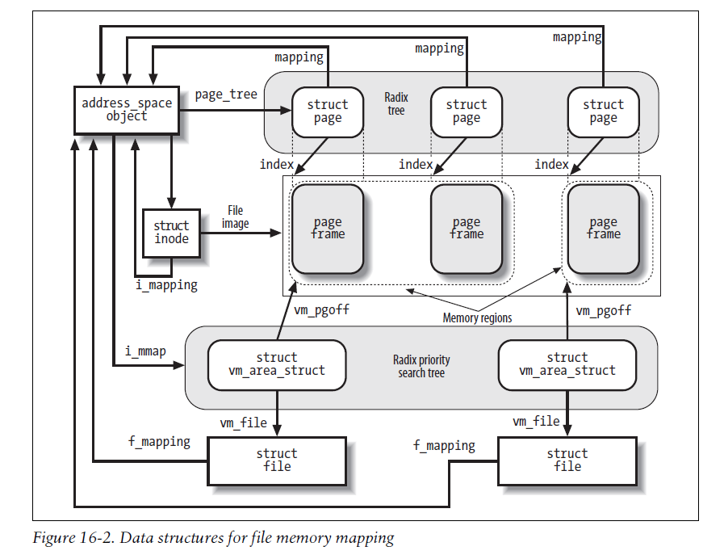

Slide 8
16.3 Direct I/O Transfers
accessing a regular file through the filesystem, accessing it by referencing its blocks on the underlying block device file, or even establishing a file memory mapping.
high-performance database servers implement their own caching mechanisms
to bypass the page cache: direct I/O transfers

Slide 9
16.4 Asynchronous I/O
“Asynchronous” essentially means that when a User Mode process invokes a library function to read or write a file, the function terminates as soon as the read or write operation has been enqueued, possibly even before the actual I/O data transfer takes place. The calling process can thus continue its execution while the data is being transferred.
Non Blocking
The application can later check (Polling Mode) the status of the outstanding I/O operation.
(Callback function) # Interrupt Mode

