Slide 1

1. Introduction
2. Memory Addressing
3. Processes
4. Interrupts and Exceptions
5. Kernel Synchronization
6. Timing Measurements
7. Process Scheduling
8. Memory Management
9. Process Address Space
10. System Calls
11. Signals
12. The Virtual Filesystem
13. I/O Architecture and Device Drivers
14. Block Device Drivers
15. The Page Cache
16. Accessing Files
17. Page Frame Reclaiming
18. The Ext2 and Ext3 Filesystems
19. Process Communication
20. Program Execution
进程相关/CPU/MEM/硬件
文件系统相关/IO/软件
Notes:
2020-08-05

Slide 2
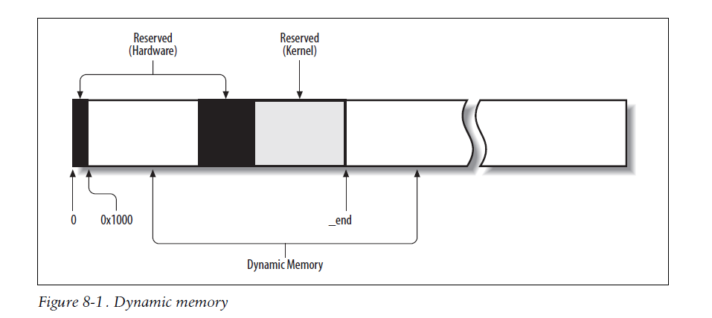

Slide 3
kernel handles dynamic memory by keeping track of free/busy page frames.
分配：
User Mode process address space
# lazy, last moment, page fault handling
memory and disk caches.
"virtual memory subsystem"
17.1 The Page Frame Reclaiming 回收 Algorithm # released
17.2 Reverse Mapping
17.3 Implementing the PFRA
17.4 Swapping
subsystem, is almost a chapter by itself

Slide 4
17.1 The Page Frame Reclaiming Algorithm
One of the fascinating aspects of Linux is that the checks performed before allocating dynamic memory to User Mode processes or to the kernel are somewhat perfunctory.
Thus, sooner or later all the free memory will be assigned to processes and caches.
The page frame reclaiming algorithm of the Linux kernel refills the lists of free blocks of the buddy system by “stealing” page frames from both User Mode processes and kernel caches.
Actually, page frame reclaiming must be performed before all the free memory has been used up.
conserve a minimal pool of free page frames so that the kernel may safely recover from “low on memory” conditions

Slide 5
1、Selecting a Target Page
“The Buddy System Algorithm”
unreclaimable pages, swappable pages, syncable pages, and discardable pages.

Slide 6
2、Design of the PFRA
While it is easy to identify the page candidates for memory reclaiming—roughly
speaking, any page belonging to a disk or memory cache, or to the User Mode
address space of a process—selecting the proper target pages is perhaps the most
sensitive issue in kernel design
As a matter of fact, the hardest job of a developer working on the virtual memory
subsystem consists of finding an algorithm that ensures acceptable performance both
for desktop machines (on which memory requests are quite limited but system
responsiveness is crucial) and for high-level machines such as large database servers
(on which memory requests tend to be huge).
# adaptive !
“let’s try this approach and see what happens.”
An unpleasant side effect of this empirical design is that the code changes quickly. For that reason, we cannot ensure that the memory reclaiming algorithm we are going to describe—the one used in Linux 2.6.11—will be exactly the same, by the time you’ll read this chapter, as the one adopted by the most up-to-date version of the Linux 2.6 kernel. However, the general ideas and the main heuristic rules described here should continue to hold.

Slide 7
Looking too close to the trees’ leaves might lead us to miss the whole forest.
rules:
1)Free the “harmless” pages first
2)Make all pages of a User Mode process reclaimable
3)Reclaim a shared page frame by unmapping at once all page table entries that reference it
4)Reclaim “unused” pages only
the page frame reclaiming algorithm heuristics:
1)Careful selection of the order in which caches are examined.
2)Ordering of pages based on aging (least recently used pages should be freed
before pages accessed recently).
3)Distinction of pages based on the page state (for example, non-dirty pages are better candidates than dirty pages because they don’t have to be written to disk).

Slide 8
17.2 Reverse Mapping
to locate quickly all the Page Table entries that point to the same page frame.
A trivial solution for reverse mapping would be to include in each page descriptor additional fields to link together all the Page Table entries that point to the page frame associated with the page descriptor.

Slide 9
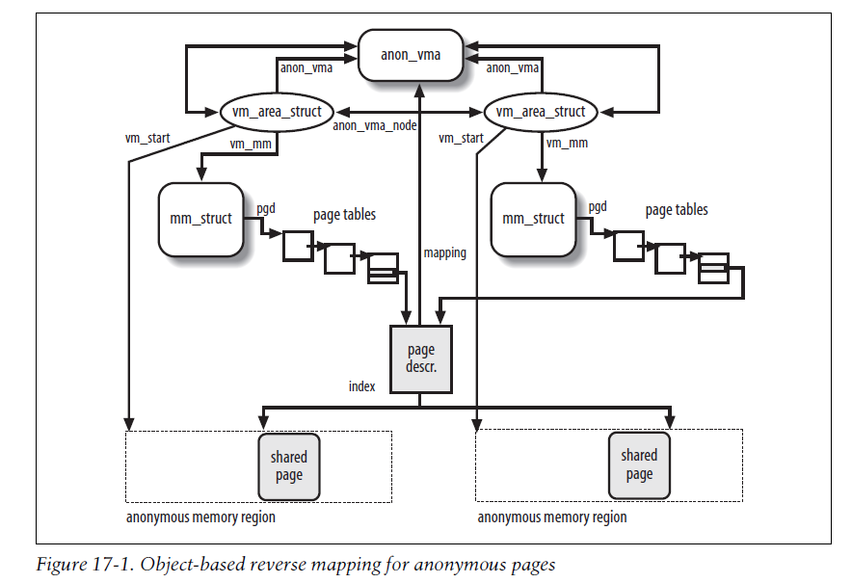

Slide 10
17.3 Implementing the PFRA - Page Frame Reclaiming Algorithm
1）Low on memory reclaiming
2）Hibernation reclaiming
3）Periodic reclaiming
The Least Recently Used (LRU) Lists
The Out of Memory Killer
To cope with this dramatic situation, the PFRA makes use of a so-called out of memory (OOM) killer, which selects a process in the system and abruptly kills it to free its page frames. The OOM killer is like a surgeon that amputates the limb of a man to save his life: losing a limb is not a nice thing, but sometimes there is nothing better to do.

Slide 11
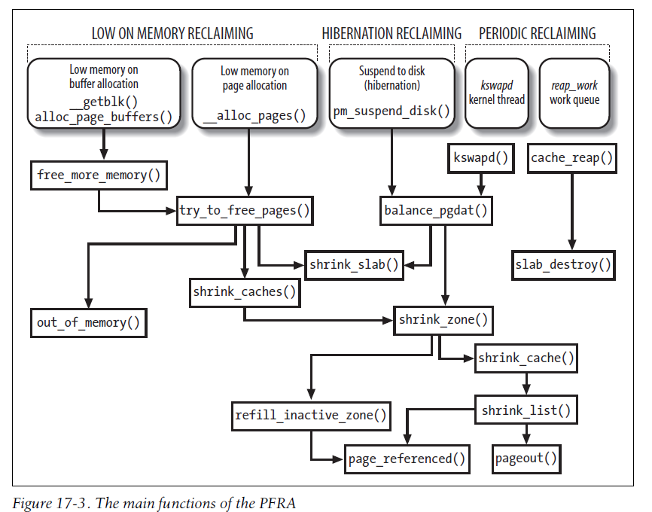

Slide 12
17.4 Swapping
to offer a backup on disk for “unmapped pages”
three kinds of pages that must be handled by the swapping subsystem
1）Pages that belong to an “anonymous memory region” of a process (User Mode stack or heap)
2）Dirty pages that belong to a private memory mapping of a process
3）Pages that belong to an IPC shared memory region (Chapter 19)
Like demand paging, swapping must be transparent to programs.

Slide 13
The main features of the swapping subsystem can be summarized as follows:
1） Set up “swap areas (Partition)” on disk to store pages that do not have a disk image (Unmapped).
2） Manage the space on swap areas allocating and freeing “page slots” as the need occurs.
3） Provide functions both to “swap out” pages from RAM into a swap area and to
“swap in” pages from a swap area into RAM.
4） Make use of “swapped-out page identifiers” in the Page Table entries of pages that are currently swapped out to keep track of the positions of data in the swap areas.

Slide 14
Swapping is the crowning feature of page frame reclaiming.
If we want to be sure that all the page frames obtained by a process, and not only those containing pages that have an image on disk, can be reclaimed at will by the PFRA, then swapping has to be used.
you might turn off swapping by using the swapoff command.
However, simulation of RAM is not like RAM in terms of performance.
several orders of magnitude longer than an access to a page in RAM
In short, if performance is of great importance, swapping should be used only as a last resort; adding RAM chips still remains the best solution to cope with increasing computing needs.

Slide 15
1、Swap Area (disk partition, a specific file ?)
2、Swap Area Descriptor # 数据结构
3、Swapped-Out Page Identifier
4、Activating and Deactivating a Swap Area # 动作、算法、函数
5、Allocating and Releasing a Page Slot
6、The Swap Cache
7、Swapping Out Pages
8、Swapping in Pages
“Talk is cheap, show me the code!”

Slide 16
