Slide 1

1. Introduction
2. Memory Addressing
3. Processes
4. Interrupts and Exceptions
5. Kernel Synchronization
6. Timing Measurements
7. Process Scheduling
8. Memory Management
9. Process Address Space
10. System Calls
11. Signals
12. The Virtual Filesystem
13. I/O Architecture and Device Drivers
14. Block Device Drivers
15. The Page Cache
16. Accessing Files
17. Page Frame Reclaiming
18. The Ext2 and Ext3 Filesystems
19. Process Communication
20. Program Execution
进程相关/CPU/MEM/硬件
文件系统相关/IO/软件
Notes:
2020-08-06

Slide 2
Ext2: Native file system
two versions of the same data structures：on disk vs in memory
kernel activities, low-level：mostly inodes and data blocks
CPU
|
MEMORY （暂时的） mapping 映射
|
DISK （永久的）

Slide 3
18.1 General Characteristics of Ext2
18.2 Ext2 Disk Data Structures
18.3 Ext2 Memory Data Structures
18.4 Creating the Ext2 Filesystem
18.5 Ext2 Methods
18.6 Managing Ext2 Disk Space
18.7 The Ext3 Filesystem (journaling, 日志)

Slide 4
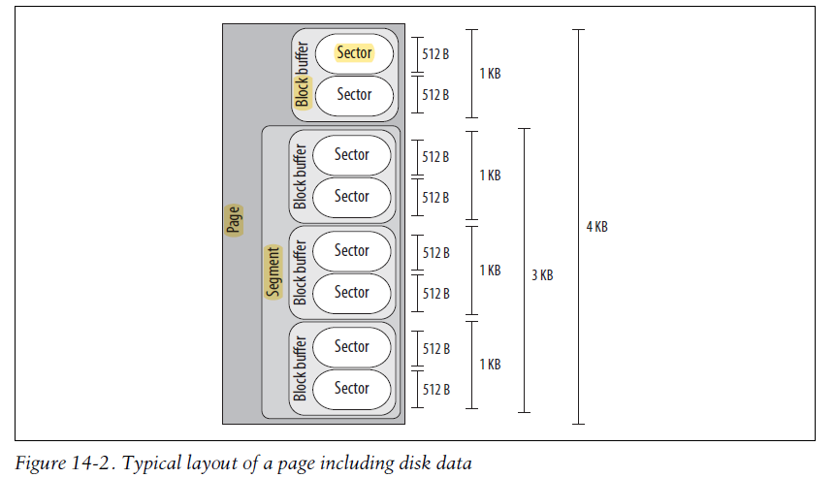
18.1 General Characteristics of Ext2

Slide 5
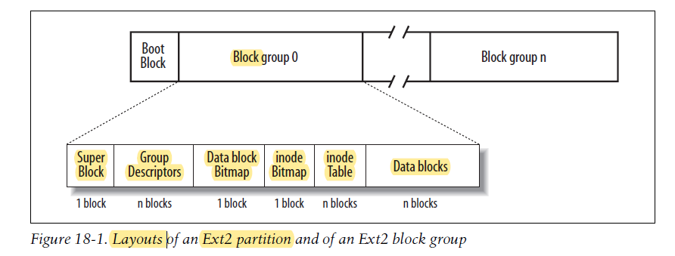
18.2 Ext2 Disk Data Structures
The first block in each Ext2 partition is never managed by the Ext2 filesystem, because it is reserved for the partition boot sector.
redundant

Slide 6
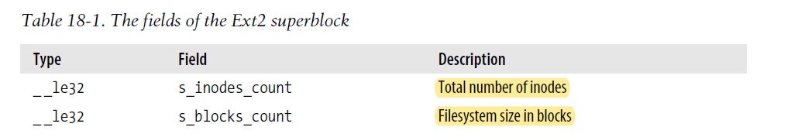
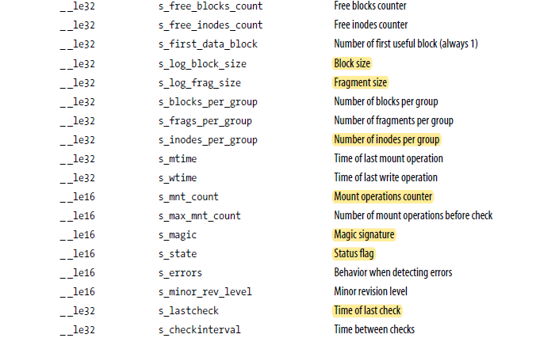

Slide 7
Access Control Lists
a file — owner, group, and others
ACL - specific users (or groups of users) and the privileges

Slide 8
18.3 Ext2 Memory Data Structures
For the sake of efficiency, most information stored in the disk data structures of an Ext2 partition are copied into RAM when the filesystem is mounted, thus allowing the kernel to avoid many subsequent disk read operations.

Slide 9
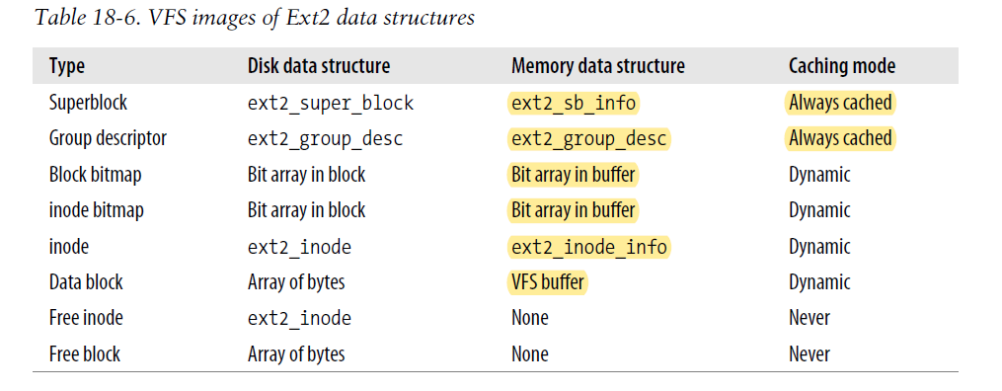

Slide 10
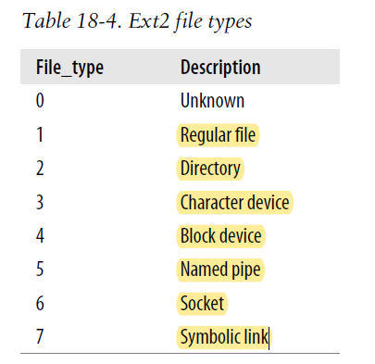

Slide 11
18.4 Creating the Ext2 Filesystem
format
Ext2 filesystems are created by the mke2fs utility program
The program performs the following actions:
1. Initializes the superblock and the group descriptors.
2. Optionally, checks whether the partition contains defective blocks.
3. For each block group, reserves all the disk blocks needed to store the superblock,
the group descriptors, the inode table, and the two bitmaps.
4. Initializes the inode bitmap and the data map bitmap of each block group to 0.
5. Initializes the inode table of each block group.
6. Creates the /root directory.
7. Creates the lost+found directory to link the lost and found defective blocks.
8. Updates the inode bitmap and the data block bitmap of the block group in
which the two previous directories have been created.
9. Groups the defective blocks (if any) in the lost+found directory.

Slide 12
18.5 Ext2 Methods
1、Ext2 Superblock Operations
2、Ext2 inode Operations
3、Ext2 File Operations

Slide 13
18.6 Managing Ext2 Disk Space
1、Creating inodes
2、Deleting inodes
3、Data Blocks Addressing
4、File Holes
5、Allocating a Data Block
6、Releasing a Data Block

Slide 14
18.7 The Ext3 Filesystem
The goal of a journaling filesystem is to avoid running time-consuming consistency checks on the whole filesystem by looking instead in a special disk area that contains the most recent disk write operations named journal. Remounting a journaling filesystem after a system failure is a matter of a few seconds.
1、Journaling Filesystems
2、The Ext3 Journaling Filesystem
3、The Journaling Block Device Layer
4、How Journaling Works
ext4

