Slide 1

1. Introduction
2. Memory Addressing
3. Processes
4. Interrupts and Exceptions
5. Kernel Synchronization
6. Timing Measurements
7. Process Scheduling
8. Memory Management
9. Process Address Space
10. System Calls
11. Signals
12. The Virtual Filesystem
13. I/O Architecture and Device Drivers
14. Block Device Drivers
15. The Page Cache
16. Accessing Files
17. Page Frame Reclaiming
18. The Ext2 and Ext3 Filesystems
19. Process Communication
20. Program Execution
进程相关/CPU/MEM/硬件
文件系统相关/IO/软件
Notes:
2020-08-06

Slide 2
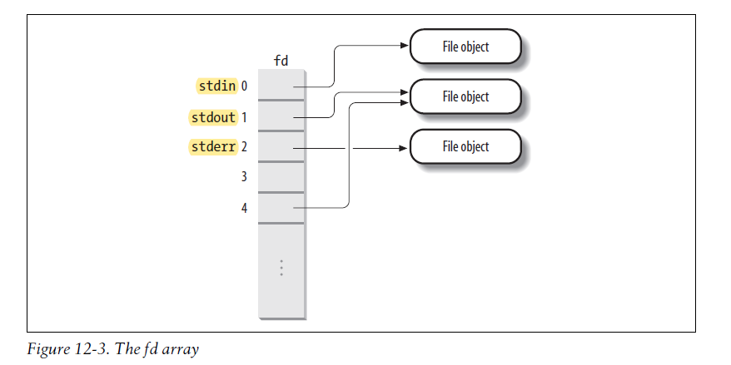

Slide 3
1、Pipes and FIFOs (named pipes)
2、Semaphores
3、Messages
4、Shared memory regions
5、Sockets
19.1 Pipes
19.2 FIFOs
19.3 System V IPC - Inter Process Communication
IPC Semaphores
IPC Messages
IPC Shared Memory
19.4 POSIX Message Queues
$ ls | more
$ ls > temp
$ more < temp

