Slide 1
1. Introduction
2. Memory Addressing
3. Processes
4. Interrupts and Exceptions
5. Kernel Synchronization
6. Timing Measurements
7. Process Scheduling
8. Memory Management
9. Process Address Space
10. System Calls
11. Signals
12. The Virtual Filesystem
13. I/O Architecture and Device Drivers
14. Block Device Drivers
15. The Page Cache
16. Accessing Files
17. Page Frame Reclaiming
18. The Ext2 and Ext3 Filesystems
19. Process Communication
20. Program Execution
Understanding
Linux Kernel
概念/Concepts !!!
理解 !!!
Notes:
2020-07-23

Slide 2
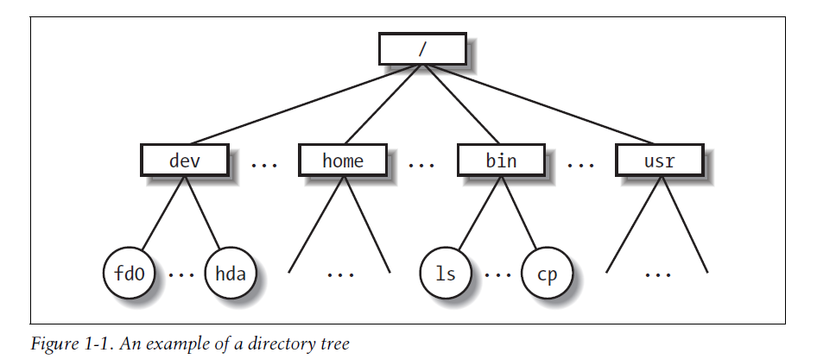
1、Introduction
Multiuser Systems 多用户系统 ？
/etc, /var, /tmp, /root
Disk Device vs File System !
/proc

Slide 3
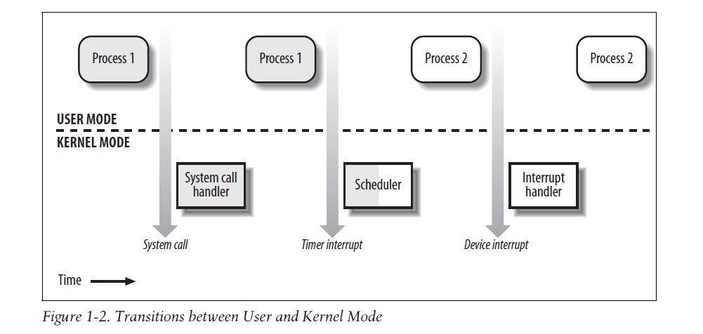
User Space vs Kernel Space
Memory Segmentation (vs Paging)

Slide 4
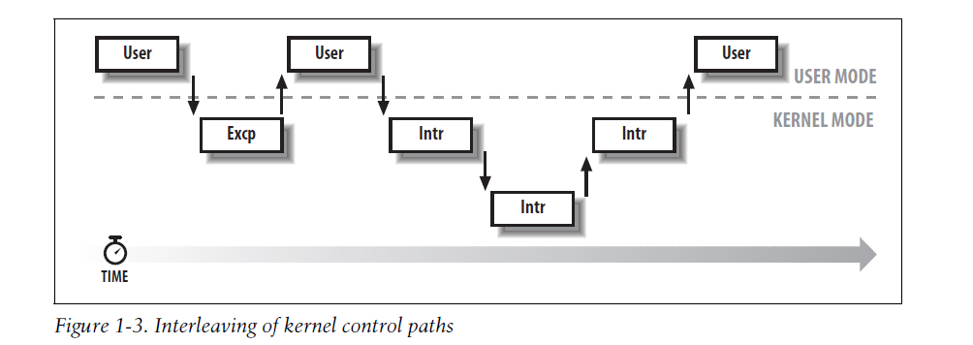
Kernel Control Paths
Kernel: Soft IRQ, Tasks, Bottom Half

Slide 5
