Slide 1
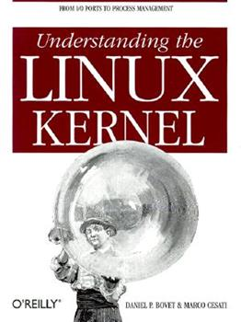
1. Introduction
2. Memory Addressing
3. Processes
4. Interrupts and Exceptions
5. Kernel Synchronization
6. Timing Measurements
7. Process Scheduling
8. Memory Management
9. Process Address Space
10. System Calls
11. Signals
12. The Virtual Filesystem
13. I/O Architecture and Device Drivers
14. Block Device Drivers
15. The Page Cache
16. Accessing Files
17. Page Frame Reclaiming
18. The Ext2 and Ext3 Filesystems
19. Process Communication
20. Program Execution
进程相关/CPU/MEM/硬件
文件系统相关/IO/软件
Notes:
2020-08-06

Slide 2
describe how the kernel sets up the execution context for a process according to the contents of the program file.
1、Different executable formats
2、Shared libraries
3、Other information in the execution context
command-line arguments and environment variables
A program is stored on disk as an executable file, which includes both the object code of the functions to be executed and the data on which these functions will act.
Many functions of the program are service routines available to all programmers; their object code is included in special files called “libraries.”
Actually, the code of a library function may either be statically copied into the executable file (static libraries) or linked to the process at runtime (shared libraries, because their code can be shared by several independent processes).

Slide 3
20.1 Executable Files
20.2 Executable Formats
20.3 Execution Domains
20.4 The exec (system call) Functions

Slide 4
20.1 Executable Files
a process as an “execution context”.
When a process is created, it always inherits the credentials of its parent.
1、Process Credentials and Capabilities
user, group, others - file
Process capabilities
Neither the VFS nor the Ext2 filesystem currently supports the capability model, so there is no way to associate an executable file with the set of capabilities
The Linux Security Modules framework
# SELinux - Security-Enhanced Linux

Slide 5
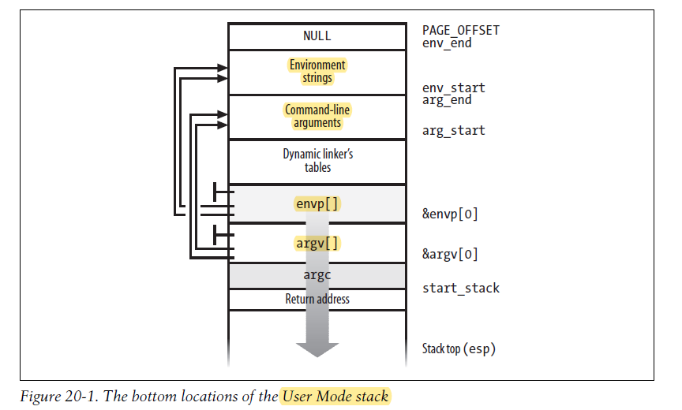

Slide 6
2、Command-Line Arguments and Shell Environment
int main(int argc, char *argv[], char *envp[])
3、Libraries
static vs shared/dynamic

Slide 7
4、Program Segments and Process Memory Regions
1) Text segment => Code
2) Initialized data segment
3) Uninitialized data segment
4) Stack segment
mm_struct memory descriptor # <= process descriptor
1) start_code,end_code
2) start_data,end_data
3) start_brk,brk
4) start_stack
5) arg_start,arg_end
6) env_start,env_end
Classical vs Flexible memory region layout

Slide 8
5、Execution Tracing
Execution tracing is a technique that allows a program to monitor the execution of another program.
The traced program can be executed step by step, until a signal is received, or until a system call is invoked.
traced process
tracing process # debugger gdb
real_parent

Slide 9
20.2 Executable Formats
ELF - Executable and Linking Format
An executable format is described by an object of type linux_binfmt
load_binary
load_shlib
core_dump

Slide 10
20.3 Execution Domains
machine code for the same computer architecture
Emulated execution:
not POSIX-compliant
Microsoft MS-DOS (DOSemu) and Windows (Wine) programs are emulated
Native execution:
Programs whose system calls are totally POSIX compliant
(similar vs identical)
execution domain descriptors
A process specifies its execution domain by setting the personality

Slide 11
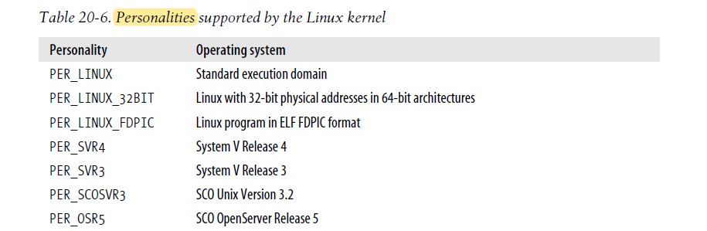
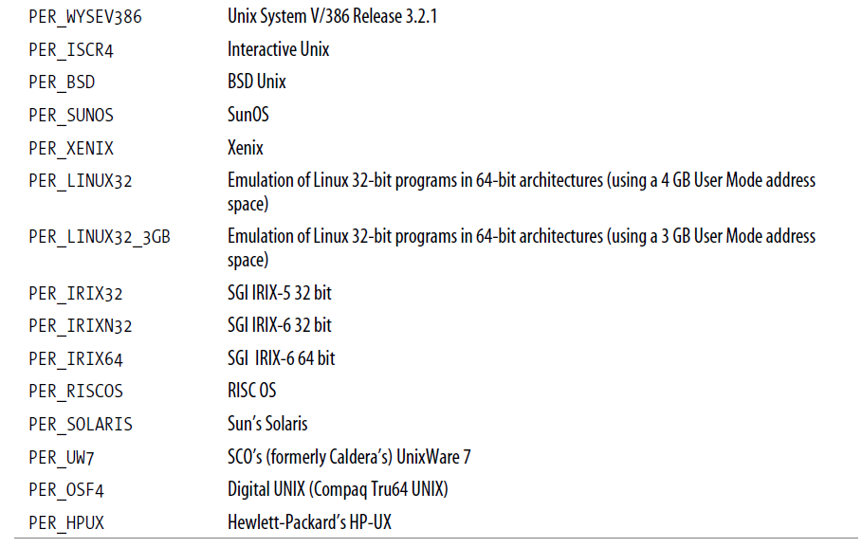

Slide 12
20.4 The exec Functions
Unix systems provide a family of functions (system calls) that replace the execution context of a process with a new context described by an executable file.
to create a new memory region that maps the text segment (that is, the code) of the executable file.
to create a new memory region that maps the data segment of the executable file.
the dynamic linker terminates its execution by jumping to the main entry point of the program to be executed.

Slide 13
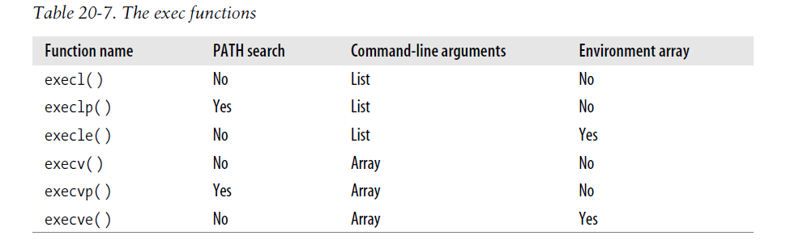

Slide 14
As you may have noticed, executing a program is a complex activity that involves many facets of kernel design, such as process abstraction, memory management, system calls, and filesystems. It is the kind of topic that makes you realize what a marvelous piece of work Linux is!

