Slide 1
1. Introduction
2. Memory Addressing
3. Processes
4. Interrupts and Exceptions
5. Kernel Synchronization
6. Timing Measurements
7. Process Scheduling
8. Memory Management
9. Process Address Space
10. System Calls
11. Signals
12. The Virtual Filesystem
13. I/O Architecture and Device Drivers
14. Block Device Drivers
15. The Page Cache
16. Accessing Files
17. Page Frame Reclaiming
18. The Ext2 and Ext3 Filesystems
19. Process Communication
20. Program Execution
Understanding
Linux Kernel
概念/Concepts !!!
理解 !!!
Notes:
2020-07-23

Slide 2
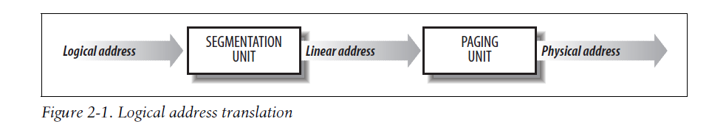
2、Memory Addressing x86
2.1 Memory Addresses

Slide 3
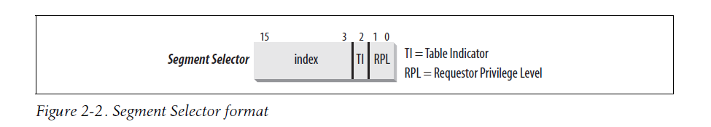
2.2 Segmentation in Hardware : User Mode vs Kernel Mode

Slide 4
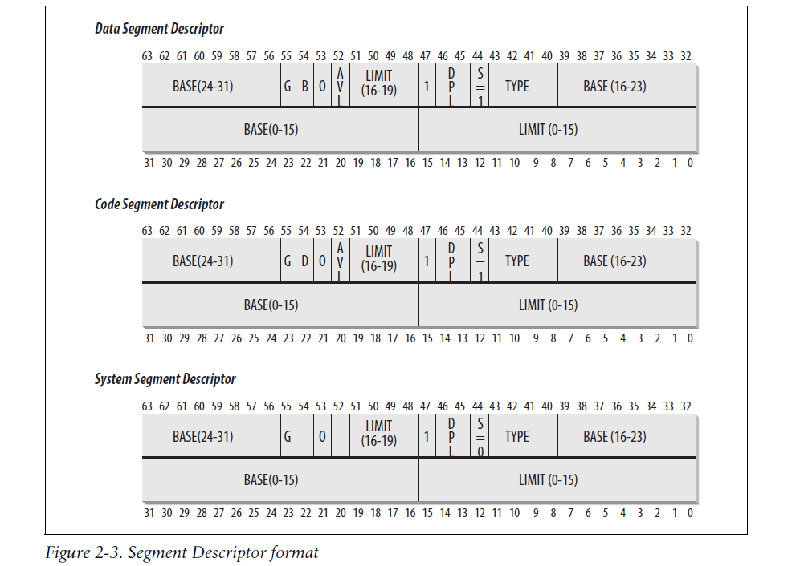

Slide 5
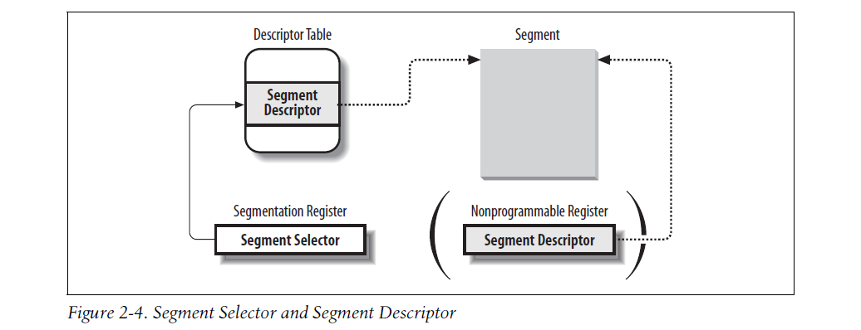

Slide 6
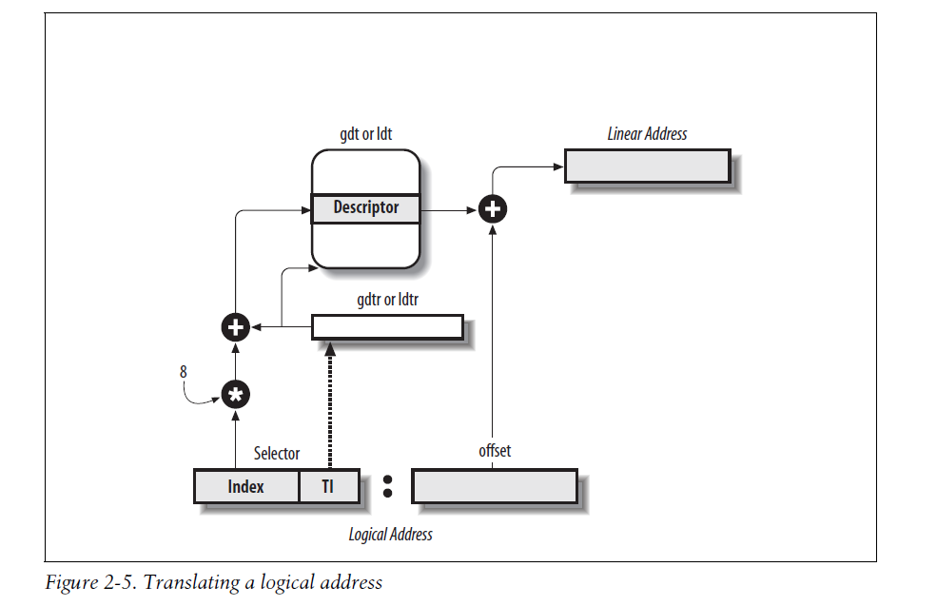

Slide 7
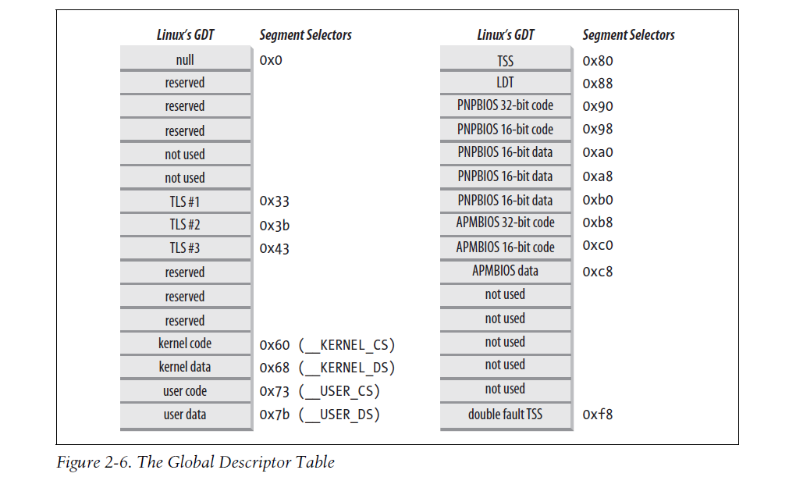
2.3 Segmentation in Linux

Slide 8
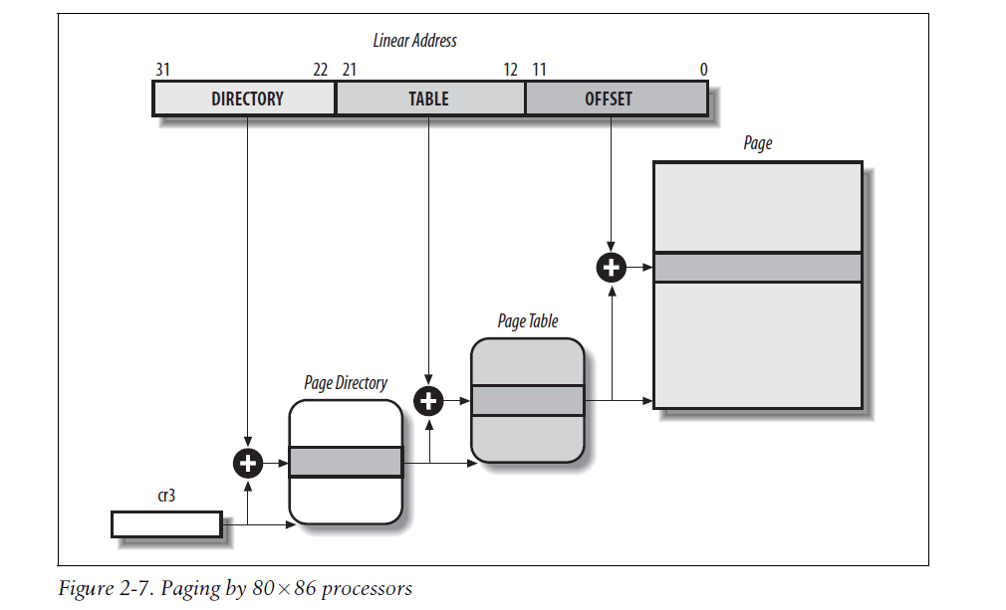
2.4 Paging in Hardware

Slide 9
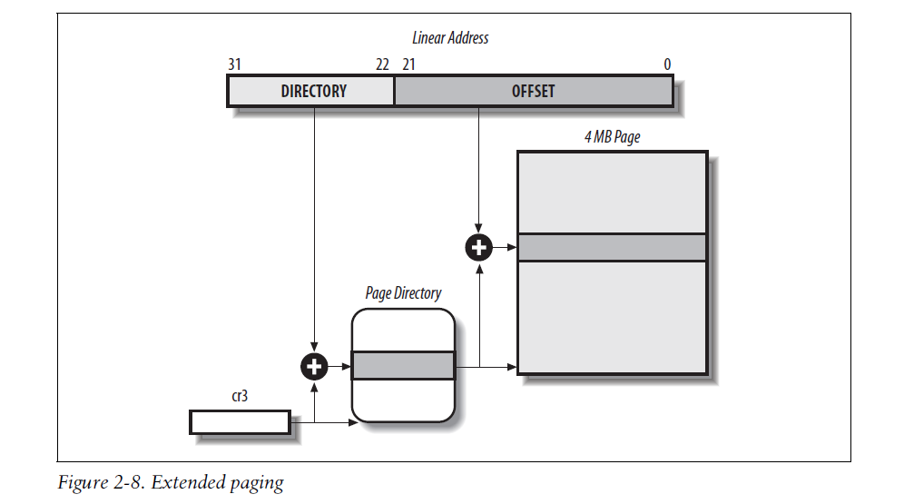
Translation Lookaside Buffers (TLB)

Slide 10
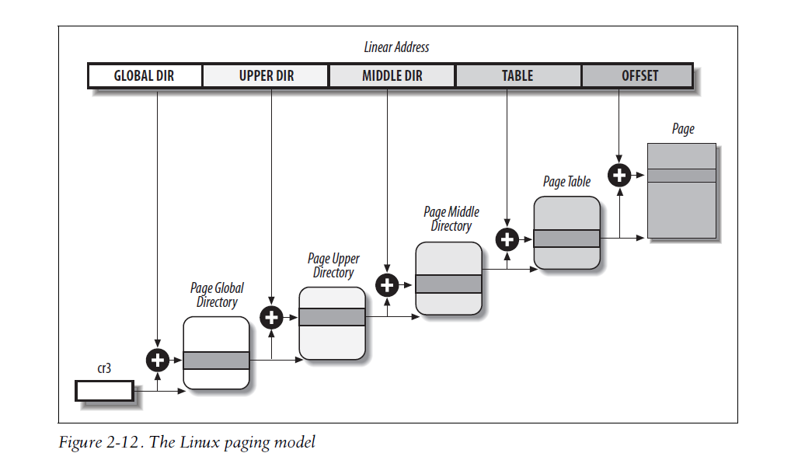
2.5 Paging in Linux

Slide 11
Physical Memory Layout
Process Page Tables
Kernel Page Tables
The first fetched address is F000:FFF0
=> BIOS (Basic Input/Output System)

