Slide 1
1. Introduction
2. Memory Addressing
3. Processes
4. Interrupts and Exceptions
5. Kernel Synchronization
6. Timing Measurements
7. Process Scheduling
8. Memory Management
9. Process Address Space
10. System Calls
11. Signals
12. The Virtual Filesystem
13. I/O Architecture and Device Drivers
14. Block Device Drivers
15. The Page Cache
16. Accessing Files
17. Page Frame Reclaiming
18. The Ext2 and Ext3 Filesystems
19. Process Communication
20. Program Execution
Understanding
Linux Kernel
概念/Concepts !!!
理解 !!!
Notes:
2020-07-23

Slide 2
CHAPTER 3、 Processes
3.1 Processes, Lightweight Processes, and Threads
Kernel Threads, Tasks
3.2 Process Descriptor # 数据结构 struct、type
3.3 Process Switch # 算法 函数function、API
3.4 Creating Processes
3.5 Destroying Processes

Slide 3
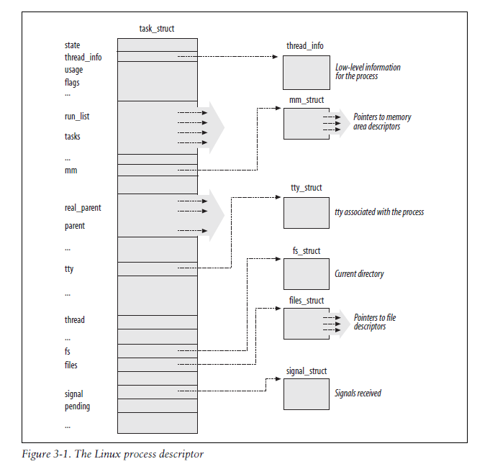
3.2 Process
Descriptor
Process State
TASK_RUNNING
TASK_INTERRUPTIBLE
TASK_UNINTERRUPTIBLE
TASK_STOPPED
TASK_TRACED
EXIT_ZOMBIE
EXIT_DEAD

Slide 4
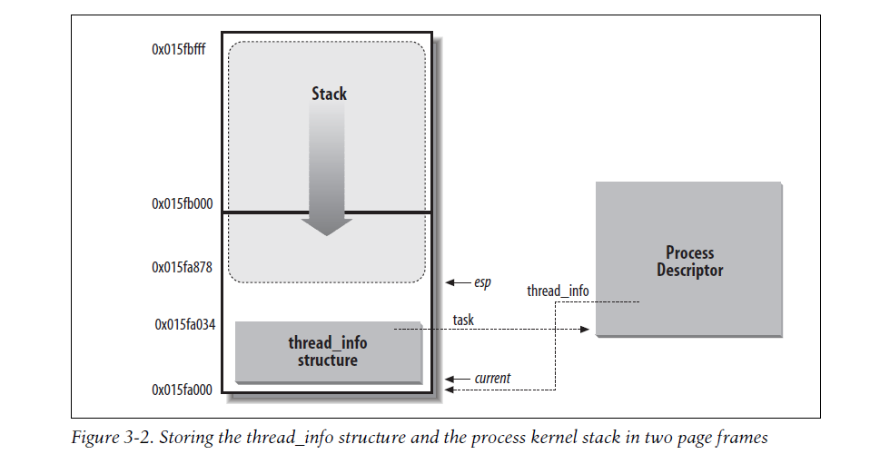

Slide 5
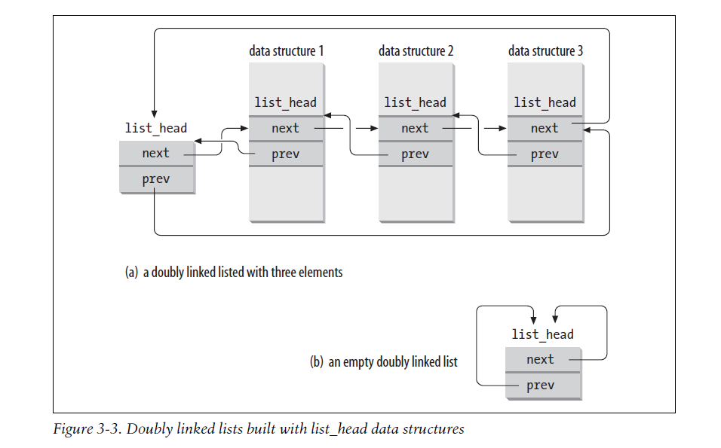
The lists of TASK_RUNNING processes

Slide 6
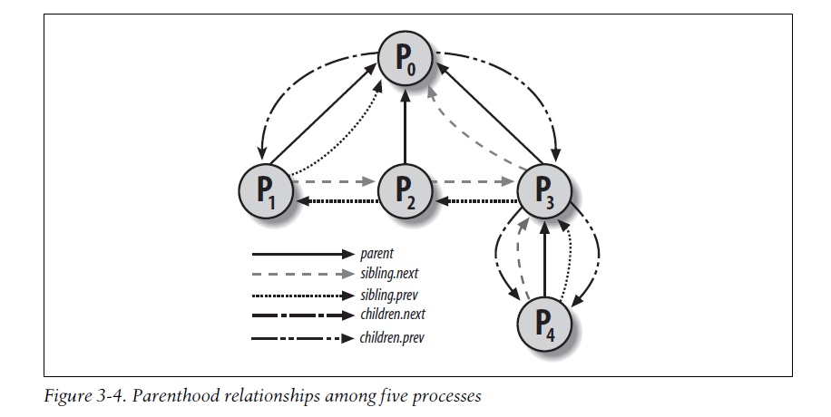

Slide 7
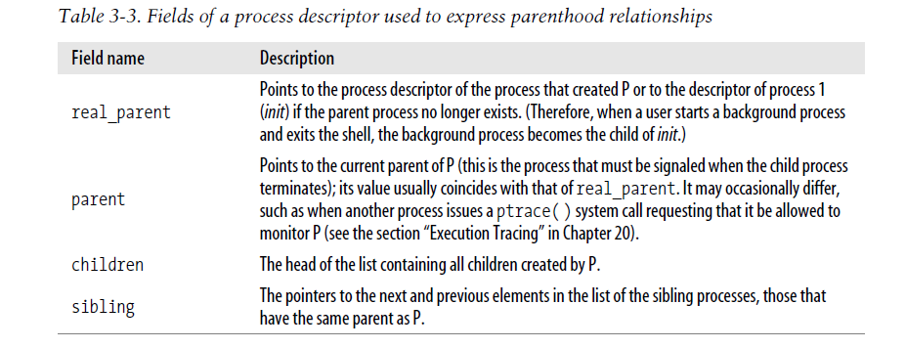
Relationships Among Processes

Slide 8
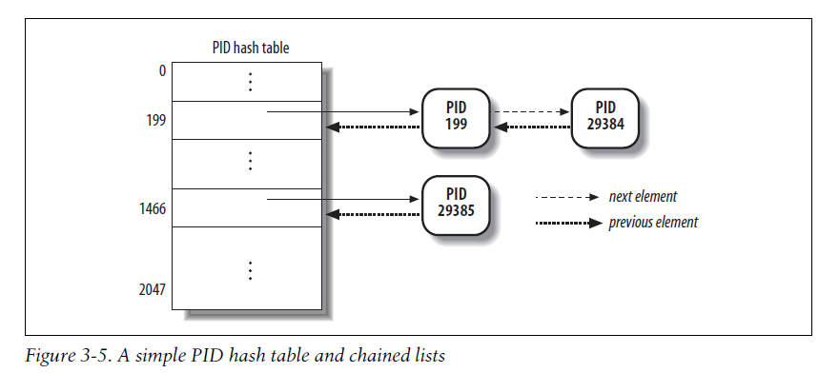
The pidhash table and chained lists

Slide 9
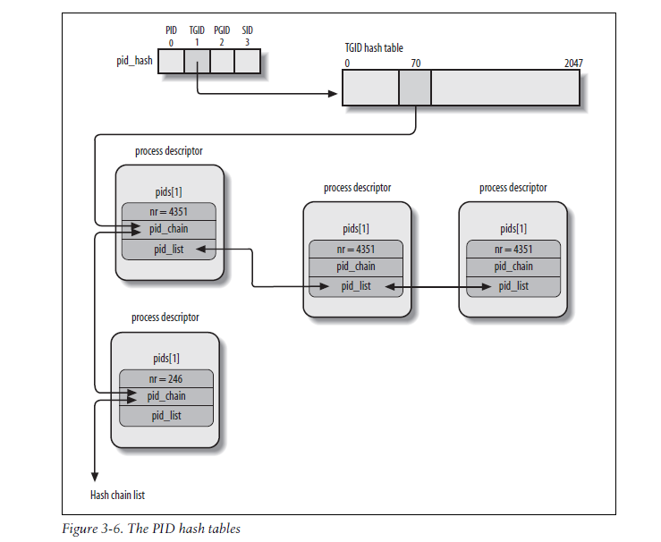

Slide 10
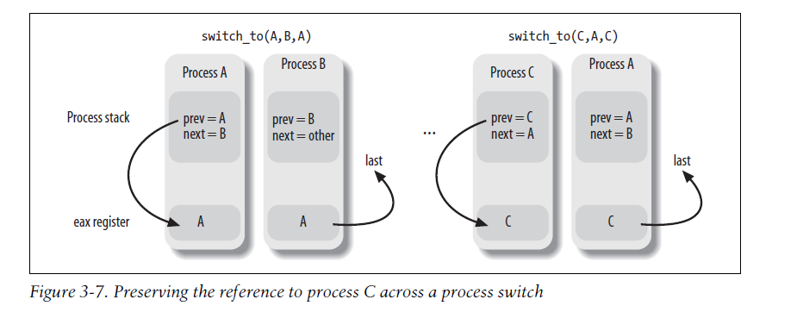
Hardware Context
3.3 Process Switch
Task State Segment
Performing the Process Switch
Saving and Loading the FPU, MMX, and XMM Registers

Slide 11
3.4 Creating Processes
The clone( ), fork( ), and vfork( ) System Calls
Kernel Threads
Creating a kernel thread
Process 0
The ancestor of all processes, called process 0, the idle process, or, for historical reasons, the swapper process, is a kernel thread created from scratch during the initialization phase of Linux
Process 1 Init

Slide 12
3.5 Destroying Processes
Process Termination
exit_group() system call
_exit() system call
Process Removal

