Slide 1
1. Introduction
2. Memory Addressing
3. Processes
4. Interrupts and Exceptions
5. Kernel Synchronization
6. Timing Measurements
7. Process Scheduling
8. Memory Management
9. Process Address Space
10. System Calls
11. Signals
12. The Virtual Filesystem
13. I/O Architecture and Device Drivers
14. Block Device Drivers
15. The Page Cache
16. Accessing Files
17. Page Frame Reclaiming
18. The Ext2 and Ext3 Filesystems
19. Process Communication
20. Program Execution
Understanding
Linux Kernel
概念/Concepts !
理解 !!!
Notes:
2020-07-23

Slide 2
You could think of the kernel as a server that answers requests; these requests can come either from a process running on a CPU or an external device issuing an interrupt request.
We make this analogy to underscore that parts of the kernel are not run serially, but in an interleaved way. （串行、并行，并发）
(Kernel Control Paths：PC/SoftIRQ/Interrupt)
Thus, they can give rise to race conditions, which must be controlled through proper synchronization techniques.
# Memory locations： Data struct / Device IO

Slide 3
5.1 How the Kernel Services Requests
5.2 Synchronization Primitives
5.3 Synchronizing Accesses to Kernel Data Structures
5.4 Examples of Race Condition Prevention

Slide 4
5.1 How the Kernel Services Requests
Mom who must satisfy two types of requests:
those issued by 油热了、水开了
those issued by Jerry，Dad
The policy adopted by Mom
...
1、Kernel Preemption
planned process switch
forced process switch
the main characteristic of a preemptive kernel is that a process running in Kernel Mode can be replaced by another process while in the middle of a kernel function.
Priority

Slide 5
2、When Synchronization Is Necessary
3、When Synchronization Is Not Necessary

Slide 6
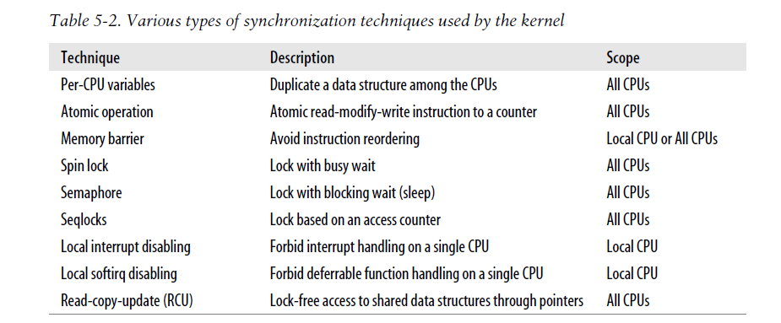
5.2 Synchronization Primitives (原语)

Slide 7
1）Per-CPU Variables
2）Atomic Operations
3）Optimization and Memory Barriers
4）Spin Locks
5）Read/Write Spin Locks
6）Seqlocks
7）Read-Copy Update (RCU)
8）Semaphores
9）Read/Write Semaphores
10）Completions
11）Local Interrupt Disabling
12）Disabling and Enabling Deferrable Functions

Slide 8
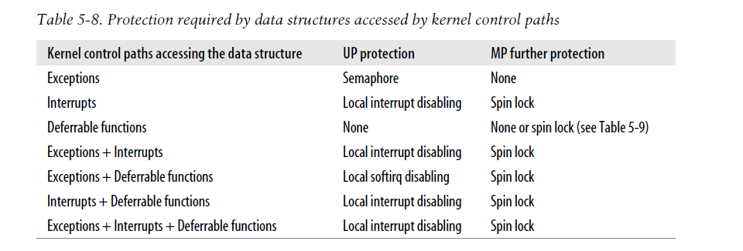
5.3 Synchronizing Accesses to Kernel Data Structures
Kernel vs Processes/Threads

Slide 9
5.4 Examples of Race Condition Prevention
1、Reference Counters
2、The Big Kernel Lock
3、Memory Descriptor Read/Write Semaphore
4、Slab（内存管理） Cache List Semaphore
5、Inode（文件系统）Semaphore

