Slide 1
1. Introduction
2. Memory Addressing
3. Processes
4. Interrupts and Exceptions
5. Kernel Synchronization
6. Timing Measurements
7. Process Scheduling
8. Memory Management
9. Process Address Space
10. System Calls
11. Signals
12. The Virtual Filesystem
13. I/O Architecture and Device Drivers
14. Block Device Drivers
15. The Page Cache
16. Accessing Files
17. Page Frame Reclaiming
18. The Ext2 and Ext3 Filesystems
19. Process Communication
20. Program Execution
Understanding
Linux Kernel
概念/Concepts !!!
理解 !!!
Notes:
2020-07-31

Slide 2
Timing Measurement:
• Keeping the current time (时间)and date: user and kernel to watch.
• Maintaining timers(定时器)—mechanisms： to notify kernel or user program.
6.1 Clock and Timer Circuits 硬件基础
6.2 The Linux Timekeeping Architecture 软件/数据结构
6.3 Updating the Time and Date 维护/更新者
6.4 Updating System Statistics 维护/更新者
6.5 Software Timers and Delay Functions 内部 Kernel 使用者
6.6 System Calls Related to Timing Measurements 外部 User Mode 使用者

Slide 3
6.1 Clock and Timer Circuits 硬件基础
1、Real Time Clock (RTC)
2、Time Stamp Counter (TSC)
3、Programmable Interval Timer (PIT)
4、CPU Local Timer
5、High Precision Event Timer (HPET) chip
6、ACPI Power Management Timer

Slide 4
6.2 The Linux Timekeeping Architecture 软件/数据结构
Linux/Kernel must carry on several time-related activities:
• Updates the time elapsed since system startup.
• Updates the time and date.
• Determines, for every CPU, how long the current process has been running, and preempts it if it has exceeded the time allocated to it.
• Updates resource usage statistics.
• Checks whether the interval of time associated with each software timer has elapsed.
Linux’s timekeeping architecture is the set of kernel data structures and functions related to the flow of time.

Slide 5
Actually, 80 × 86-based multiprocessor machines have a timekeeping architecture that is slightly different from the timekeeping architecture of uniprocessor machines:
• In a uniprocessor system, all time-keeping activities are triggered by interrupts raised by the global timer (either the Programmable Interval Timer or the High Precision Event Timer).
• In a multiprocessor system, all general activities (such as handling of software timers) are triggered by the interrupts raised by the global timer, while CPU-specific activities (such as monitoring the execution time of the currently running process) are triggered by the interrupts raised by the local APIC timer.

Slide 6
1、Data Structures of the Timekeeping Architecture
2、Timekeeping Architecture in Uniprocessor Systems
3、Timekeeping Architecture in Multiprocessor Systems

Slide 7
6.3 Updating the Time and Date 维护/更新者

Slide 8
6.4 Updating System Statistics 维护/更新者
1、Updating Local CPU Statistics
2、Keeping Track of System Load swapper/idle process 0
3、Profiling the Kernel Code hot spots
The profiler is based on a simple Monte Carlo algorithm: at every timer interrupt occurrence, the kernel determines whether the interrupt occurred in Kernel Mode; if so, the kernel fetches the value of the eip register before the interruption from the stack and uses it to discover what the kernel was doing before the interrupt. In the long run, the samples accumulate on the hot spots.
4、Checking the NMI Watchdogs
watchdog system, to detect kernel bugs that cause a system freeze.

Slide 9
6.5 Software Timers and Delay Functions 内部 Kernel 使用者
SoftIRQ vs IRQ
A timer is a software facility that allows functions to be invoked at some future moment, after a given time interval has elapsed; a time-out denotes a moment at which the time interval associated with a timer has elapsed.
kernel/driver and process
“Talk is cheap. Show me the code.” ― Linus Torvalds

Slide 10
1、Dynamic Timers 软件定时器
Dynamic timers may be dynamically created and destroyed. No limit is placed on the number of currently active dynamic timers.
1) Dynamic timers and race conditions
2) Data structures for dynamic timers
3) Dynamic timer handling
2、An Application of Dynamic Timers:
nanosleep() System Call
3、Delay Functions
void udelay(unsigned long usecs)
void ndelay(unsigned long nsecs)

Slide 11
6.6 System Calls Related to Timing Measurements 外部 User Mode 使用者
1、The time( ) and gettimeofday( ) System Calls
2、The adjtimex( ) System Call
Network Time Protocol (NTP)
3、The setitimer( ) and alarm( ) System Calls
Linux/Kernel allows User Mode processes to activate special timers called interval timers. Periodically or once.
ITIMER_REAL
ITIMER_VIRTUAL
ITIMER_PROF

Slide 12
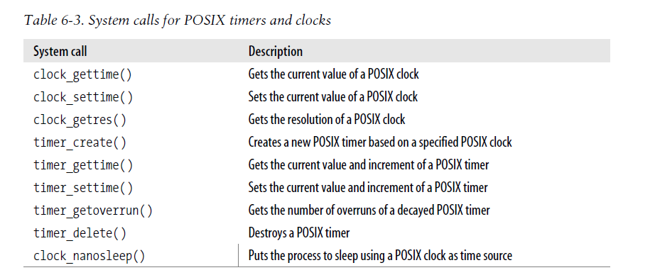
4、System Calls for POSIX Timers
POSIX -- Portable Operating System Interface. IEEE/UNIX

