Slide 1
1. Introduction
2. Memory Addressing
3. Processes
4. Interrupts and Exceptions
5. Kernel Synchronization
6. Timing Measurements
7. Process Scheduling
8. Memory Management
9. Process Address Space
10. System Calls
11. Signals
12. The Virtual Filesystem
13. I/O Architecture and Device Drivers
14. Block Device Drivers
15. The Page Cache
16. Accessing Files
17. Page Frame Reclaiming
18. The Ext2 and Ext3 Filesystems
19. Process Communication
20. Program Execution
Understanding
Linux Kernel
概念/Concepts !!!
理解 !!!
Notes:
2020-07-23

Slide 2
segmentation and paging circuits
logical addresses, into linear addresses, and into physical ones
some portion of RAM is permanently assigned to the kernel and used to store both the kernel code and the static kernel data structures.
dynamic memory
describes how the kernel allocates dynamic memory for its own use.
memory zones, kernel mappings, the buddy system, the slab cache, and memory pools.

Slide 3
8.1 Page Frame Management
8.2 Memory Area Management 跨 Page Frame 吗？
8.3 Noncontiguous Memory Area Management

Slide 4
8.1 Page Frame Management
4 KB and 4 MB
The Page Fault exceptions issued by the paging circuitry are easily interpreted. Either the page requested exists but the process is not allowed to address it, or the page does not exist. In the second case, the memory allocator must find a free 4 KB page frame and assign it to the process.
Although both 4 KB and 4 MB are multiples of all disk block sizes, transfers of data between main memory and disks are in most cases more efficient when the smaller size is used.

Slide 5
1、Page Descriptors
It is not free when the page frame contains data of a User Mode process, data of a software cache, dynamically allocated kernel data structures, buffered data of a device driver, code of a kernel module, and so on.
2、Non-Uniform Memory Access (NUMA) Nodes -> Zones
3、Memory Zones
every memory node into three zones:
1）ZONE_DMA - Contains page frames of memory below 16 MB
2）ZONE_NORMAL - Contains page frames of memory at and above 16 MB and below 896 MB
3）ZONE_HIGHMEM - Contains page frames of memory at and above 896 MB
zone descriptor

Slide 6
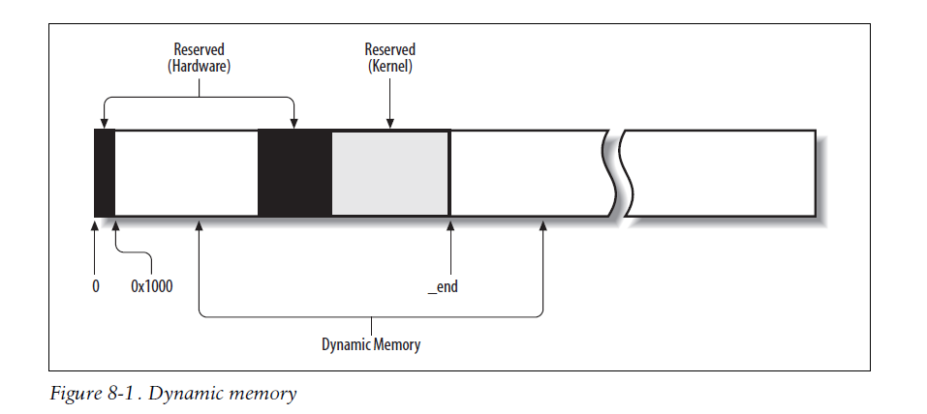

Slide 7
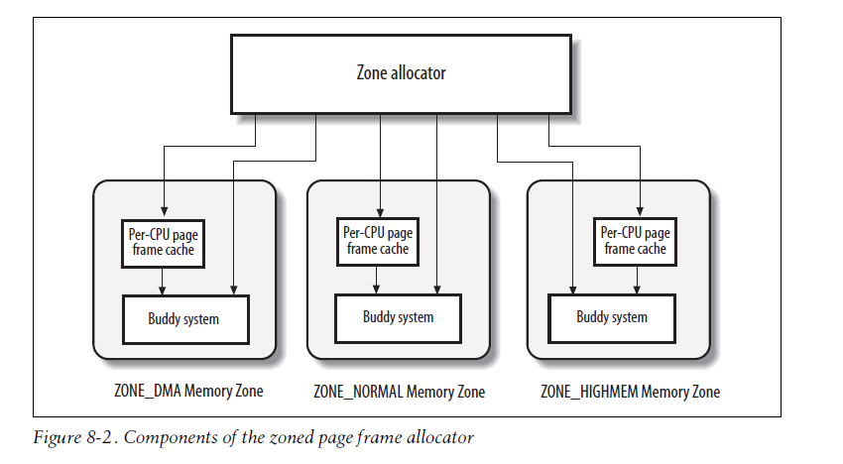
4、The Pool of Reserved Page Frames
atomic memory allocation requests
5、The Zoned Page Frame Allocator
groups of contiguous
page frames

Slide 8
Requesting and releasing page frames
6、Kernel Mappings of High-Memory Page Frames
Permanent kernel mappings
Temporary kernel mappings

Slide 9
7、The Buddy System Algorithm
external fragmentation
• Use the paging circuitry to map groups of noncontiguous free page frames into
intervals of contiguous linear addresses.
• Develop a suitable technique to keep track of the existing blocks of free contiguous
page frames, avoiding as much as possible the need to split up a large free
block to satisfy a request for a smaller one.
1) Data structures
2) Allocating a block
3) Freeing a block

Slide 10
8、The Per-CPU Page Frame Cache
the kernel often requests and releases single page frames. To boost system performance, each memory zone defines a per-CPU page frame cache.
9、The Zone Allocator
The zone allocator is the frontend of the kernel page frame allocator.

Slide 11
8.2 Memory Area Management 跨 Page Frame 吗？
sequences of memory cells having contiguous physical addresses and an arbitrary length.
1、The Slab Allocator
2、Cache Descriptor
3、Slab Descriptor
4、General and Specific Caches
5、Interfacing the Slab Allocator with the Zoned Page Frame Allocator
6、Allocating a Slab to a Cache
7、Releasing a Slab from a Cache
8、Object Descriptor
9、Aligning Objects in Memory
10、Slab Coloring
11、Local Caches of Free Slab Objects
12、Allocating a Slab Object
13、Freeing a Slab Object
14、General Purpose Objects
15、Memory Pools

Slide 12
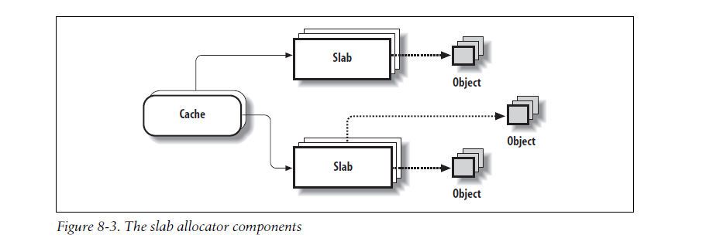
internal fragmentation. sizes are geometrically distributed
1、The Slab Allocator
buddy algorithm （for page）
objects with constructor and destructor
the same type
The slab allocator groups objects into caches.

Slide 13
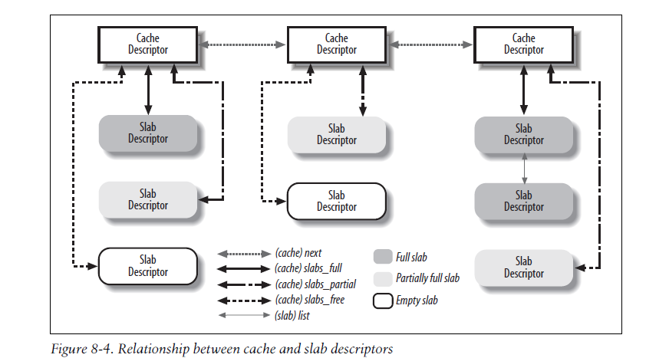
2、Cache Descriptor
3、Slab Descriptor
4、General and Specific Caches
General caches are used only by the slab allocator for its own purposes, while specific caches are used by the remaining parts of the kernel.

Slide 14
5、Interfacing the Slab Allocator with the Zoned Page Frame Allocator
When the slab allocator creates a new slab, it relies on the zoned page frame allocator to obtain a group of free contiguous page frames.
6、Allocating a Slab to a Cache
• A request has been issued to allocate a new object.
• The cache does not include a free object.
7、Releasing a Slab from a Cache
Slabs can be destroyed in two cases:
• There are too many free objects in the slab cache.
• A timer function invoked periodically determines that there are fully unused slabs that can be released.
8、Object Descriptor
External object descriptors
Internal object descriptors

Slide 15
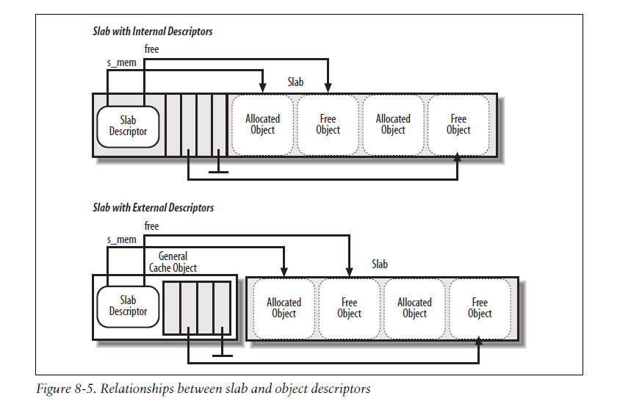

Slide 16
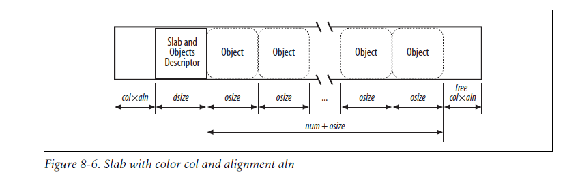
9、Aligning Objects in Memory
alignment factor
trading memory space for access time;
10、Slab Coloring
hardware cache
11、Local Caches of Free Slab Objects
a per-CPU data structure

Slide 17
12、Allocating a Slab Object
kmem_cache_alloc( )
13、Freeing a Slab Object
kmem_cache_free( )
14、General Purpose Objects
geometrically distributed sizes
kmalloc( )
kfree( )
15、Memory Pools
low-on-memory emergencies
block device
“The Pool of Reserved Page Frames” reserved page frames
by a specific kernel component, namely the “owner” of the pool.
a memory pool is stacked over the slab allocator

Slide 18
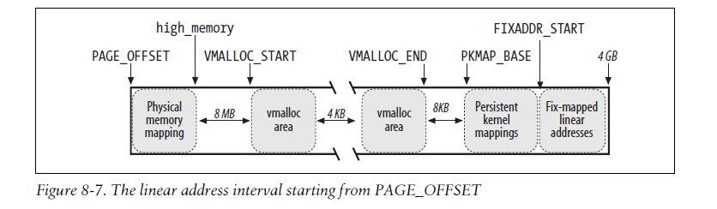
8.3 Noncontiguous Memory Area Management
avoid external fragmentation
to fiddle with the kernel Page Tables
swap areas, module, buffers to some I/O drivers. high memory page frames

Slide 19
1、Linear Addresses of Noncontiguous Memory Areas Paging
2、Descriptors of Noncontiguous Memory Areas
3、Allocating a Noncontiguous Memory Area
4、Releasing a Noncontiguous Memory Area

