Slide 1
1. Introduction
2. Memory Addressing
3. Processes
4. Interrupts and Exceptions
5. Kernel Synchronization
6. Timing Measurements
7. Process Scheduling
8. Memory Management
9. Process Address Space
10. System Calls
11. Signals
12. The Virtual Filesystem
13. I/O Architecture and Device Drivers
14. Block Device Drivers
15. The Page Cache
16. Accessing Files
17. Page Frame Reclaiming
18. The Ext2 and Ext3 Filesystems
19. Process Communication
20. Program Execution
Understanding
Linux Kernel
概念/Concepts !!!
理解 !!!
Notes:
2020-07-23

Slide 2
内核线程是一种只运行在内核地址空间的线程。所有的内核线程共享内核地址空间，所以也共享同一份内核页表。这也是为什么叫内核线程，而不叫内核进程的原因。
These simple Kernel approaches work for two reasons:
• The kernel is the highest-priority component of the operating system. If a kernel function makes a request for dynamic memory, it must have a valid reason to issue that request, and there is no point in trying to defer it.
• The kernel trusts itself. All kernel functions are assumed to be error-free, so the kernel does not need to insert any protection against programming errors.

Slide 3
When allocating memory to User Mode processes, the situation is entirely different:
• Process requests for dynamic memory are considered non-urgent. When a process’s executable file is loaded, for instance, it is unlikely that the process will address all the pages of code in the near future. Similarly, when a process invokes malloc( ) to get additional dynamic memory, it doesn’t mean the process will soon access all the additional memory obtained. Thus, as a general rule, the kernel tries to defer allocating dynamic memory to User Mode processes.
• Because user programs cannot be trusted, the kernel must be prepared to catch all addressing errors caused by processes in User Mode.
When a User Mode process asks for dynamic memory, it doesn’t get additional page frames; instead, it gets the right to use a new range of linear addresses, which become part of its address space. This interval is called a “memory region.”

Slide 4
放的是程序还是数据？
9.1 The Process’s Address Space
9.2 The Memory Descriptor
9.3 Memory Regions
9.4 Page Fault Exception Handler
9.5 Creating and Deleting a Process Address Space
9.6 Managing the Heap

Slide 5
9.1 The Process’s Address Space
The address space of a process consists of all linear addresses that the process is allowed to use.
memory regions, which are characterized by an initial linear address, a length, and some access rights.
4K page aligned
demand paging: the kernel provides the missing page frame and lets the process continue.

Slide 6
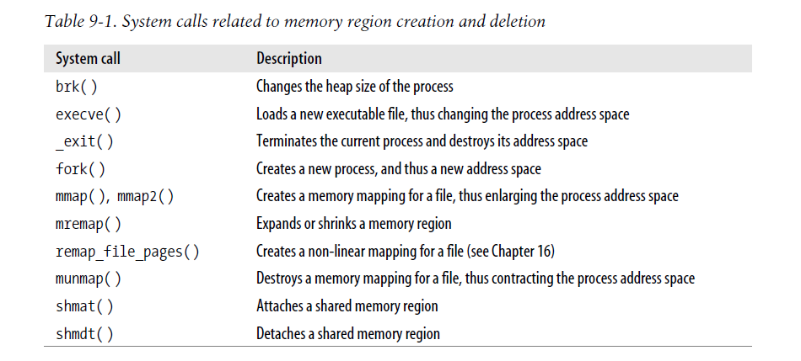
9.2 The Memory Descriptor
This object is referenced by the mm field of the process descriptor.

Slide 7
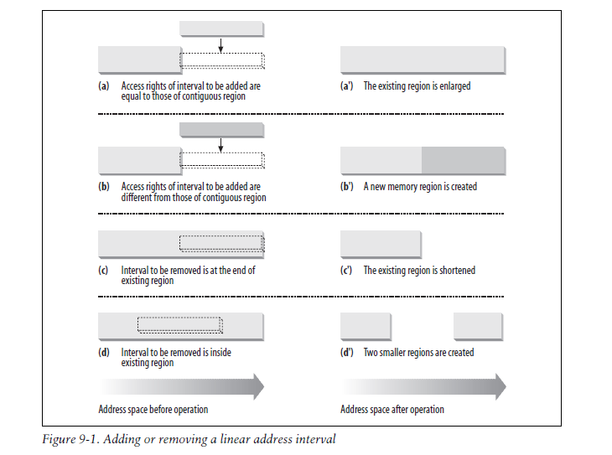
9.3 Memory Regions

Slide 8
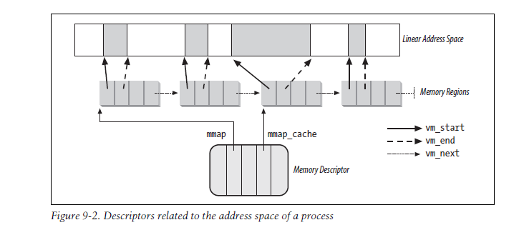
1、Memory Region Data Structures
Execute
2、Memory Region Access Rights Read/Write, Present, or User/Supervisor

Slide 9
3、Memory Region Handling
low-level functions
Finding the closest region to a given address: find_vma()
Finding a region that overlaps a given interval: find_vma_intersection( )
Finding a free interval: get_unmapped_area()
Inserting a region in the memory descriptor list: insert_vm_struct( )
4、Allocating a Linear Address Interval
do_mmap( )
5、Releasing a Linear Address Interval
The do_munmap() function
The split_vma() function
The unmap_region() function

Slide 10
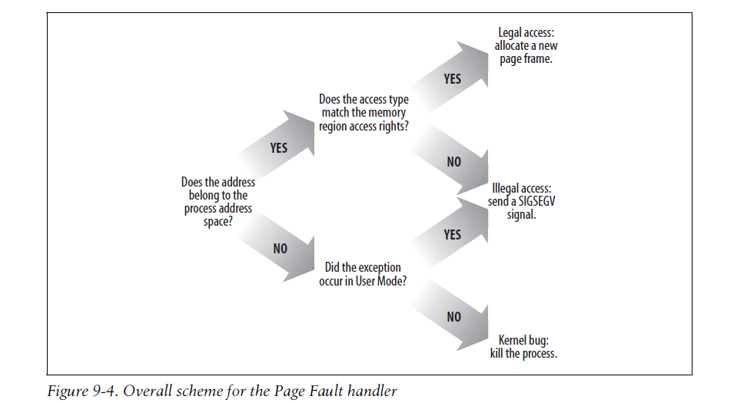
9.4 Page Fault Exception Handler
distinguish exceptions caused by programming errors from those caused by a reference to a page that legitimately belongs to the process address space but simply hasn’t been allocated yet.

Slide 11
1、Handling a Faulty Address Outside the Address Space
2、Handling a Faulty Address Inside the Address Space
3、Demand Paging
4、Copy On Write
5、Handling Noncontiguous Memory Area Accesses

Slide 12
9.5 Creating and Deleting a Process Address Space
Creating a Process Address Space
Deleting a Process Address Space
9.6 Managing the Heap
Each Unix process owns a specific memory region called the heap, which is used to satisfy the process’s dynamic memory requests. The start_brk and brk fields of the memory descriptor delimit the starting and ending addresses, respectively, of that region.
malloc(size)
calloc(n,size)
realloc(ptr,size)
free(addr)
brk(addr)
sbrk(incr)

