Slide 1
Understanding Linux Kernel
APPENDIX
A System Start
B Modules
Notes:
2020-08-06

Slide 2
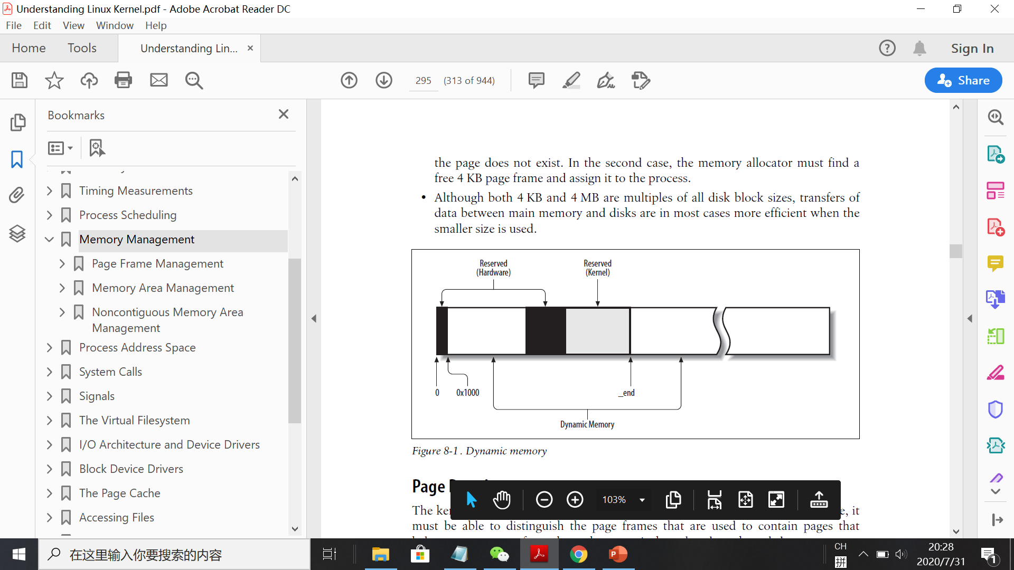
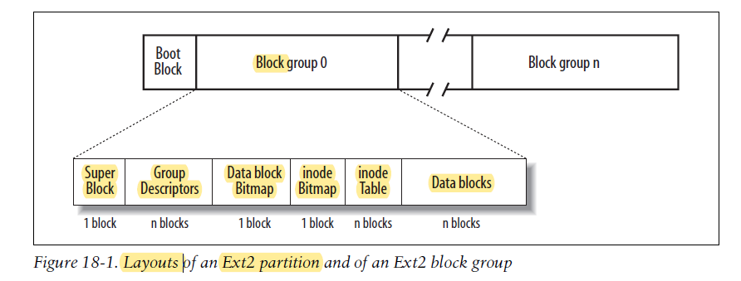

Slide 3
highly dependent on the computer architecture
A.1 the BIOS
some registers of the processor (including cs and eip) are set to fixed values, and the code found at physical address 0xfffffff0 is executed.
Basic Input/Output System (BIOS)
A.2 the Boot Loader
A.3 the setup( ) Function
A.4 the startup_32( ) Functions

Slide 4
A.5 the start_kernel( ) Function
The start_kernel( ) function completes the initialization of the Linux kernel. Nearly every kernel component is initialized by this function;
• The scheduler: sched_init()
• The memory zones: build_all_zonelists()
• The Buddy system allocators: page_alloc_init() and mem_init()
• The final initialization of the IDT is performed by invoking trap_init( )
• The TASKLET_SOFTIRQ and HI_SOFTIRQ are initialized by invoking the softirq_init() function
• The system date and time are initialized by the time_init( ) function
• The slab allocator is initialized by the kmem_cache_init( ) function
• The speed of the CPU clock is determined by invoking the calibrate_delay()function
• The kernel thread for process 1 is created by invoking the kernel_thread( ) function.
In turn, this kernel thread creates the other kernel threads and executes the /sbin/init program.

Slide 5
At the end, the familiar login prompt appears on the console (or in the graphical screen, if the X Window System is launched at startup), telling the user that the Linux kernel is up and running.

