Slide 1
KNN and SVC

Slide 2
Outline
Project work
Written/Technical part
Code
Website
Presentation
Flash talk (3-4 minutes)
Presentation (10 minute)

Slide 3
Planning the week
Weekday | Session | Task
Tuesday | 1 | Finish the draft of the code
Tuesday | 2 | Discuss website & presentations’ design Start working on the website
Wednesday | 1 | Finish the draft version of the website
Wednesday | 2 | Start working on the presentations
Thursday | 1 | Finish the presentation
Thursday | 2 | Finilize all work Practice the flash talk and presentation

Slide 4
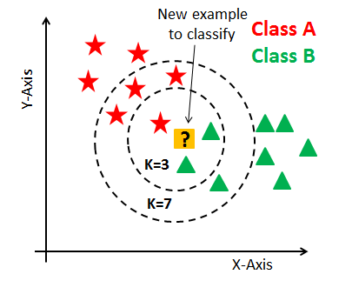
KNN principles:
Identify k
Measure the distance to the closest k number of examples
Choose the dominant class

Slide 5
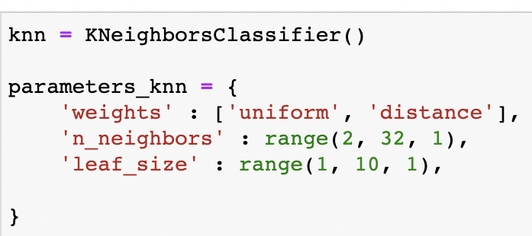
For our project, we want to tune the model with the following parameters

Slide 6
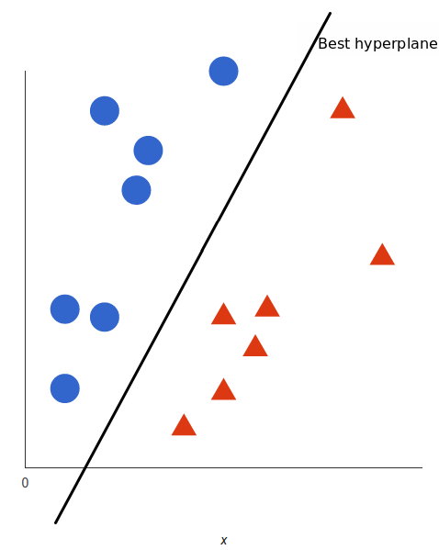
Support Vector Machine (SVM)
The SVM is a classifier that tries to build a hyperplane splitting the data points from different labels.
So the main task is to find the best hyperplane.
A good hyperplane maximizes the margins from both sides.

Slide 7
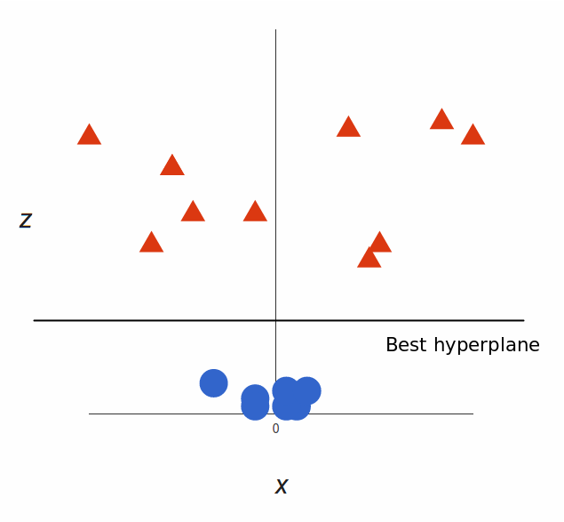
Support Vector Machine (SVM)
Up until now, we had two dimensions: x and y.
We create a new z dimension, and we rule that it be calculated a certain way that is convenient for us: z = x² + y² (you’ll notice that’s the equation for a circle).
With x and z we can easily find a hyperplane.

Slide 8
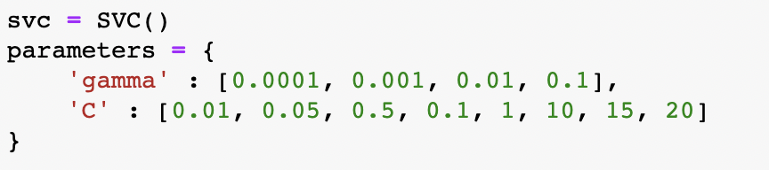
For our project, we want to tune the model:

Slide 9
Reference
How to plot a nice confusion matrix?

