Slide 2
Initialize starting values of y_i,j for i = 1, j =1, M,N, ita, beta;
for B do (while not at convergence): pick an order of the M × N variables;
for each variable y_i,j do:
sample y_i,j based on P(y_i,j|y_Nbr(i,j));
update y_i,j to Y ;
end
end
for S do (while at convergence): pick an order of the M × N variables;
for each variable y_i,j do:
sample y_i,j based on P(y_i,j|y_Nbr(i,j));
update y_i,j to Y ;
end
end

Slide 3
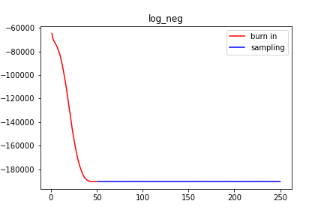

Slide 4
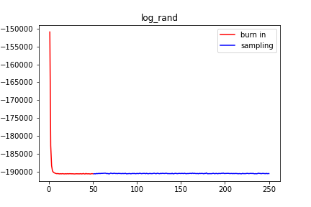
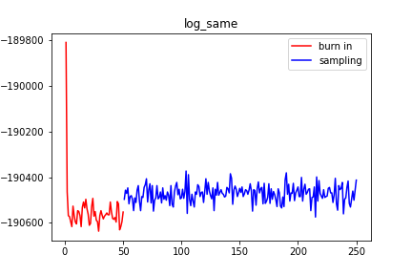
Section | Log_neg | Log_rand | Log_same
1 | Converges to the region between -180000 and -190000 | Converges to the region between -190000 and -192000 | Converges to the region between -190400 and -190700
2 | The assigned length of burn-in is reasonable | The assigned length of burn-in is reasonable, but the value converged approximately after 20th iteration | Can obviously observe the difference between burn-in and sample, therefore, the length is reasonable
3 | No significant flactuations here | No significant flactuations | The substantial fluctuation from iteration to iteration is observed (the chain is mixing well)

Slide 5
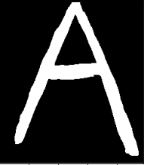

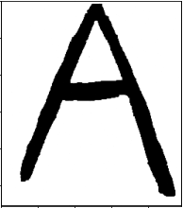
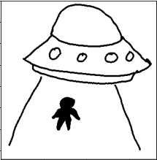
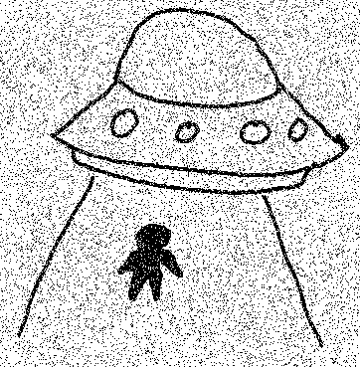
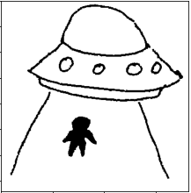
Original image
Noisy image
Denoised image

