Slide 1
Helpdesk assistant (A chat-bot)

Slide 2
Problem Statement
Help desk assistant for private and government organizations
College Name : Gyanmanjari institute of technology
College code : 129
Team leader : Karm Bhatt
Team members:
Vanshi Makwana
Kushal Dodiya
Madhav Rathod

Slide 3
Idea details
Solution:
We will be making a CHATBOT based helpdesk for the easiness of the organizations and companies.
The Chatbot will guide and answer about the questions by the employee and work accordingly, It will answer the commands in both voice and text format.
The government employees don’t need to rush in the work place or office area. The CHATBOT will help employees to locate the particular employee in the office and also can provide the location of in organization and also if someone needs to request a leave when he/she wants the chat bot will send the request for leave on behalf of the employee.
When any employee will request a leave, the reason for leave will be asked by the chatbot and will be sent to the higher authorities.
We have also used google search engine for surfing and web searching and also one can directly search the particular website.

Slide 4
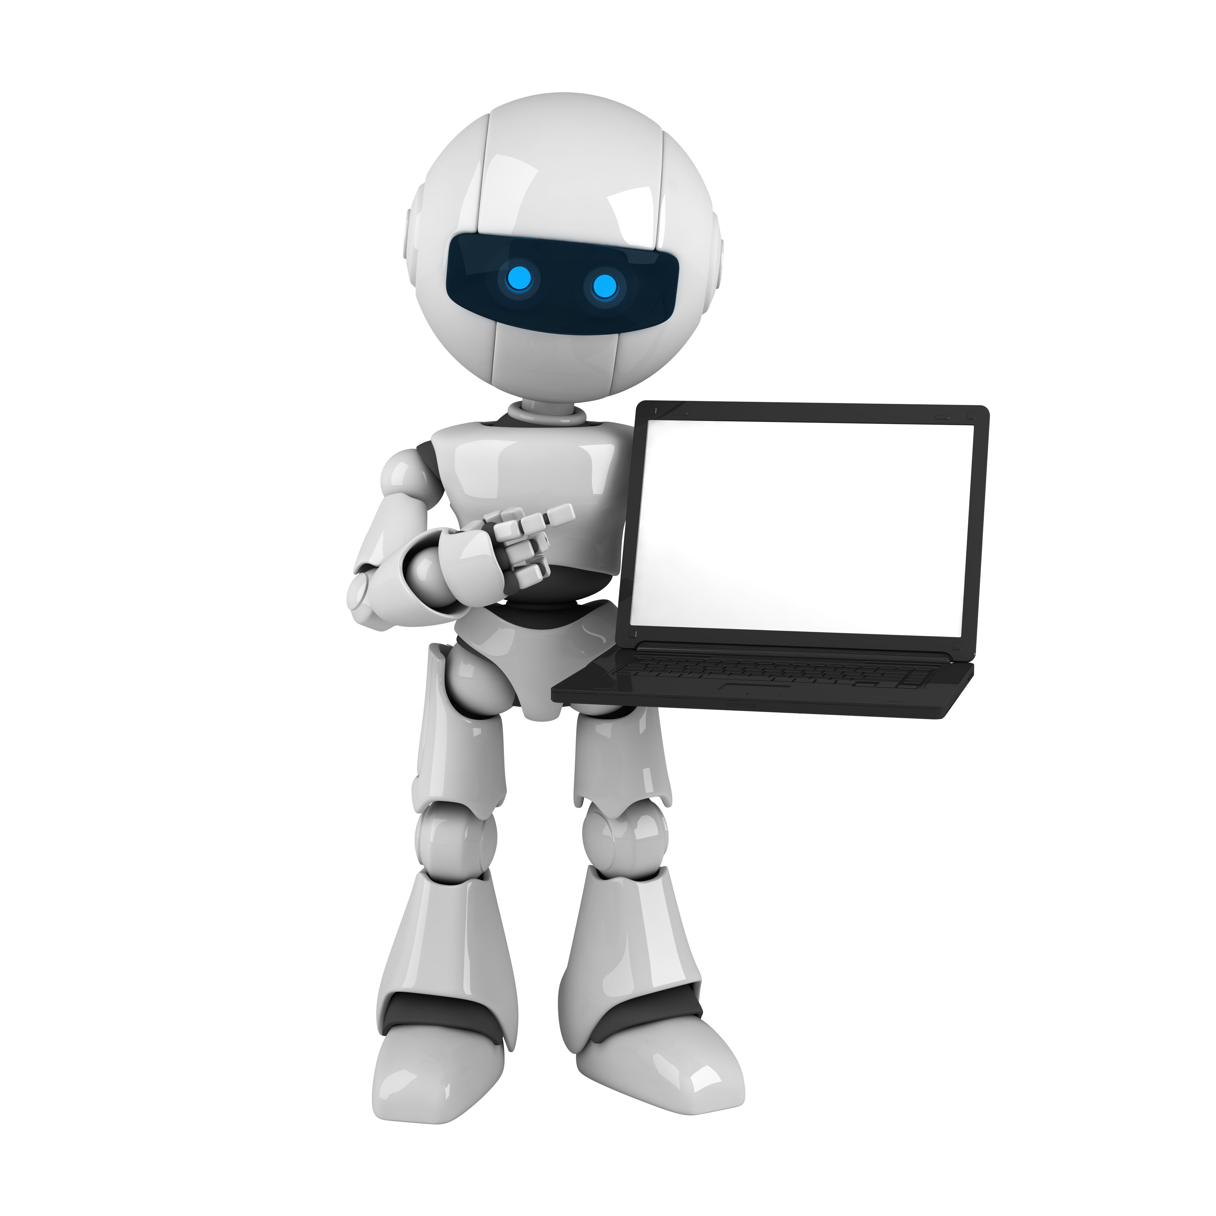
Tools and Technologies
Technologies Used:
Visual studio for app build.
Python for coding.
Terminal window for running the program.
Hii..

Slide 5

Problem statement
The main problem in organizations is time consumption and due to work load employees cannot help each other when needed so they have to wait for each other and that’s time consuming and their tasks may get interrupted.
Also if some new employee or freshers entering the organization cannot locate the sitting area of other employees and that’s inconvenient for them.

Slide 6
Result
Benefits:
Easier for the new government employees to locate any of the cabin or desk at the office or workplace.
Less wastage of time, as if the manager is in the meeting and someone want a leave then he doesn’t have to wait ,he can directly request a leave from the chatbot ; it will ask the reason and mail will be sent to the head and from that head can approve the leave.
Improves searching by using google search engine for searching.

Slide 7
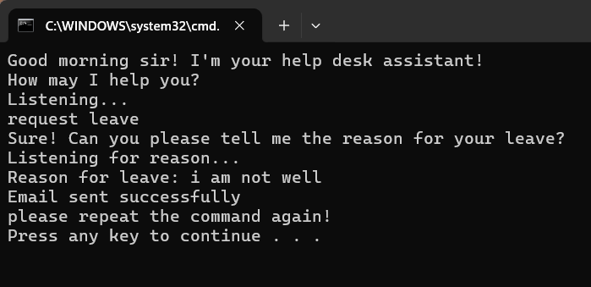
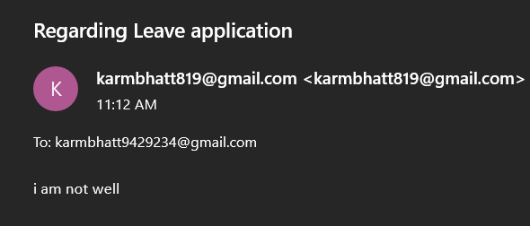
SCREENSHOTS
Email sent by chatbot
Email received

Slide 8
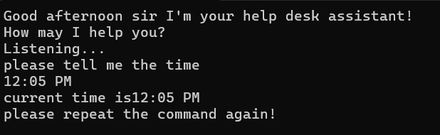
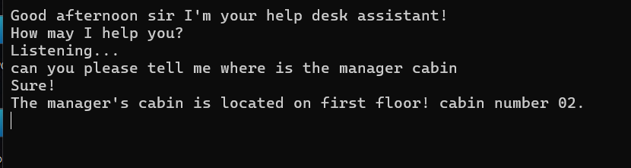
What is the time
Locate any cabin or employee

Slide 9
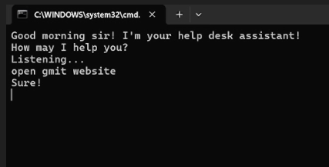
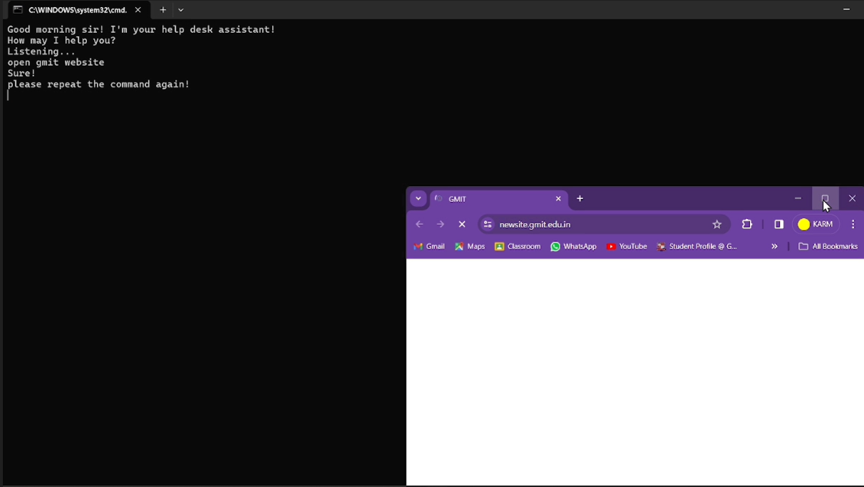
Command to open website
Website pop’s up

Slide 10
THANK
YOU

